Slide 1
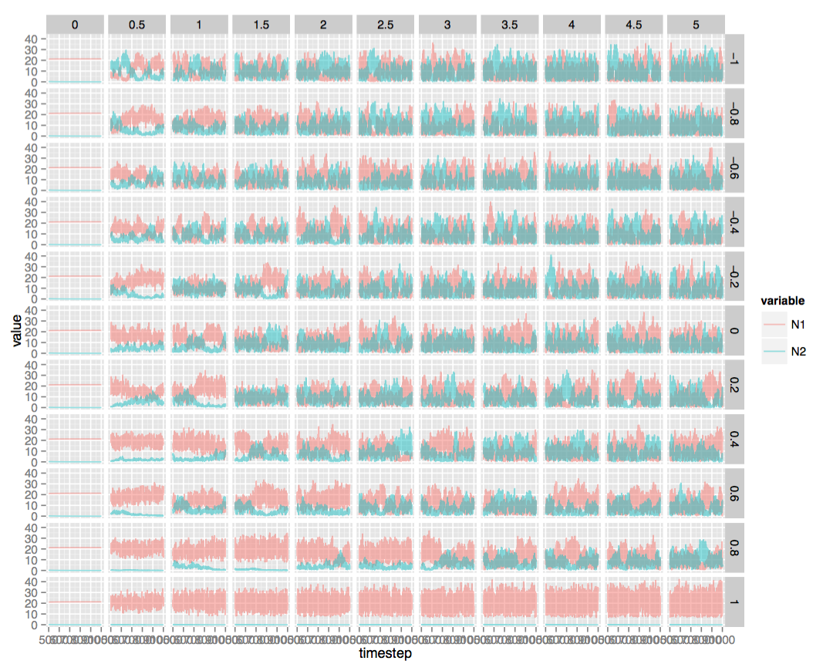
Storage effect factorial experiment time series (variance of environmental cue in horizontal direction, correlation of species responses to cue in vertical direction). N2 is the inferior competitor.

Slide 2
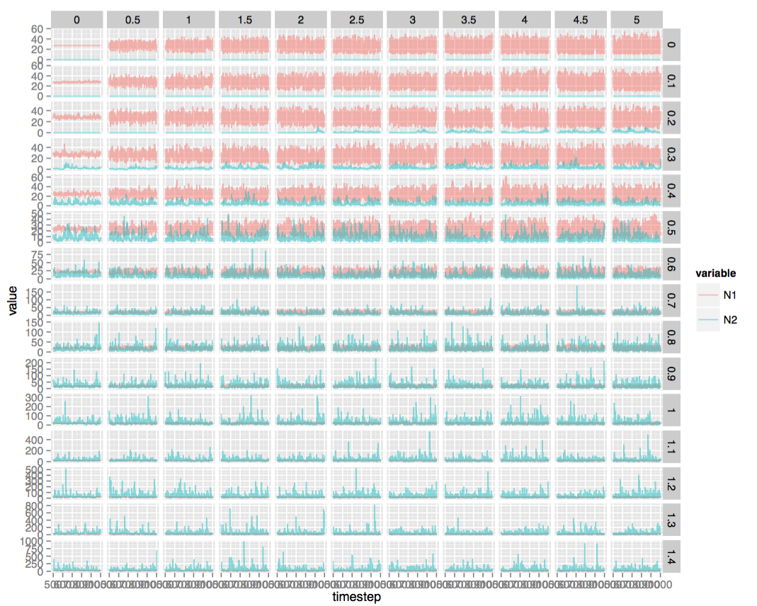
Relative nonlinearity factorial experiment time series (variance of environmental cue in horizontal direction, sd of annual resource supply in vertical direction). N2 is the inferior competitor.

Slide 3
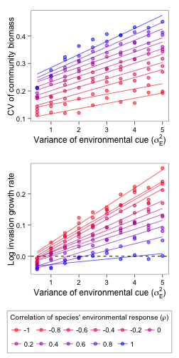
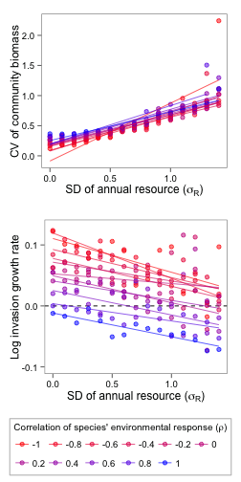
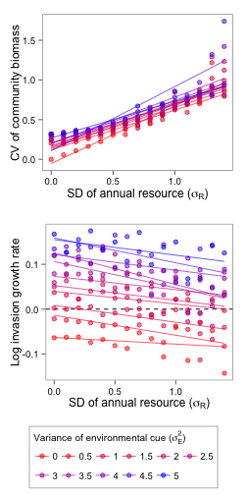
STORAGE EFFECT
Constant annual resource supply
Variance of environmental cue = 2
Correlation of environmental responses = 0

Slide 4
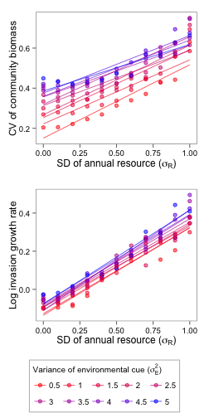
RELATIVE NONLINEARITY

Slide 5
STORAGE EFFECT
CV increases with strength of coexistence, along the sigma_E axis, but the correlation of environmental responses buffers CV increases.
Coexistence Strength

Slide 6
RELATIVE NONLINEARITY
More variability is more or less always better for coexistence, and there is no buffering mechanism for unique responses to the environment.
Coexistence Strength

