Slide 1
Anniversaries
special moments
24 June 2021

Slide 2
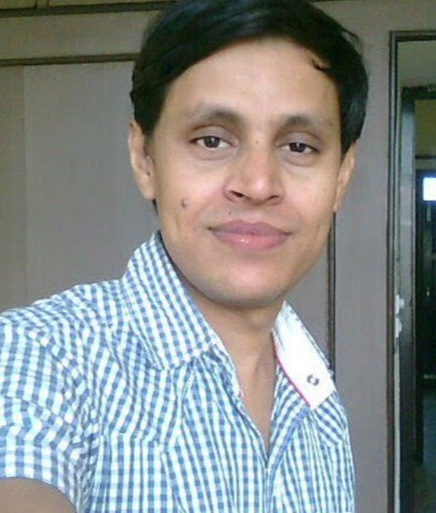
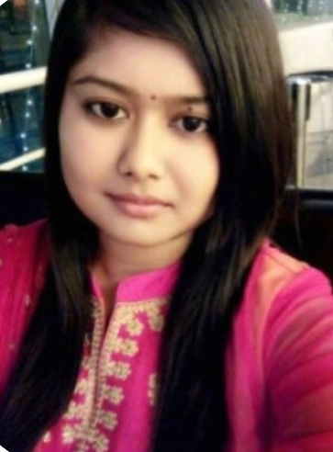
Celebrating 3 Years
Bhasker
3 YEARS
2 July
Payel
3 YEARS
21 May

Slide 3
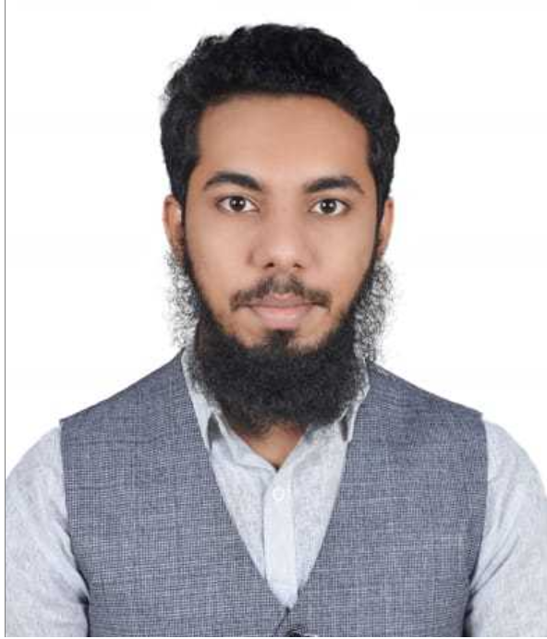
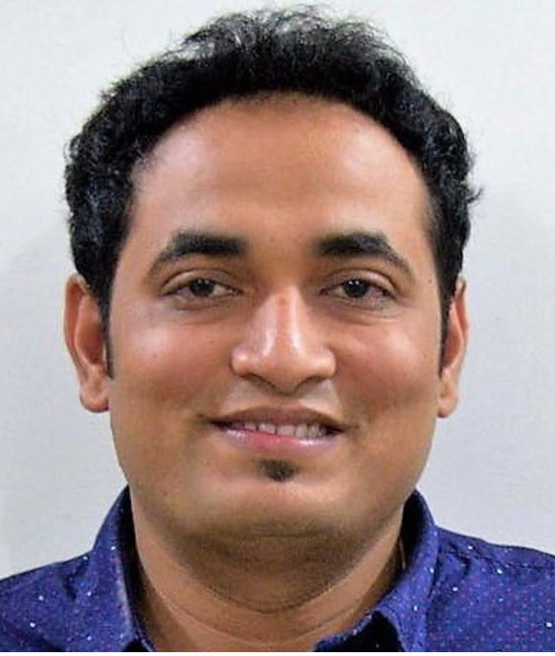
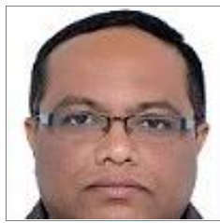
Greater Milestones To Cherish
Sarvesh
25 June
Mansoor
5 YEARS
11 Jul
Rohit
13 YEARS
9 June

