Slide 1
Data Volume Estimates
Tracy Becker
September 12, 2017

Slide 2
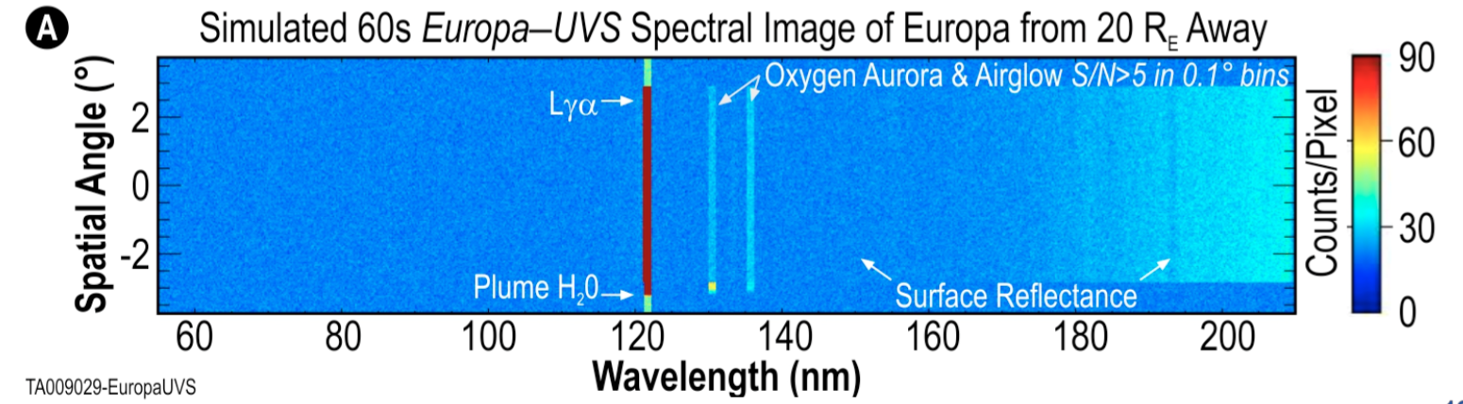
Detector

Slide 3
Many ways to slice it
Observation in which only the emission lines are of particular interest
1
1
Low spectral resolution
High spectral resolution
Low spectral resolution

Slide 4
Many ways to slice it
Observation where surface reflectance at longer wavelength is of most importance
Low resolution
1
High resolution

Slide 5
Many ways to slice it
Spatial Resolutions
Europa small on detector – high spatial res in just this region
Europa larger on detector
This flexibility allows UVS to optimize the trade-off between science and data volume restrictions.
However, this also complicates our ability to know exactly how much data volume we need for each type of observation at this moment.

Slide 6
UVS_JUP_AP_ AIRGLOW_STARE_001 | UVS Jupiter AP Airglow Stare
Conceptual Description | Monitoring auroral and airglow emissions in stare mode using the Airglow Port (AP). Slit held along Jupiter’s North/South and on the central meridian, while Jupiter rotates below S/C creating a map. Histogram mode.
Pointing Type | Nadir
Data rate | 2.25 kb/s (for 512 spatial bins) --> Can be less: 0.6 kb/s enough
Data rate reduction factor | K = [Jupiter’s angular size]/[slit length (7.5 deg)]
Total duration | 10 h (= Jupiter’s rotation period)
Data package information | 16 spectral bins, 128 spatial bins, 8 bit value 30s histograms
Total data volume | 20 Mbits x K
Scheduling/Avoidance rules | - Specific cadence for a given period during the tour, to be constrained by 1 Gbit/week data downlink. Typically every 1 or 2 days - Observations including when distance to Jupiter R>20 Rj - To assess temporal evolution requires repetitive observations, including over short periods to look for changes over short timescales. - Synergistic observations with MAJIS and JANUS (and SWI)
EXAMPLE FROM JUICE-UVS
Example showing how we will describe each of our standard observation techniques

Slide 7
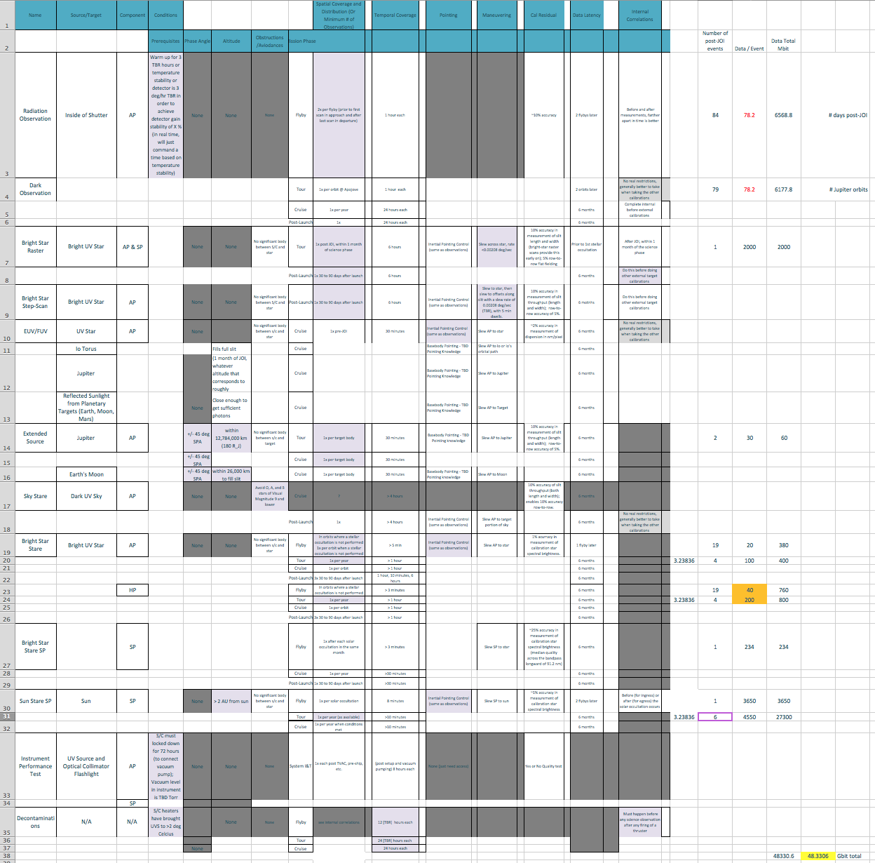
Cal Document Computation Mar 2
This document shared between JPL and UVS has the estimated data volume for each post-JOI calibration.

Slide 8
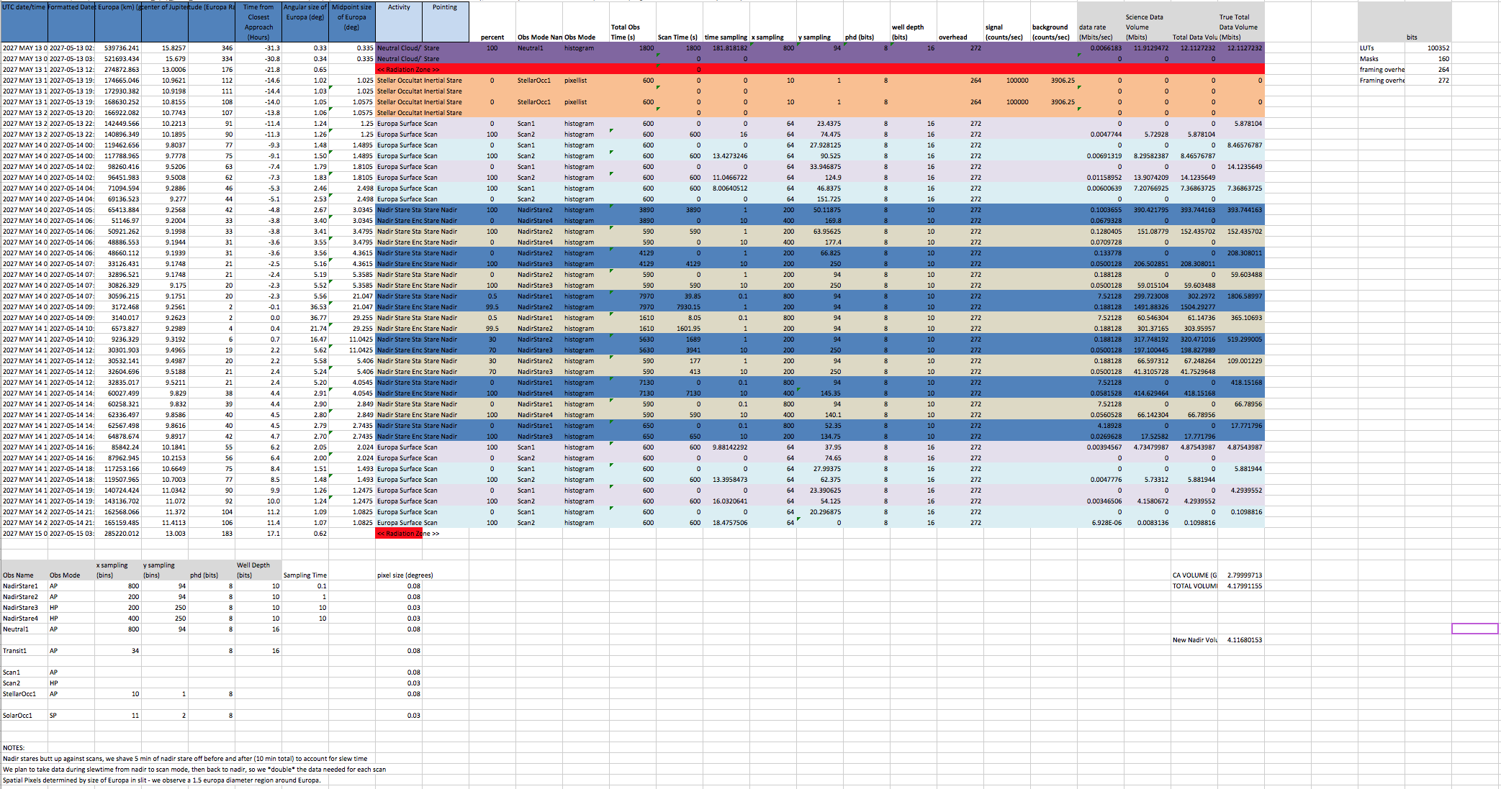
See flyby sequence E27
We also sent this spreadsheet several months ago to show what an example UVS flyby might look like and how we may alternate between modes, and the resulting data volume for the flyby with such a sequencing.

