Slide 1
Paper Review and Implementation of
Generating Fuzzy Rules by Learning from Examples
(Li-Xin Wang and Jerry M. Mendel)
EE658A COURSE PROJECT
Atreya Goswami
Roll No. 190201

Slide 2
ACKNOWLEDGEMENT
I would like to take this opportunity to express my gratitude to Course Instructor Prof. Nischal K. Verma and Course TA Mohd. Aquib for their continued support and guidance. Also, I would like to thank my parents, without whose constant motivation and support, I would never be able to complete this project.

Slide 3
AGENDA
Background
Motivation
Introduction
Contribution
Approach
Experimental Results
References

Slide 4
Introduction to fuzzy logic and fuzzy systems
Deals with uncertainties due to imprecision, ambiguity and vagueness
Key agent of Computational Intelligence
Introduced by Prof. Lotfi A Zadeh in 1965
Multivalued logic
Involves soft or partial truth

Slide 5
MOTIVATION
Most contemporary intelligent control and signal processing approaches were heuristic in nature – they used some ad hoc method to combine standard control or signal processing methods with expert systems.
Limitations of existing approaches:
Problem specificity of the approach
Difficulty in theoretical analysis

Slide 6
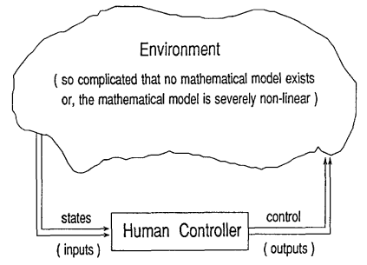
INTRODUCTION
TASK: Design a control system to replace the human controller
INFORMATION: 2 kinds of information are available to us.
Linguistic rules: Experience of the human controller
Numerical data: Sampled successful input-output pairs
Neither of the above alone is usually sufficient for designing a successful control system.

Slide 7
CONTRIBUTION
Previous work has shown that fuzzy control is an effective way to utilize linguistic rules, whereas neural control is suited for using numerical data.
Through this paper, the authors propose a new approach – numerical-fuzzy control.
The key ideas of this approach are –
Generating fuzzy rules from numerical data pairs.
Collecting the numerical fuzzy rules and linguistic fuzzy rules into a common fuzzy rule base.
Designing a control or signal processing system based on the combined fuzzy rule base.
The paper has also evaluated the proposed approach against existing neural and fuzzy approaches, on two benchmark problems – the Truck Backer-Upper Control problem and the Mackey-Class chaotic time series prediction problem.

Slide 8
APPROACH
The paper proposes a 5-stage approach for generating fuzzy rules from numerical data and using these rules along with linguistic fuzzy rules to obtain a mapping from input space to output space.
Step 1: Dividing the Input and Output spaces into fuzzy regions
Step 2: Generating fuzzy rules from given data pairs
Step 3: Assigning a degree to each rule
Step 4: Creating a combined Fuzzy Rule Base
Step 5: Determine a mapping based on the combined Fuzzy Rule Base

Slide 9
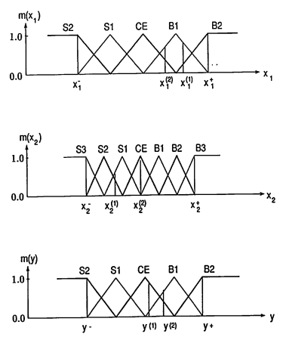
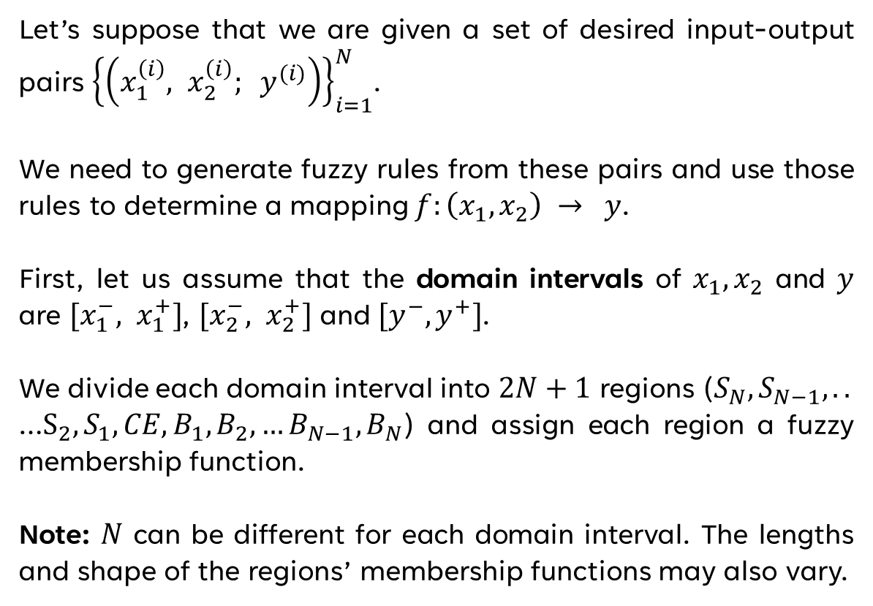
STEP 1: Dividing Input and Output spaces into fuzzy regions
Let’s suppose that we are given a set of desired input-output pairs ${\left\{\left(x_{1}^{\left(i\right)}, x_{2}^{\left(i\right)}; y^{(i)}\right)\right\}}_{i=1}^{N}$.
We need to generate fuzzy rules from these pairs and use those rules to determine a mapping $f:\left(x_{1}, x_{2}\right) → y$.
First, let us assume that the domain intervals of $x_{1}, x_{2}$ and $y$ are ${[x}_{1}^{−}, x_{1}^{+}]$, ${[x}_{2}^{−}, x_{2}^{+}]$ and ${[y}^{−},y^{+}]$.
We divide each domain interval into $2N+1$ regions ($S_{N}, S_{N−1},..$
…$S_{2},S_{1},CE, B_{1},B_{2},…B_{N−1},B_{N}$) and assign each region a fuzzy membership function.
Note: $N$ can be different for each domain interval. The lengths and shape of the regions’ membership functions may also vary.

Slide 10
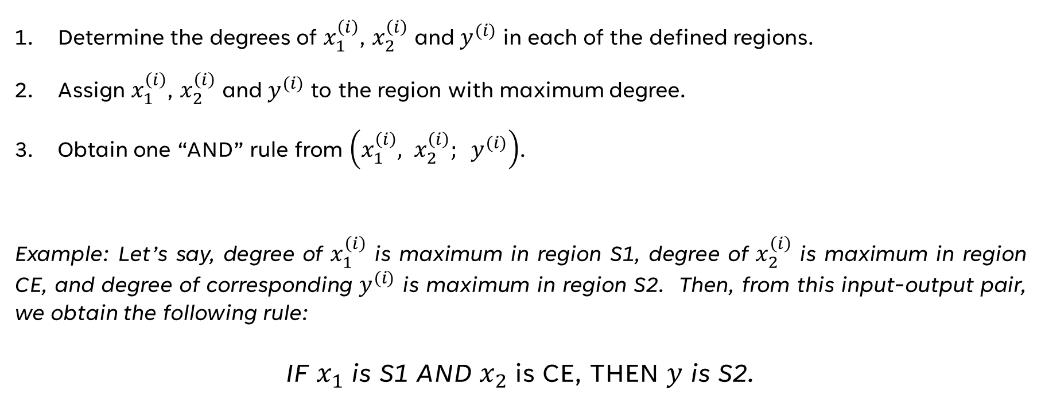
STEP 2: Generating fuzzy rules from given data pairs
Determine the degrees of $x_{1}^{\left(i\right)}$, $x_{2}^{\left(i\right)}$ and $y^{(i)}$ in each of the defined regions.
Assign $x_{1}^{\left(i\right)}$, $x_{2}^{\left(i\right)}$ and $y^{(i)}$ to the region with maximum degree.
Obtain one “AND” rule from $\left(x_{1}^{\left(i\right)}, x_{2}^{\left(i\right)}; y^{(i)}\right)$.
Example: Let’s say, degree of $x_{1}^{\left(i\right)}$ is maximum in region S1, degree of $x_{2}^{\left(i\right)}$ is maximum in region CE, and degree of corresponding $y^{(i)}$ is maximum in region S2. Then, from this input-output pair, we obtain the following rule:
IF $x_{1}$ is S1 AND $x_{2}$ is CE, THEN $y$ is S2.

Slide 11
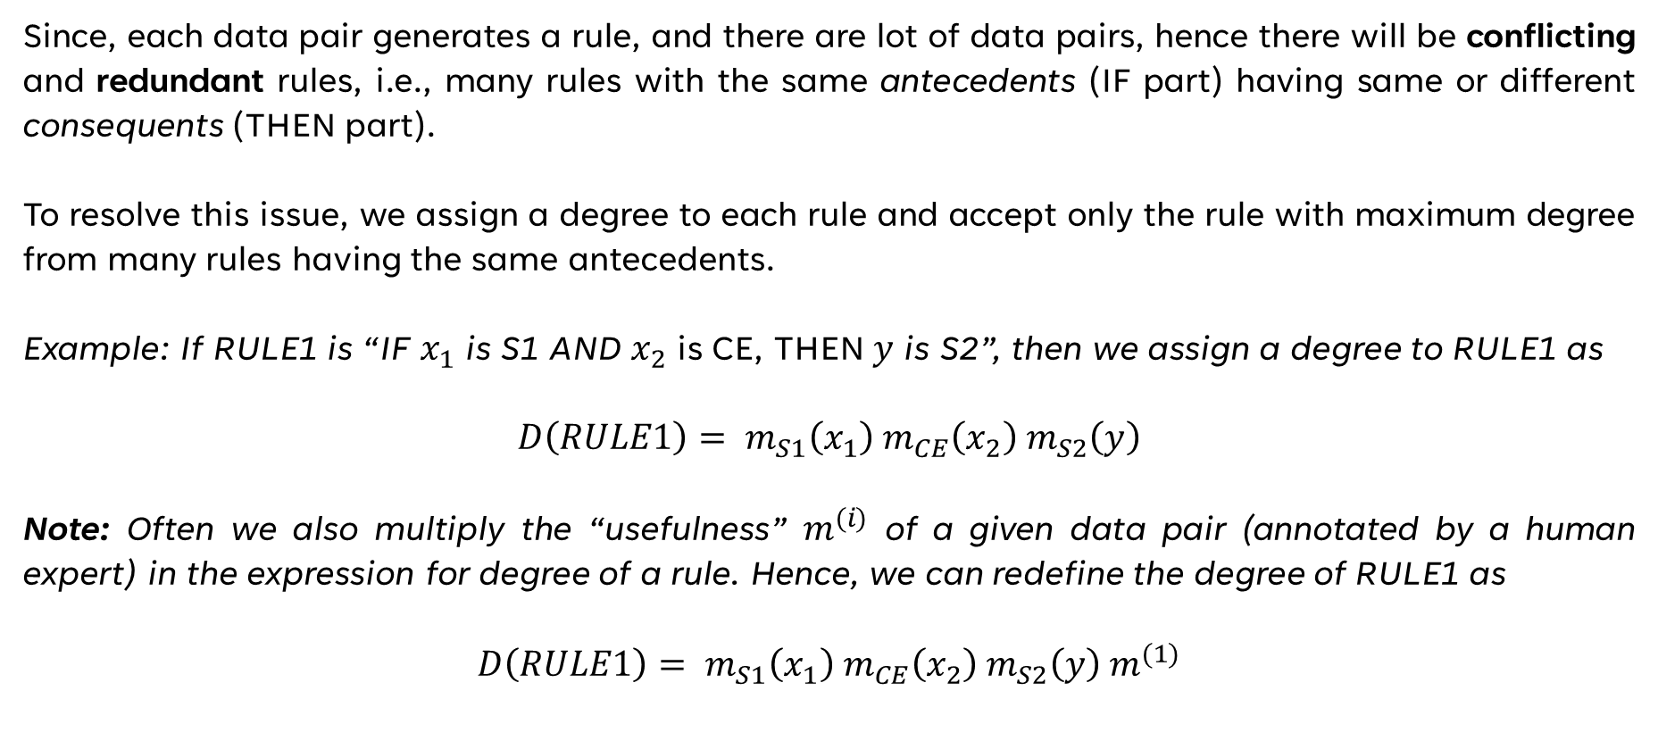
STEP 3: Assigning a degree to each rule
Since, each data pair generates a rule, and there are lot of data pairs, hence there will be conflicting and redundant rules, i.e., many rules with the same antecedents (IF part) having same or different consequents (THEN part).
To resolve this issue, we assign a degree to each rule and accept only the rule with maximum degree from many rules having the same antecedents.
Example: If RULE1 is “IF $x_{1}$ is S1 AND $x_{2}$ is CE, THEN $y$ is S2”, then we assign a degree to RULE1 as
$$D\left(RULE1\right)= m_{S1}\left(x_{1}\right) m_{CE}\left(x_{2}\right) m_{S2}\left(y\right)$$
Note: Often we also multiply the “usefulness” $m^{(i)}$ of a given data pair (annotated by a human expert) in the expression for degree of a rule. Hence, we can redefine the degree of RULE1 as
$$D\left(RULE1\right)= m_{S1}\left(x_{1}\right) m_{CE}\left(x_{2}\right) m_{S2}\left(y\right){ m}^{(1)}$$

Slide 12
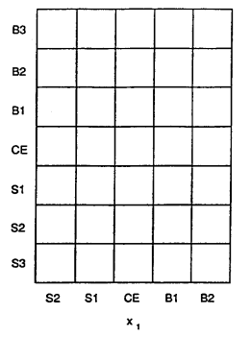
STEP 4: Creating a combined Fuzzy Rule Base
In this step, we combine the fuzzy rules obtained in Step 3, and linguistic fuzzy rules annotated by human experts into a common framework – the combined fuzzy rule base.
Assuming that linguistic rules are also assigned a degree, in case of a conflict, only the rule with a higher degree will be accepted.
We know from Step 2 that fuzzy rules obtained from numerical data pairs will always be ”AND” rules. However, linguistic fuzzy rules may be ”OR” rules, in which case, all the boxes corresponding to the antecedents of the rule need to be filled with the output of the rule.

Slide 13
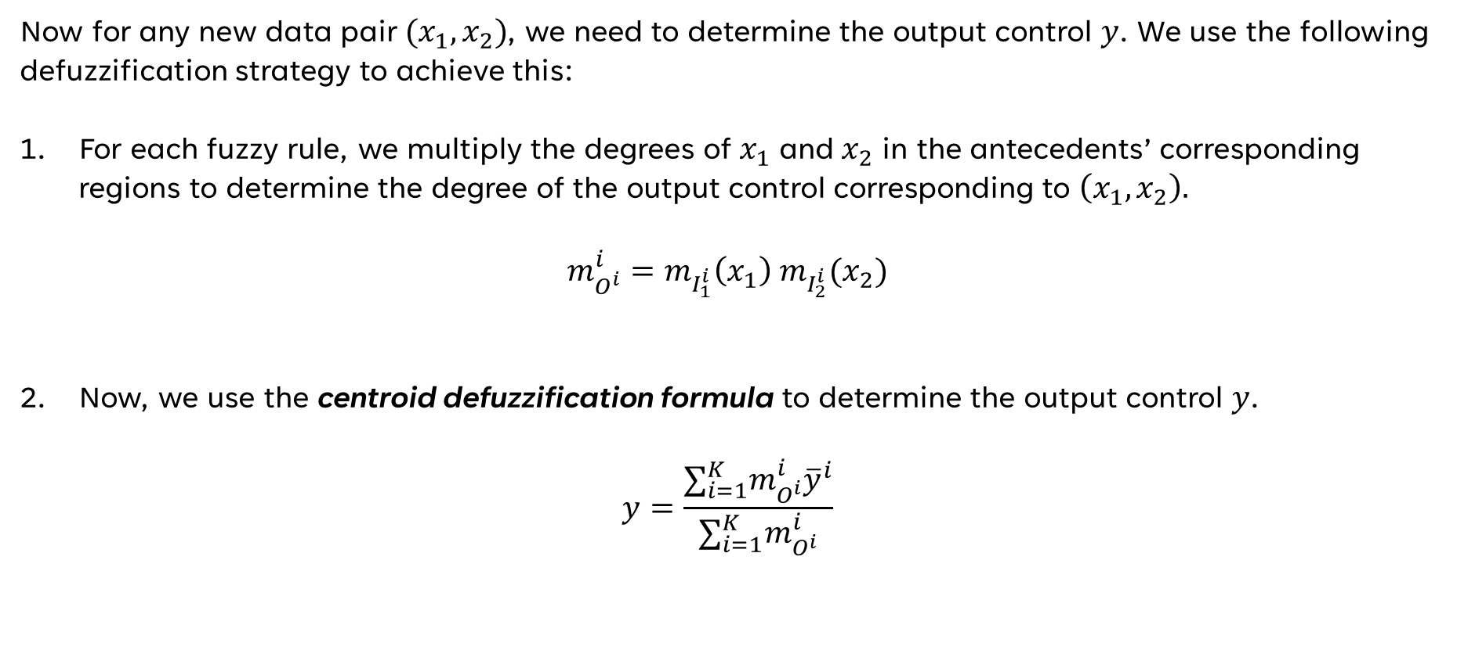
STEP 5: Determine a mapping based on the fuzzy rule base
Now for any new data pair $(x_{1}, x_{2})$, we need to determine the output control $y$. We use the following defuzzification strategy to achieve this:
For each fuzzy rule, we multiply the degrees of $x_{1}$ and $x_{2}$ in the antecedents’ corresponding regions to determine the degree of the output control corresponding to $\left(x_{1}, x_{2}\right).$
$$m_{O^{i}}^{i}=m_{I_{1}^{i}}{\left(x_{1}\right) m}_{I_{2}^{i}}(x_{2})$$
Now, we use the centroid defuzzification formula to determine the output control $y$.
$$y=\frac{∑_{i=1}^{K}m_{O^{i}}^{i}{\overline{y}}^{i}}{∑_{i=1}^{K}m_{O^{i}}^{i}}$$

Slide 14
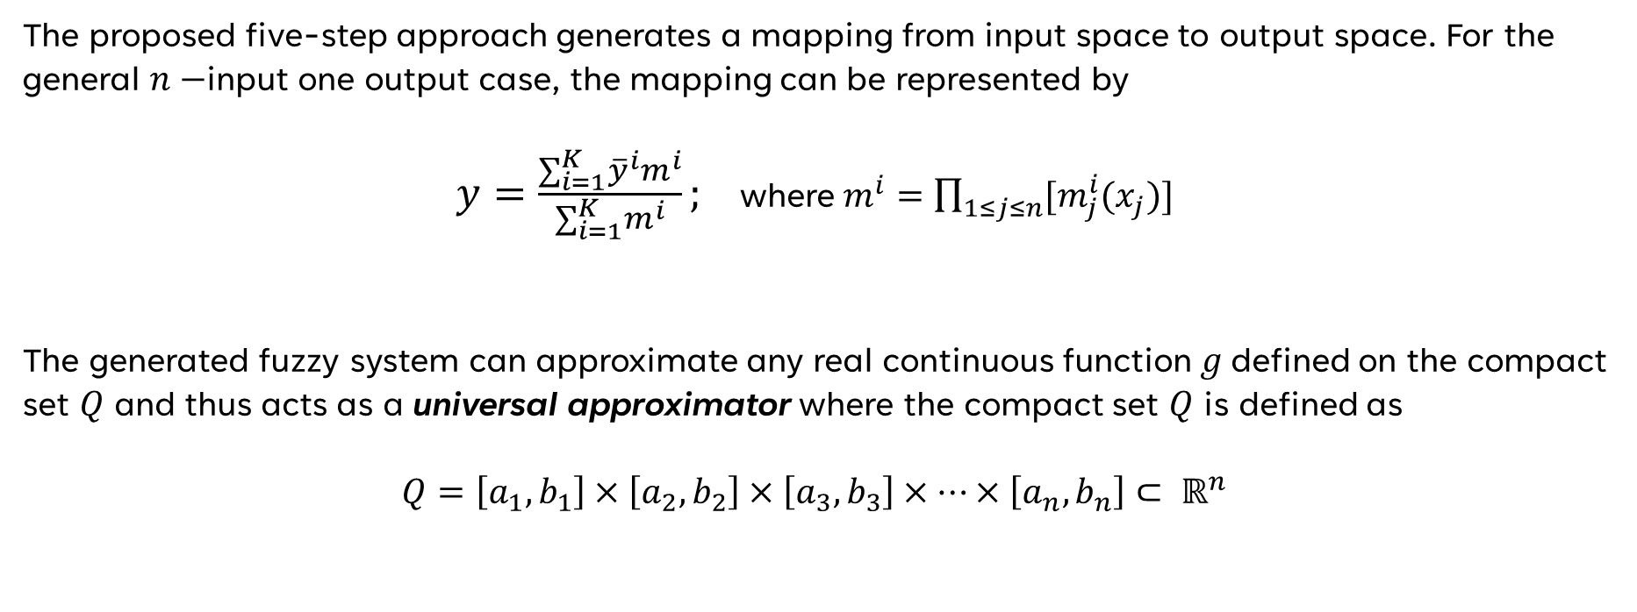
FUZZY SYSTEM AS AN "UNIVERSAL APPROXIMATOR”
The proposed five-step approach generates a mapping from input space to output space. For the general $n−$input one output case, the mapping can be represented by
$y=\frac{∑_{i=1}^{K}{\overline{y}}^{i}m^{i}}{∑_{i=1}^{K}m^{i}};$ where$m^{i}=\prod_{1≤j≤n}{[m_{j}^{i}(x_{j})]}$
The generated fuzzy system can approximate any real continuous function $g$defined on the compact set $Q$ and thus acts as a universal approximator where the compact set $Q$ is defined as
$$Q=\left[a_{1},b_{1}\right]×\left[a_{2},b_{2}\right]×\left[a_{3},b_{3}\right]×⋯×\left[a_{n},b_{n}\right]⊂ ℝ^{n}$$

Slide 15
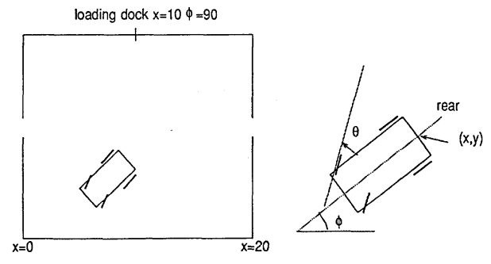
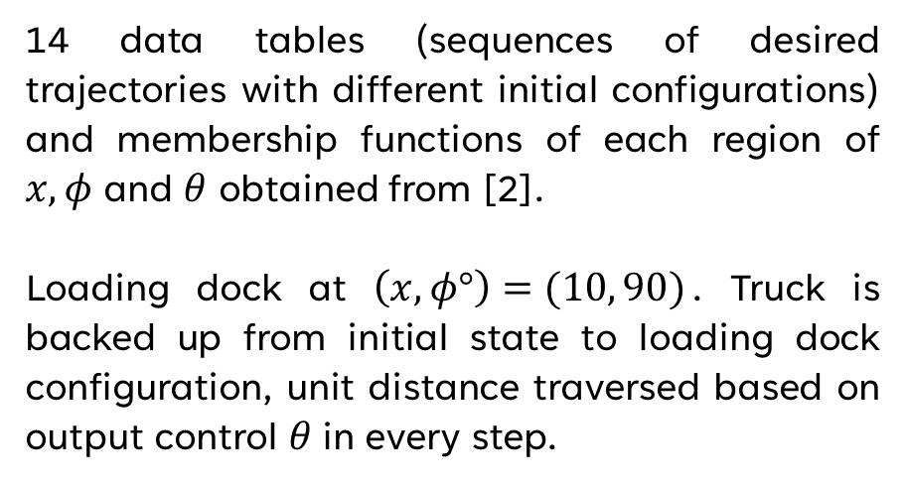
TRUCK BACKER-UPPER CONTROL PROBLEM
System defined by 3 state variables $(x,y,φ)$ and control $θ$. $y$ is not considered as input variable.
14 data tables (sequences of desired trajectories with different initial configurations) and membership functions of each region of $x,φ$ and $θ$ obtained from [2].
Loading dock at $\left(x,φ°\right)=(10, 90)$. Truck is backed up from initial state to loading dock configuration, unit distance traversed based on output control $θ$in every step.
Kinematics of truck governed by approximate equations (13) – (15) listed in [1].

Slide 16
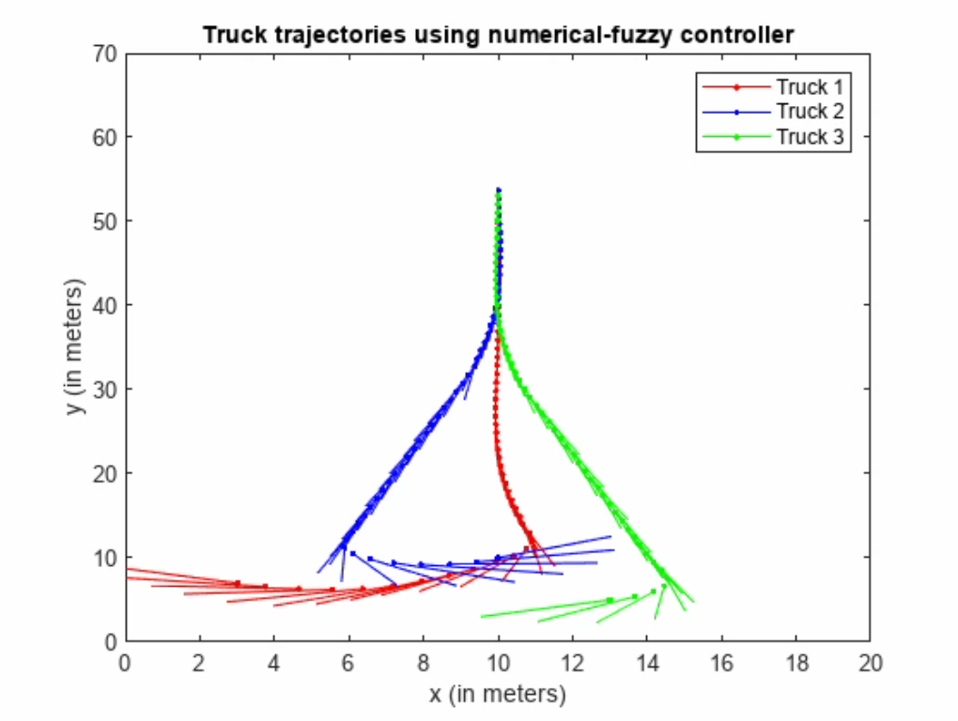
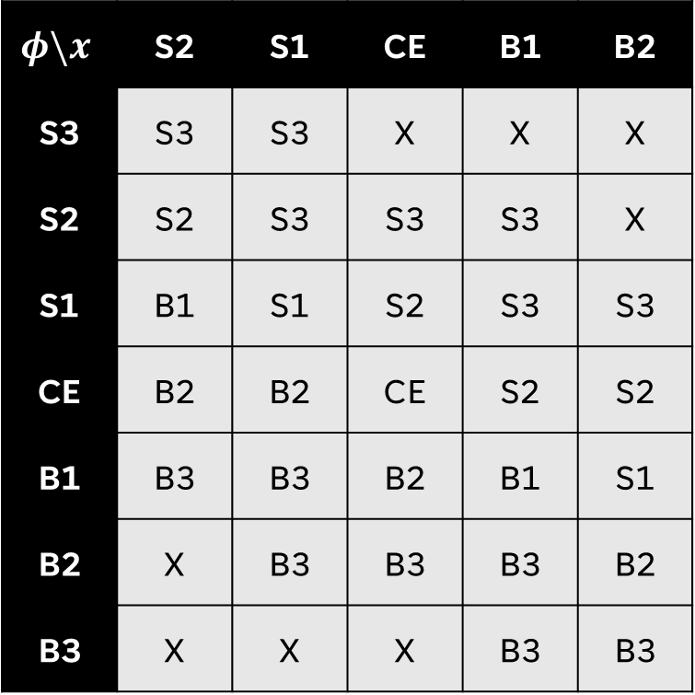
EXAMPLE 1 (WITH COMPLETE DATA AND NO LINGUISTIC RULES)
$$φ\backslash x$$ | S2 | S1 | CE | B1 | B2
S3 | S3 | S3 | X | X | X
S2 | S2 | S3 | S3 | S3 | X
S1 | B1 | S1 | S2 | S3 | S3
CE | B2 | B2 | CE | S2 | S2
B1 | B3 | B3 | B2 | B1 | S1
B2 | X | B3 | B3 | B3 | B2
B3 | X | X | X | B3 | B3
Fuzzy rule base for example 1
video showing trajectory of trucks for example 1

Slide 17
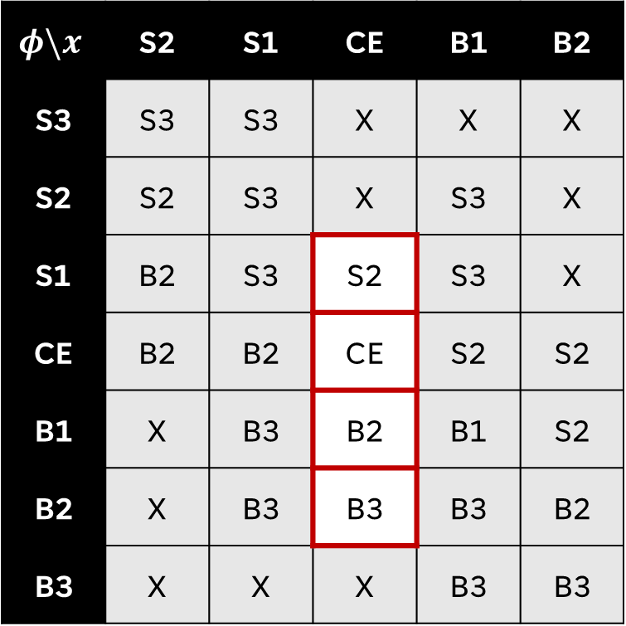
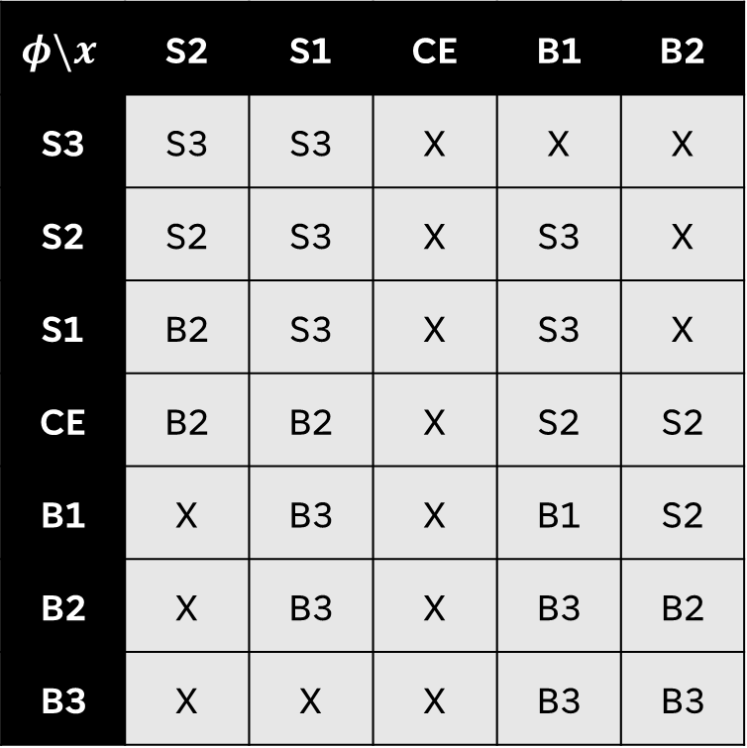
EXAMPLE 2 (With truncated data and linguistic rules)
$$φ\backslash x$$ | S2 | S1 | CE | B1 | B2
S3 | S3 | S3 | X | X | X
S2 | S2 | S3 | X | S3 | X
S1 | B2 | S3 | X | S3 | X
CE | B2 | B2 | X | S2 | S2
B1 | X | B3 | X | B1 | S2
B2 | X | B3 | X | B3 | B2
B3 | X | X | X | B3 | B3
$$φ\backslash x$$ | S2 | S1 | CE | B1 | B2
S3 | S3 | S3 | X | X | X
S2 | S2 | S3 | X | S3 | X
S1 | B2 | S3 | S2 | S3 | X
CE | B2 | B2 | CE | S2 | S2
B1 | X | B3 | B2 | B1 | S2
B2 | X | B3 | B3 | B3 | B2
B3 | X | X | X | B3 | B3
Fuzzy rule base for example 2
(with truncated data)
Fuzzy rule base for example 2
(with added linguistic rules)

Slide 18
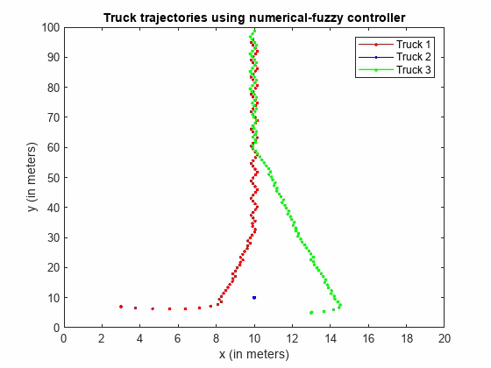
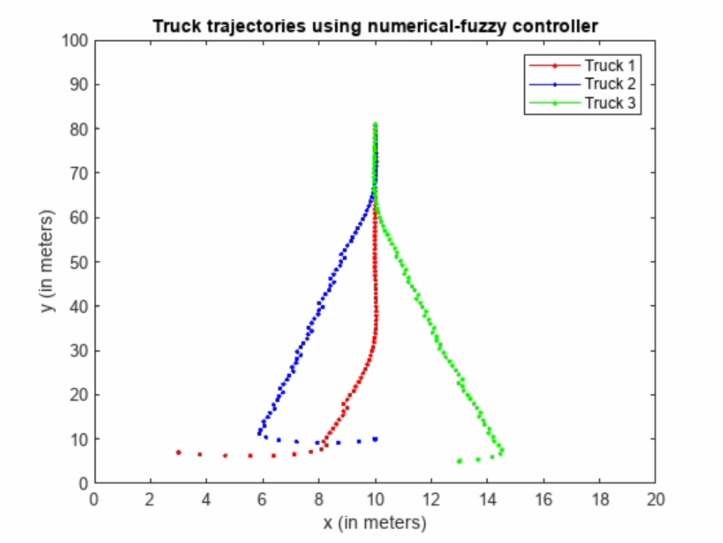
EXAMPLE 2 (With truncated data and linguistic rules)
video showing trajectory of trucks for example 2 (with truncated data)
video showing trajectory of trucks for example 2 (with truncated data and added linguistic rules)

Slide 19
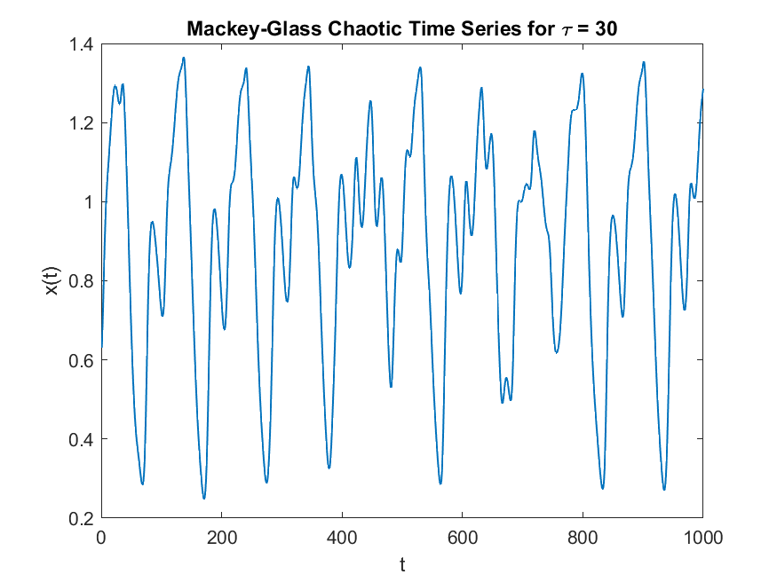
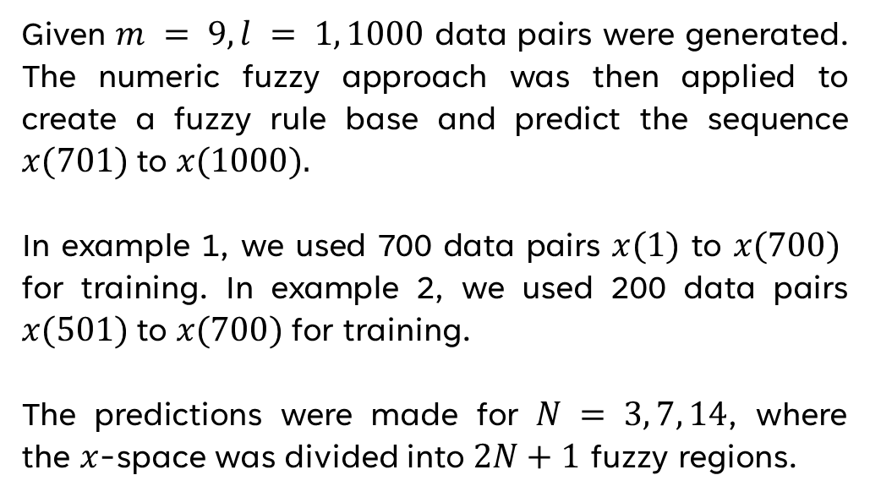
MACKEY-GLASS CHAOTIC TIME SERIES PREDICTION
A section of the Mackey-Glass chaotic time series was generated from the delay-differential equation mentioned in the paper [1, 18].
Given $m = 9, l = 1, 1000$ data pairs were generated. The numeric fuzzy approach was then applied to create a fuzzy rule base and predict the sequence $x(701)$to $x(1000).$
In example 1, we used 700 data pairs $x(1)$ to $x(700)$ for training. In example 2, we used 200 data pairs $x(501)$to $x(700)$for training.
The predictions were made for $N = 3, 7, 14$, where the $x$-space was divided into $2N+1$ fuzzy regions.

Slide 20
MEMBERSHIP FUNCTIONS FOR FUZZY REGIONS $(N = 3, 7)$

Slide 21
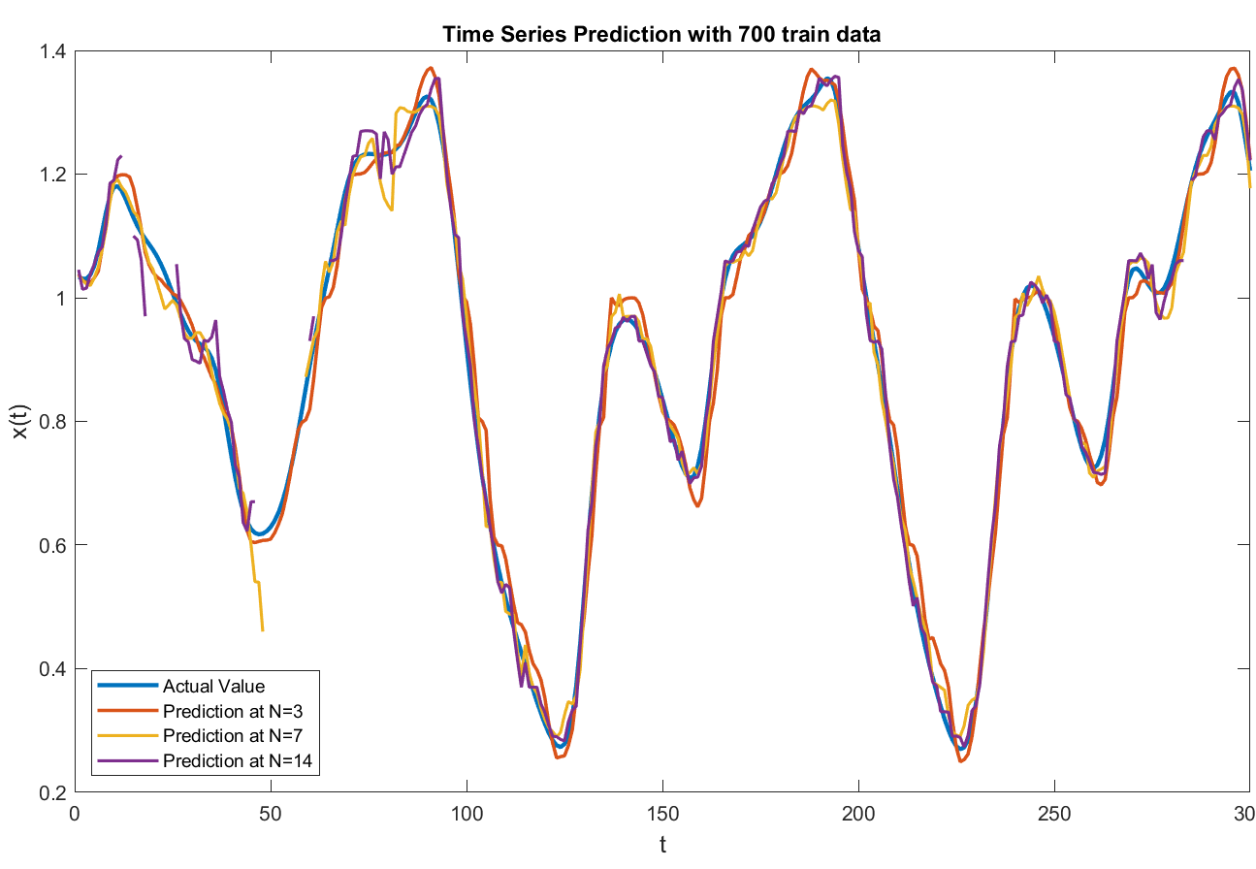
EXAMPLE 1: MACKEY-GLASS CHAOTIC TIME SERIES PREDICTION

Slide 22
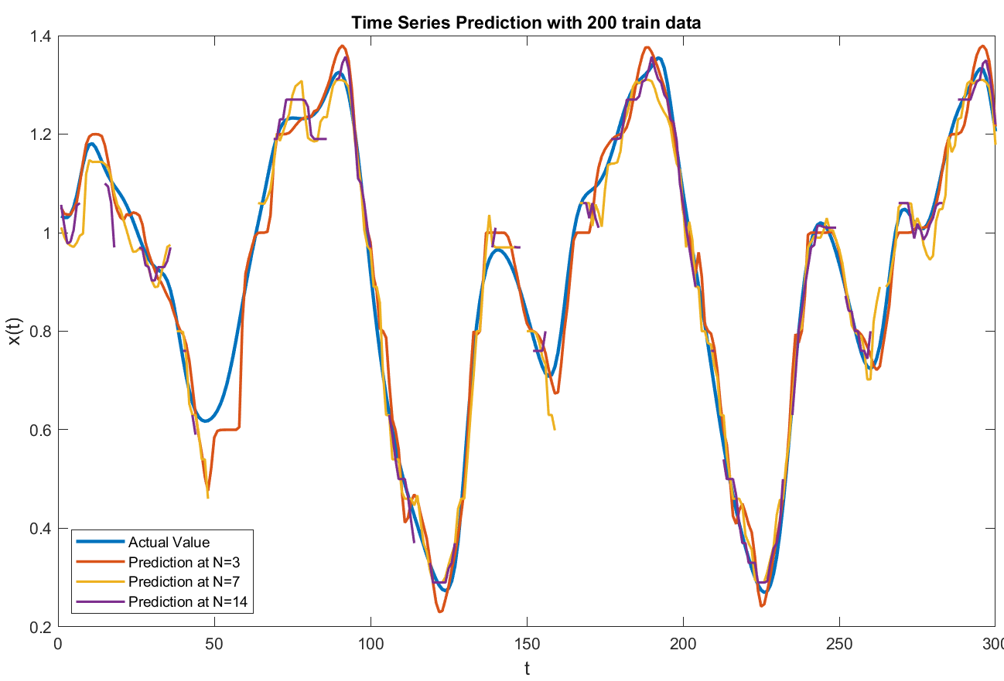
EXAMPLE 2: MACKEY-GLASS CHAOTIC TIME SERIES PREDICTION

Slide 23
REFERENCES
L-X Wang and Jerry M Mendel. “Generating fuzzy rules by learning from examples”. In: IEEE Transactions on systems, man, and cybernetics 22.6 (1992), pp. 1414– 1427.
Li-Xin Wang. “Generating fuzzy rules from numerical data, with applications”. In: University of Southern California, tech. report (1991).

Slide 24
THANK YOU

