Slide 1
Final Project
By:
Daniel Budhram, Daniel Espin
Austin Rodriguez, Gregg Saldutti
Rochelle Williams

Slide 2
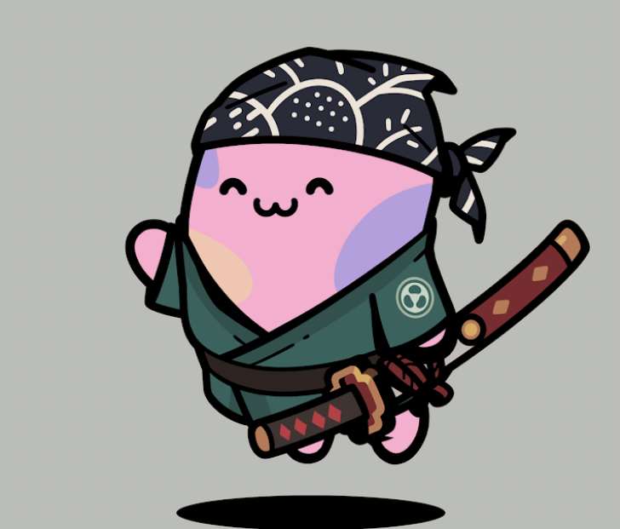
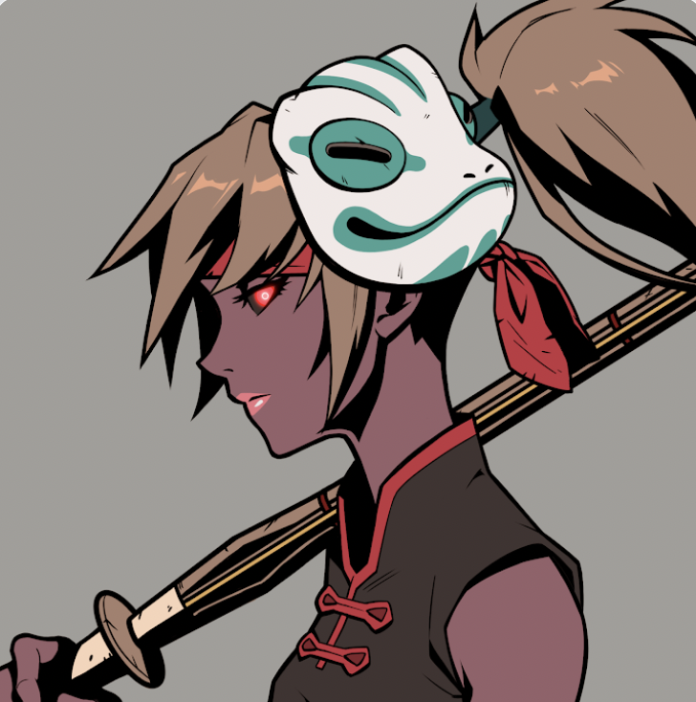
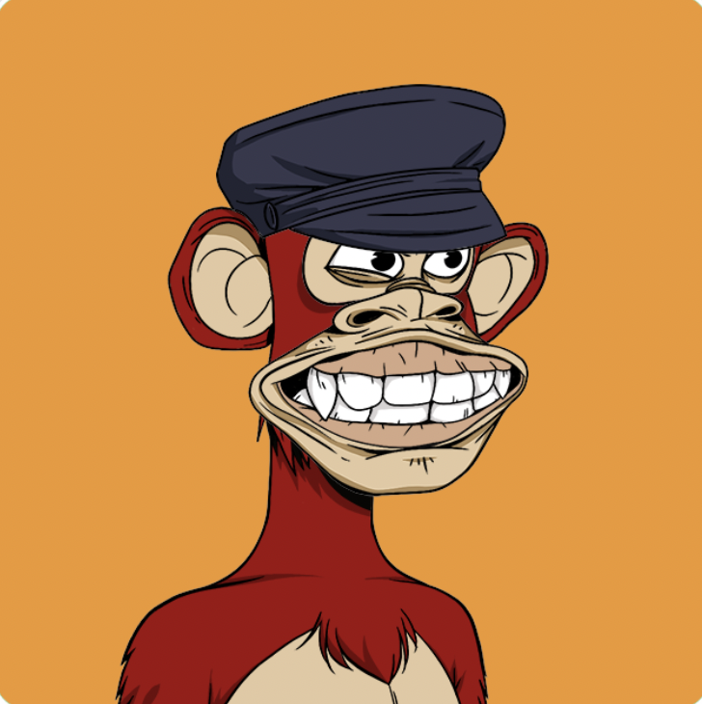
Project Topic - NFT Creation
Purpose:
Create an NFT(s) that can be sold and bought via a marketplace
Technologies Implemented:
CSS
Next.js
Tailwind CSS
Solidity
MetaMask
Pinata
Rinkeby

Slide 3
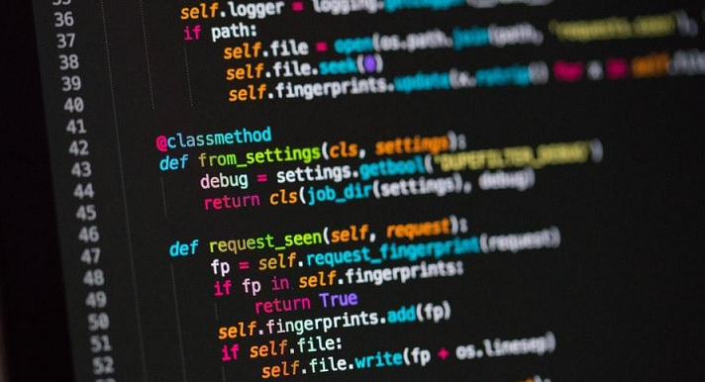
How did we get here?
Dan B., Dan E. and Austin R. decided to work on a project outside of the Bootcamp.
Initial ideas included creating an NFT to be introduced into the market.
Project will be conducted in phases with the Final Project of the course as proof of concept of NFT creation and testing

Slide 4
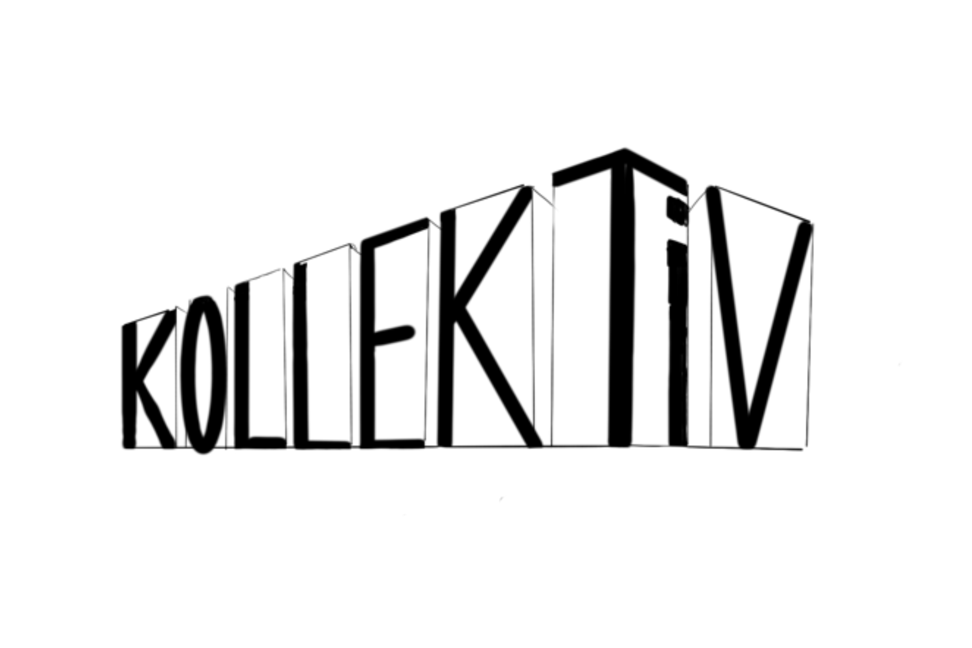
The KollekTiV
What is it all about?
The KollekTiV

Slide 5
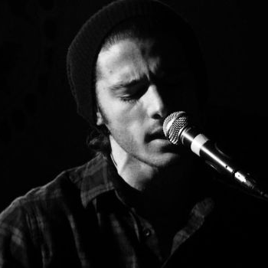
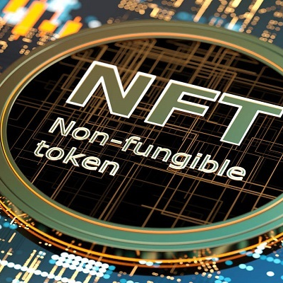
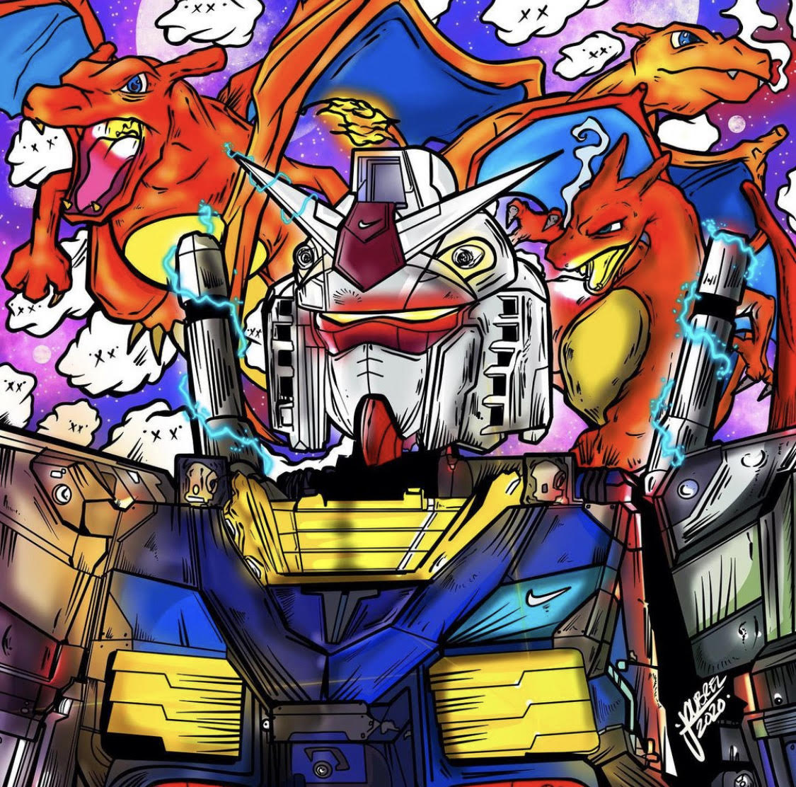
What Are NFTS?
Non-fungible tokens (NFTs) are cryptographic assets on a blockchain with unique identification codes and metadata that distinguish them from each other.
Digital creations of assets that already exist
Almost anything can be turned in an NFT
NFTs are good investments

Slide 6
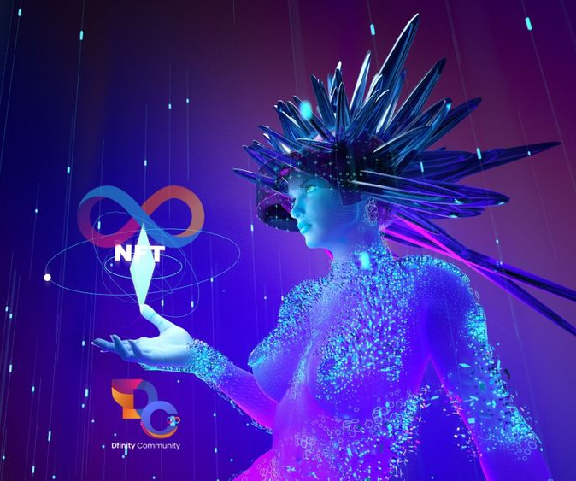
The Rise of NFTs
Been around since 2014
Tuesday, February 2, 20XX
Sample Footer Text

Slide 7
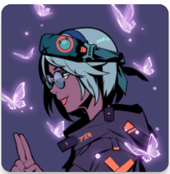
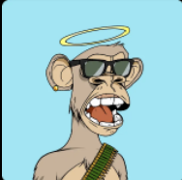
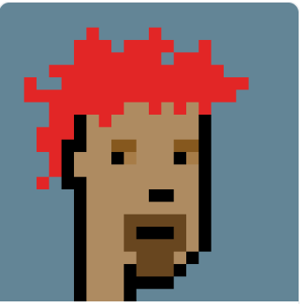
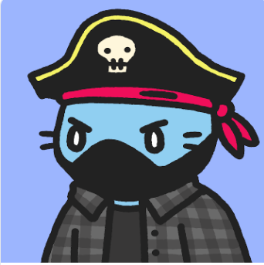
Popular NFTs
Azuki
Bored Ape Yacht Club
CryptoPunks
Cool Cats
We rise together. We build together. We grow together.
Title
Title
Title
Tuesday, February 2, 20XX
Sample Footer Text

Slide 8
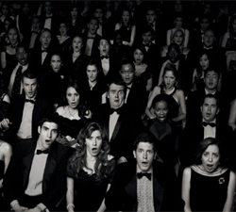
Introducing The KollekTiV NFT
Tuesday, February 2, 20XX
Sample Footer Text

Slide 9
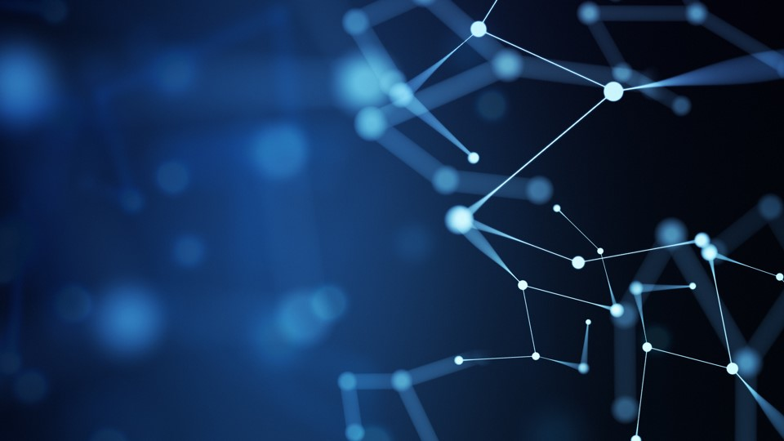
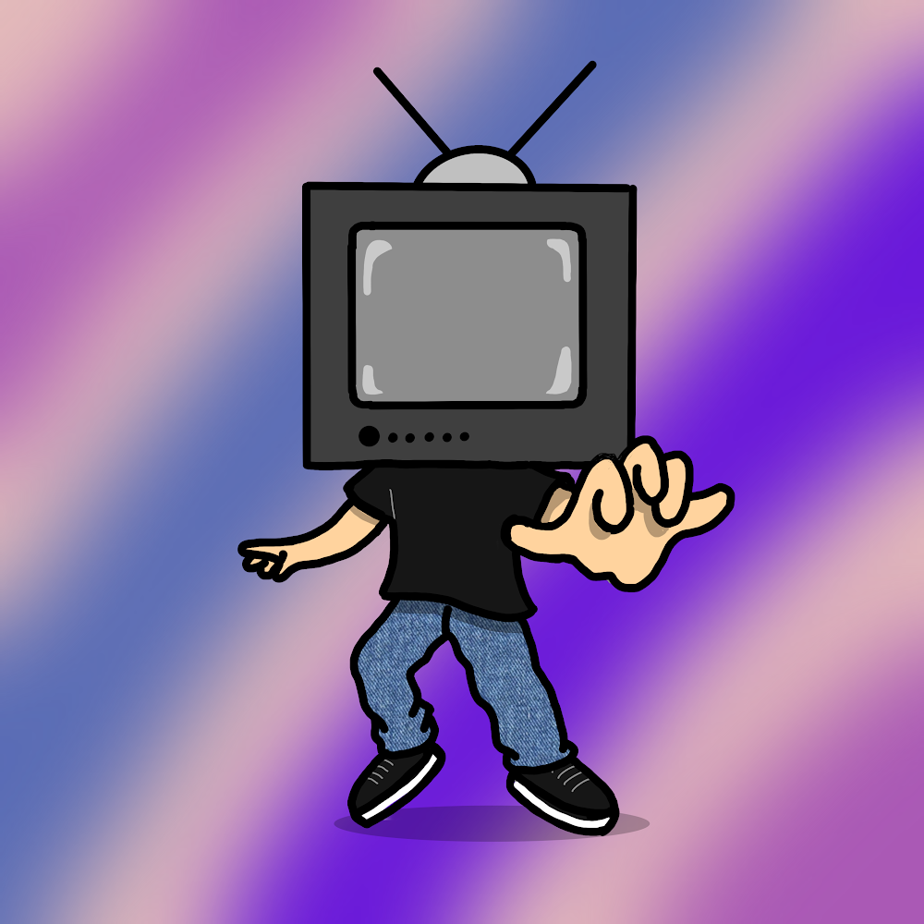
Teebo
See the real you
Tuesday, February 2, 20XX
Sample Footer Text

Slide 10

Teebo vs. Current NFTs
Advantages
Disadvantages
Unique idea with its own storyline
Near infinite possible NFTs creations
Exclusive benefits are given to owners
The team behind this venture has a vision for the future

Slide 11
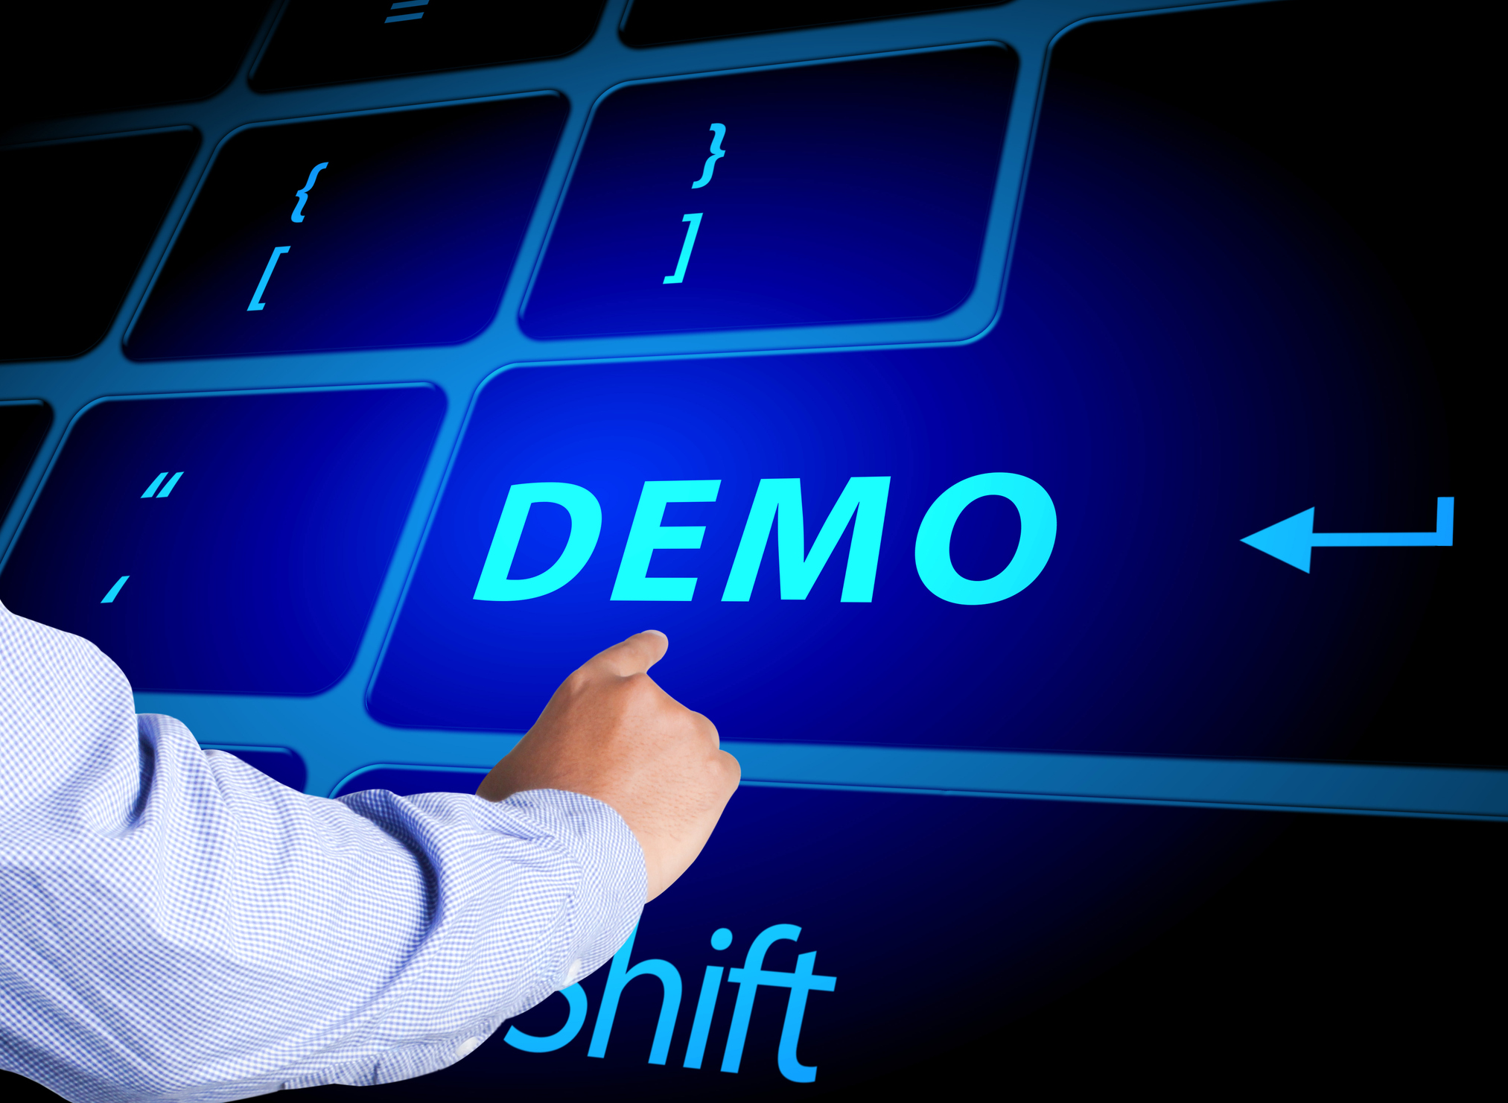
Live Demo

Slide 12
Thank you!
The Future – The KollekTiV
Any questions?

