Slide 1
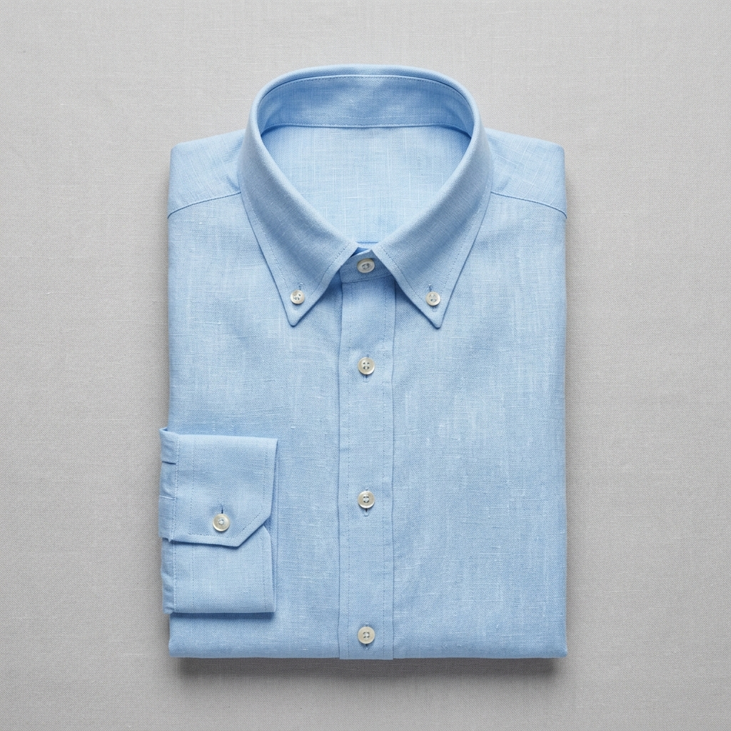

netcore •
✨ UNIFIED COMMERCE EXPERIENCE PLATFORM
ON-SITE STORE SEARCH • 2:02 PM
🔍 “linen shirt for a summer wedding”
Filters: Sky Blue • Size M • $60–$90
Market to Every Shopper Like You Already Know Them
Netcore connects on-site search and real-time product discovery directly with email, SMS, mobile push, and WhatsApp. What a shopper searches, filters, and leaves in their cart immediately shapes the very next message they receive.
⚡ Zero Data Lag: Real-time intent captured from in-session search & browse behavior.
🎯 1:1 Relevance: Automated outbound triggers matching exact size, color & budget.
🤖 Autonomous AI: Unified agents driving search ranking and omnichannel campaigns.
NETCORE SHOPPER MEMORY [LIVE SYNC]
Tags: [linen] [sky blue] [size: M] [affinity: wedding] [cart: $79]
Action: Trigger contextual cart recovery + matching chinos
OUTBOUND TRIGGER • EMAIL & WHATSAPP
“Your sky blue linen shirt is still in your cart”
Size M in stock. Wedding planning? Pair it with stone chinos.
6,500+ ENTERPRISE BRANDS GROW WITH NETCORE: adidas • UNDER ARMOUR • Columbia • crocs • ALDO • TOMMY HILFIGER • Walmart

Slide 2
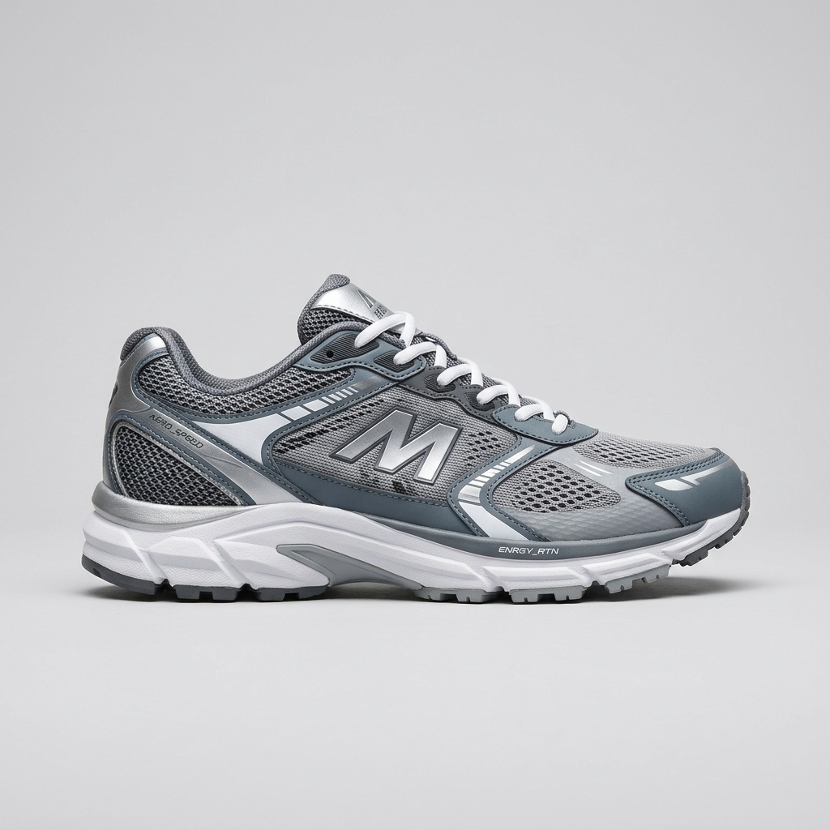
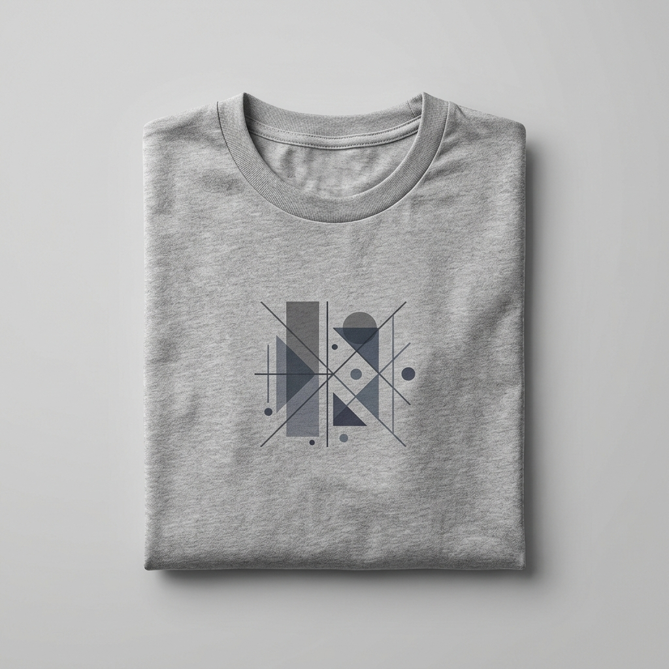
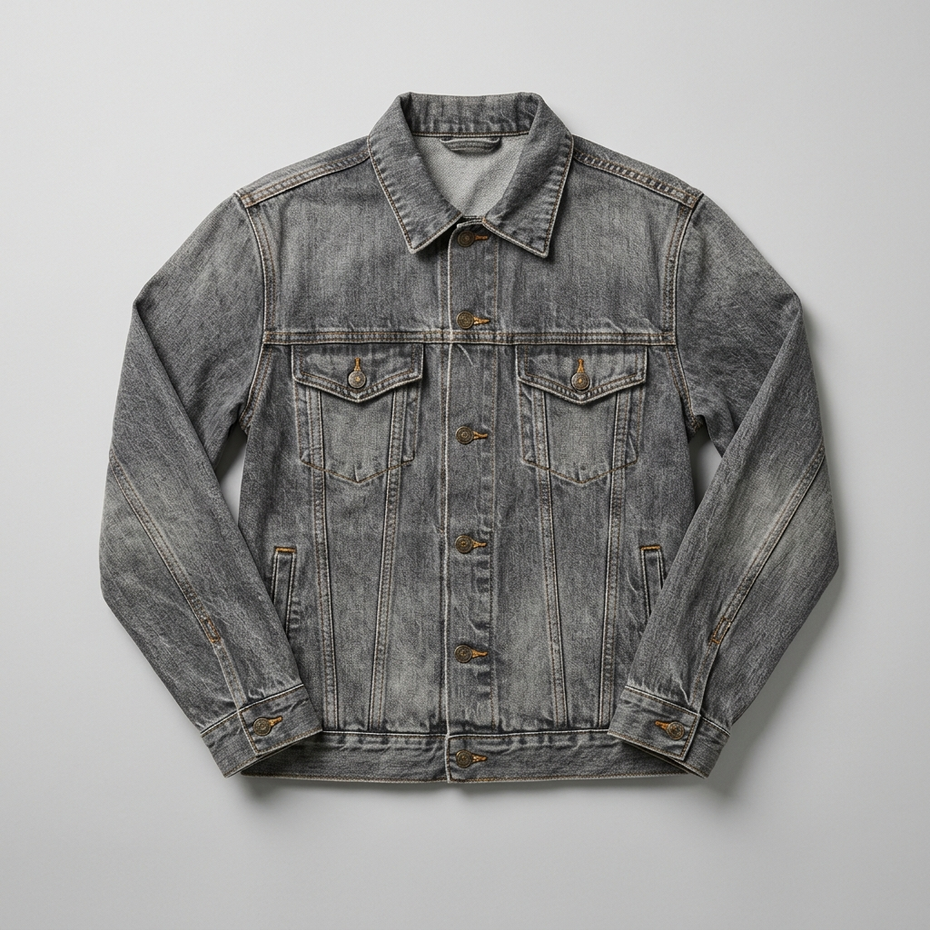
THE STATUS QUO CHALLENGE
netcore •
Most Stacks Would Have Sent This Instead
When on-site search and customer engagement live in separate tools, campaigns ignore the shopper's real intent.
⚠️ THE TRADITIONAL CART ABANDONMENT EMAIL
“You left something behind!”
“Still thinking it over? Your cart is waiting. While you’re here, check out this week’s bestsellers:”
🧩 FRAGMENTED SILOS
1. On-Site Search Knows. Email Doesn't.
On-site search and product discovery sit in one tool; marketing campaigns sit in another. Each vendor sees only 50% of the customer's actual behavior.
🔌 INTEGRATION FRICTION
2. Connecting Them Is a Project, Not a Setting.
Bolt-on connectors pass a few delayed events across. Everything else the shopper searched, filtered, and compared stays trapped behind engineering backlogs.
Generic catalog bestsellers: Running sneakers, Graphic tee, Denim jacket
❌ No size or stock check: Fails to confirm if abandoned size is available.
❌ Completely misses intent: Zero awareness that the shopper is shopping for a summer wedding.
❌ Ignores search history: Recommends athletic sneakers instead of coordinating linen trousers.
🤖 BLIND AI AGENTS
3. AI Agents Only Act on What They Can See.
Split the data and every AI agent works from half the story. As you add more specialized agents, the context gap grows exponentially.

Slide 3
REAL-TIME INTENT LOOP
netcore •
What Shoppers Do on Your Site Writes Your Next Email
Follow every shopper from search bar to inbox. Automatically capture intent in real time to build the next message.
STEP 01 • 2:02 PM
Searches
“linen shirt for a summer wedding”
High-intent category & occasion captured
STEP 02 • 2:05 PM
Filters
Sky blue, Size M, $60 to $90
Specific style, sizing & budget locked
STEP 03 • 2:09 PM
Compares
Opens Sky Blue Linen twice
Deep product affinity identified
STEP 04 • 2:14 PM
Cart Exit
Sky Blue Linen ($79) left in cart
Immediate high-intent drop-off logged
STEP 05 • 5:14 PM
Triggered
Automated email + WhatsApp sent
Contextual recovery + matching chinos
NETCORE REAL-TIME SHOPPER PROFILE [AUTOMATICALLY ENRICHED]
2:02 PM — Intent: summer wedding | Fabric: linen | Category: men's shirts
2:05 PM — Color: sky blue | Size: M | Budget ceiling: $90
2:09 PM — Top product: Sky blue linen shirt (viewed twice)
2:14 PM — Cart: $79 | Left without checkout
5:14 PM — Action: Send cart recovery email + matching chinos recommendation
THE NETCORE CONTEXT-AWARE MESSAGE (INBOX VIEW)
“Your sky blue linen shirt is still in your cart”
“Size M is still in stock. Planning for the wedding? These pair well with it.”
Sky Blue Linen
$79 (In Cart)
Size M
Stone Linen Chinos
$68 (Recommended)
Size M

Slide 4

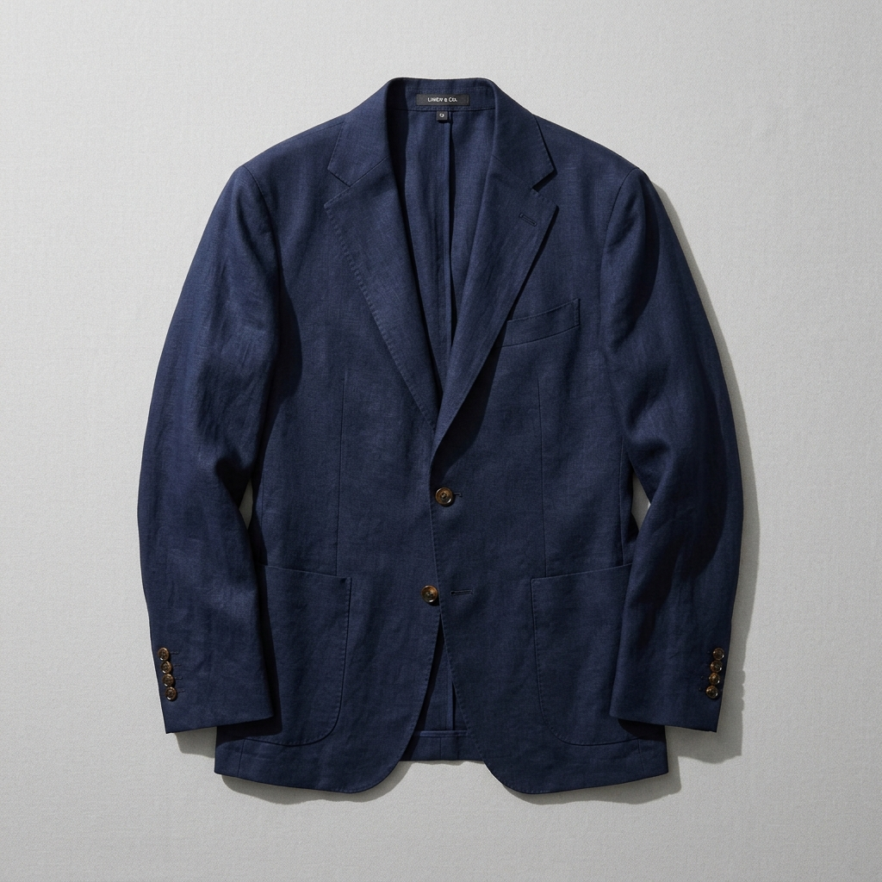
OMNICHANNEL CAMPAIGN PLAYBOOK
netcore •
Four Campaigns Built From What Shoppers Actually Do
Combining on-site search intelligence with customer lifecycle marketing enables campaigns point solutions can never replicate.
CAMPAIGN 01
Segments Built From Search Queries
Reach shoppers by what they are looking for right now, not just what they bought last year.
• Rule: Searched “linen” 2+ times AND Last 7 days, no purchase AND Size M
• Dynamic Audience: 1,240 active shoppers ready for immediate conversion
CAMPAIGN 02
Email Recommendations That Match Your Site
The exact same AI that ranks on-site search chooses products in every email, automatically respecting size and price.
CAMPAIGN 03
Merchandising Triggers for the Right Shoppers
Price drops, back-in-stock, and new arrivals message ONLY the shoppers who previously searched or viewed those products.
⚡ WHEN: Linen shirt price drops to $69
👥 WHO: Shoppers who searched or viewed it in last 14 days
📲 SEND: Multi-channel blast via WhatsApp, SMS, and Email
CAMPAIGN 04
Recommendations Across Every Channel
Click a product in an email and the site leads with it. Browse on site, and the next push notification continues right where they left off.
• Channels: Web • Email • SMS • Push • WhatsApp

Slide 5
ENTERPRISE ARCHITECTURE
netcore •
One Shopper Memory Behind Every Experience
Product discovery and customer engagement read from and write to the same profile. Nothing to sync, nothing lost.
WHAT SHOPPERS DO (SIGNALS)
🔍 Searches & faceted filter refinements
🖱️ Products viewed, compared & clicked
🛒 Cart additions, checkouts & returns
💬 Email, SMS & WhatsApp responses
🏷️ Catalog sync (price drops, stock levels)
📍 Context (device, geolocation, season)
NETCORE SHOPPER MEMORY
Real-Time Unified State Machine
• Returning Shoppers: Builds upon historic LTV, past orders & cross-channel brand affinities.
• New Shoppers: Seeds intent from location, referring traffic, and catalog trending velocity.
• In-Session Adaptation: Dynamically updates recommendations and cart triggers with every click.
WHERE IT SHOWS UP (SURFACES)
On Your Store:
• On-site search ranking & visual auto-suggest
• 1:1 Personalized product recommendations
• Real-time visual merchandising badges
In Your Campaigns:
• Dynamic triggered & lifecycle emails
• SMS and RCS conversational messaging
• Mobile app push notifications & WhatsApp commerce
9 SPECIALIZED AUTONOMOUS AI AGENTS WORKING FROM ONE MEMORY
On Your Site: 🛍️ Shopping Agent • 🗂️ Merchandising Agent • 🛠️ Debugger Agent
In Campaigns: 👥 Audience Agent • ✍️ Content Agent • 📅 Scheduler Agent • 🔀 Decisioning Agent • 📊 Insights Agent • 🚀 Co-Marketer
Every agent operates on 100% complete customer context — no data blindness, no cross-tool latency.

Slide 6
BUSINESS IMPACT & CONSOLIDATION
netcore •
What Changes for Your Marketing Team
Replace four fragmented point solutions with one unified platform. Less time stitching tools together, more campaigns that sell.
THE LEGACY FRAGMENTED STACK
Four Disjointed Tools, Four Invoices
📄 1. On-Site Search & Discovery Vendor
Separate contract, custom event tracking, catalog sync latency.
📄 2. Standalone ESP / Cross-Channel Vendor
Disconnected profile data, limited browsing events, costly volume tiers.
📄 3. Third-Party Personalization Engine
Custom tag management, fragile script execution, inconsistent rules.
📄 4. Dedicated Deliverability Tool
Separate monitoring dashboard, vendor finger-pointing when issues arise.
Result: High engineering overhead, fragmented data, delayed campaigns.
THE NETCORE ADVANTAGE
One Platform • One Invoice • One Partner
🚀 More Revenue From Every Send
Messages built on real-time shopping intent get opened, clicked, and converted. New York & Company saw 70% higher revenue per email.
⚡ Zero-Integration Campaigns
Search, browse, cart, and campaign data live together natively. No custom syncs, no event mapping, no developer backlogs.
📋 Unified Procurement & Support
Consolidate 4 vendor contracts, renewals, and support tickets into a single enterprise SLA and trusted account team.
🧠 Smarter, Context-Rich AI
Every AI agent operates on the complete shopper memory, getting sharper with every search query and catalog update.

Slide 7
PROVEN ENTERPRISE SCALE
netcore •
Real Results From Brands Running Both Together
Validated by global commerce leaders and top-tier independent industry analyst firms.
FEATURED CASE STUDY: NEW YORK & COMPANY
Unifying On-Site Search & Personalized Lifecycle
On-site search learned from live shopper behavior, and those exact signals instantly triggered personalized emails and SMS.
INDUSTRY ANALYST VALIDATION
Recognized on Both Sides of the Stack
GARTNER MAGIC QUADRANT — LEADER
Named a Leader in the 2026 Gartner® Magic Quadrant™ for Search and Product Discovery for the 3rd consecutive year.
+600%
Higher Email Click Rate
+70%
More Revenue Per Email
+8%
Higher Search Conversion
1,228%
Verified Return on Investment (ROI)
FORRESTER WAVE — STRONG PERFORMER
Recognized as a Strong Performer in The Forrester Wave™: Email Marketing Service Providers (Q1 2026).
“With AI-powered search and personalized emails working together, we created a smoother shopping journey. Every click fueled smarter marketing.”
— VP of Marketing, New York & Company
FORRESTER WAVE — COMMERCE SEARCH
Achieved the Highest Score in Current Offering in The Forrester Wave™: Commerce Search & Product Discovery (Q3 2025).

Slide 8
SUMMARY & NEXT STEPS
netcore •
Your Shoppers Already Told You What They Want
Put every search, click, and cart to work across the next email, SMS, push, and WhatsApp message you send.
🔄 SEAMLESS INTEGRATION
1. Unify Search & Lifecycle
Eliminate data lag and architectural silos between what shoppers do on site and what your campaigns deliver.
⚡ IMMEDIATE ACTION
2. Trigger Real-Time Intent
Transition from generic batch-and-blast emails to automated 1:1 triggers within minutes of customer activity.
📈 PROVEN ROI
3. Maximize Commerce GMV
Drive double-digit revenue growth with search-driven recommendations and synchronized omnichannel touchpoints.
READY TO TRANSFORM YOUR COMMERCE EXPERIENCE?
Book a Live Architectural Walkthrough & Product Discovery Audit
See how Netcore connects on-site search, merchandising, and cross-channel lifecycle marketing to deliver immediate double-digit conversion lift for your brand.
BOOK A DEMO • netcorecloud.com
Trusted by 6,500+ global brands | Gartner Magic Quadrant Leader

