Slide 1

Discussion: Alternative and complementary approaches for advancing research on dementia
Michael Donohue
Alzheimer’s Therapeutic Research Institute
University of Southern California
USC ATRI

Slide 2
Review
Speaker | Topic
Scott Hofer | The role of replication and research synthesis in dementia research
Sarah Bauermeister | Dementias Platform UK (DPUK): Data Portal: Bringing Researchers to Data and Using the Power of Cohorts
Ivan Koychev | Using Cohort Data to Empower Trial Selection: Dementias Platform UK Clinical Studies Register
Jyl Boline | Global Alzheimer's Association Interactive Network (GAAIN): A gateway to dementia data
Graciela Muniz-Terrera | Integrative Analysis of Longitudinal Studies of Aging and Dementia (IALSA): A coordinated analysis approach

Slide 3
Other resources
Trial Ready Cohort for Preclinical AD (TRC-PAD)
PIs: Aisen, Sperling, Cummings)
Alzheimer Prevention Trials Webstudy (APT)
https://www.aptwebstudy.org/welcome

Slide 4
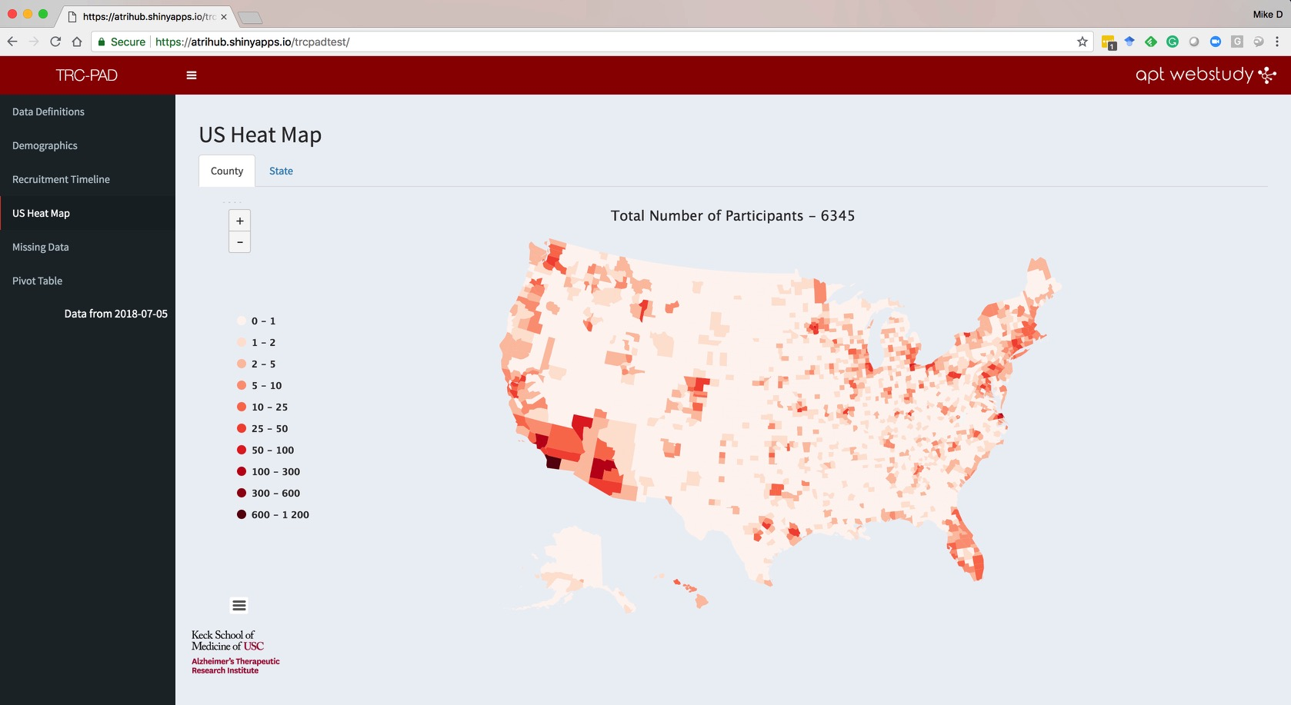

Slide 5
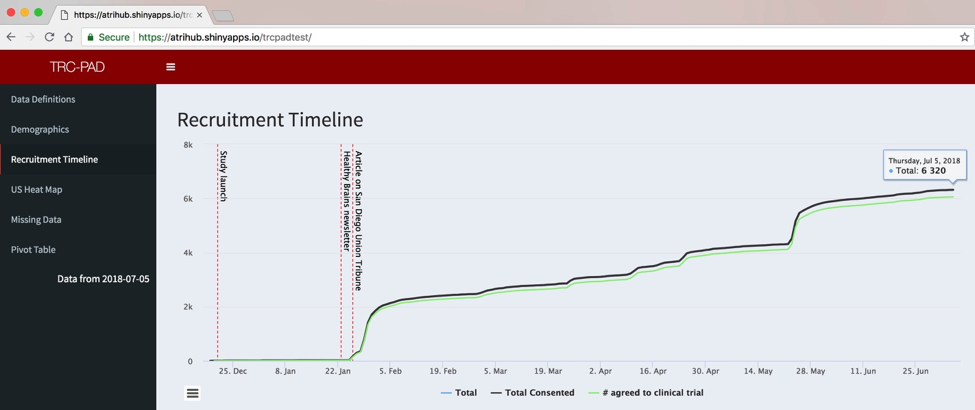
TRC-PAD Enrollment January-July 2018

Slide 6
Other resources
Clinical Trials Data
NIH funded ADCS trials: https://www.adcs.org/data-sharing/
NIH recently funded the Alzheimer’s Clinical Trials Consortium (ACTC)
Anti-Amyloid Treatment for Asymptomatic Alzheimer’s (A4)
All screening data will be shared by end of the year
Rest of data will be available after study close
N=4,486 subjects with amyloid PET scans, MRI, APOE, cognitive testing, etc.
Session: 8:00 AM Sunday, Room 183
Title: “Predicting amyloid burden at screen in Anti-Amyloid Treatment in Asymptomatic AD (A4) study participants”
Roche: “We provide qualified researchers access to individual patient data” via remote access to their servers (data doesn’t leave Roche).
Other companies, etc?

Slide 7
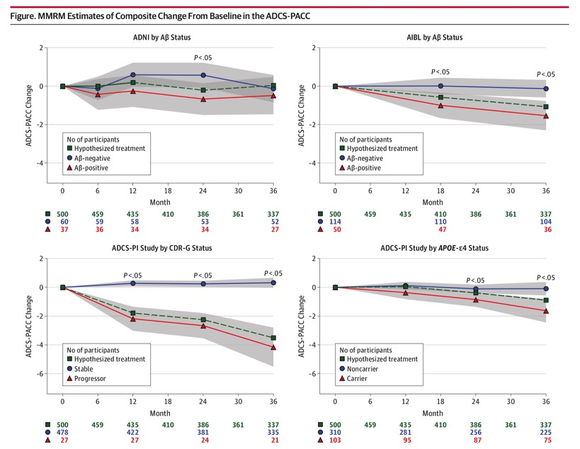
Challenges of AD meta-analysis
Donohue, et al 2014 JAMA Neur

Slide 8
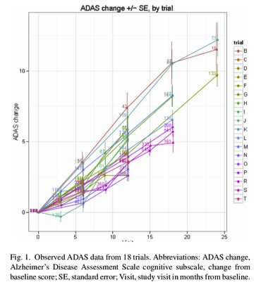
Placebo group project
“N=4,515 placebo-arm subjects, followed for a duration ranging from 12 to 24 months in 20 trials”
Thomas, et al 2016 Alz & Dem

Slide 9
AD meta-analysis challenges
Cohort heterogeneity
Geographic (countries, regions, urban/rural)
Epoch
Academic/Commercial
Design heterogeneity
Outcomes
Predictors
Cross-sectional/longitudinal; Interval/duration

