Slide 1

Discussion: Alternative and complementary approaches for advancing research on dementia
Michael Donohue
Alzheimer’s Therapeutic Research Institute
University of Southern California
USC ATRI

Slide 2
Review
Speaker | Topic
Scott Hofer | The role of replication and research synthesis in dementia research
Sarah Bauermeister | Dementias Platform UK (DPUK): Data Portal: Bringing Researchers to Data and Using the Power of Cohorts
Ivan Koychev | Using Cohort Data to Empower Trial Selection: Dementias Platform UK Clinical Studies Register
Jyl Boline | Global Alzheimer's Association Interactive Network (GAAIN): A gateway to dementia data
Graciela Muniz-Terrera | Integrative Analysis of Longitudinal Studies of Aging and Dementia (IALSA): A coordinated analysis approach

Slide 3
Other resources
Trial Ready Cohort for Preclinical AD (TRC-PAD)
PIs: Aisen, Sperling, Cummings)
Alzheimer Prevention Trials Webstudy (APT)
https://www.aptwebstudy.org/welcome

Slide 4
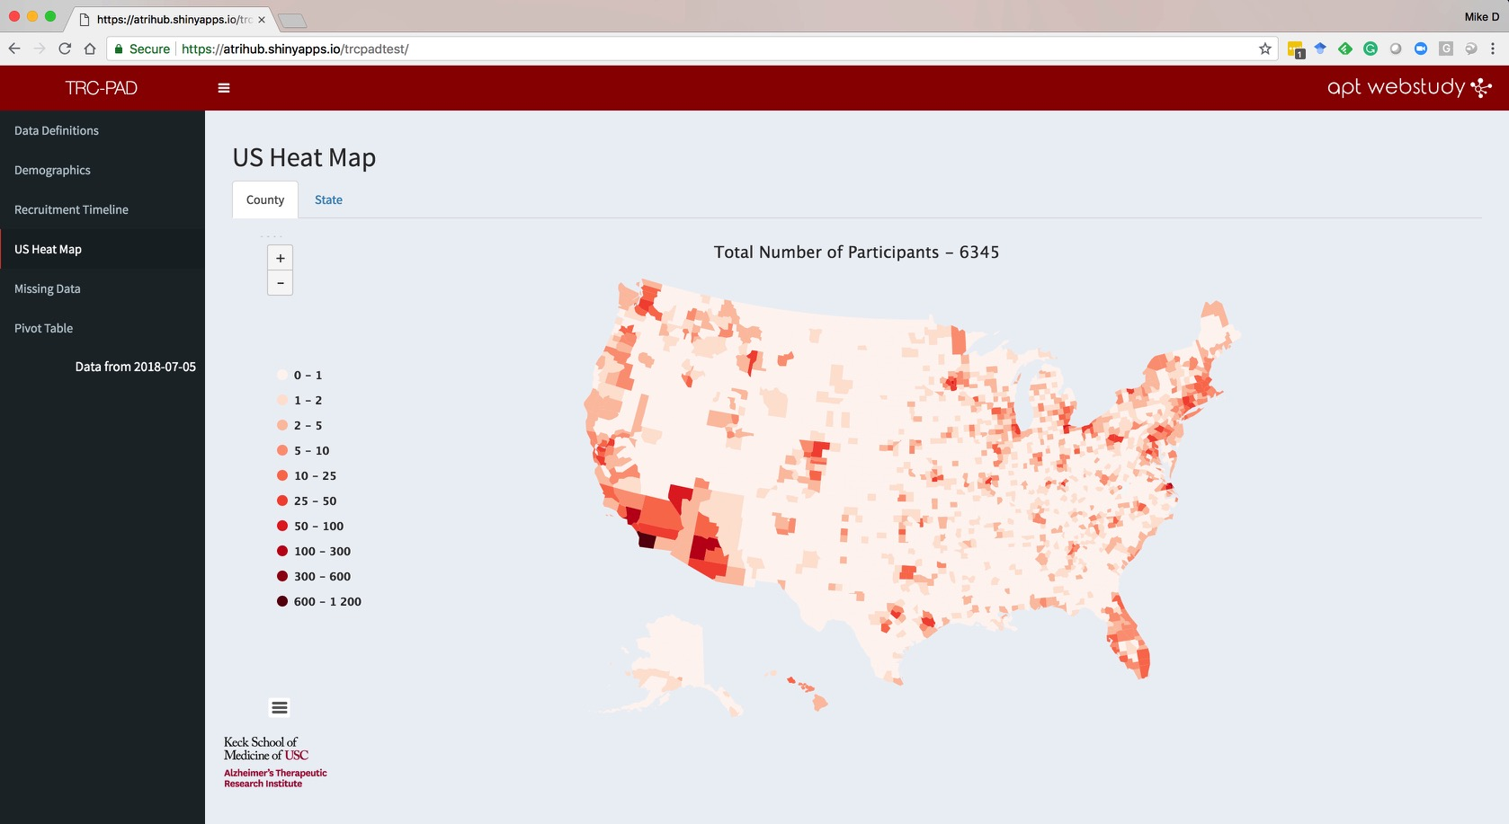

Slide 5
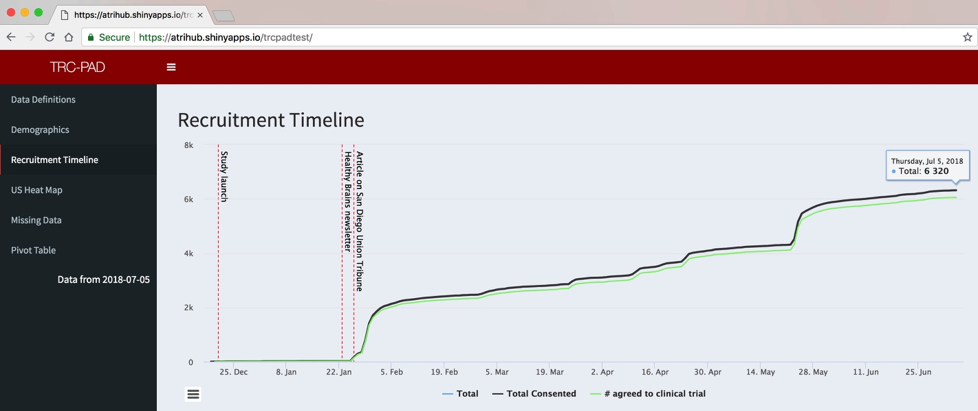
TRC-PAD Enrollment January-July 2018

Slide 6
Other resources
Clinical Trials Data
NIH funded ADCS trials: https://www.adcs.org/data-sharing/
NIH recently funded the Alzheimer’s Clinical Trials Consortium (ACTC)
Anti-Amyloid Treatment for Asymptomatic Alzheimer’s (A4)
All screening data will be shared by end of the year
Rest of data will be available after study close
N=4,486 subjects with amyloid PET scans, MRI, APOE, cognitive testing, etc.
Session: 8:00 AM Sunday, Room 183
Title: “Predicting amyloid burden at screen in Anti-Amyloid Treatment in Asymptomatic AD (A4) study participants”
Roche: “We provide qualified researchers access to individual patient data” via remote access to their servers (data doesn’t leave Roche).
Other companies, etc?

Slide 7
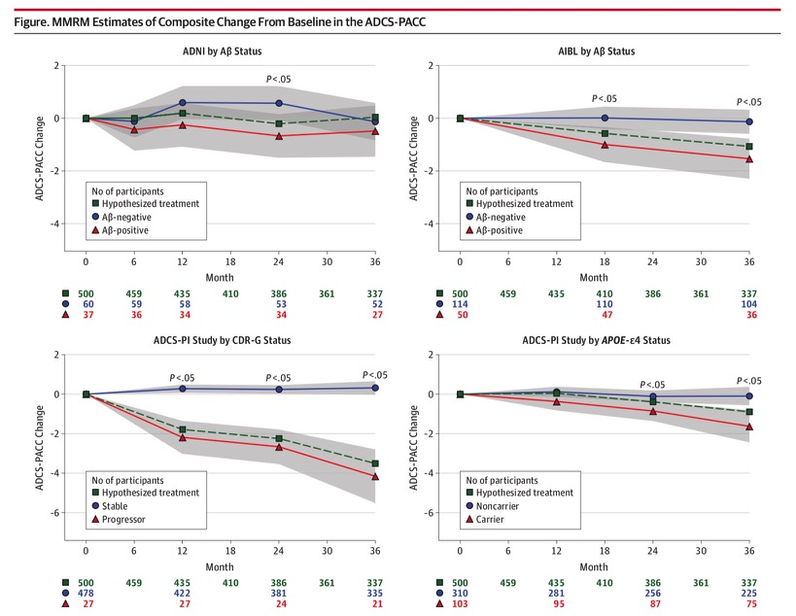
Challenges of AD coordinated replication
Donohue, et al 2014 JAMA Neur

Slide 8
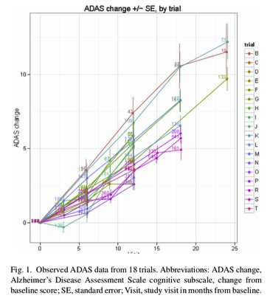
Placebo group project
“N=4,515 placebo-arm subjects, followed for a duration ranging from 12 to 24 months in 20 trials”
Thomas, et al 2016 Alz & Dem

Slide 9
AD integrative data analysis challenges
Cohort heterogeneity
Geographic (countries, regions, urban/rural)
Epoch
Academic/Commercial
Design heterogeneity
Outcomes
Predictors
Cross-sectional/longitudinal; Interval/duration

Slide 10
Challenges of AD integrative data analysis
Challenging even when studies are relatively familiar
Should we be concerned about nuances of heterogeneity that might be missed when we have easy access to many unfamiliar studies?
Missing data concerns, survivor bias, …

Slide 11
What about analysis code sharing?
Key for reproducibility
Tools are already there (e.g. github)
Data portals might consider ways to facilitate/encourage/mandate workflows that encourage code transparency and sharing
Remote server access model might have advantages over data download model (e.g. ADNI)

