Slide 1
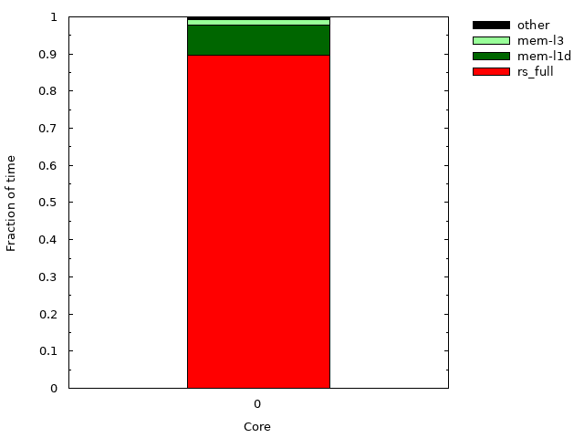
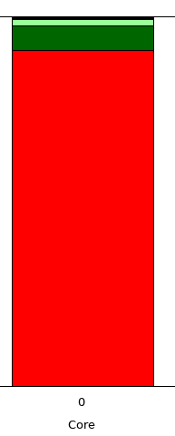
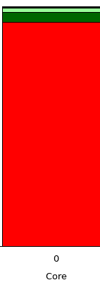
(a) 2 RS entries.
(b) 4 RS entries.
(c) 8 RS entries.
radix
Notes:
Splash2-radix

Slide 2
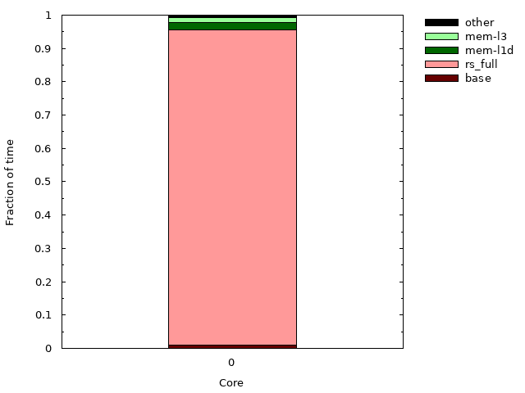
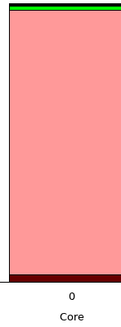

(d) 16 RS entries.
(e) 32 RS entries.
(f) 48 RS entries.
radix
Notes:
Splash2-radix

Slide 3
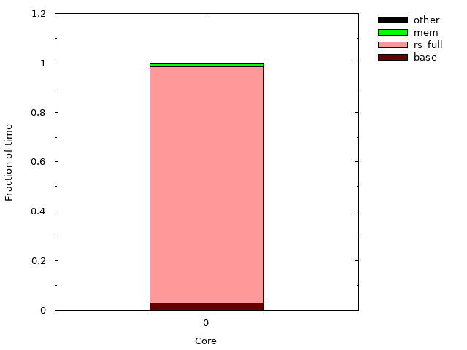
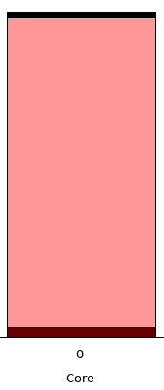
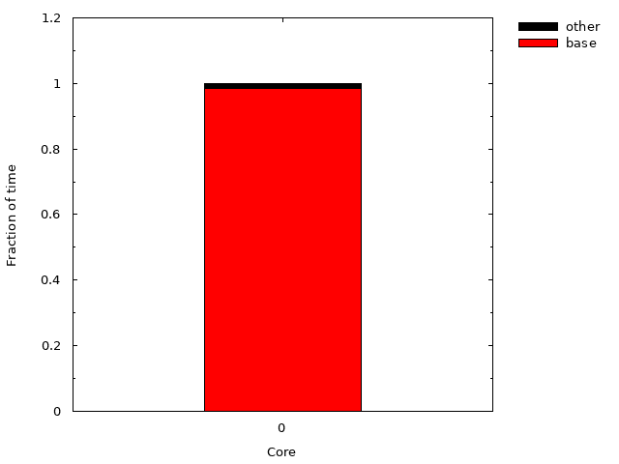
(g) 64 RS entries.
(h) 98 RS entries.
(i) 128 RS entries.
radix
Notes:
Splash2-radix

Slide 4
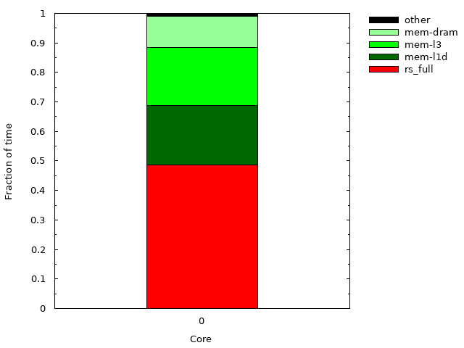
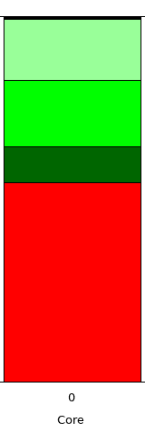
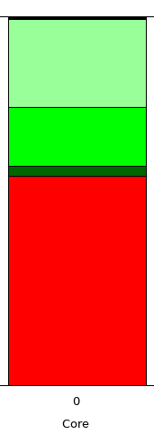
(a) 2 RS entries.
(b) 4 RS entries.
(c) 8 RS entries.
Ocean.cont
Notes:
ocean

Slide 5
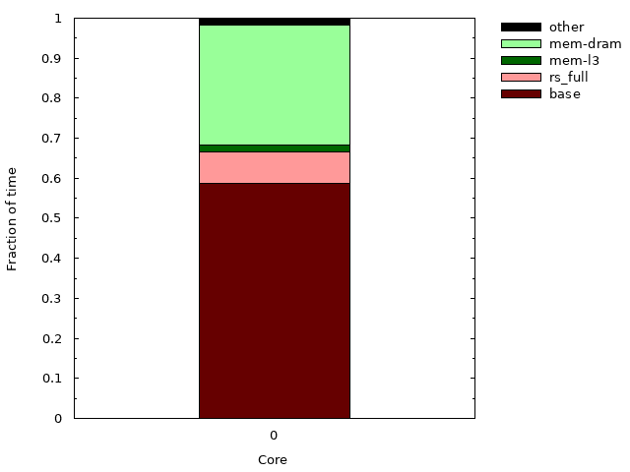
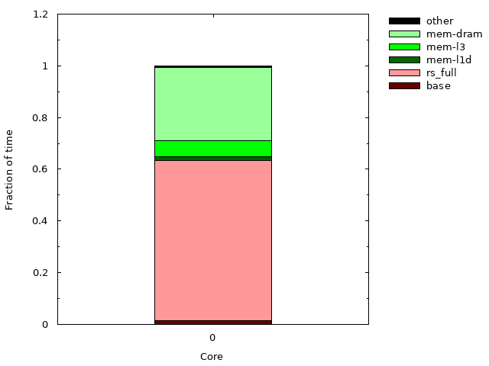
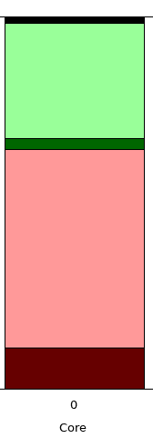
(d) 16 RS entries.
(e) 32 RS entries.
(f) 48 RS entries.
Ocean.cont
Notes:
ocean

Slide 6
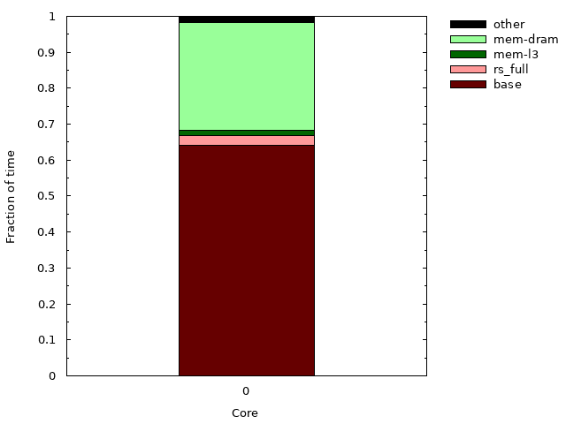
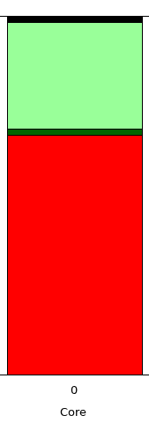

(g) 64 RS entries.
(h) 98 RS entries.
(i) 128 RS entries.
Ocean.cont
Notes:
ocean

Slide 7
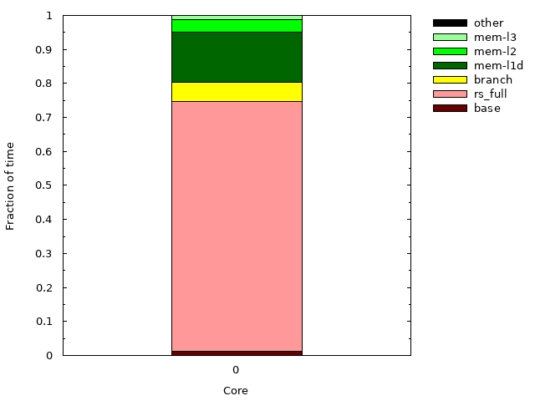
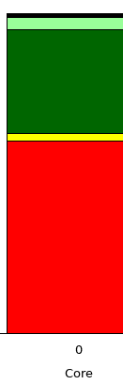
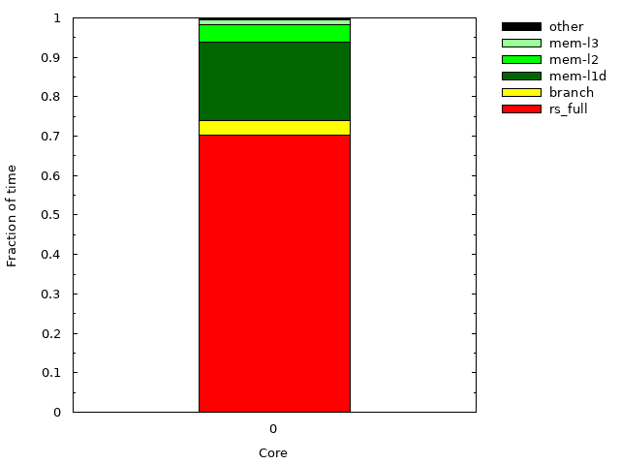
(a) 2 RS entries.
(b) 4 RS entries.
(c) 8 RS entries.
barnes
Notes:
barnes

Slide 8
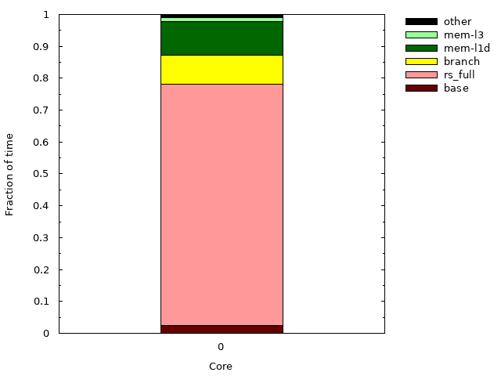
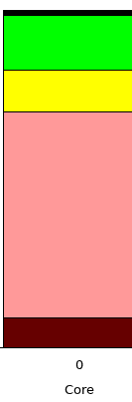
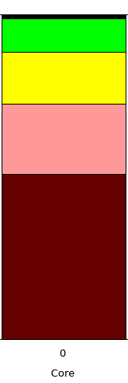
(d) 16 RS entries.
(e) 32 RS entries.
(f) 48 RS entries.
barnes
Notes:
barnes

Slide 9
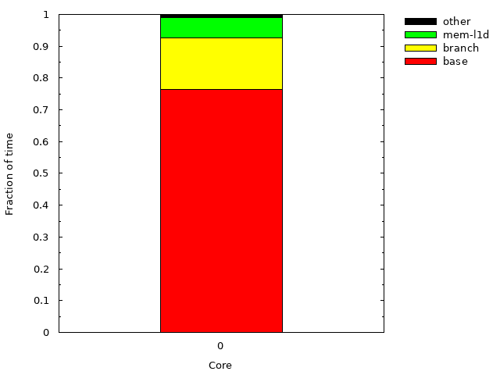
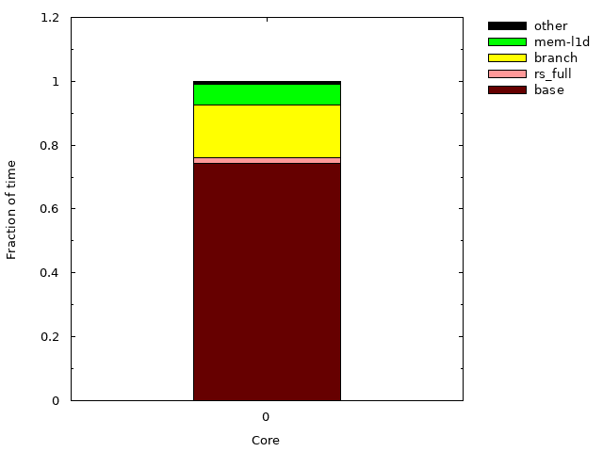
(g) 64 RS entries.
(h) 98 RS entries.
(i) 128 RS entries.
barnes
Notes:
barnes

Slide 10
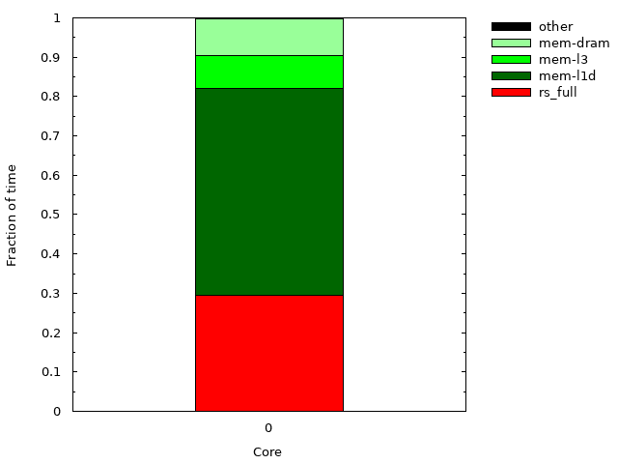
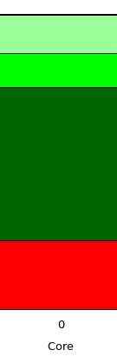
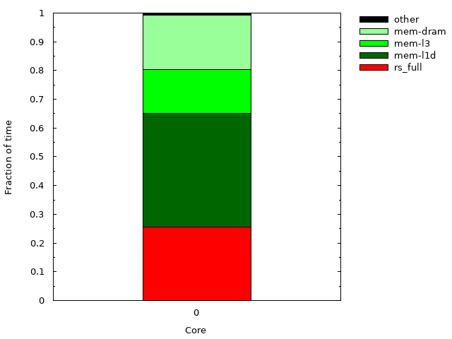
(a) 2 RS entries.
(b) 4 RS entries.
(c) 8 RS entries.
IS
Notes:
IS

Slide 11
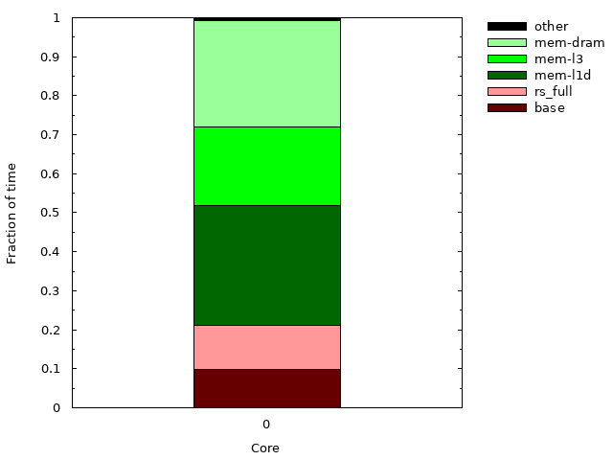
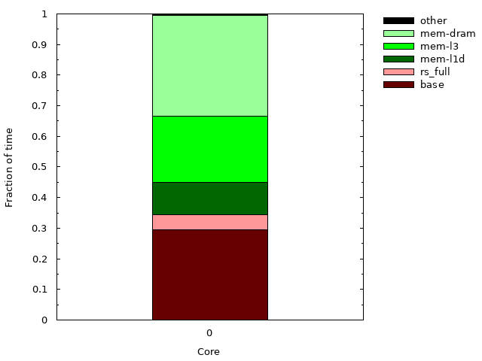
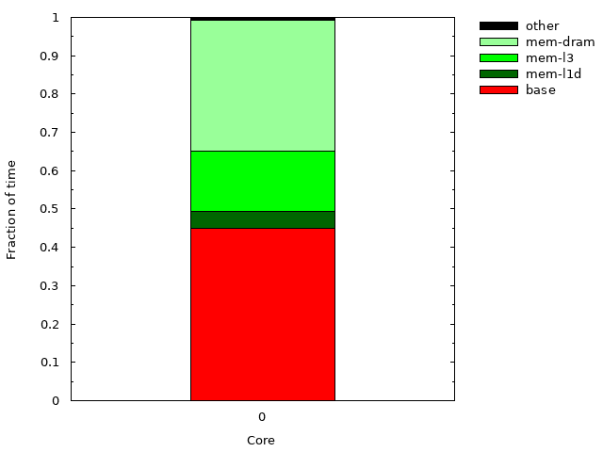
(d) 16 RS entries.
(e) 32 RS entries.
(f) 48 RS entries.
IS
Notes:
IS

Slide 12
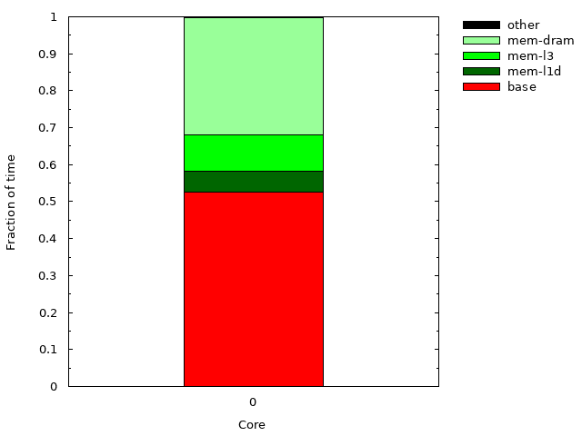
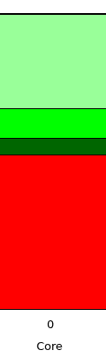

(g) 64 RS entries.
(h) 98 RS entries.
(i) 128 RS entries.
IS
Notes:
IS

Slide 13
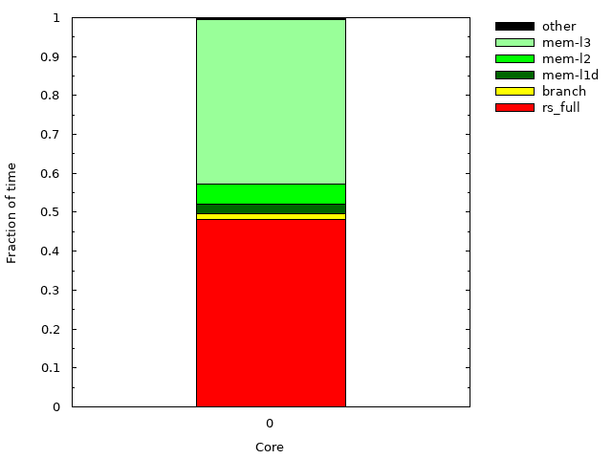
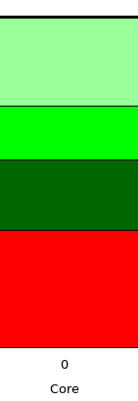
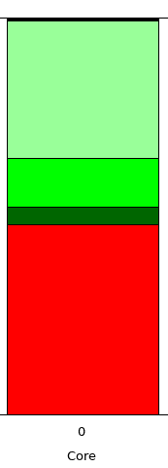
(a) 2 RS entries.
(b) 4 RS entries.
(c) 8 RS entries.
CG
Notes:
Npb-cg

Slide 14
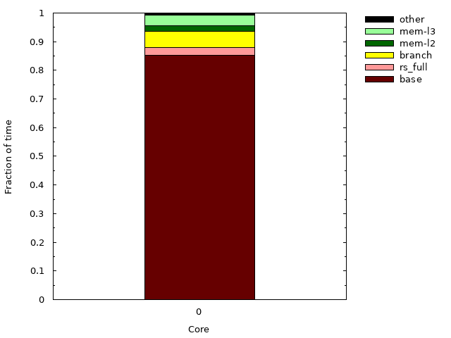
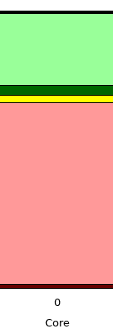
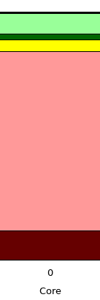
(d) 16 RS entries.
(e) 32 RS entries.
(f) 48 RS entries.
CG
Notes:
Npb-cg

Slide 15
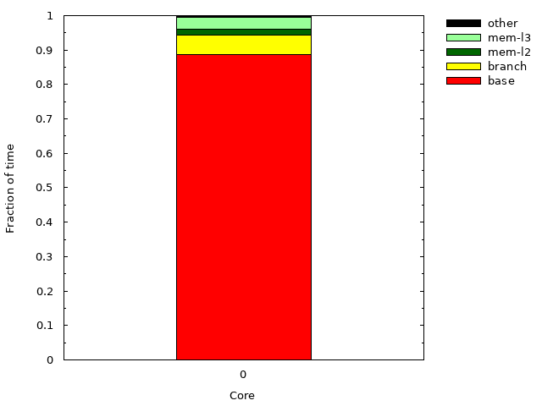
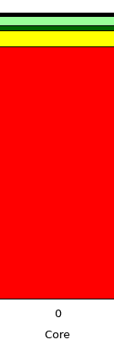

(g) 64 RS entries.
(h) 98 RS entries.
(i) 128 RS entries.
CG
Notes:
Npb-cg

Slide 16
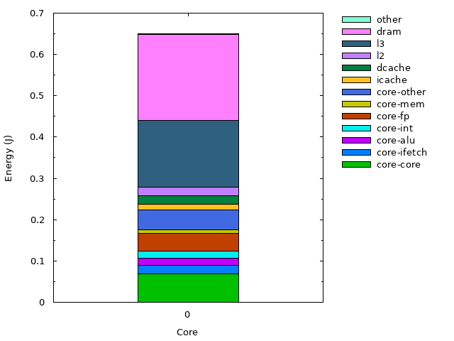
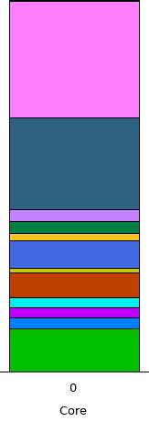
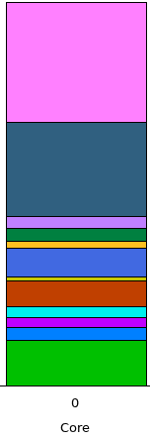
(a) 2 RS entries.
(b) 4 RS entries.
(c) 8 RS entries.
radix
Notes:
radix

Slide 17
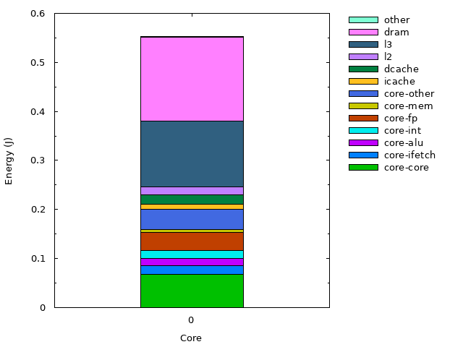
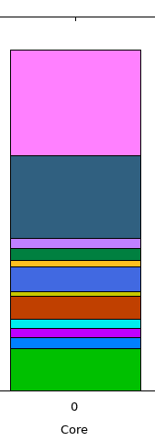

(d) 16 RS entries.
(e) 32 RS entries.
(f) 48 RS entries.
radix
Notes:
radix

Slide 18

(g) 64 RS entries.
(h) 98 RS entries.
(i) 128 RS entries.
radix
Notes:
radix

Slide 19
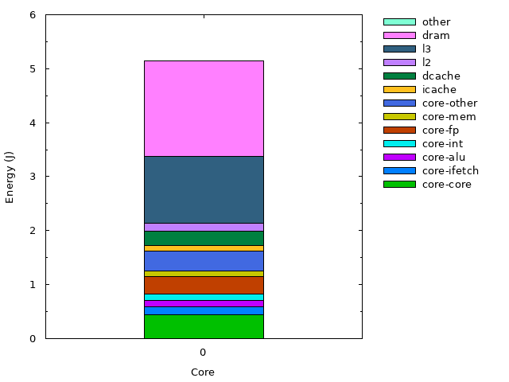
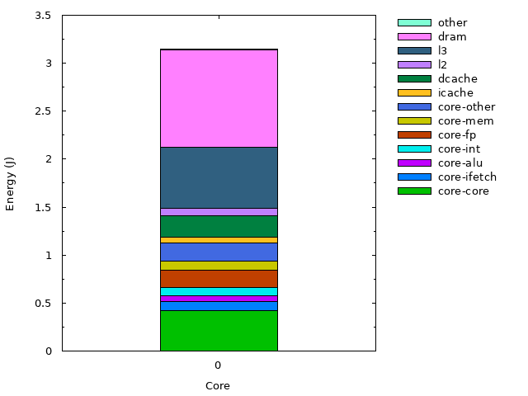
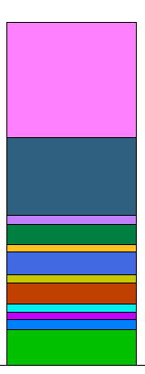
(a) 2 RS entries.
(c) 8 RS entries.
(b) 4 RS entries.
ocean
Notes:
ocean

Slide 20
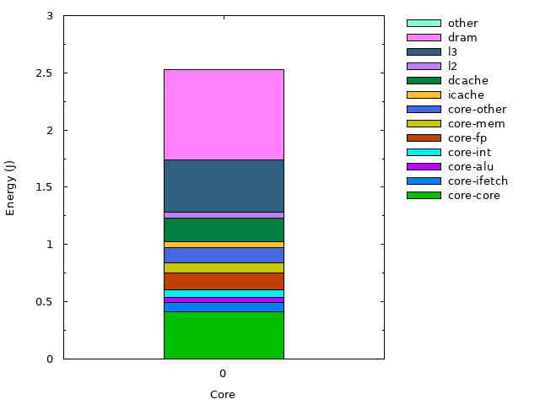
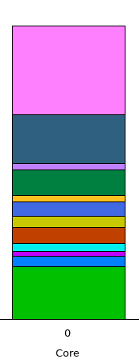

(d) 16 RS entries.
(e) 32 RS entries.
(f) 48 RS entries.
ocean
Notes:
ocean

Slide 21

(g) 64 RS entries.
(h) 98 RS entries.
(i) 128 RS entries.
ocean
Notes:
ocean

Slide 22



(a) 2 RS entries.
(b) 4 RS entries.
(c) 8 RS entries.
barnes
Notes:
barnes

Slide 23



(d) 16 RS entries.
(f) 48 RS entries.
(e) 32 RS entries.
barnes
Notes:
barnes

Slide 24
(g) 64 RS entries.
(h) 98 RS entries.
(i) 128 RS entries.
barnes
Notes:
barnes

Slide 25



(a) 2 RS entries.
(c) 8 RS entries.
(b) 4 RS entries.
IS
Notes:
Npb-is

Slide 26



(d) 16 RS entries.
(f) 48 RS entries.
(e) 32 RS entries.
IS
Notes:
Npb-is

Slide 27


(g) 64 RS entries.
(h) 98 RS entries.
(i) 128 RS entries.
IS
Notes:
Npb-is

Slide 28



(a) 2 RS entries.
(b) 4 RS entries.
(c) 8 RS entries.
cg
Notes:
Npb-cg

Slide 29



(d) 16 RS entries.
(f) 48 RS entries.
(e) 32 RS entries.
cg
Notes:
Npb-cg

Slide 30

(g) 64 RS entries.
(h) 98 RS entries.
(i) 128 RS entries.
cg
Notes:
Npb-cg

