Slide 1
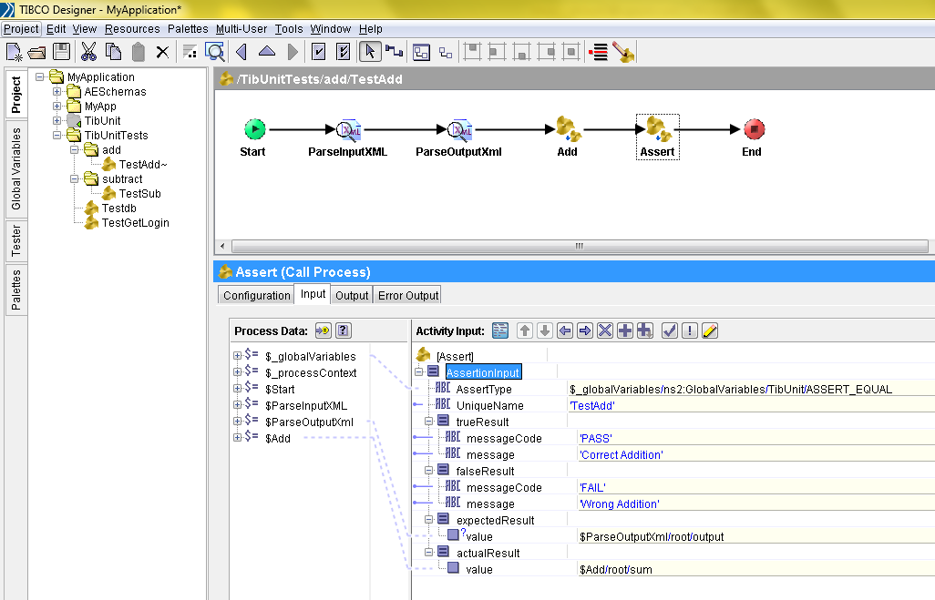
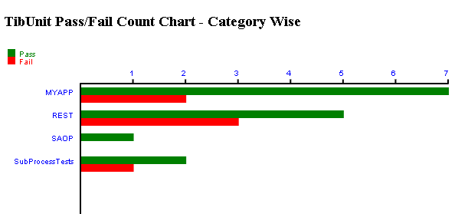
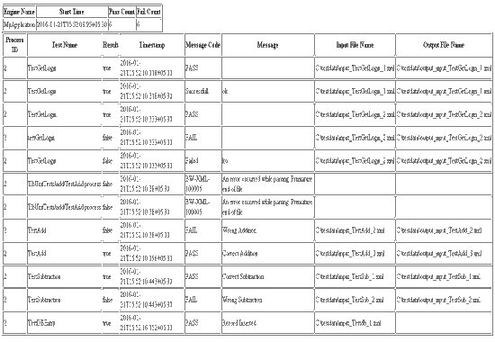
TibUnit – A unit testing framework for Tibco BW Rahul Gupta Akhil Gupta Feb 2016
Manager – BCP & Disaster Recovery

Slide 2
TibUnit : Introduction
TibUnit is a TIBCO Unit and integration testing Tool written as BusinessWorks processes.
Business Works process approach helps in shortens learning curve for Developers.
With TIBUnit supporting TDD Approach, we can test every process your BW Project and it can be used not only for writing unit test cases for protocol like JMS, HTTP and JDBC as BusinessWorks , but also provides ability to write integration test cases that need to invoke services and components across various platforms.
It supports multiple assertions with in single test case. It comes with predefined asserts including assertions for Exception handling, test reports , Test report history.
TIBUnit provides flexibility to changes configurations settings for different environments. Also it allows us to setup multiple test inputs for test cases and ability to control test case execution.
TIBUnit is developed as Business works, so this can be accessed from TIBCO Designer which make developers life easy.
CI Tools can be easily integrated with CI environment which helps in reducing the B&R time and ensures reliable repeatable builds that can be deployed across multiple environments.

Slide 3
TibUnit : Features
Unit & Integration Testing - TIBUnit provides ability to write Unit Tests having test assertions, integration test cases that need to invoke services and components across various platforms.
Multi step tests - Multiple assertions can be used in one test case.
Developer IDE - TIBCO Designer can be used as IDE
Assertion - support is wide variety of assert functions for logical operation and Exceptions checks.
BW Pallet support provides flexibility to use any feature or pallet supported by BW for test case writing.
CLI Execution -Full test suite can be executed from Command Line and from within TIBCO Designer.
CI Integration – Support integration with Build Servers like Jenkins.
Test Result – generates XML and HTML based reports, maintains history of Test Run results. These results can be accessed via a web URL, and via a file sharing as XML.
Test Input Data Parameterization Multiple Input Data set and expected Outcomes can be defined for one TIBUnit Test case.
Protocol Support - TIBUnit can use be for all protocols supported by BW.
Reusable and distributable - TIBUnit is distributed as BW library which can be shared and imported

Slide 4
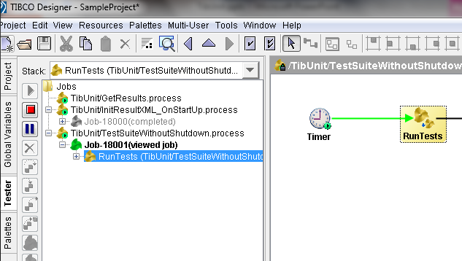
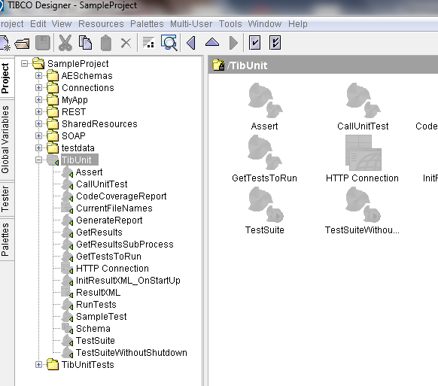
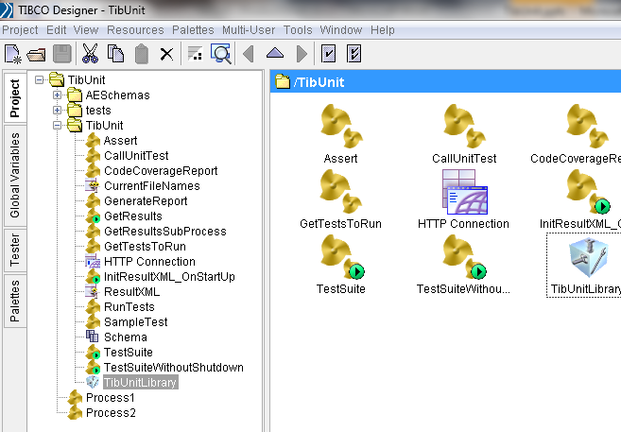

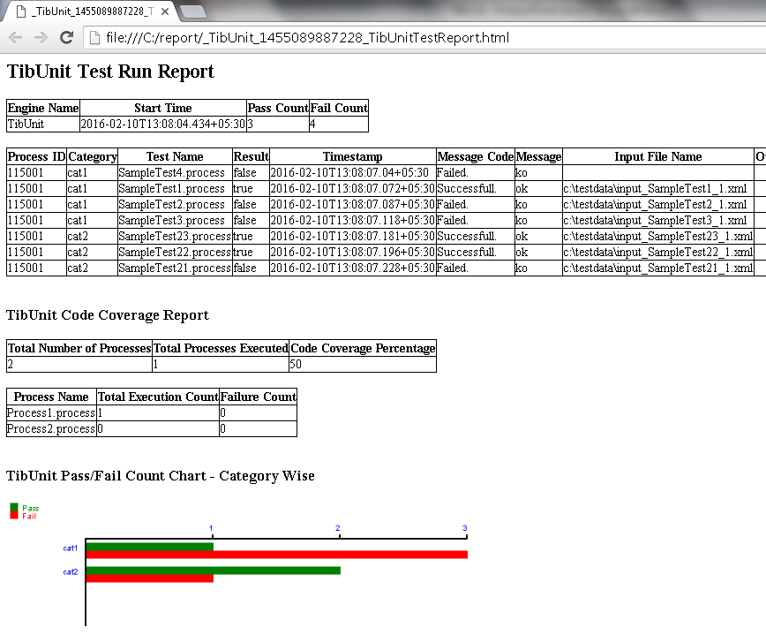
TibUnit : Process Flow
Distributable
Library
Imports
in project
Local testing
in designer
TibUnit
Framework
TibUnit
library
Developer write TibUnits in
Application project
Testing on
CI server
Test Report
From CI server

Slide 5
Demo Screenshots

Slide 6
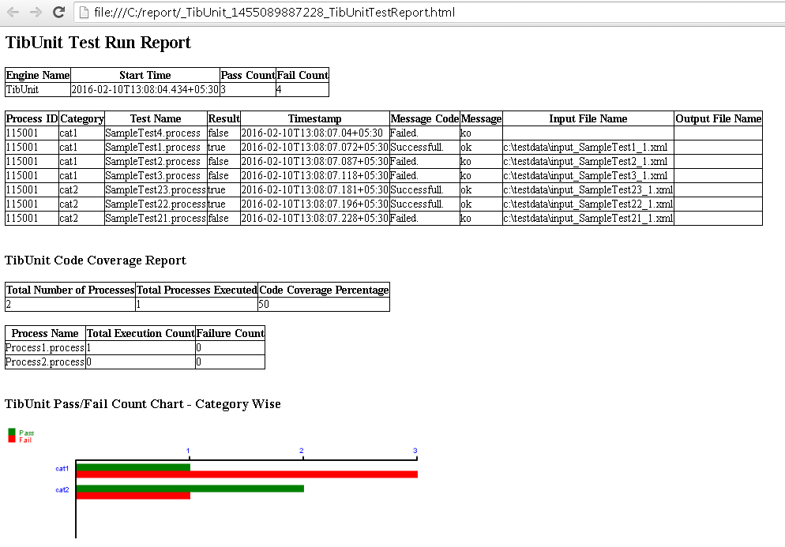
TibUnit : Process Flow
TibUnit Test report shows the following-
Number of test passed and failed.
Success and failure message for each test assertion.
Source of test data used in each test.
Code coverage report at process level. Gives a count of how many processes are executed.
A graphical chart to show the pass/fail count of TibUnits category wise.

Slide 7
THANK YOU

