Slide 1




Slide 2
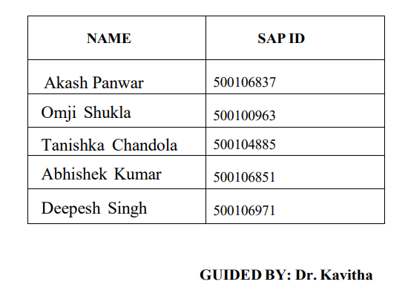
MUSIC RECOMMENDATION SYSTEM

Slide 3
Table of Contents
Introduction
Literature
Problem Statement
Objective
Research Gap
Conclusion
References

Slide 4
1. Introduction
In a world brimming with music, finding the right song can be daunting. Our system uses AI and machine learning to personalize your music experience, making it easier than ever to discover songs that truly resonate with you.
Python, Machine learning libraries (Scikit-learn, TensorFlow/PyTorch), and data processing tools (NumPy, Pandas)

Slide 5
2. Literature Survey
Patel R, Thakkar P and Ukani V. (2024). A survey. Engineering Applications of Artificial Intelligence. 10.1016/j.engappai.2024.108062. 133. (108062). Online publication date: 1-Jul-2024.
Shuai Zhang, Lina Yao, Aixin Sun, and Yi Tay. 2019. Clustering Based Recommender System: A Survey and New Perspectives. ACM Comput. Surv. 52, 1, Article 5 (January 2020), 38 pages. https://doi.org/10.1145/3285029 1, Article 5 (January 2020), 38 pages. https://doi.org/10.1145/3285029
R. Mu, "A Survey of Recommender Systems Based on Deep Learning," in IEEE Access, vol. 6, pp. 69009-69022, 2018, doi: 10.1109/ACCESS.2018.2880197.

Slide 6
3. Problem Statement
PROBLEM STATEMENT
The current music streaming landscape lacks personalized recommendation systems that effectively leverage advanced AI algorithms to cater to individual user preferences
Users often struggle to discover new and relevant music content due to the limitations of existing recommendation systems

Slide 7
RESEARCH GAP
There's a gap in catering to the diverse musical tastes and preferences of users from various cultural backgrounds, with many systems heavily biased towards Western music, neglecting the richness of global music scenes.
Existing systems struggle to adapt in real-time to user feedback and interactions, leading to static recommendations that may not accurately reflect users' evolving tastes and preferences

Slide 8
OBJECTIVE
Develop an AI-powered music recommendation system capable of delivering personalized suggestions based on user preferences
Implement advanced machine learning algorithms to analyze user preferences and generate tailored recommendations
Enhance user satisfaction and engagement by providing diverse and relevant music content through the recommendation system

Slide 9
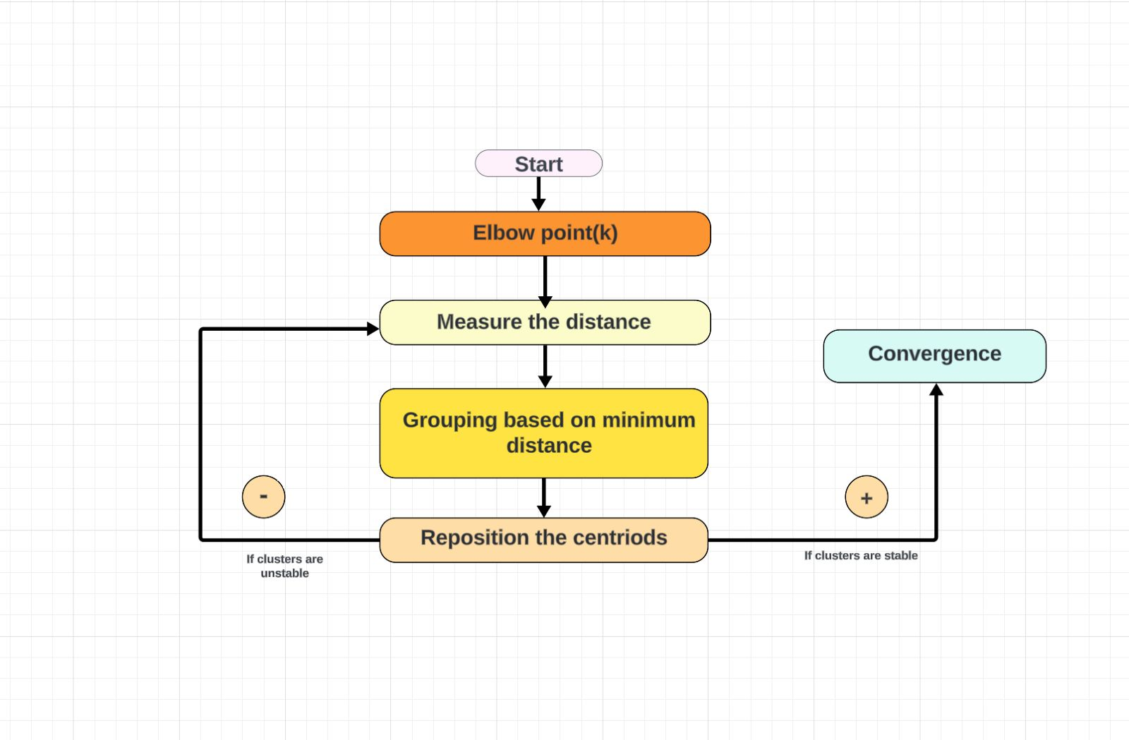
4. K-MEANS ARCHITECTURE

Slide 10
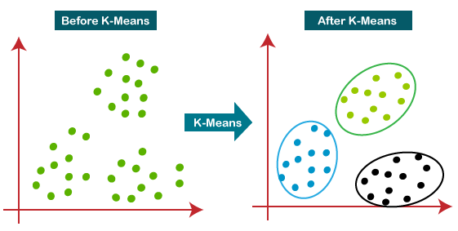
5. K-MEANS Diagram

Slide 11
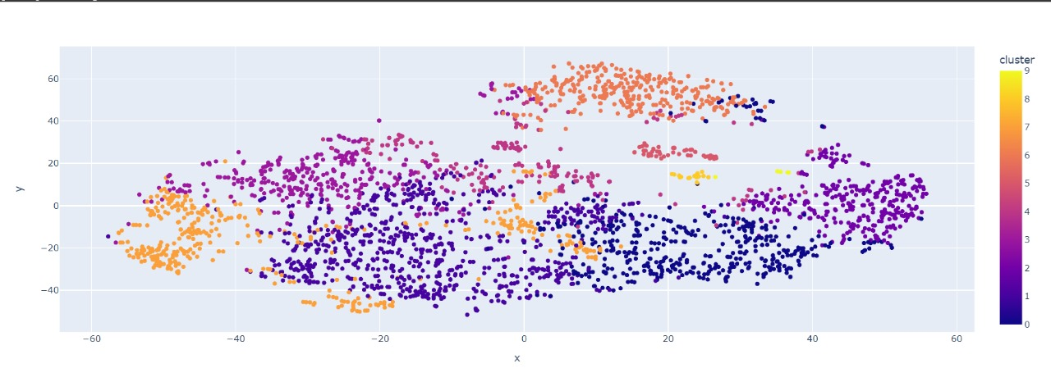
6. Clustering songs with k-means

Slide 12
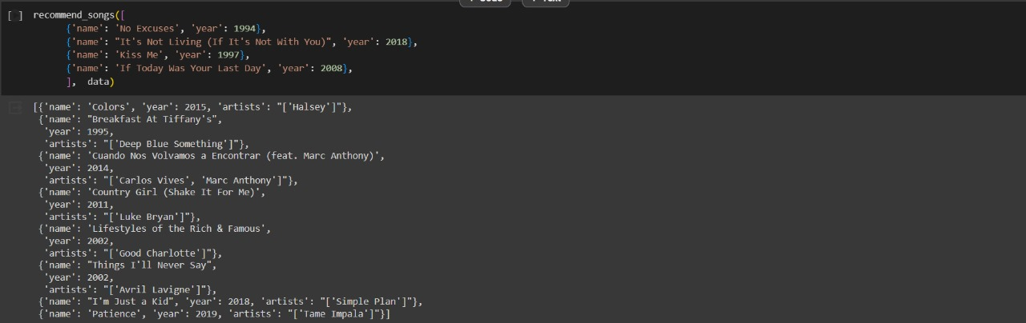
7. OUTPUT

Slide 13
8. Conclusion
Through our project, we've demonstrated the potential to revolutionize how users interact with music, providing tailored recommendations that resonate with their unique preferences and contexts.
Continuous refinement and optimization are imperative to uphold the system’s efficiency and adaptability in the evolving realm of music streaming platforms.

Slide 14
9. Reference
https://doi.org/10.1145/3285029
https://doi.org/10.1145/2988450.2988454
https://doi.org/10.1145/2783258.2783273
TensorFlow Documentation. (n.d.). Retrieved from https://www.tensorflow.org/
Scikit learn Documentation (n.d.). Retrieved from https://scikit-learn.org/

Slide 15
THANK YOU

