Slide 1
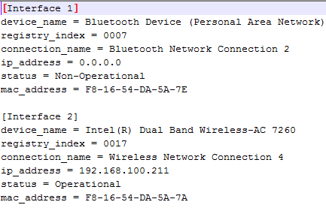
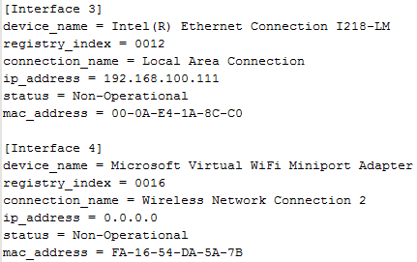
List of all network adapters/interfaces installed on your system
List of all network adapters/interfaces installed on your system
BT
Wifi
LAN
Virtual device

Slide 2
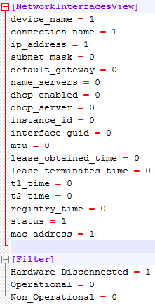
Configuration
Edit “NetworkInterfacesViewpy.ini”. You can set what info you want.
For [NetworkInterfacesView] section, set value as ‘1’ will show the value.
For [Filter] section, set value as ‘1’ will filter the device with corresponding status.

Slide 3
For WPTA Configuration
Recommended configuration for WPTA, please refer to right side figure with red line marked. And the output will be as follows:

Slide 4

Integrated with WPTA
Copy files listed on figure to c:\user\admin
Run “netinfo.exe”
Rename “netinfo.def” to “netinfo.ctrl”.
Copy following command into:
benchmark.bat: check after WPTA main process
Or
PreCKConfig.bat: check before WPTA main process
netinfocompare.bat

Slide 5
OS support
Win xp, win 7, win8.1. (For English Language system only.)

