Slide 1

Decision Quality for Data Scientists: Lessons from Decision Analysis Professionals
Presenter: John Mark Agosta, Azure Networking
Based on collaborations in Azure ML, with members of ADS.
Sept 3, 2019

Slide 2
This talk --
offers a comprehensive formulation framework with insights for framing and implementing Machine Learning models,
by bringing together findings from forty years of experience solving business problems by the Decision Analysis community.
We apply this Decision Quality framework to current challenges in Data Science.
Automated ML systems should be held to the same decision-making principles as are people in organizations.

Slide 3


... And ne’er the twain shall meet.
Decision Analysis
Data Science
Statistics

Slide 4
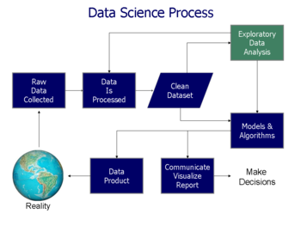


The Data Science Process can begin only after you’ve grasped the Problem.
As a Data Scientist, where do you start?

Slide 5
Start by identifying the decisions
A Decision is --
A tangible change—something moved or modified; a resource committed,
At a point in time,
By a decision-maker, typically identified as a person,
That can be defined by a set of outcomes, uncertainties and consequences.

Slide 6
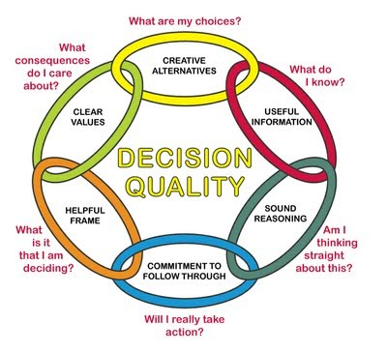
Six Principles of Decision Quality.
Solve the right problem.
Consider a true range of alternatives.
Search out curated and relevant information,
Value consequences of decision outcomes,
Apply solid reasoning.
Implement what has been decided.
We can learn how to improve Data Science applications from the lessons of how organizations fail.

Slide 7
Automated decisions in Data Science can go seriously wrong, …in the same way that Decision Makers Satisfice in Organizations

Slide 8
Satisficing: down-plays uncertainty, limits search, and sub-optimizes.

Slide 9

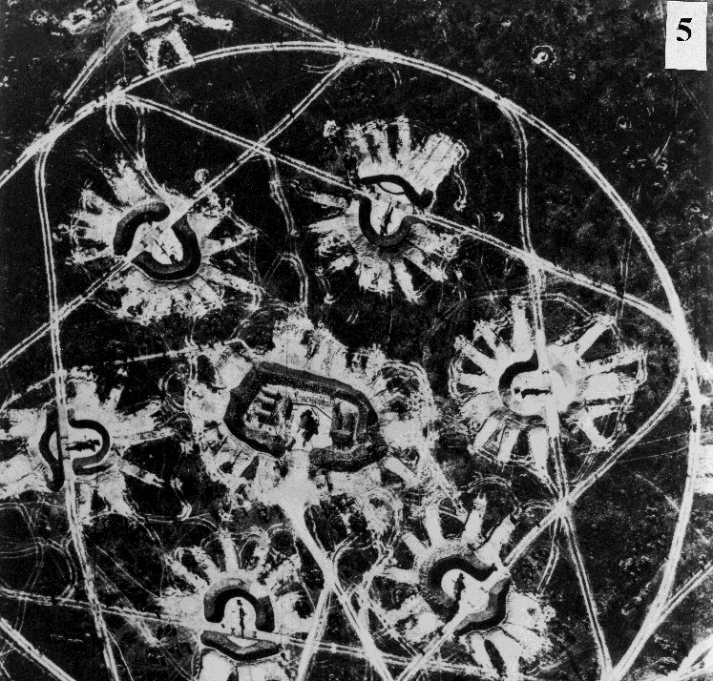
Past History is Replete with Examples of Satisficing Decisions
In 1773, the British Crown levied a tax on tea in the American Colonies, leading to the American Revolution
In 1962, Soviets secretly moved missiles into Cuba, but construction crews built them in plain sight, leading to U.S. forcing their removal.

Slide 10
Lessons from the Wild
“On Time and In Full:” Is that the right problem?
Sales Opportunity Propensities: What to do next?
The cult of Accuracy: When accuracy alone doesn’t cut it.

Slide 11
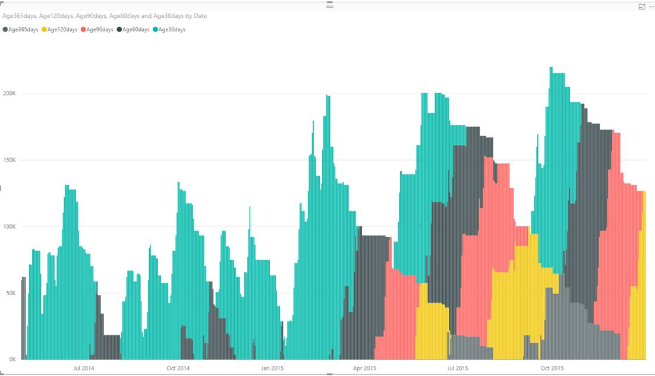
“On Time and In Full (OTIF)” Delivery fulfillment
Poor predictability: Relevant features occurred after the sales order was placed
Most variation was negative not positive (early delivery)
KPI is not a goal value
OTIF preserved at cost of bad inventory stock level management.
True alternative – when to schedule production runs.
The stock levels mountains

Slide 12
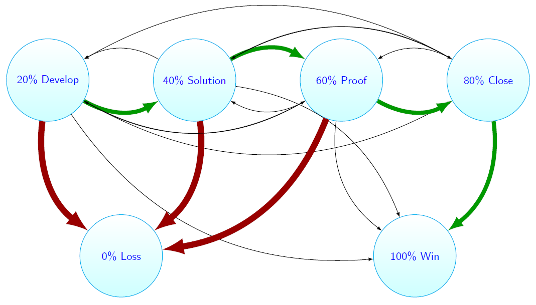
Sales Opportunity Propensity-Scoring
Predicts a score that a sale will close (make money)
Routine renewals gave false impression of accuracy
Confusing outcomes “succeed or fail” with decision alternatives
Decision: where and when is effort best applied?
Data entered after the sale completed corrupts the model.
Beware of “Predicting predictions”

Slide 13
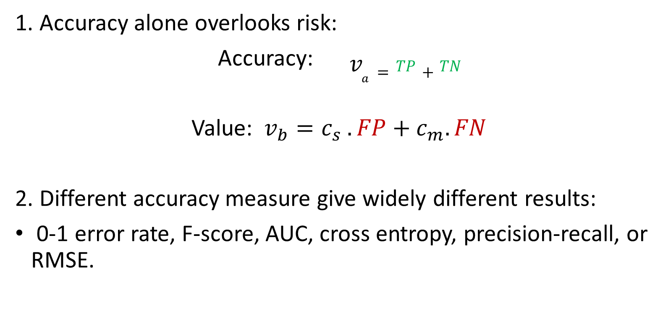
When Accuracy doesn’t cut it.
Confusion matrix | Detected Positive | Detected Negative
Actual True | TP | FN
Actual False | FP | TN
1. Accuracy alone overlooks risk:
Accuracy: $v_{a}=TP+TN$
Value: $v_{b}=c_{s} .FP+c_{m}.FN$
2. Different accuracy measure give widely different results:
0-1 error rate, F-score, AUC, cross entropy, precision-recall, or RMSE.

Slide 14
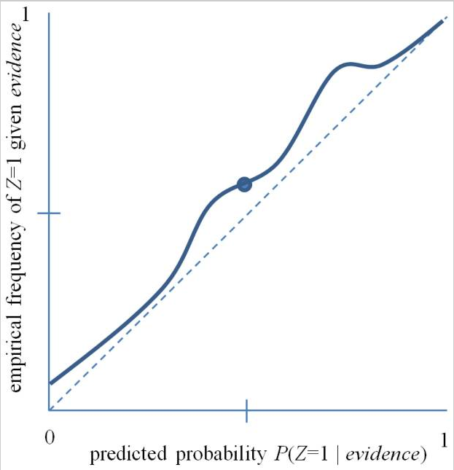
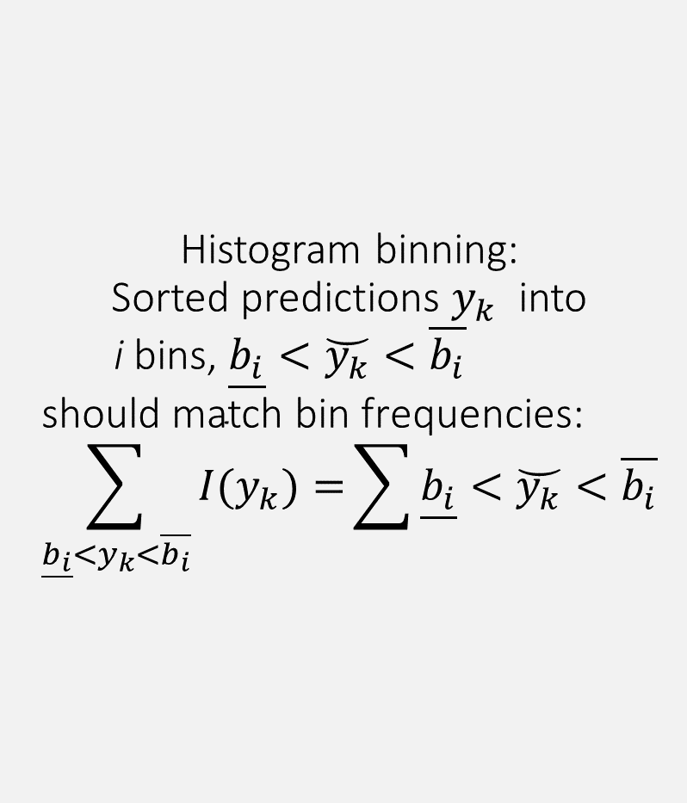


Histogram binning: Sorted predictions $y_{k}$ into i bins, $\underline{b_{i}}<\breve{y_{k}}<\overline{b_{i}}$ $$\text{s}\text{hould} \text{match} \text{bin} \text{frequencies}\text{:} \\ \sum_{\underline{b_{i}}<y_{k}<\overline{b_{i}}}{{I(y}_{k})=}\sum{\underline{b_{i}}<\breve{y_{k}}<\overline{b_{i}}}$$
Scores are not calibrated probabilities.
$$\underline{b_{i}}$$
$$\overline{b_{i}}$$

Slide 15
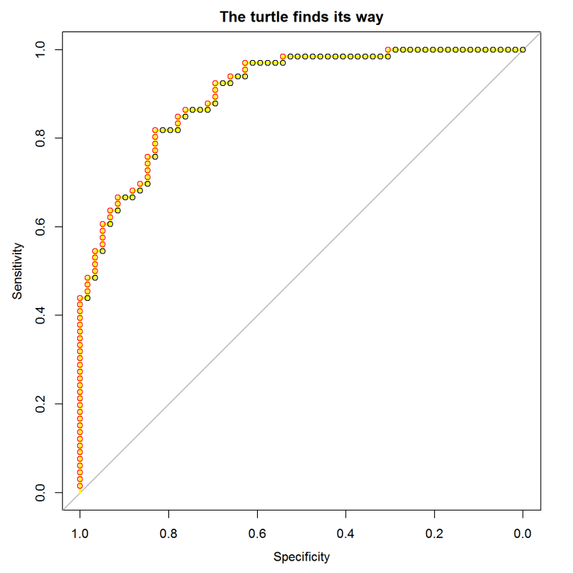
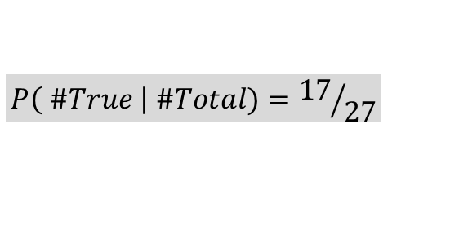
Calibrating with theROC Curve:
sort test cases by their score from the model
march along the sequence, stepping up for positives and right for negatives
17 up
$$P\left( \#True \right| \#Total)={17}/{27}$$
10 over
TPR
0.0 0.2 0.4 0.6 0.8 1.0
FPR
Notes:
The “turtle’s eye view” of ROC curves is described here:
https://blog.revolutionanalytics.com/2016/08/roc-curves-in-two-lines-of-code.html

Slide 16
A Final word about Implementation
Engineering – is 90% of the work.
Question of Trust: Trust depends on Quality
Ethical choice in values

Slide 17
Conclusion:
Borrowing from the field of Decision Science,
the principles of Data Quality
guide the formulation of automated decision-making.

Slide 18
References
C. Spetzler, H. W. (2016). Decision Quality: Value Creation from Better Business Decisions .
Wiley.
Caruana, R. a.-M. (2004). Data Mining in Metric Space: An Empirical Analysis of Supervised Learning Performance Criteria.
KDD'04. ACM.
Fienberg, S. E. (1982). The Comparison and Evaluation of Forecasters.
Proceedings of the 1982 I.O.S. Annual Conference on Practical Bayesian Statistics. 32 No. 1/2, pp. 12-22. NYC:
Journal of the Royal Statistical Society. Series D (The Statistician).
G. Allison, P. Z. (1999). Essence of Decision 2nd Ed. Pearson.
Kahneman, D. (2011). Thinking Fast, Thinking Slow. Farrar, Straus & Giroux.
Merkhofer, M. W. (2012). Decision Science and Social Risk. Springer.
Naeini, M. P. (2015). Binary Classifier Calibration Using a Bayesian Non-Parametric Approach.
Proceedings of the SIAM International Conference on Data Mining., 208–216.
Platt, J. C. (1999). Probabilistic Outputs for Support Vector Machines and Comparisons to Regularized Likelihood Methods
(Vol. Advances in Large Margin Classifiers). (P. B. A. Smola, Ed.) Cambridge, MA: MIT Press.

Slide 19
C. Spetzler, H. W. (2016). Decision Quality: Value Creation from Better Business Decisions . Wiley.
Caruana, R. a.-M. (2004). Data Mining in Metric Space: An Empirical Analysis of Supervised Learning Performance Criteria. KDD'04. ACM.
Fienberg, S. E. (1982). The Comparison and Evaluation of Forecasters. Proceedings of the 1982 I.O.S. Annual Conference on Practical Bayesian Statistics. 32 No. 1/2, pp. 12-22. NYC: Journal of the Royal Statistical Society. Series D (The Statistician).
G. Allison, P. Z. (1999). Essence of Decision 2nd Ed. Pearson.
Kahneman, D. (2011). Thinking Fast, Thinking Slow. Farrar, Straus & Giroux.
Merkhofer, M. W. (2012). Decision Science and Social Risk. Springer.
Naeini, M. P. (2015). Binary Classifier Calibration Using a Bayesian Non-Parametric Approach. Proceedings of the SIAM International Conference on Data Mining., 208–216.
Platt, J. C. (1999). Probabilistic Outputs for Support Vector Machines and Comparisons to Regularized Likelihood Methods (Vol. Advances in Large Margin Classifiers). (P. B. A. Smola, Ed.) Cambridge, MA: MIT Press.

