Slide 1

Running R from Excel through VBA: Turning your Old Scripts into Interactive Tools
Sara Brumbaugh
Ceres Analytics

Slide 2
Why Consider VBA?
Cross-functional teamwork arises where R is used between
Upstream Excel inputs
Downstream Excel review
Recurrence of (1) suggests need for automation
Example: Exploratory data analysis in survey research
Less technical folks need to follow in your footsteps
VBA is best leveraged when:
Need for customization is based on inputs (rather than on concept)
Example: Stratify sampling by different variables for different studies
Some run-time information for automation depends on Windows-based elements
Example: Capture folder path from pop-up browser
Efficiencies result from collecting both (a) and (b) in central location (workbook) and manipulating them in formulas with visible impacts (on R code)

Slide 3
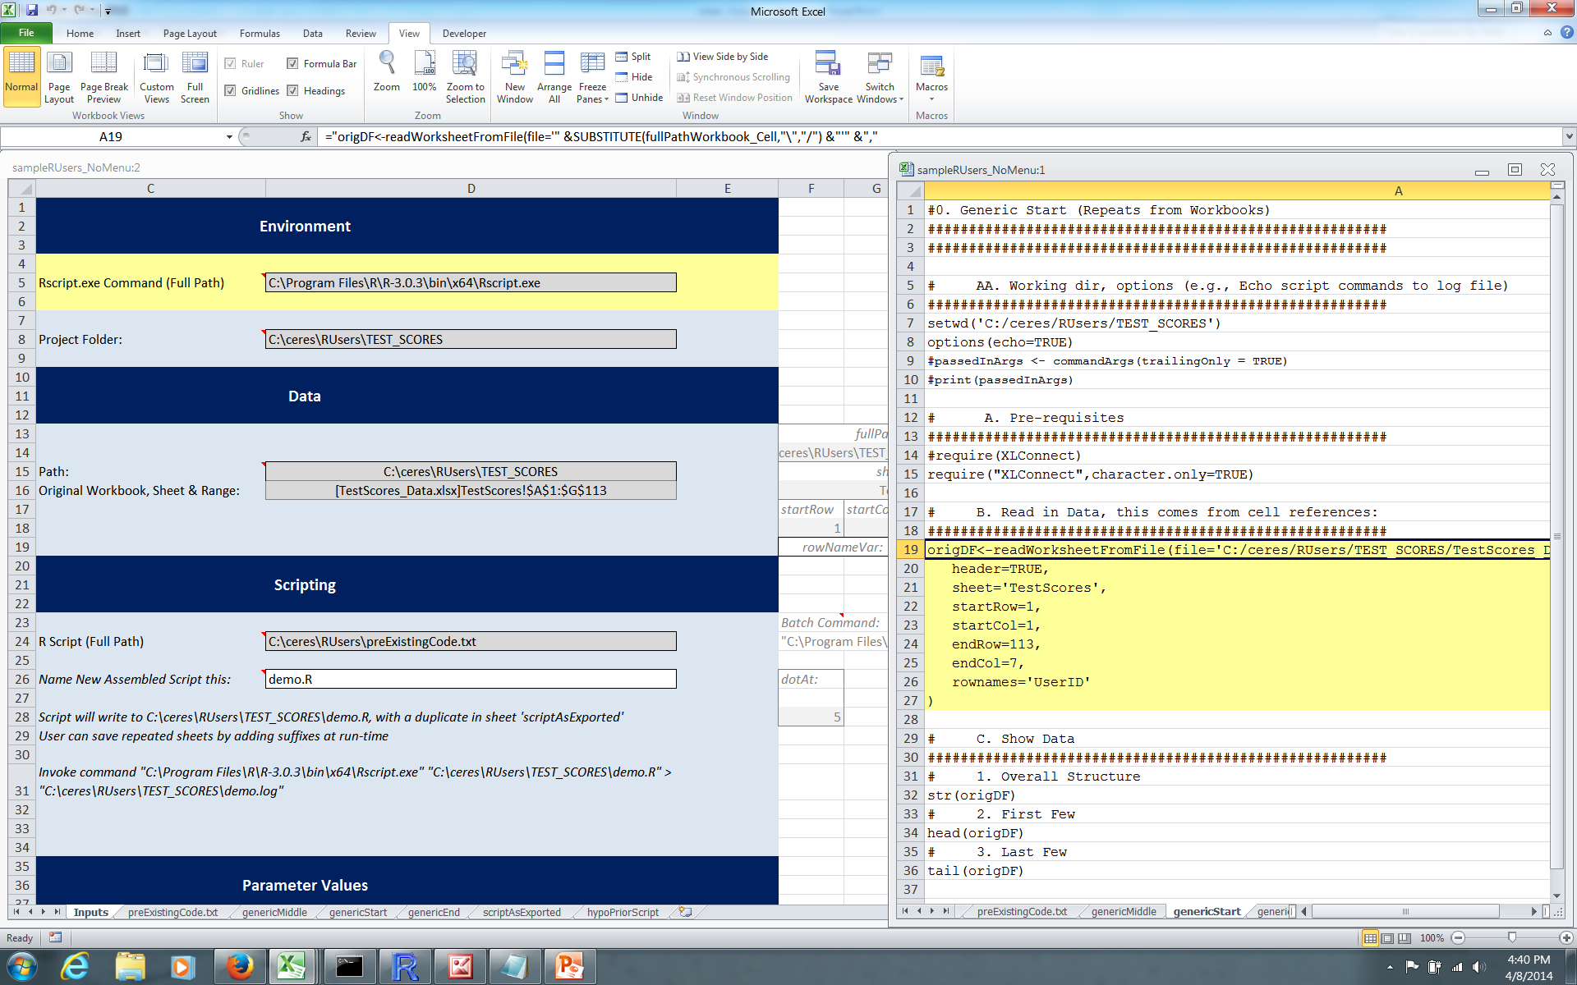
Example
After dragging through Range, VBA puts Captured Elements in Cells
R Code Assembled by Formula

Slide 4
Key Excel <-> R Options
R Package * | Functionality | Notes | Today’s Examples?
RExcelXML | Manipulate Excel files through their underlying XML structures (2007+) | In progress as of 3/03/14 per www.omegahat.org/RExcelXML/
XLConnect | Manipulate Excel files from R via Java-based Apache POI (2007+) | Leverages underlying XML structure of Excel 2007+ Need compatible 64 vs. 32-bit R and Java | XL->R
RExcel | Real-time use of R through Excel add-in | 32-bit R only, uses DCOMClient
xlsx | Transfer data (I/O) between R and Excel (as XML file) via Java-based Apache POI | http://danganothererror.wordpress.com/2012/02/12/write-data-frame-to-excel-file/
RODBC | ODBC database operations for Excel from R | Only 32-bit R for .xlsx files
Text or CSV, PNG/JPG/etc. | Write text files from one package to read with the other. Write R graphs for Excel import | R Output available outside of both R and Excel | R->XL
Other | gdata:Perl-based, rcom and RDCOMClient package(s)

Slide 5
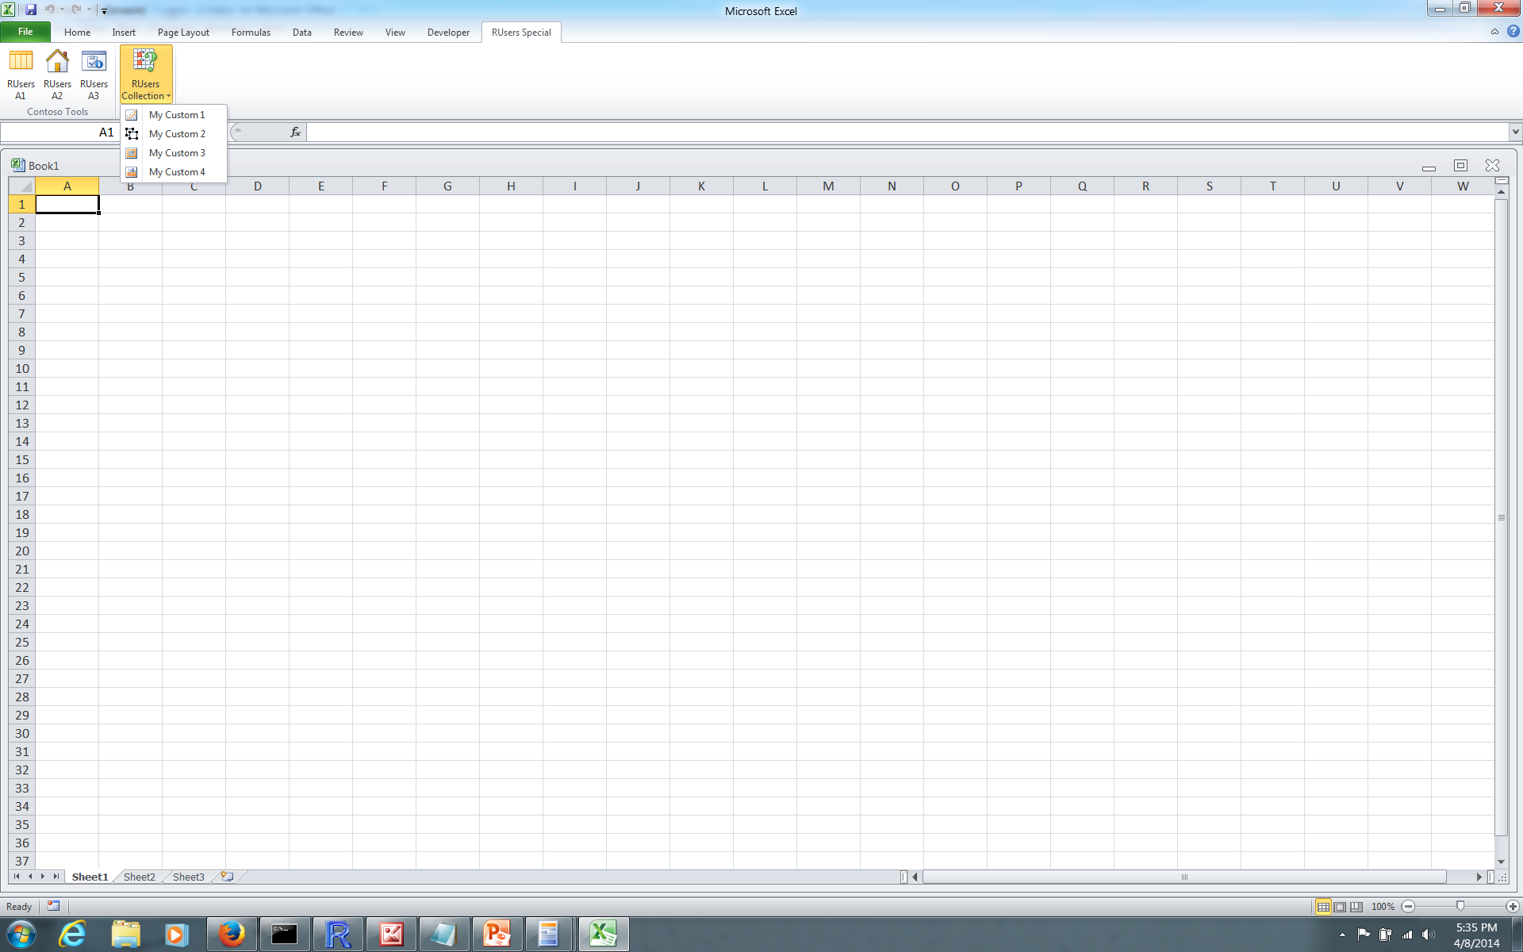
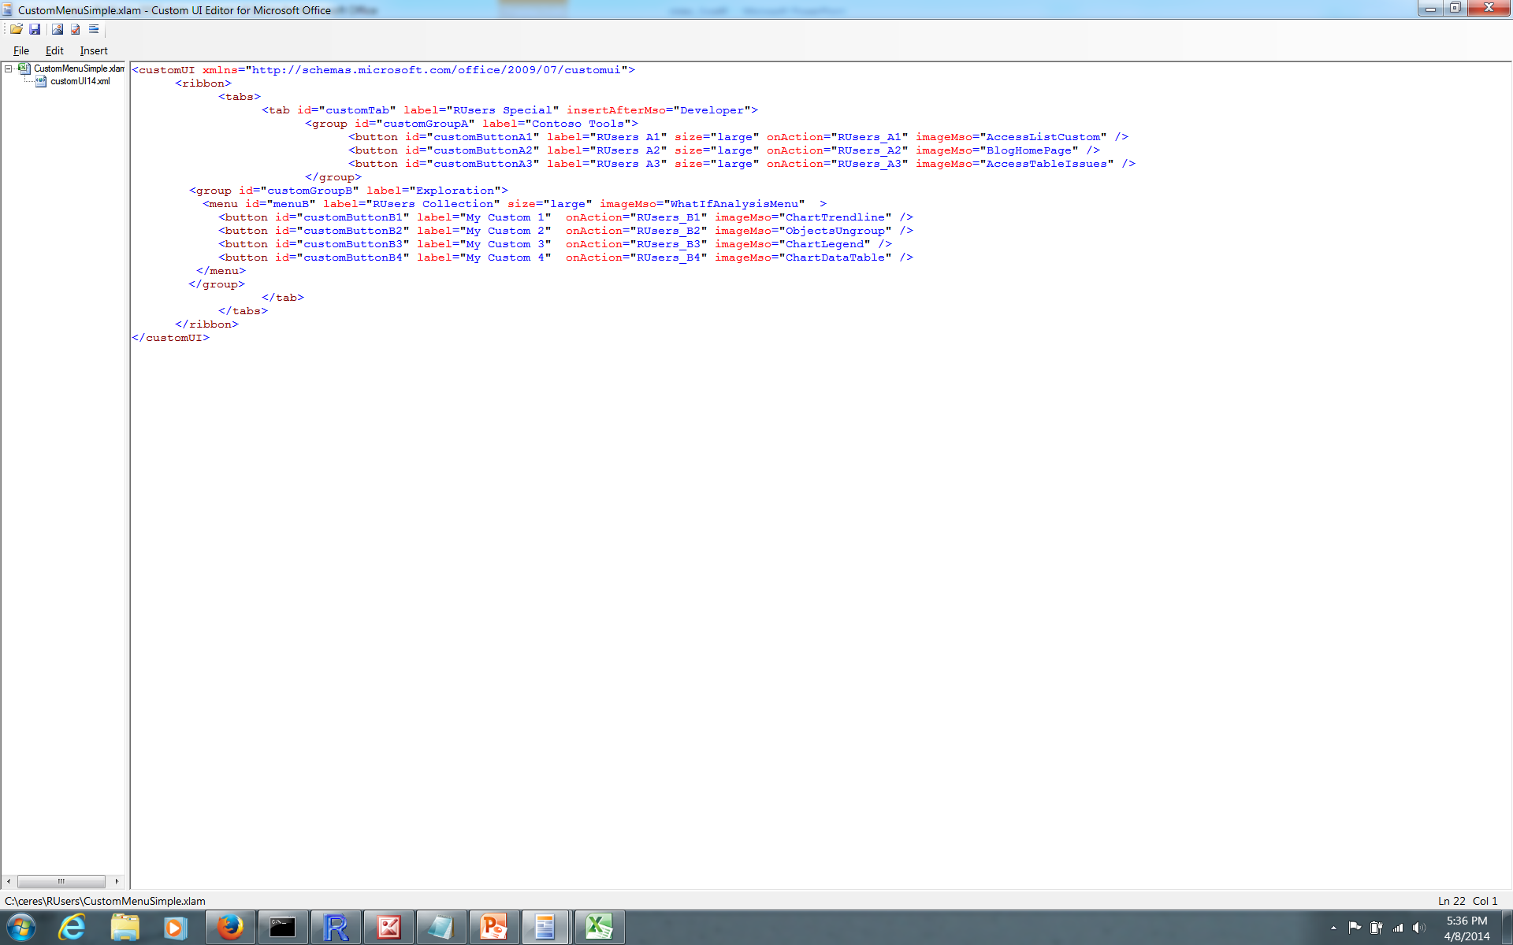
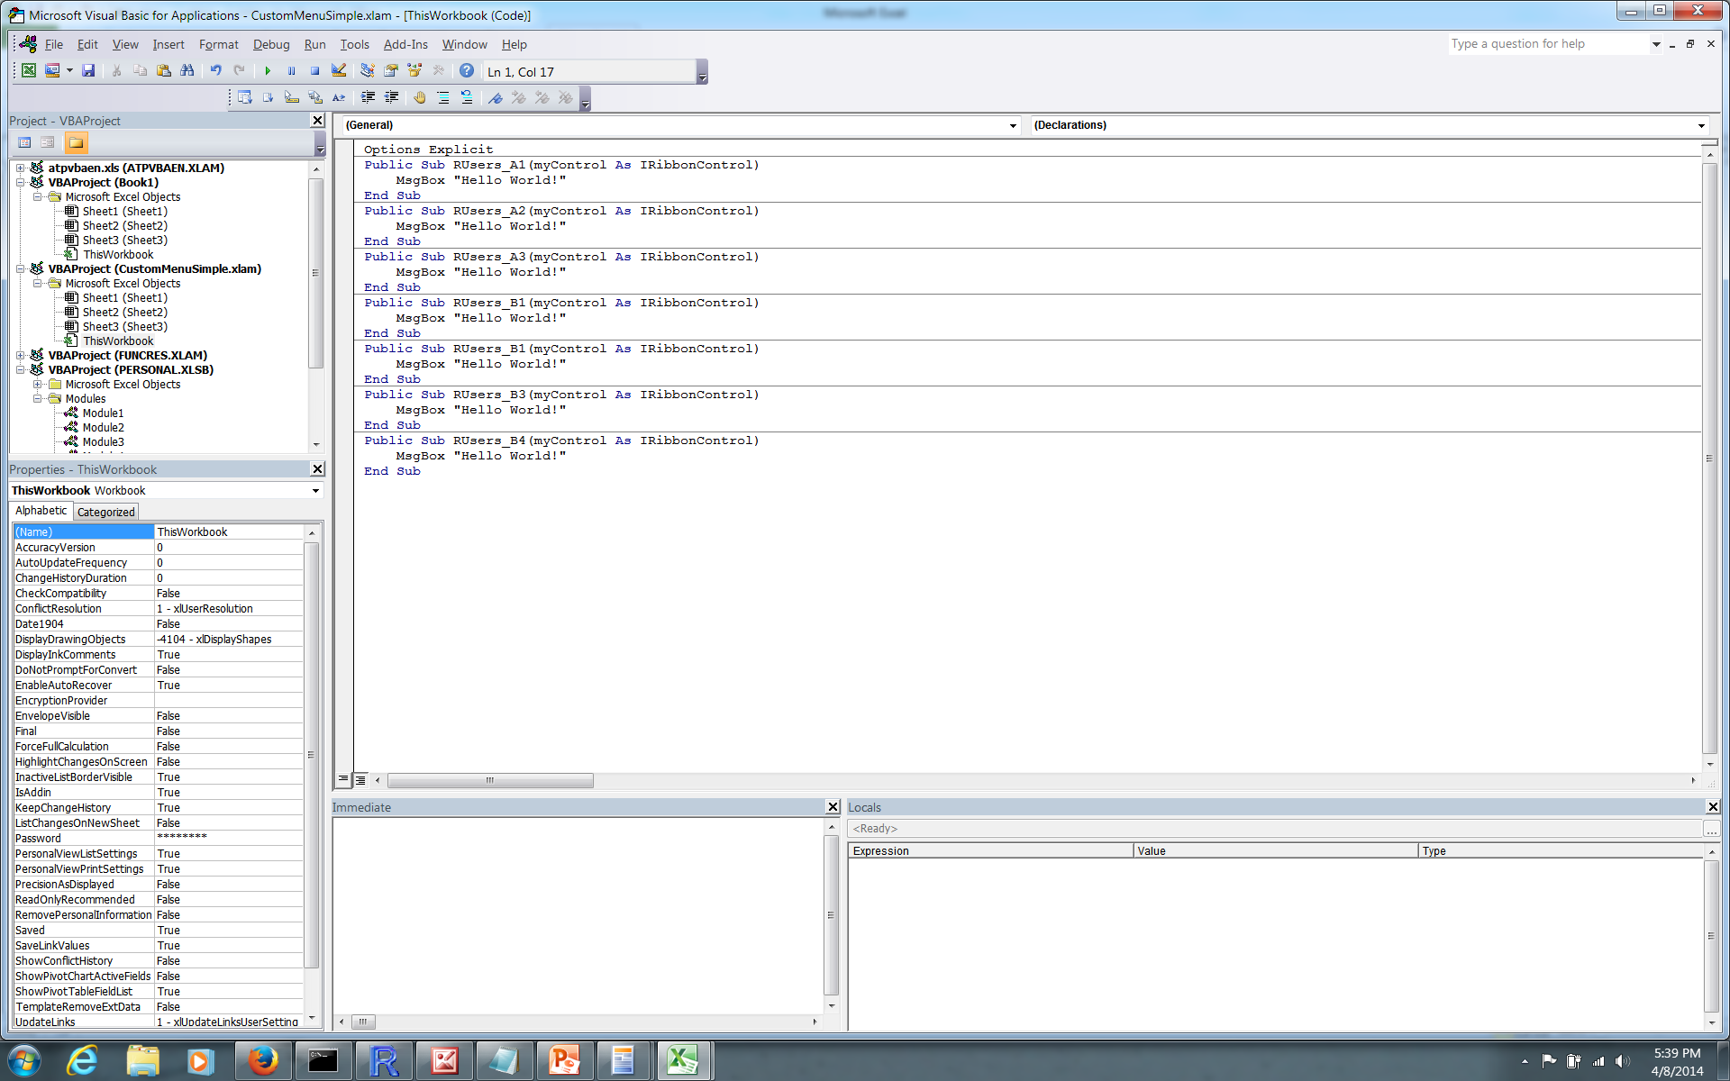
Speaking of XML
A Custom Menu

Slide 6
To Maximize Flexibility
# | In… | Use…
1 | Excel | Named Ranges Example: one-cell range names can be used in worksheet formulas like variables
2 | Excel | Worksheet Controls (buttons, pull-downs, etc.) -or- Custom Menu (your own ribbon)
3 | VBA | User Interaction (MsgBox and InputBox) Expanded API with Tools/References
4 | R | Excel-generated code sections (e.g., a “generic start”) Example: opening section that reads, into a data frame, whatever Excel data the user drags through as a range)

Slide 7
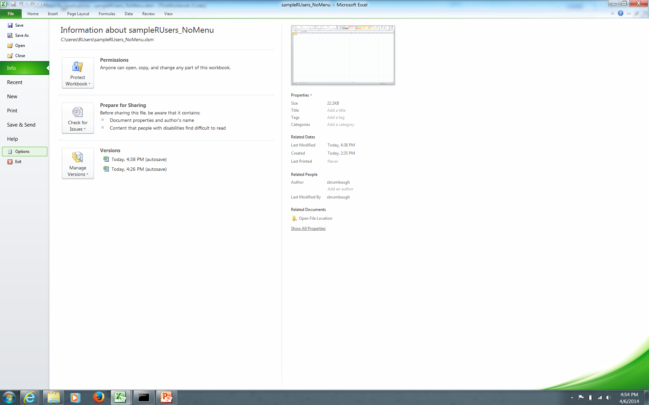
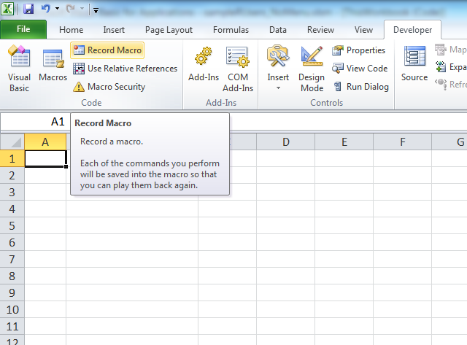
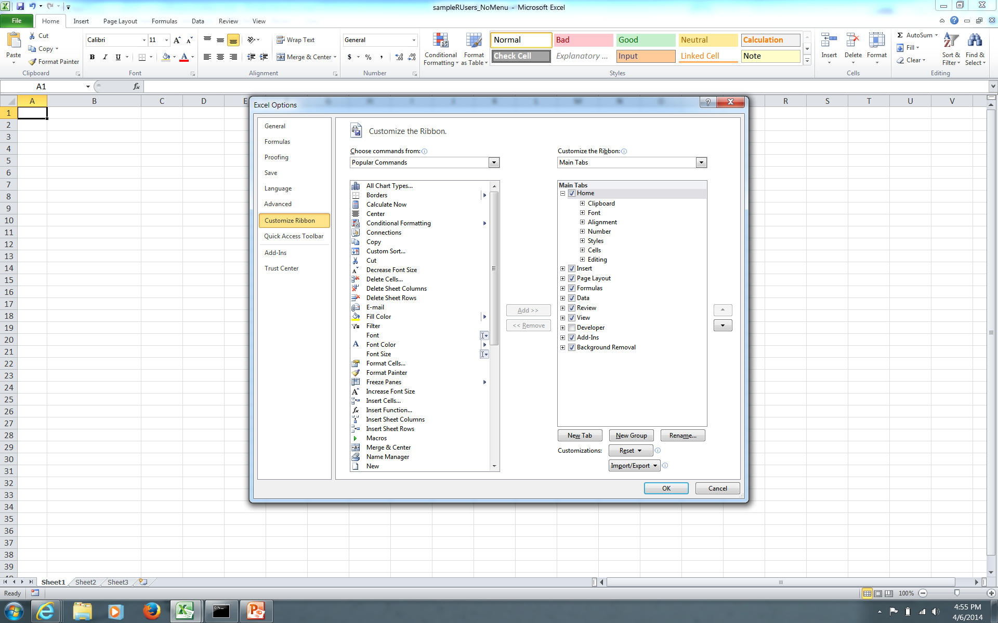
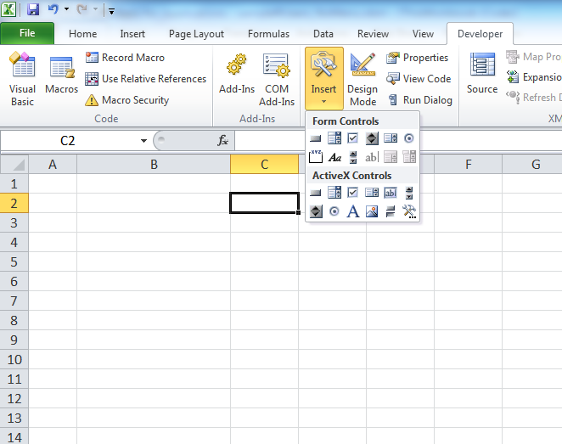
1 of 2 Techie: For Controls and Macros in Excel: Show Developer Tab
1
3
Handy Crutch
2
Check “Developer”, then click “OK”
4
Controls to Add to Worksheet

Slide 8
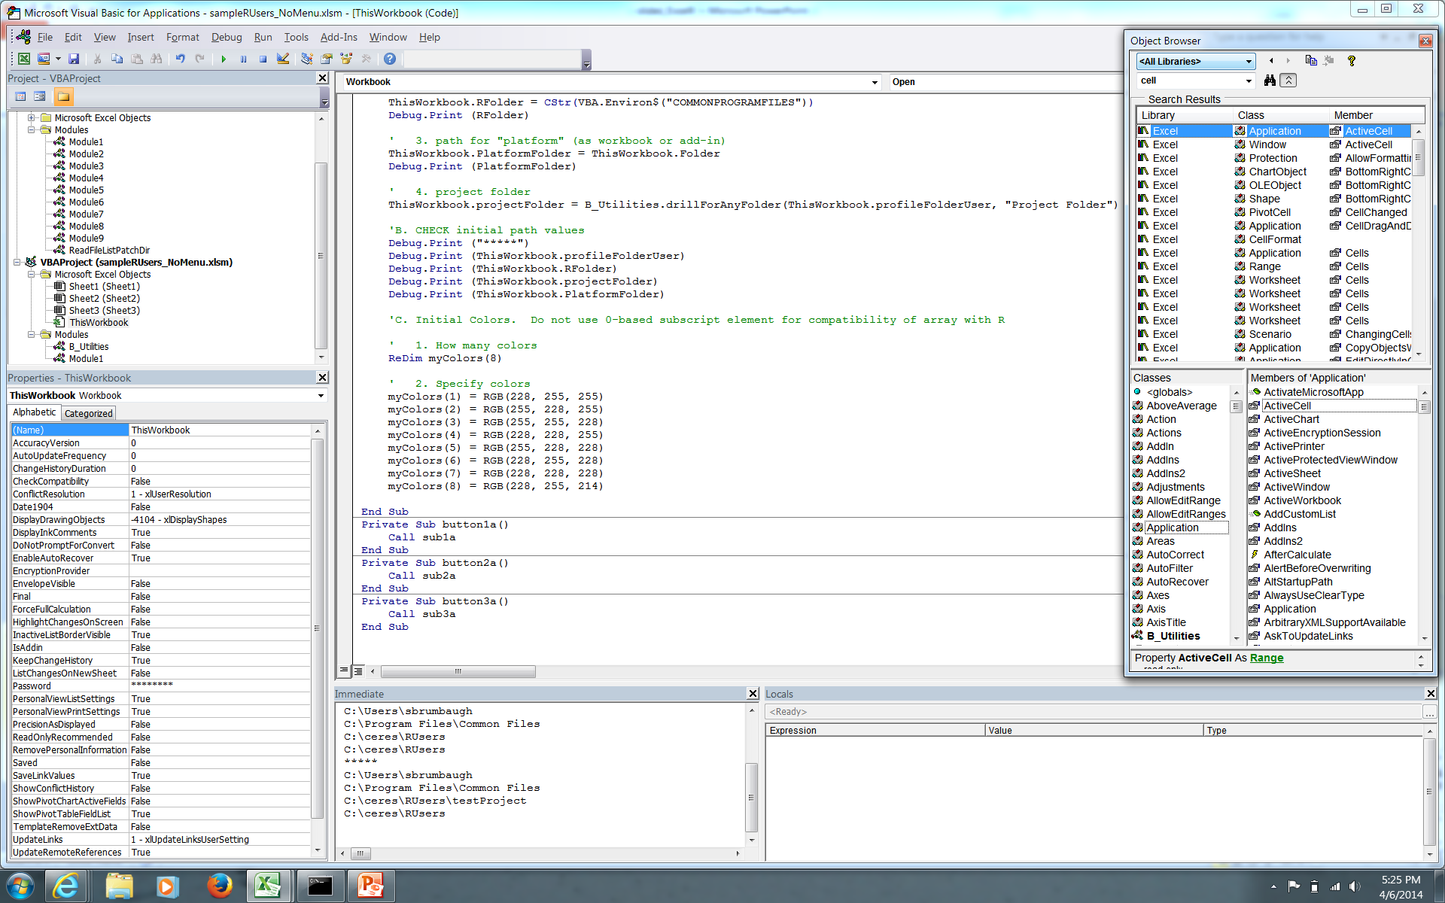
2 of 2 Techie: Excel to VBA <Alt><F11> Goes behind the Scenes
VBA Menu:
Styled like Excel 2003, pre-”ribbon”
1
4
5
Code for Selected Item
Object Browser
(Not docked)
2
Project Explorer
3
Properties of
Selected Item (in
Project Explorer)
Notes:
Windows arranged through “View” menu item
b) <F8> steps through macro
Locals Window
(view assignments)
6
Immediate Window
(useful for debug.print)
7

Slide 9
Run Example
Adapted Exploratory Data Analysis

