Slide 1
weatherData
Ram Narasimhan

Slide 2
A True weather story…
“Sunnyvale temperatures are comparable to Chicago”
“No way! Let’s compare the average temperatures”
“Averages hide a lot of the detail”
“Let’s compare minimums for all 12 months”
“Let’s compare the number of below freezing days”
“Anything less than 50 degrees is too cold”
“Give me any measure.”

Slide 3
weatherData 0.3
What does it do?
Given a Location and Time interval, it fetches a data frame of weather data.
Input 1: Location: Airport Code or WeatherStation ID
Input 2: Time Interval: Date, Year, or custom date range
Output: Data Frame with Time Stamps and data columns
> wdf <- getWeatherForDate(“SFO”, “2014-04-07”)
> wdf <- getWeatherForDate(“SFO”, start_date = “2014-01-01”,
end_date = “2014-04-07”)
> wdf <- getWeatherForYear(“SFO”, 2013)
Time Temperature
1 2013-01-01 00:56:00 44.1
2 2013-01-01 01:21:00 44.6
3 2013-01-01 01:56:00 45.0
...
9504 2013-12-31 20:56:00 50.0
9505 2013-12-31 21:56:00 48.9
9506 2013-12-31 22:56:00 46.9
9507 2013-12-31 23:56:00 48.0

Slide 4
weatherData 0.3
Utility Functions
> getCurrentTemperature("MIA")
Time TemperatureF
13 2014-04-06 12:53:00 82
> getStationCode("Alice Springs")
[1] "AUSTRALIA ALICE SPRINGS AR YBAS
94326 23 48S 133 54E 541 X T 6 AU“
> checkDataAvailabilityForDateRange("BWI",
"2013-12-13", "2014-01-01”)
Checking Data Availability For BWI
Found 12 records for 2013-12-13
Found 12 records for 2014-01-01
Data is Available for the interval.

Slide 5

weatherData 0.4
Two main enhancements based on suggestions
Summarized vs Detailed
Choose the level of detail you are interested in
Ability to choose specific columns
Choose which aspects of the weather you wish to analyze

Slide 6
Detailed vs Summarized
Time
1/1 | 0:00 | t10
1/1 | 1:00 | t11
1/1 | 2:00 | t12
1/1 | …
1/1 | 23:00
1/2 | 0:00 | t20
1/2 | 1:00 | t21
1/2 | 2:00 | t22
1/2 | …
1/2 | 23:00
1/3 | 0:00 | t30
1/3 | 1:00 | t31
1/3 | 2:00
1/3 | …
1/3 | 23:00
24 x 365 = 8760
8760 x 10 = 87600 data points
Summarized Data has 1 row per day
Date |  | Mean | Min | Max
1/1 | 0-23 | T1_avg | T1_min | T1_max
1/2 | 0-23 | T2_avg | T2_min | T2_max
1/3 | 0-23 | T3_avg | T3_min | T3_max
Typically, mean, max and min for the day
For Temperature, Pressure, WindSpeed etc.
Compact data frames

Slide 7
Interested only in specific columns
Date | Time | Temp | Max Temp | Wind | Pressure | Humidity
1/1 | 0:00 | t10
1/1 | 1:00 | t11
1/1 | 2:00 | t12
1/1 | …
1/1 | 23:00
1/2 | 0:00 | t20
1/2 | 1:00 | t21
1/2 | 2:00 | t22
1/2 | …
1/2 | 23:00
1/3 | 0:00 | t30
1/3 | 1:00 | t31
opt_all_columns = TRUE
opt_temperature_columns = TRUE
showAvailableColumns(“SEA”,
“2010-08-13”)
The following columns are available:
[1] "TimeEST" "TemperatureF"
[3] "Dew_PointF" "Humidity"
[5] "Sea_Level_PressureIn" "VisibilityMPH"
[7] "Wind_Direction" "Wind_SpeedMPH"
[9] "Gust_SpeedMPH" "PrecipitationIn"
[11] "Events" "Conditions"
[13] "WindDirDegrees" "DateUTC"
opt_custom_columns =TRUE
custom_columns = c(7,8,13)

Slide 8
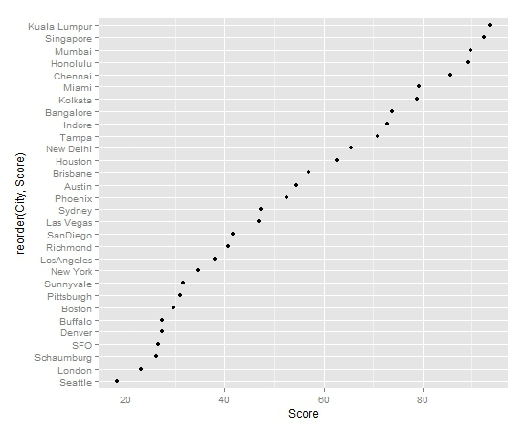
World Cities Comfort Score - 2012

Slide 9
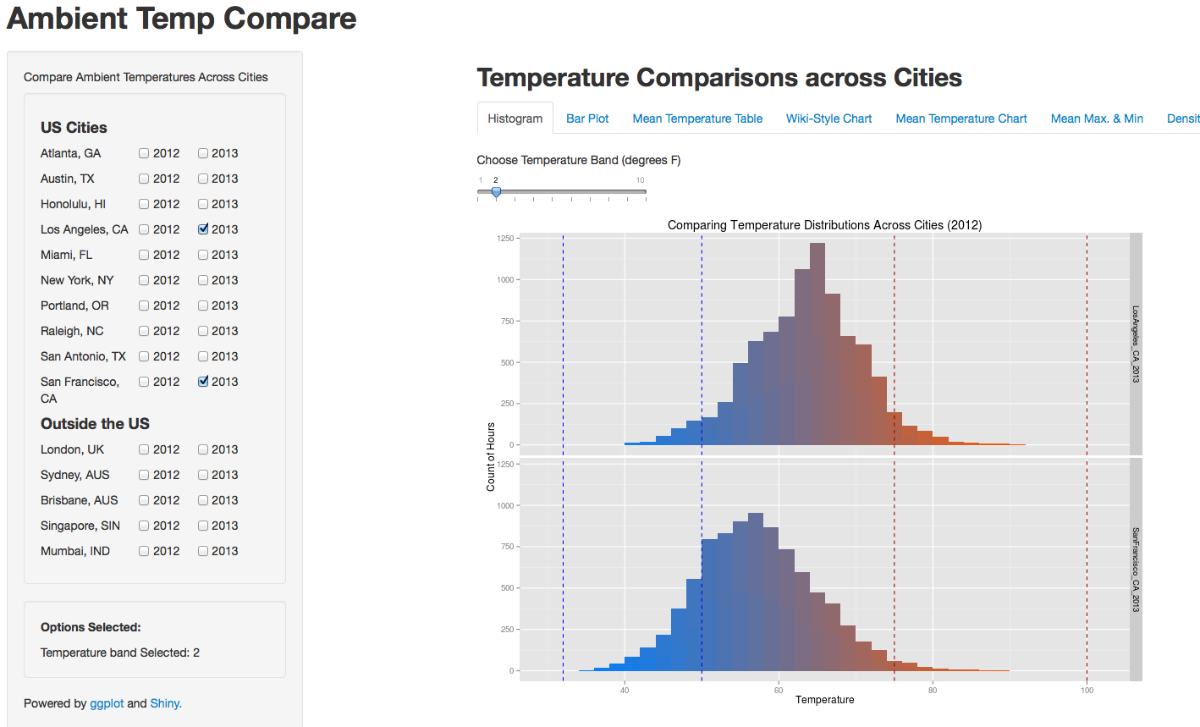
weatherCompare – Shiny App
http://spark.rstudio.com/ram/WeatherCompare/

Slide 10
How does the Shiny App work?
Data
For each city of interest,
Invoke GetWeatherForYear() for 2012 & 2013
Plotting
Using ggplot for all plots
ggplot works only with data frames
Works great with “melted” dataframes (reshape2)
Shiny: Reactive Elements
Generous use of subset() based on checkboxes
Created different “reactive” functions for each type of plot

Slide 11
LINKS
weatherData (on CRAN)
http://cran.r-project.org/web/packages/weatherData/index.html
weatherCompare (Shiny)
http://spark.rstudio.com/ram/WeatherCompare
Github
For the package
https://github.com/Ram-N/weatherData
For weatherCompare
https://github.com/Ram-N/WeatherCompare
Github Pages (with a few examples)
http://ram-n.github.io/weatherData/

