Slide 1
Data Science Stack with MongoDB and RStudio
Building up an easy data science platform with RStudio server on top of your MongoDB
Winston Chen – Lead Software Engineer

Slide 2
What does Fliptop do?
Predictive Lead Scoring, using data science
Pull opportunity/lead/contact data from CRM
Aggregate company data and social data from various data sources and the internet
Over 3000 signals
Build conversion/revenue model
Predict lead conversion and revenue

Slide 3
Our Platform Stack
Java/Scala
Liftweb
JMS/Storm
MongoDB/MySql

Slide 4
Our Machine Learning Stack
Python
Numpy/Scipy/Pandas
Bottle (RESTful Server)

Slide 5
So, where is R then?
Problem:
Data is stored in MongoDB
Sales Lead Data
Sales Opportunity Data
Sales Contact Data
It’s hard to view/digest/process data on the fly using MongoDB console
(X) Text processing for insight extraction?
(X) Prototype cool machine learning algorithms on the fly?
Solution:
R and Rstudio Server
Why not scala?
Why not python/ipython

Slide 6
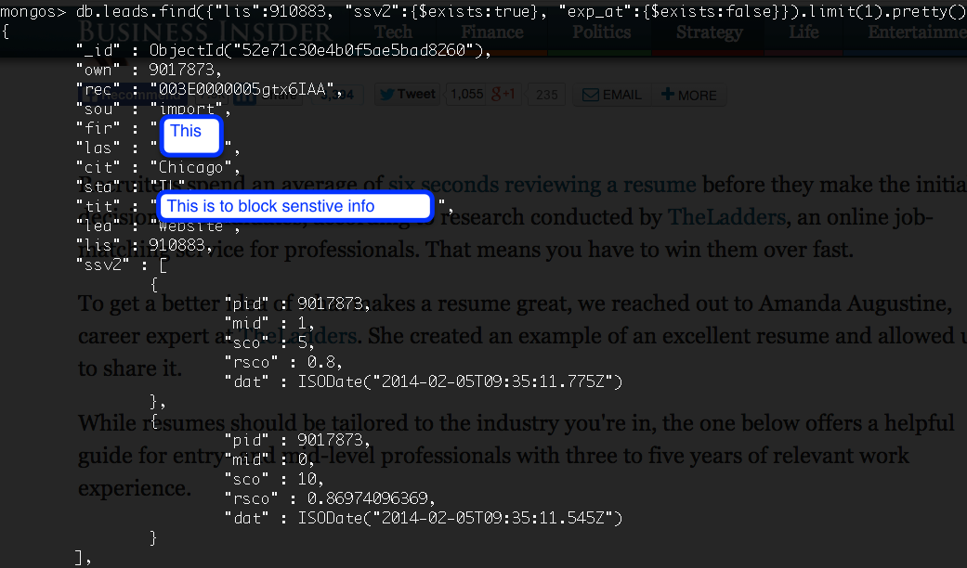
MongoDB Console & Query

Slide 7
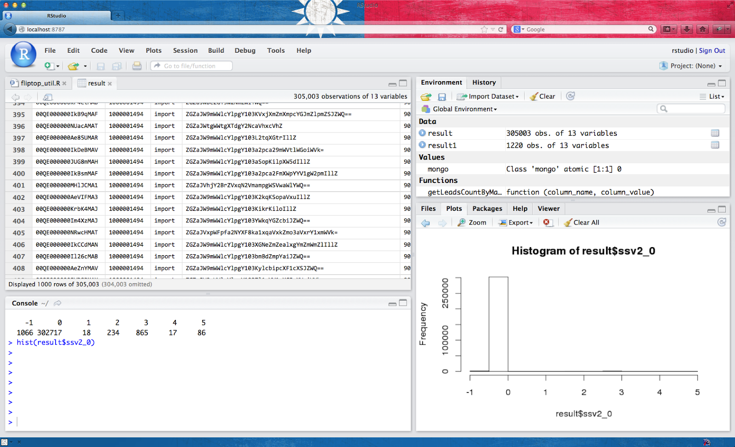
Rstudio Server

Slide 8
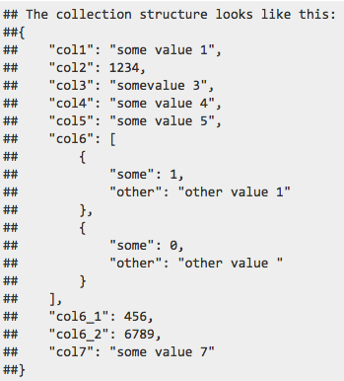
Pull MongoDB data into R data frame
rmongodb (https://github.com/gerald-lindsly/rmongodb)
Transform
Into a R data-frame

Slide 9
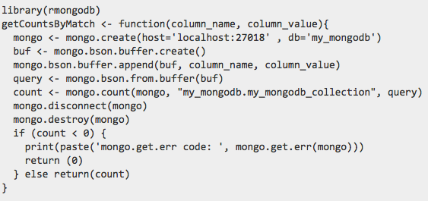
1 – Get the total count of your data set

Slide 10
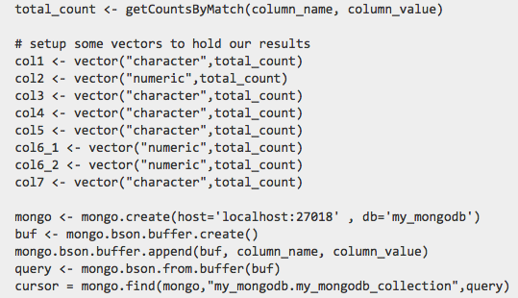
2 – Construct Vectors for each column

Slide 11
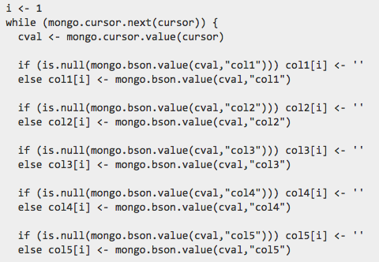
3 – Loop through curser and insert values
Where are my apply functions? - Too bad. We are using mongo cursor :P

Slide 12
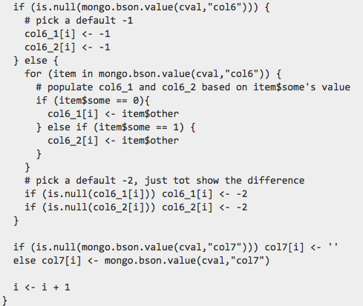
4 – Go into sub bson block to extract data (optional)

Slide 13

5 – Construct data frame and return
We now have a data frame to play with from MongoDB bson.
You are able to get the full example code here: http://goo.gl/tlyyXp

Slide 14
This is NOT a BIG DATA Stack
It takes around 1 min to process 900Mb+ of bson from Mongo.
BIG data stack – Data should fit into the ram
Most of the data in the world is not big anyways.
It works fine for us (m1.large machine in AWS)
CRM data is never big, not even after we pull in 3000+ additional signals.
The term ‘Big-Data’ is seriously overrated, ‘Data Science’ however, is the key term here.

Slide 15
@ Fliptop, we now use Rstudio to do
Data Insight Extraction
Algorithm prototyping

Slide 16
If you REALLY want BIG Data
Look into: HDFS + Pig/Hive + Hue (any other suggestion from the audience here?)

Slide 17
QA
Winston Chen
Personal Blog: http://winston.attlin.com/
Twitter: @wingchen83
winston@fliptop.com
Fliptop is hiring Data Scientists. Please email to: winston@fliptop.com

