Slide 1
Generalized Linear Models on Large Data Sets
Joseph B. Rickert
Data Scientist, Community Manager
Susan Ranney, Ph.D.
Chief Data Scientist, Revolution Analytics
BARUG August 12, 2014
UseR! 2014

Slide 2
Generalized Linear Models
1805 - Linear Regression: Legendre, Gauss
1908 - Maximum Likelihood, Edgeworth
1922 - Poisson models and Maximum Likelihood, Fisher
1926 - Design of Experiments, Fisher
1934 - Exponential Family of distributions Fisher, Darmois, Pitman & Koopman
1935 - Probit models, Bliss
1952 - Logit models, Dyke and Patterson
1972 - Generalized Linear Models, Nelder and Wedderburn
Several strands of Statistical Theory woven together to make the idea of the GLM possible
The synthesis of Nelder and Wedderburn provided a single algorithm, Iteratively reweighted least squares, that could be used to estimate a whole family of models

Slide 3
GLM development in R
GLM glm()
Theory
GAM
Glmnet
Implementation
glm2()
External memory
rxLogit() and rxGlm()
bigglm()
Data sources
* Bigmemory
* ff
Attention to data handling & environment
Much more

Slide 4
Implementation of rxGlm and rxLogit
Standard iteratively reweighted least squares algorithm, but
Implemented as Parallel External Memory Algorithms (PEMA)
Efficiently handle data, especially categorical data
Parallel External Memory Algorithms
An External Memory Algorithm (EMA) does not require all the data to be in RAM. Data is processed in chunks.
A PEMA allows EMA computations to be performed in parallel – on multiple cores and/or multiple nodes of a cluster
Code must be arranged so it can be parallelized
A chunk of data can be processed without information about other chunks
A master process collects and processes intermediate results, check for convergence, and compute final results

Slide 5
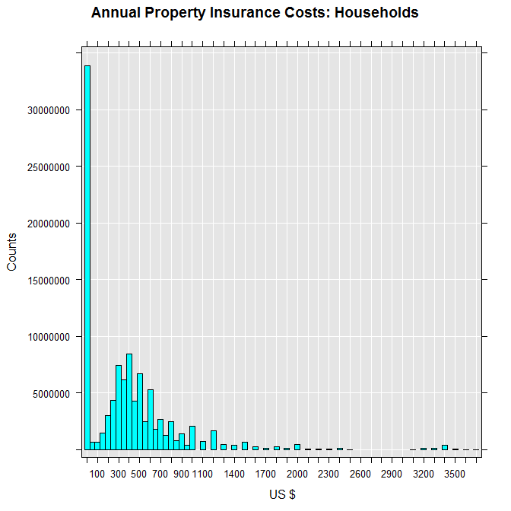
GLM Tweedie Model
The data is subsample from the 5% sample of the U.S. 2000 census.
We consider the annual cost of property insurance for heads of household ages 21 through 89, and its relationship to age, sex, and region
5,175,270 observations
propinGlm <- rxGlm(propinsr~sex + F(age) + region, pweights = "perwt", data = propinFile, family = rxTweedie (var.power = 1.5), dropFirst = TRUE)

Slide 6
Tweedie Results
Total independent variables: 82 (Including number dropped: 4)
Number of valid observations: 5,175,270
Coefficients:
Estimate Std. Error t value Pr(>|t|)
(Intercept) 1.231e-01 5.893e-04 208.961 2.22e-16 ***
sex=Male Dropped Dropped Dropped Dropped
sex=Female 9.026e-03 3.164e-05 285.305 2.22e-16 ***
F_age=21 Dropped Dropped Dropped Dropped
F_age=22 -9.208e-03 7.523e-04 -12.240 2.22e-16 ***
F_age=27 -4.894e-02 6.182e-04 -79.162 2.22e-16 ***
F_age=28 -5.398e-02 6.099e-04 -88.506 2.22e-16 ***
F_age=29 -5.787e-02 6.043e-04 -95.749 2.22e-16 ***
F_age=30 -6.064e-02 6.020e-04 -100.716 2.22e-16 ***
. . .
(Dispersion parameter for Tweedie family taken to be 546.4888)
Condition number of final variance-covariance matrix: 5980.277
Number of iterations: Computation time: 46.527 seconds
Test System
Dell Ultrabook
4 Intel i7 Cores
8 GB RAM

Slide 7
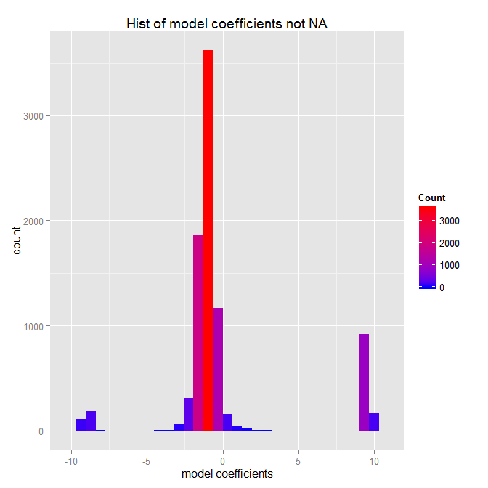
Big Logistic Regression Model
Airlines Data Set
123,497,420 observations
Factor variables
Origin: 347 levels
Dest: 352 levels
UniqueCarrier: 29 levels
DayOfWeek: 7 levels
122,180 coefficients
8641 real coefficients
rxLogit(Late ~ Origin:Dest + UniqueCarrier +
DayOfWeek, blocksPerRead = 8,
data=working.file,cube=TRUE)

Slide 8
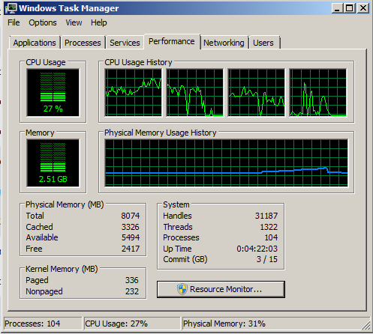
Logistic Regression Model Performance
Rows Read: 1187632, Total Rows Processed: 123497420, Total Chunk Time: 0.541 seconds
Rows Read: 37549, Total Rows Processed: 123534969, Total Chunk Time: 0.533 seconds
Iteration 9 time: 99.140 secs.
Elapsed computation time: 973.766 secs.
Parallel processing
Efficient memory use
~16 minutes on laptop

Slide 9
Really Big Tweedie GLM Model
Updated Airlines Data Set (1987 – 2012)
148,619,655 observations
140,852 coefficients
8626 real coefficients (not NA)
Factor variables used:
Origin: 373 levels
Dest: 377 levels
UniqueCarrier: 30 levels
F(Year): 26 levels
DayOfWeek: 7 levels
F(CRSDepTime): 25
(Note: F() creates an on-the-fly factor with a level for ever integer value)
Test System
IBM Platform LSF cluster of commodity hardware
5 nodes
4 cores per node
16 GB RAM per node
Estimation Time: 12.6 minutes
glmOut <- rxGlm(ArrDelayMinutes ~ Origin:Dest + UniqueCarrier + F(Year) + DayOfWeek:F(CRSDepTime),
data = airData, family = rxTweedie(var.power = 1.15),
cube = TRUE, blocksPerRead = 20)

Slide 10
Using the Estimated GLM Model for Predictions
Create a data frame (predData) with variables used in the model:
Flights from Seattle to Honolulu
All days and departure hours
3 airlines: Alaska, Delta, and Hawaiian
Use rxPredict to add predicted values to the data frame using the computed model object
Plot the results
predDataOut <- rxPredict(glmOut, data = predData,
outData = predData, type = "response")
rxLinePlot(ArrDelayMinutes_Pred~CRSDepTime|UniqueCarrier, groups = DayOfWeek,
data = predDataOut, layout = c(3,1),
title = "Expected Delay: Seattle to Honolulu by Departure Time, Day of Week, and Airline",
xTitle = "Scheduled Departure Time", yTitle = "Expected Delay")

Slide 11
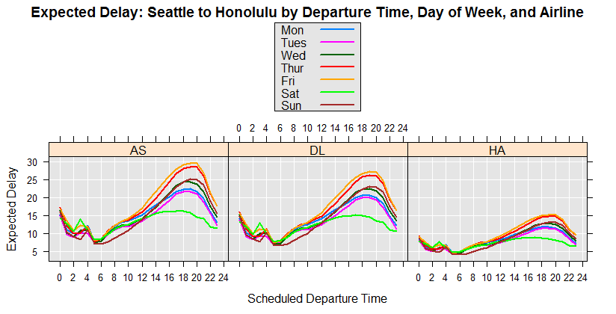

Slide 12
Summary
The pre-history of the GLM is very rich and includes much fundamental statistical theory.
Nelder and Wedderburn’s 1972 paper synthesized the idea of the GLM, and sparked research both in theory and algorithms
IRLS, the original method of estimating GLMs has proved to be remarkably effective
Good performance on large data sets can be achieved with:
The implementation of parallel code and distributed computing
Careful data handling
Attention to processing factors

Slide 13
Some References
Bliss, C.J. (1935) The calculation of the dosage-mortality curve Ann. Appl. Biol. 22, 307-30
Chambers, J.M. (1971) Regression Updating J. ASA Vol 66, Issue 336
Darmois (1935) Sur les lois de probabilité à estimation exhaustive, C.R. Acad. Sci. 200, 1265-1266
Dyke G.V., Patterson H.D. (1952) Analysis of factorial arrangements when the data are proportions Biometrics 8:1–12
Edgeworth F. Y. (1908) On the probable errors of frequency-constants J. Roy. Statist. Soc. 71 381 – 97, 499-512, 651-78
Fisher, R.A.
(1922) On the mathematical foundations of theoretical statistics. Phil Trans. R. Soc 222; 309-68
(1934) Two new properties of mathematical likelihood Proc. Roy. Soc., A.144, 285-307
(1958) Statistical Methods for Research Workers, Oliver & Boyd Edinburgh
Gentlemen W.M. Algorithm AS 75 J. Royal Statis. Soc. Vol 23, No 3
Hardin & Hilbe Generalized Linear Models and their Extensions, 3rd ed. Stata Press (2012)
Hinde, J. GLMS 40+ years on: A Personal Perspective RBras 2013
Komarek P. (2004) Logistic Regression for Data Mining and High-Dimensional Classification Thesis CMU
Koopman (1936) On Distributions admitting a sufficient statistic Trans. Amer. Math. Soc., 39, 399-409
McCullagh P., and Nelder J. A. (1989) Generalized Linear Models, 2nd ed. , Chapman and Hall
Miller, A.J. Algorithm AS 274 (1992) J. Royal Statis. Soc. Vol 41, No 2
Nelder, J. A. and R.W.M. Wedderburn (1972) Generalized Linear Models J. R. Statis. Soc. A. 135, Part 3 p 370
Pitman (1936) Sufficient statistics and intrinsic accuracy Proc. Cambridge Phil. Soc., 32, 567-579
Pratt J W (1976) F.Y. Edgeworth and R. A. Fisher on the Efficiency of Maximum Likelihood Estimation The Annals of Statistics 1976 Vol. 4., No. 3, 501-514
Savage, L.J. (1976) On Rereading R. A. Fisher Ann. Statist. Vol. 4, No. 3, 441-500
Wagner, H.M. (1959) Linear Programming Techniques for Regression Analysis, J ASA 54:285 205-212

