Slide 1
AUC Meets the Wilcoxon-Mann-Whitney U Statistic
Bob Horton
Senior Data Scientist
Microsoft

Slide 2
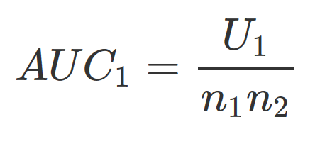
ROC curve: a graphical plot that illustrates the performance of a binary classifier system as its discrimination threshold is varied.
Wilcoxon-Mann-Whitney U test: A non-parametric alternative to the unpaired Student's t-test.
See “Mann–Whitney U test” in Wikipedia
Notes:
These seem like such different concepts that I was surprised to see they are so close to being exactly the same thing.

Slide 3
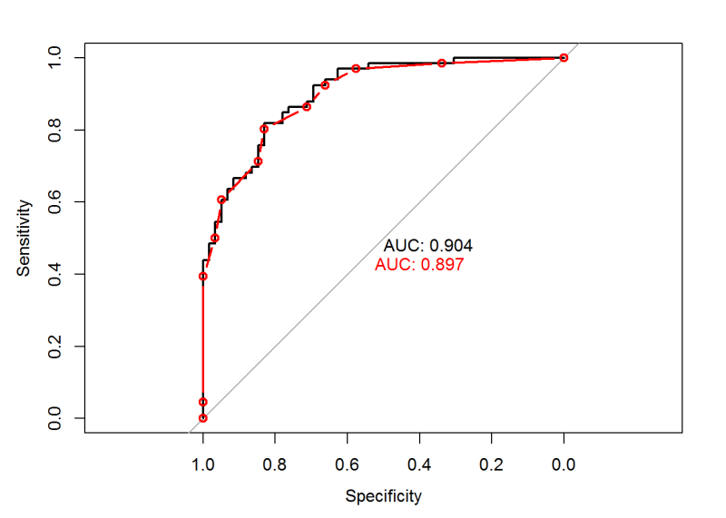
True Positive Rate
0.0 0.2 0.4 0.6 0.8 1.0
False Positive Rate
Notes:
The black line show the “full-resolution” ROC curve, where each case has a unique score, with no ties. Here we take a step for each case, either in the positive y direction (if the case is actually positive), or in the positive ex-direction (if the case is actually negative).
The red line was made from the same dataset, but the scores were first rounded to one decimal place. This creates groups of cases that all tie for the same score. These groups are represented by diagonal lines.
The main idea here is that it is easier to think about what the ROC curve means if we ignore ties, but you need to handle them in practice.

Slide 4
category <- c( 1, 1, 1, 1, 0, 1, 1, 0, 1, 0, 1, 0, 1, 0, 0, 1, 0, 0, 0, 0) prediction <- c(20,19,18,17,16,15,14,13,11.5,11.5,10, 9, 8, 7, 6, 5, 4, 3, 2, 1) library('pROC') (official_auc <- auc(roc(category, prediction)))
## Area under the curve: 0.825
auc_wmw <- function(labels, scores){ labels <- as.logical(labels) pos <- scores[labels] neg <- scores[!labels] U <- as.numeric(wilcox.test(pos, neg)$statistic) U/(length(pos) * length(neg)) }
auc_wmw(category, prediction) # 0.825
Notes:
This is the simple data set we use for most of the examples. The `prediction` vector holds the fake scores, which are just assigned so that the cases will be ranked in the order they started with. We add a minor complication by having two of the cases (one positive and one negative) have tied scores.
In the first pass at a function to use this relationship to calculate AUC from the U statistic we just take the statistic value from the result of the `wilcox.test` function. We get the same AUC value as the “official” version on the previous slide.

Slide 5
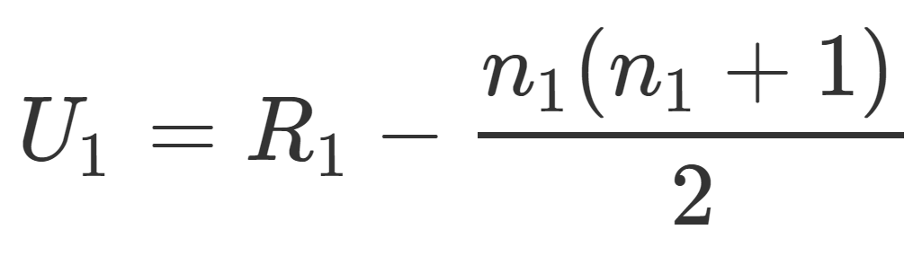
auc_wmw2 <- function(labels, scores){ labels <- as.logical(labels) n1 <- sum(labels) n2 <- sum(!labels) R1 <- sum(rank(scores)[labels]) U1 <- R1 - n1 * (n1 + 1)/2 U1/(n1 * n2) } auc_wmw2(category, prediction) # 0.825
Notes:
This is the next version of a function to compute AUC using the U statistic formula. Here we calculate the U statistic directly. It still works.

Slide 6
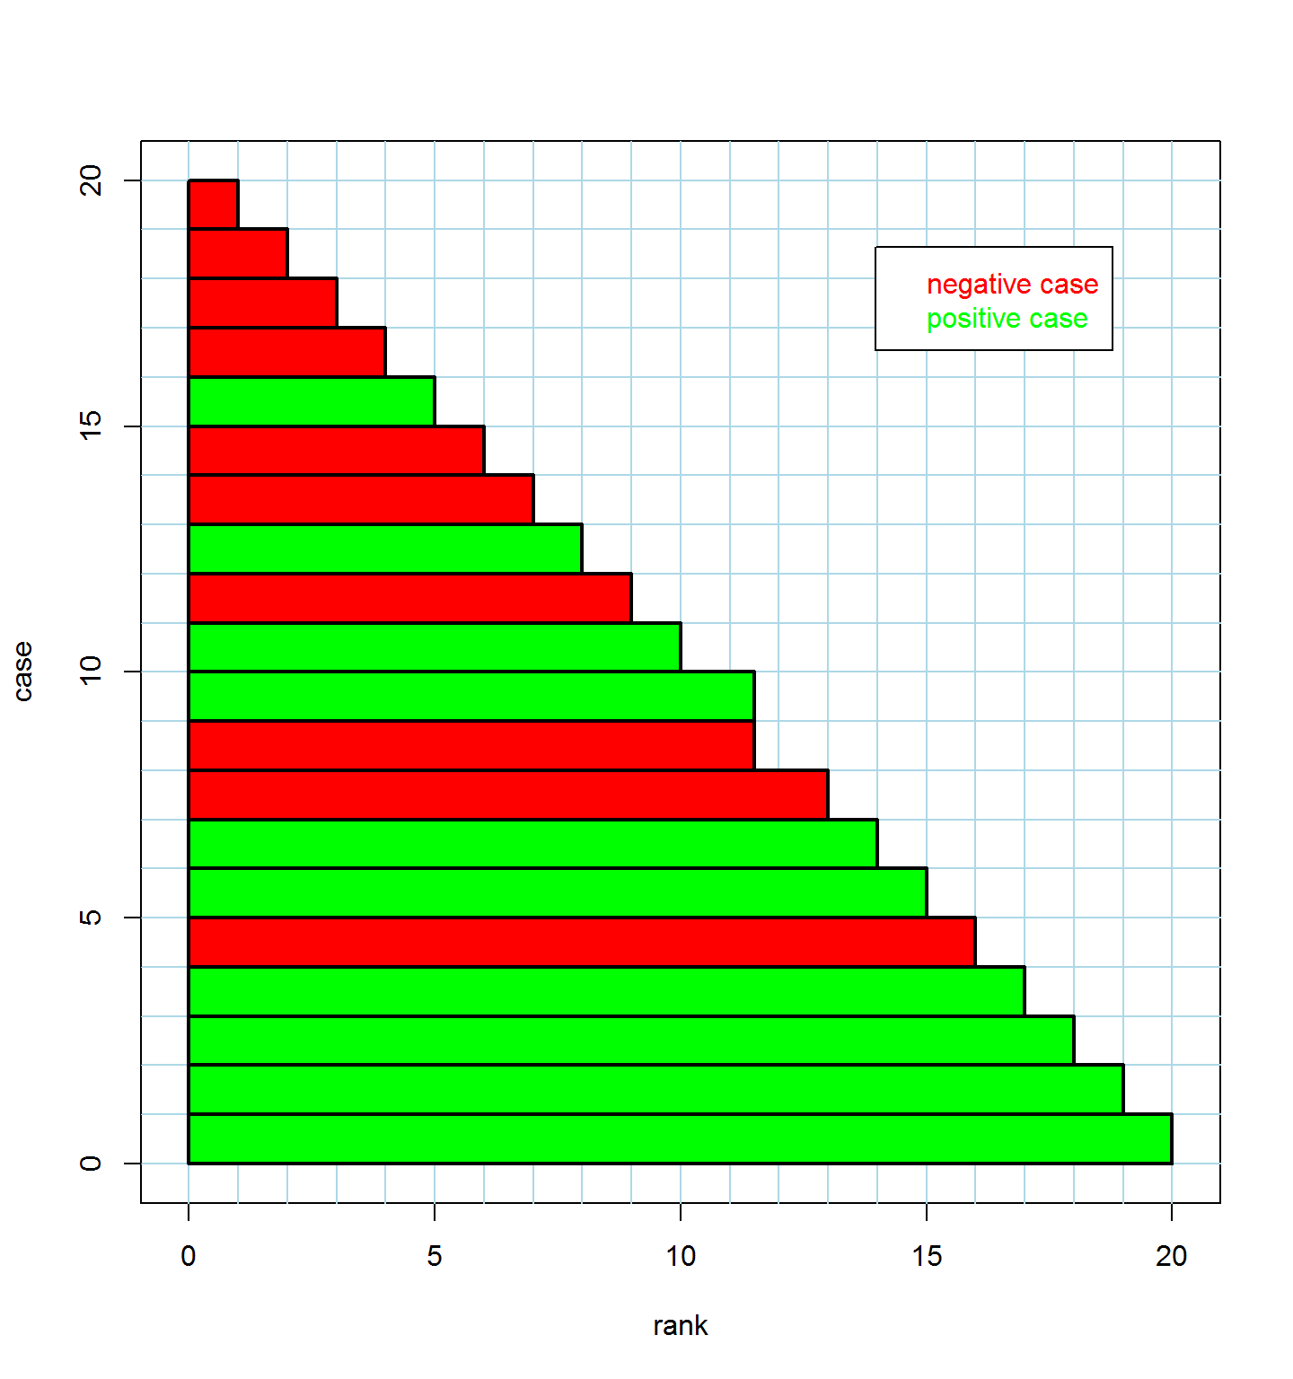
rank label
1.0 0
2.0 0
3.0 0
4.0 0
5.0 1
6.0 0
7.0 0
8.0 1
9.0 0
10.0 1
11.5 0
11.5 1
13.0 0
14.0 1
15.0 1
16.0 0
17.0 1
18.0 1
19.0 1
20.0 1
case
Notes:
This is a graphical representation of the rank-ordered data. Each case gets a bar of height 1, and width determined by its rank. The bars are colored by the label (red for negative or green for positive).
If you look closely you’ll see that the ranks in this example are the same as the `prediction` values we started with. Maybe the difference would be more clear if we divided the prediction values by 10 or something…

Slide 7
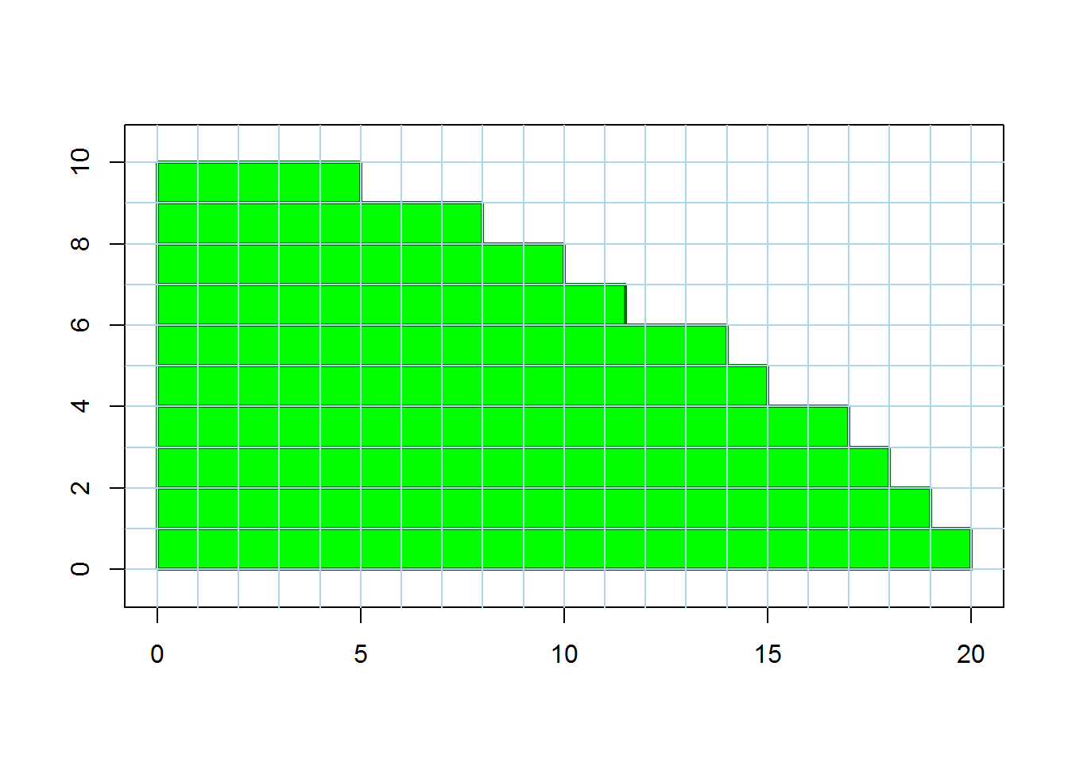
R₁
Notes:
We remove the red bars and are left with a stack the green ones. The total area of green is equal to R1, the sum of the ranks of the positive cases.

Slide 8
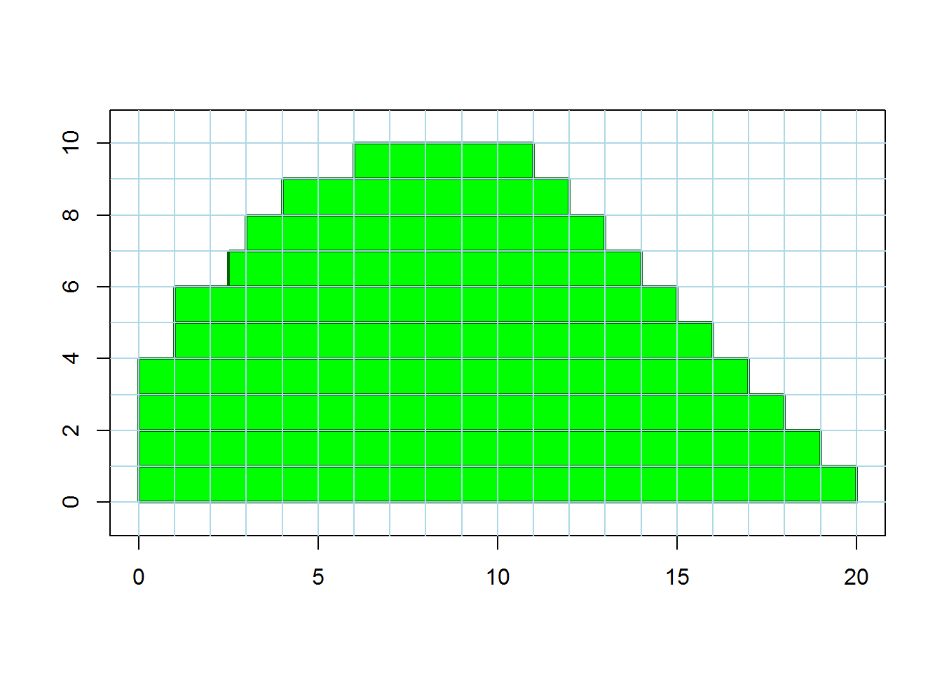
R₁
Notes:
Here we’ve slid the bars so that the right edge forms a perfect stairstep pattern. The area remains the same (still equal to R1).

Slide 9
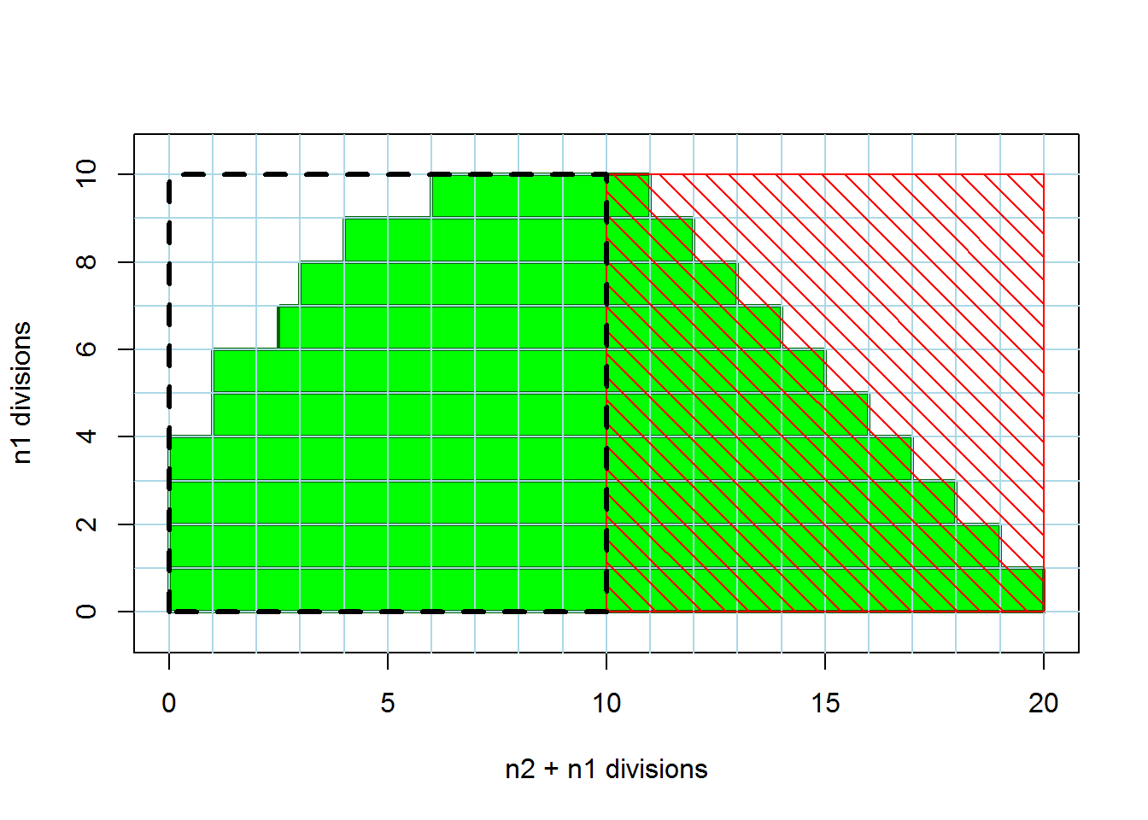
n₂
n₁
R₁
n₁
Notes:
If we subtract the area under the hatched red square, we are left with U1, the Wilcoxon-Mann-Whitney U statistic.
In this example n1 and n2 are both equal to 10, so both the red hatched area and the black dashed area are squares. But the black dashed area will only be square if n1 and n2 are equal.

Slide 10
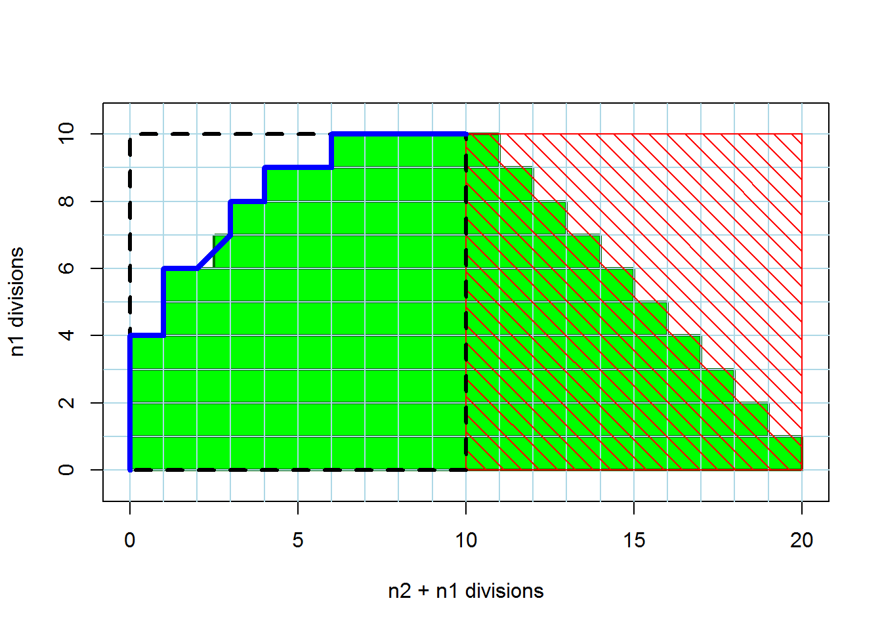
n₂
Scaled ROC curve
n₁
Notes:
Here we’ve independently calculated an ROC curve for this dataset, re-scaled it so that the true positive rate ranges from 0 to n1 (originally it would range from 0 to 1), and the false positive rate ranges from 0 to n2. When we plot it on top of this figure, it follows along the left edge of our stacked bars, except where the ties occur in the dataset. But we can see that the area of U1 is equal to the area under the scaled ROC curve. That square tht differs is split in half diagonally by the ROC curve and vertically for the green bars, but it is still divided exactly in half in both cases.
To calculate AUC from U1, we go the other way, scaling U1 down as a fraction of the n1 * n2 black dashed area.

Slide 11
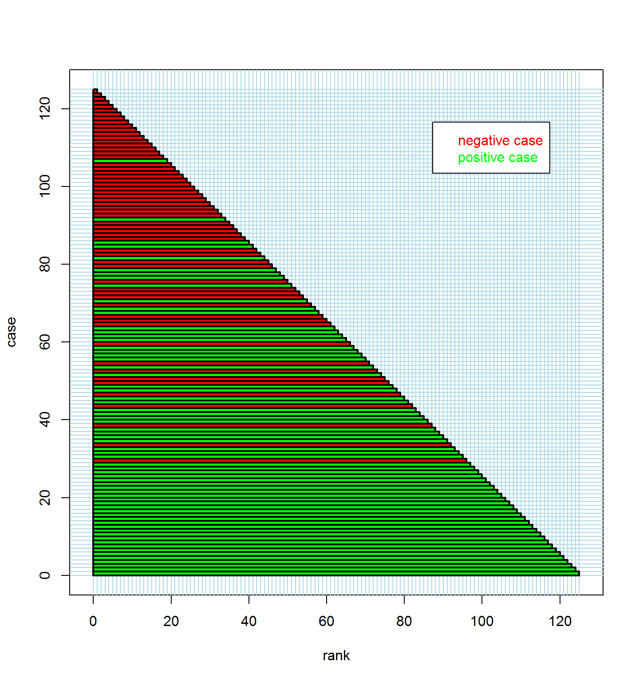
Notes:
This example is on a bigger dataset, with no ties.

Slide 12
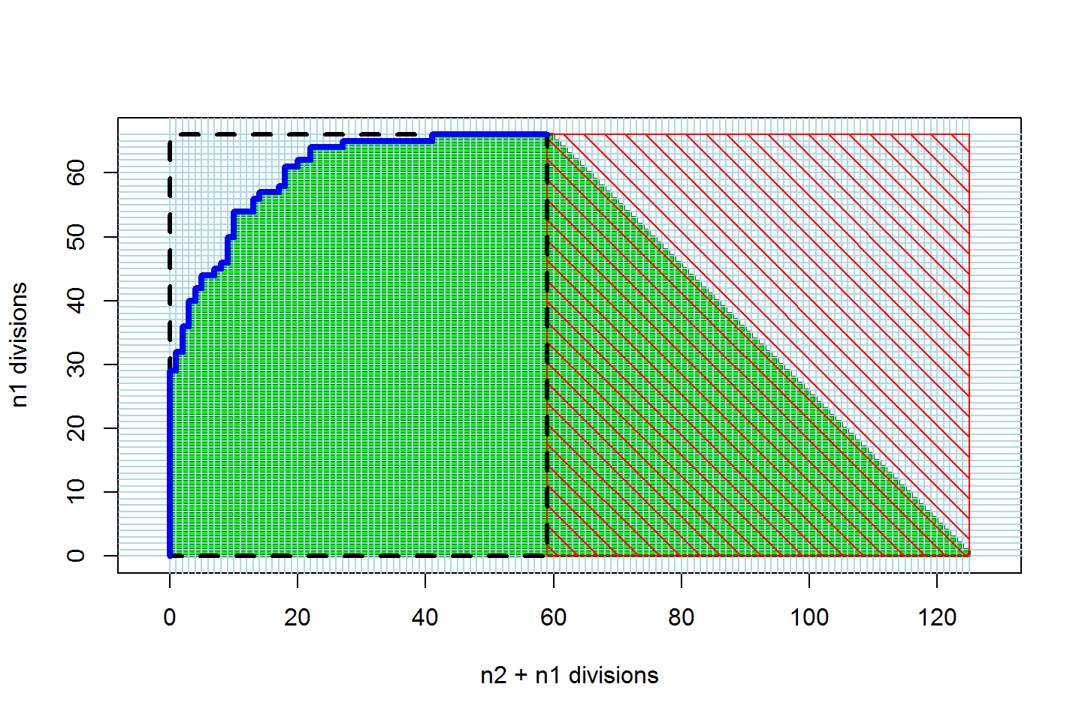
Notes:
Since there are no ties, the left edge of the stack of green bars forms a perfect (scaled) ROC curve.
We may have invented the world’s most complicated way to draw an ROC curve!

Slide 13
Bob’s Revolutions blog posts on AUC:
ROC Curves in Two Lines of R Code
Calculating AUC
AUC meets the Wilcoxon-Mann-Whitney U Statistic
Notes:
See more details in the posts at http://blog.revolutionanalytics.com/

Slide 14
Bonus Slides!

Slide 15
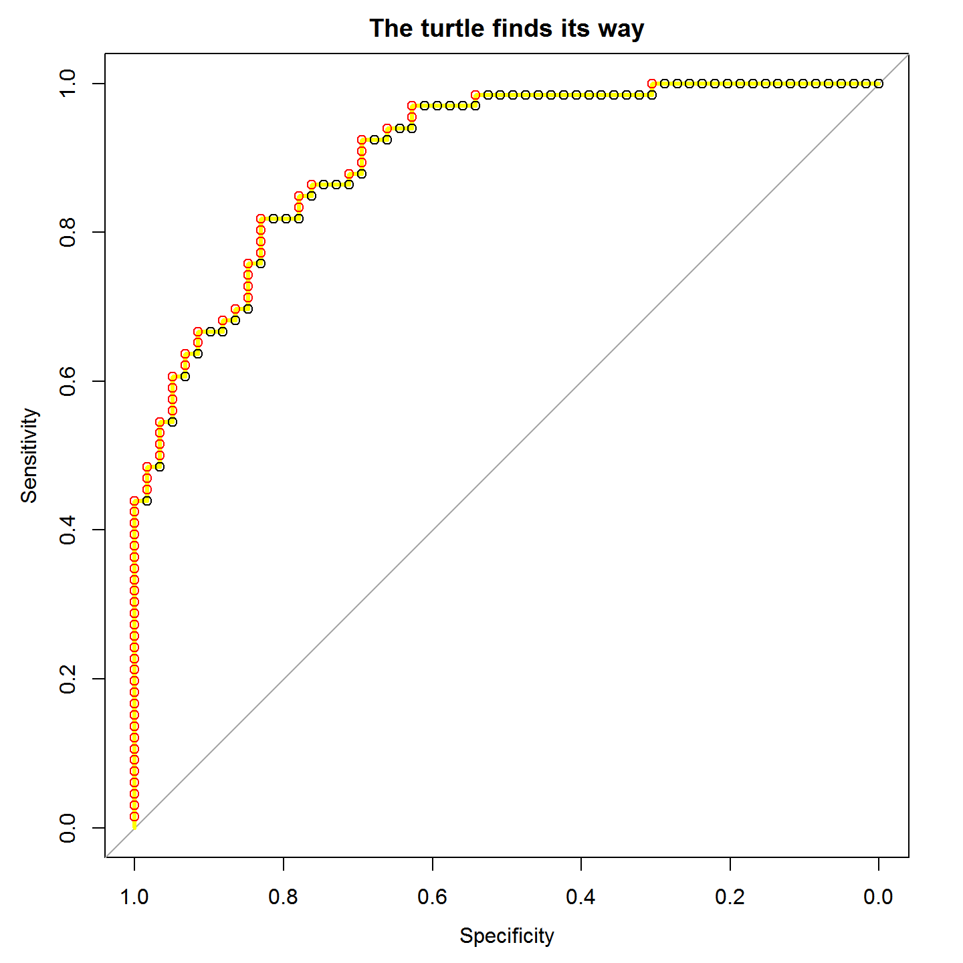
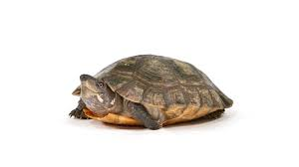
Simple ROC curves:
Think like a turtle
Sort the observed outcomes by their predicted scores with the highest scores first.
Calculate cumulative True Positive Rate (TPR) and False Positive Rate (FPR) for the ordered observed outcomes.
Plot TPR (Sensitivity) against FPR (1 – Specificity)
True Positive Rate
0.0 0.2 0.4 0.6 0.8 1.0
False Positive Rate
Notes:
This is the “turtle graphics” explanation from the first blog post. Once the cases are sorted by their scores, the turtle uses them to plot its course. Starting at (0,0) it reads the sorted labels. If it sees a positive one (red in this figure), it goes up. If it sees a negative(black) case it goes to the right. It scales its steps along each axis so that by the time it has seen all of the positive cases it will be at 1.0 on the y axis, and by the time it has seen all the negative cases it will be at 1.0 on the x axis.

Slide 16
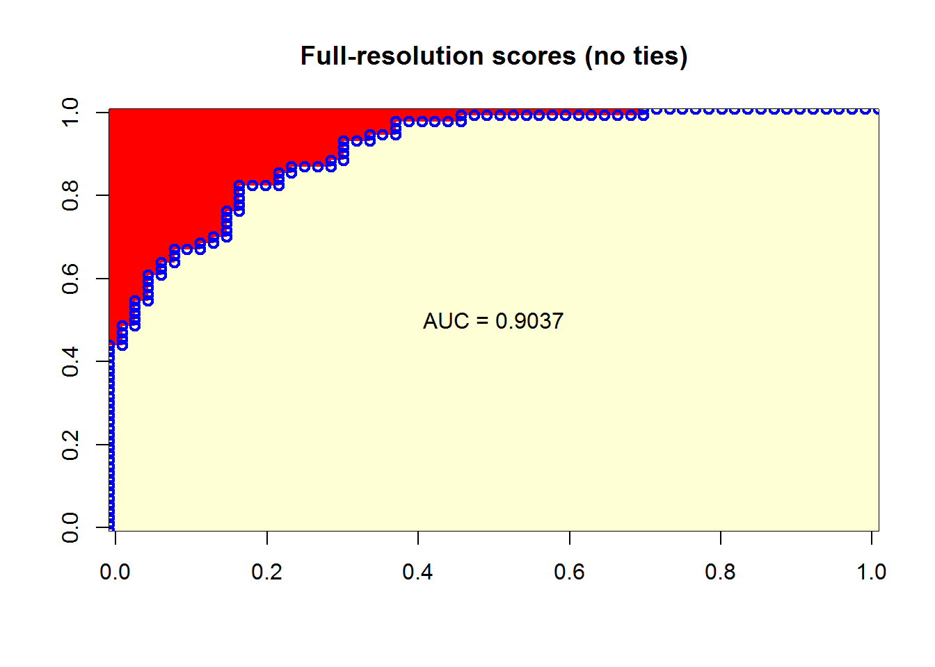
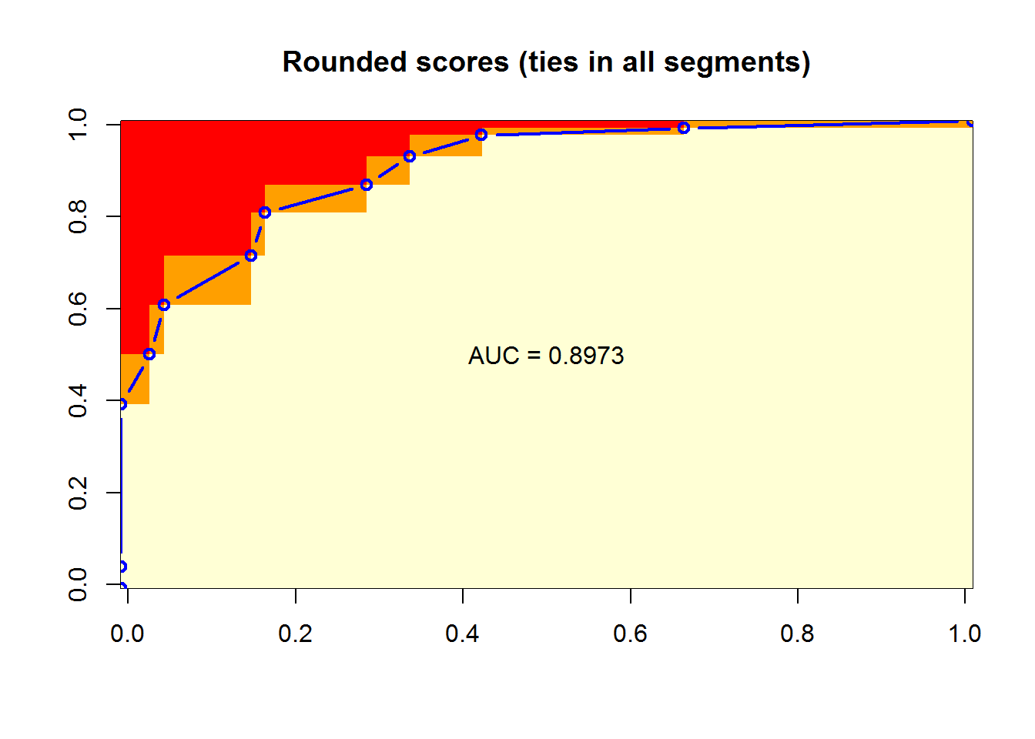
Full-resolution scores
(no ties)
Rounded scores
(includes ties)
Negative cases in columns
Positive cases in rows
Notes:
These are the plots from the blog post on “Calculating AUC” that illustrate hos AUC relates to probability. On the left is the figure for the “full resolution” data, where there are no ties, and on the right is the figure for the dataset where scores have been rounded so that we have sets of cases with tied scores. In each figure we first generate a matrix where each row represents one of the positive cases, sorted so the highest score is in the row at the bottom. The columns in this matrix represent negative cases, sorted so that the highest score among these negative cases is at the left. Each cell in the matrix is assigned a value of 1 if the positive case for its row has a higher score than the negative case for its column, 0 if the positive case for the row has a lower score than the negative case for the column, and 0.5 if they are tied. The average value for the entire matrix is the AUC.
ROC curves were calculated using the standard method, and plotted on top of the image of the matrix (after a little scaling and shifting to get the points to line up with the edges of the cells…)
This approach for finding (and visualizing) the AUC should make the probabilistic interpretation clear: AUC is the probability that a randomly chosen positive case with have a higher score than a randomly chosen negative case.

