Slide 1
A Very Brief History of ROC
Joseph Rickert
BARUG ROC Day 2020-11-10

Slide 2
Origins of the ROC
"Receiver operating characteristics" was originally a term used to describe the ability of a radar technician to discriminate between radar blips potentially representing Japanese aircraft, friendlies or random noise. In other words, it was a personal Characteristic which described how good they were at Operating the radar Receiver. The abilities of the operator were also affected by the gain of the receiver, which increased the amount of noise. Lee B. Lusted (1984) describes the origin of the medical uses of this test in his editorial for MDM. The first instance of such use occurred in the late 1950s when a newly developed Pap smear cell analyser was calibrated to operate at the optimal balance of false positives and false negatives. Deranged Psychology

Slide 3
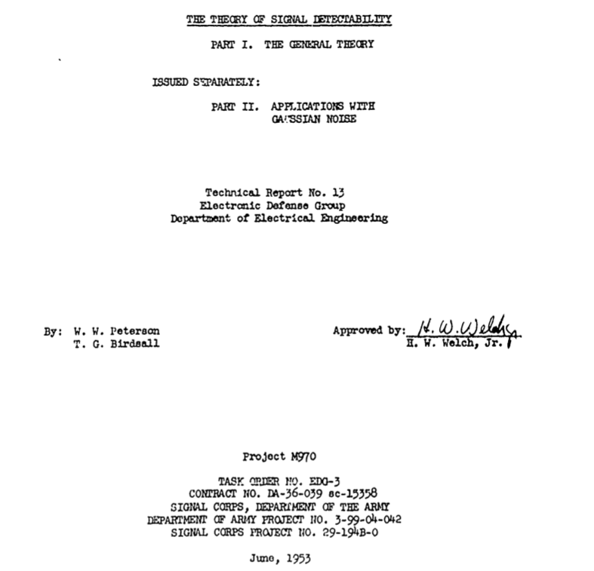
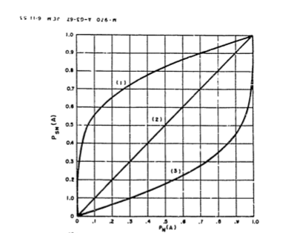
First Mention of ROC Curve in the Literature
THE-THEORY-OF-SIGNAL-DETECTABILITY.-PART-1.-Peterson-Birdsall/
https://apps.dtic.mil/dtic/tr/fulltext/u2/016786.pdf

Slide 4

Earliest Book? stack overflow

Slide 5
ROC Adoption
Not long after its inception, ROC analysis was used to establish
a conceptual framework for problems relating to sensation and perception in the field of psychophysics (Pelli and Farell (1995)) and
thereafter applied to decision problems in
Medical Diagnostics, (Hajian-Tilaki (2013)),
National Intelligence (McCelland (2011)) and
just about any field that collects data to support decision making.

Slide 6
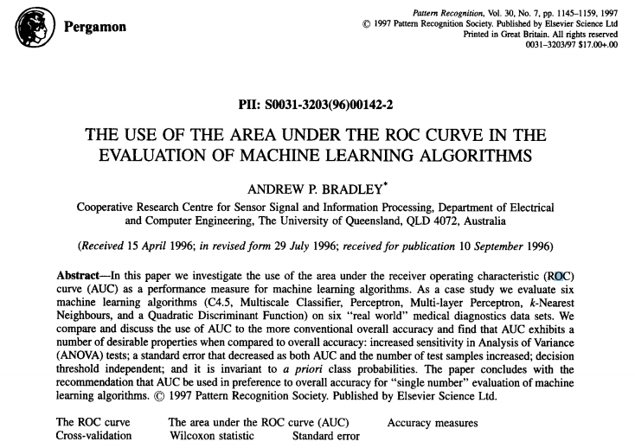
Machine Learning ROC Adoption
https://www.cse.ust.hk/nevinZhangGroup/readings/yi/Bradley_PR97.pdf

Slide 7
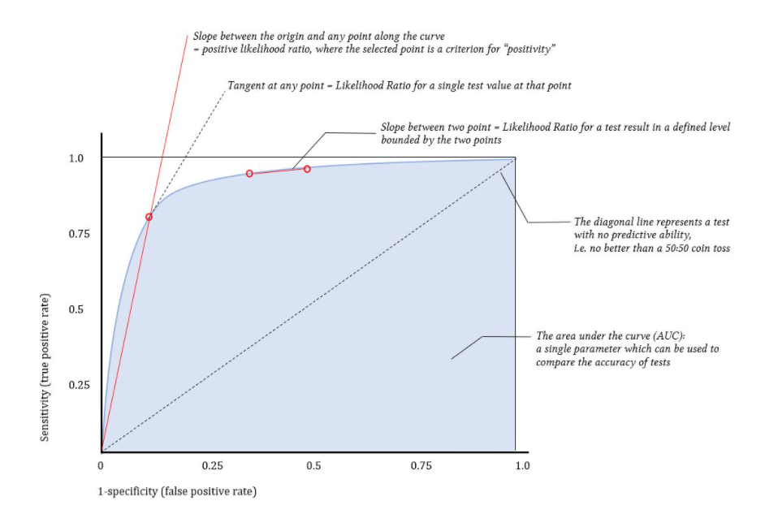
Anatomy of ROC Curve
Deranged Psychology

Slide 8
ROC Curve

Slide 9
Measuring classifier performance: a coherent alternative to the area under the ROC curve David J Hand (2009)
Abstract
The area under the ROC curve (AUC) is a very widely used measure of performance for classification and diagnostic rules. It has the appealing property of being objective, requiring no subjective input from the user. On the other hand, the AUC has disadvantages, some of which are well known. For example, the AUC can give potentially misleading results if ROC curves cross. However, the AUC also has a much more serious deficiency, and one which appears not to have been previously recognised. This is that it is fundamentally incoherent in terms of misclassification costs: the AUC uses different misclassification cost distributions for different classifiers. ...

Slide 10
H Measure Proposed by Hand
hmeasure: The H-Measure and Other Scalar Classification Performance Metrics
Classification performance metrics that are derived from the ROC curve of a classifier. The package includes the H-measure performance metric as described in <http://link.springer.com/article/10.1007/s10994-009-5119-5>, which computes the minimum total misclassification cost, integrating over any uncertainty about the relative misclassification costs, as per a user-defined prior. It also offers a one-stop-shop for other scalar metrics of performance, including sensitivity, specificity and many others, and also offers plotting tools for ROC curves and related statistics.
https://cran.r-project.org/package=hmeasure

