Slide 1


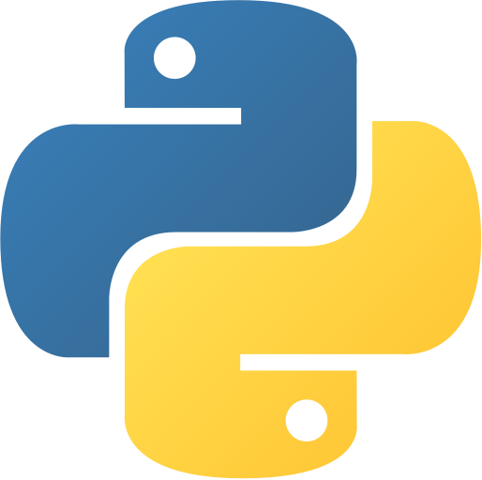
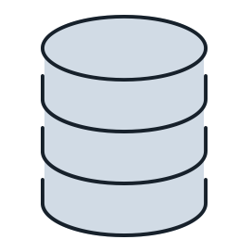


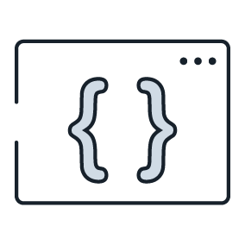


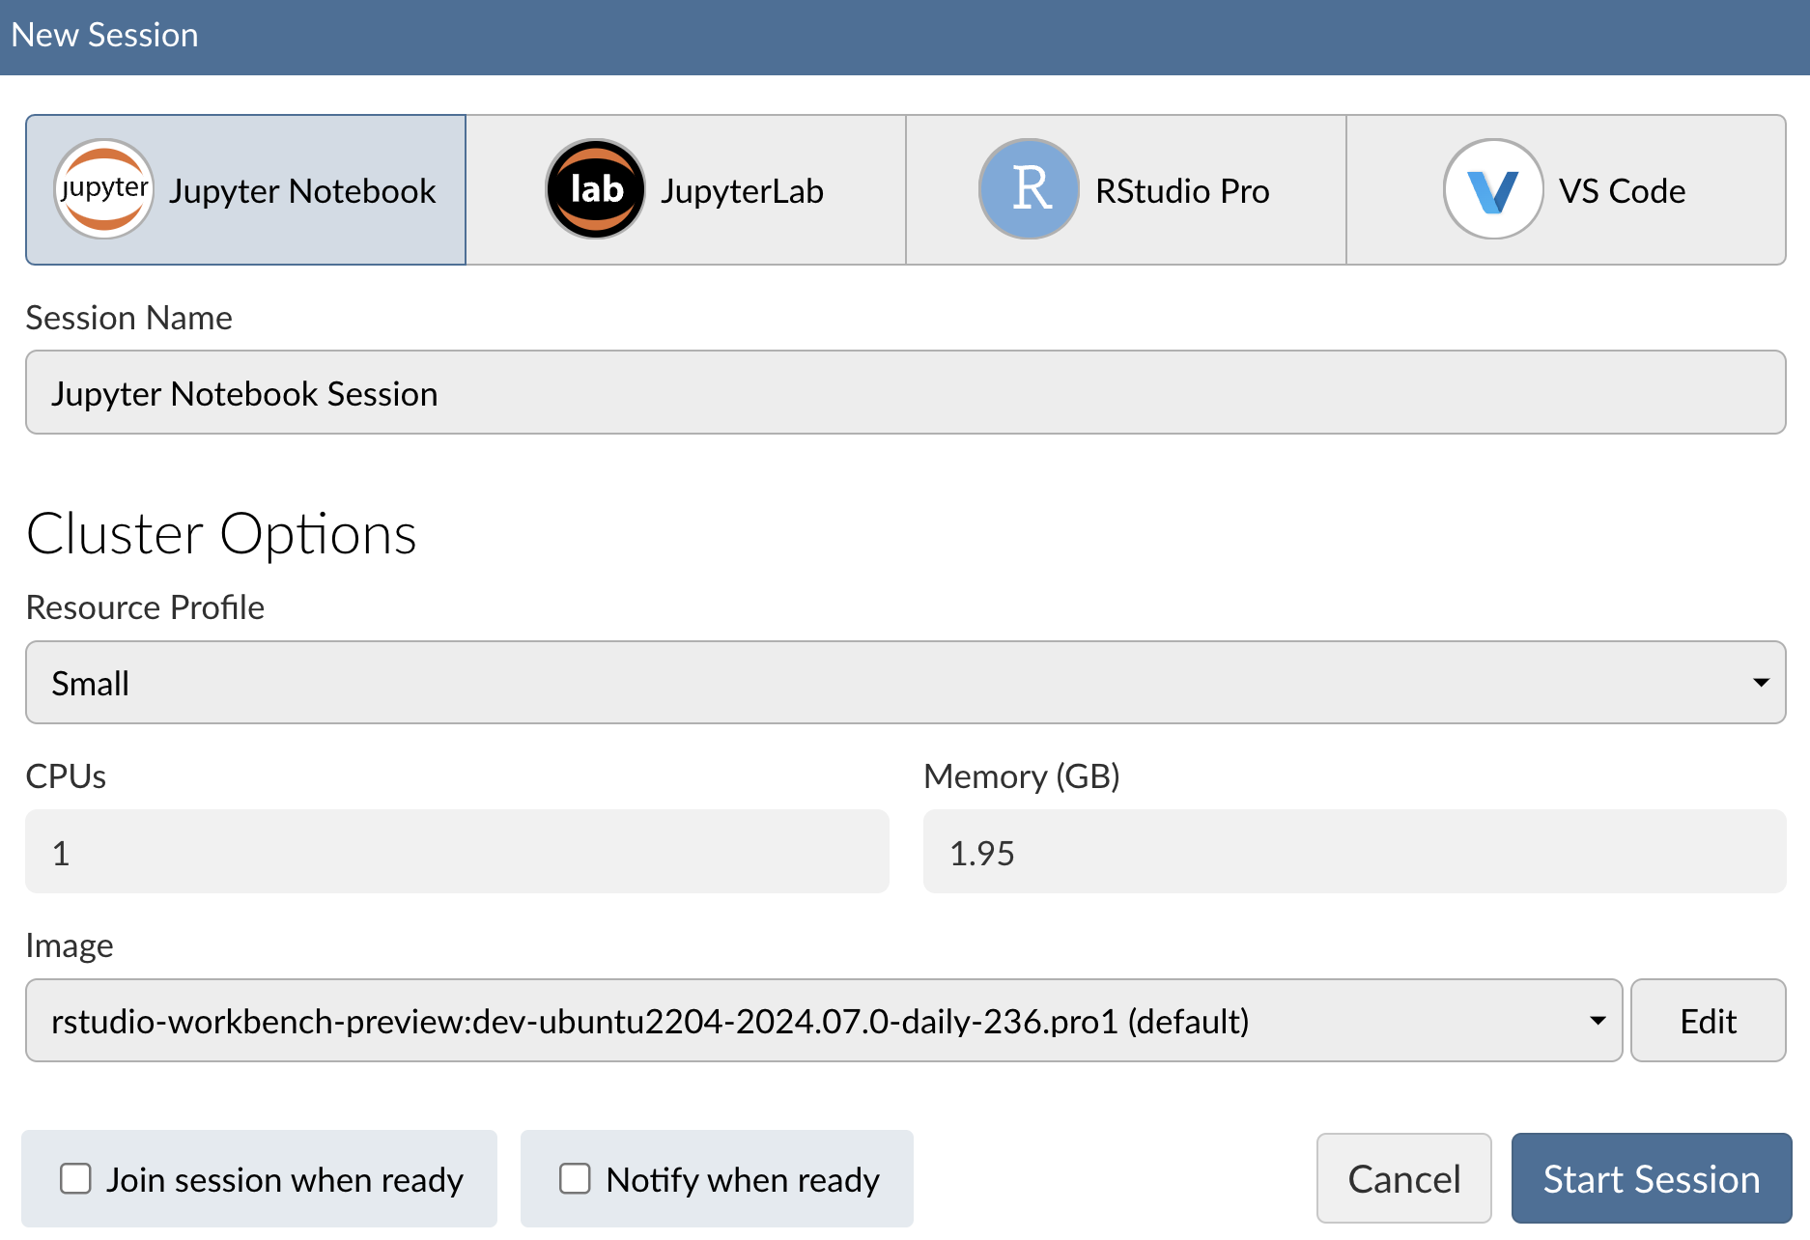
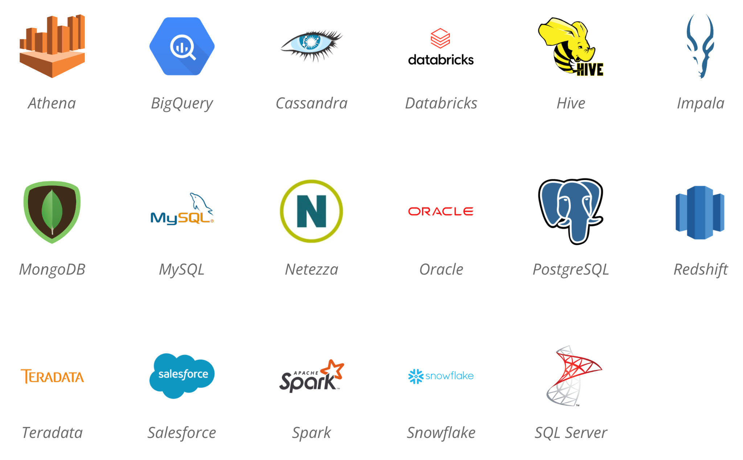
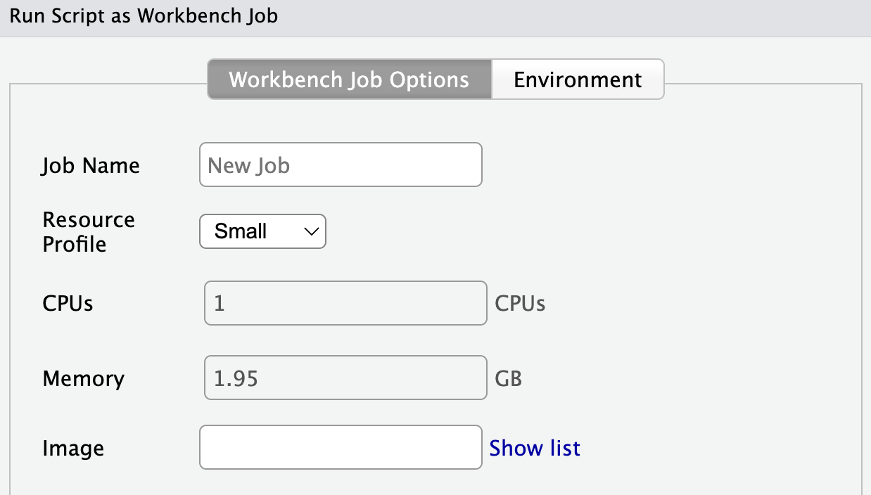


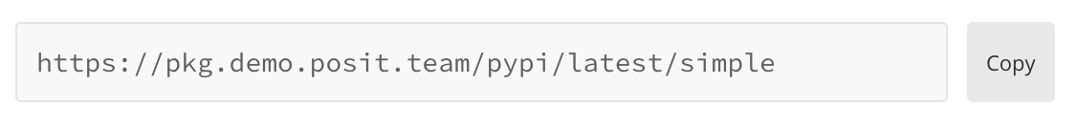


A cheat sheet for open-source developers creating and sharing data insights using Posit Team
Overview
3
Access Your Data
Posit Team bundles Posit’s premier data science tools, including:
Access your data within Posit Team no matter where it lives and what format it’s in:
DB-API
Python Database API
Development environment for creating insights
Local or Shared Directory
Examples: data.csv, data.txt, data.parquet
Example
con = sqlite3.connect('example.db')
Hosting environment for accessing and sharing insights
APIs
Interact with APIs using packages such as {requests} in Python or {httr2} and {jsonlite} in R
DBI
Database Interface
Example
con <- DBI::dbConnect(
RPostgres::Postgres(),
hostname = ”db.company.com",
port = 5432)
R and Python package repository management
Pins
Store and retrieve Python/R objects including data and models
1
Open New Session in Posit Workbench
Open a new development session by clicking + New Session
Databases
Connect to a variety of database types using DBI/DB-API/ODBC
ODBC
Open Database Connectivity
Available IDEs
Examples
Posit’s Professional ODBC Drivers
con = pyodbc.connect(
driver = 'PostgreSQL',
database = 'test_db',
server = 'localhost',
port = 5432,
uid = os.getenv('DB_USER'),
pwd = os.getenv('DB_PASSWORD'))
Cluster Options
May vary depending how Posit Workbench is configured in your environment
con <- DBI::dbConnect(odbc::odbc(),
driver = "PostgreSQL Driver",
database = "test_db",
UID = Sys.getenv("DB_USER"),
PWD = Sys.getenv("DB_PASSWORD"),
host = "localhost",
port = 5432)
2
Configure Package Repositories
Tip: Never hard code credentials! Use environment variables or talk to your administrator about setting up a DSN
Check Current Repositories
Configure Repositories with Posit Package Manager
options("repos")
options(repos = c(CRAN = "https://your-package-manager-url.com"))
4
Run your Code
pip config list
pip config set global.index-url https://your-package-manager-url.com
Support for multiple Python and R versions
Example Posit Package Manager Repository URL
VENV
Leverage virtual environments and project-oriented workflows
Obtain your repository URL by clicking
on Posit Package Manager
Tip: Talk to your administrator about configuring your repositories to ensure they persist across sessions
RStudio and VS Code: Submit long-running Python/R jobs to Posit Workbench server to run in independent sessions
CC BY SA Posit Software, PBC · info@posit.co · Learn more at posit.co/products/enterprise/team · HTML cheatsheets at pos.it/cheatsheets · Updated 2024-09

Slide 2







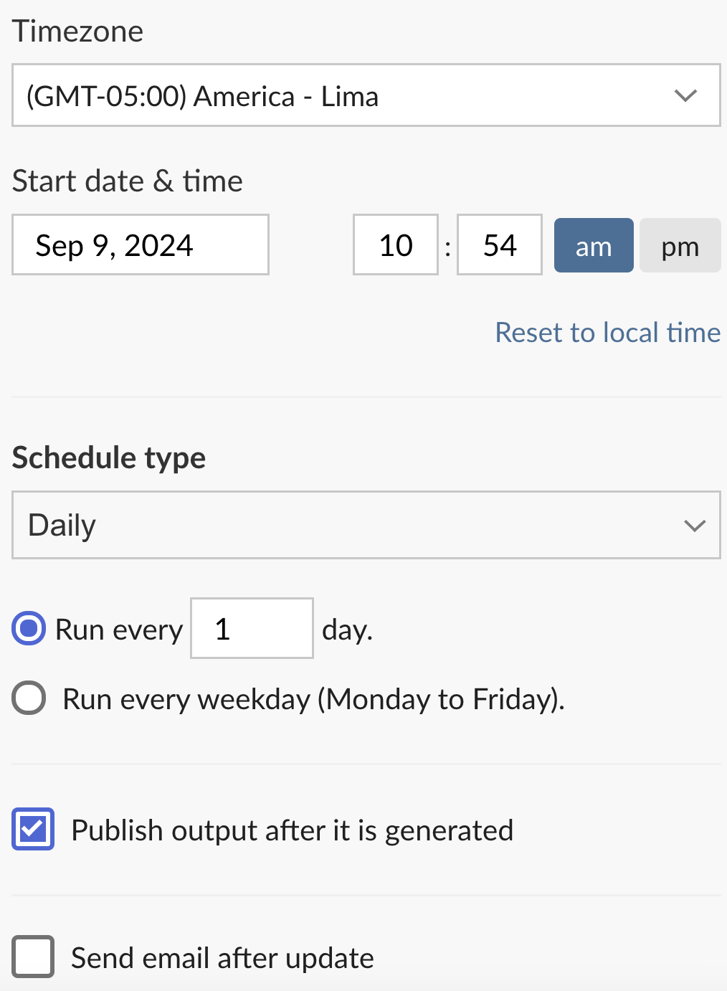



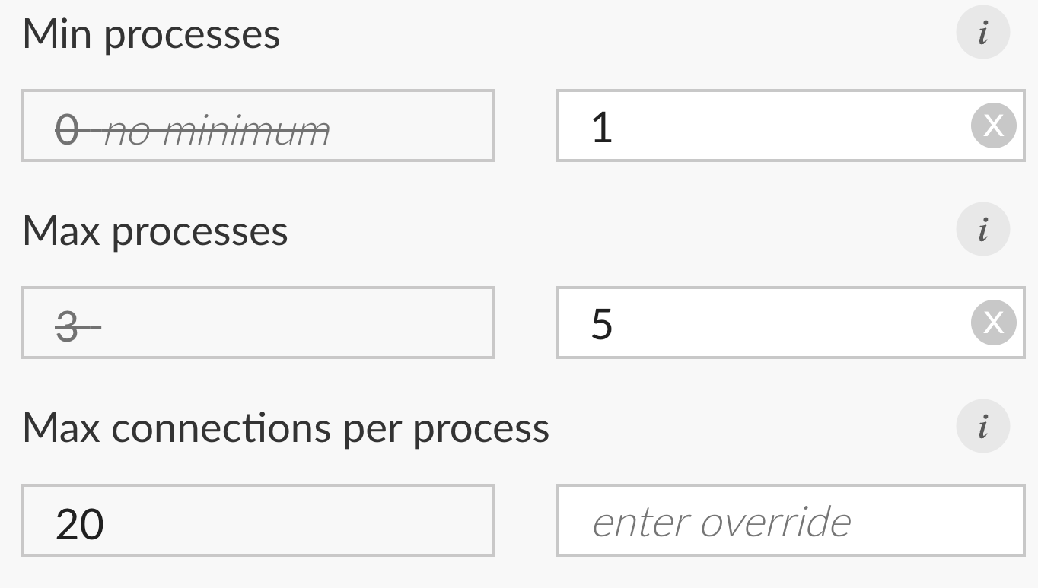
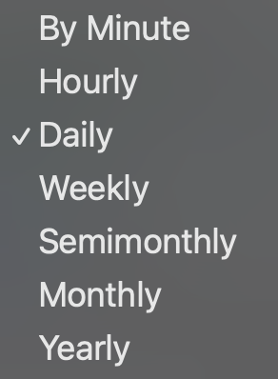
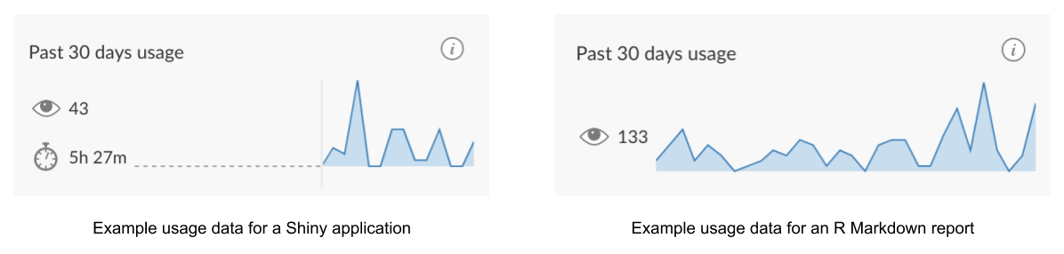






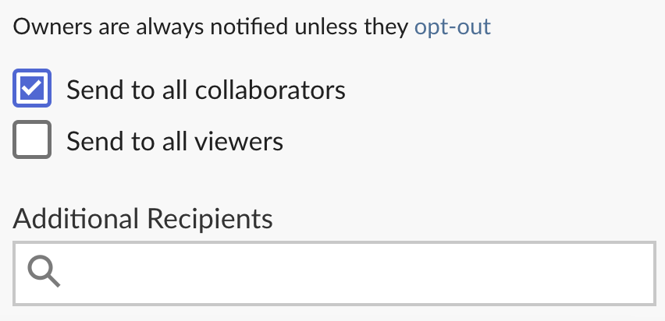
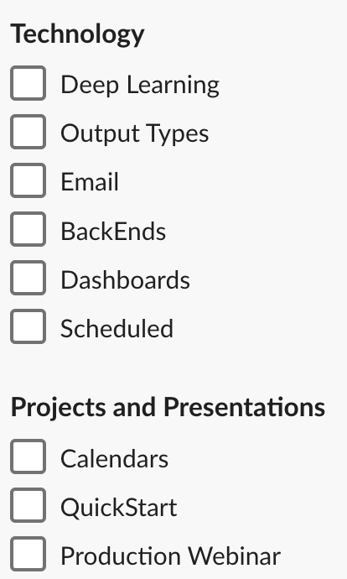

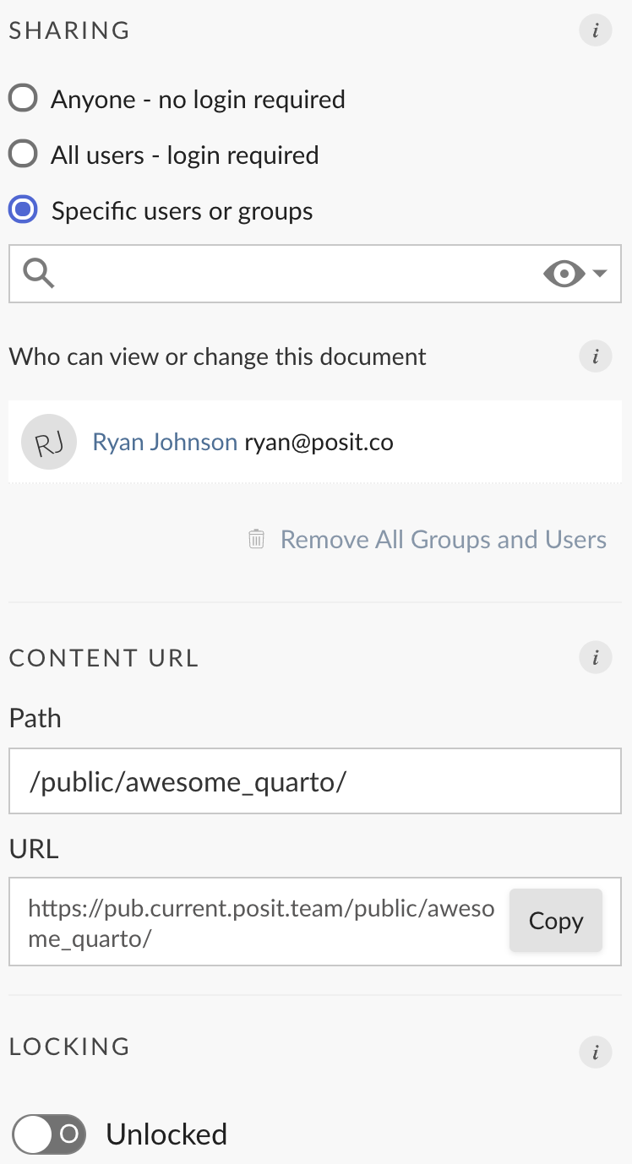
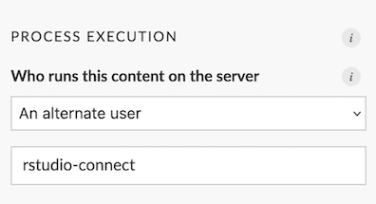
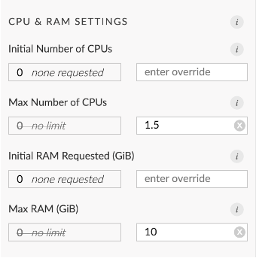
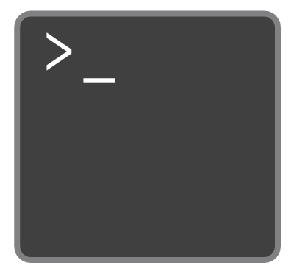


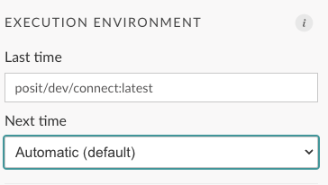
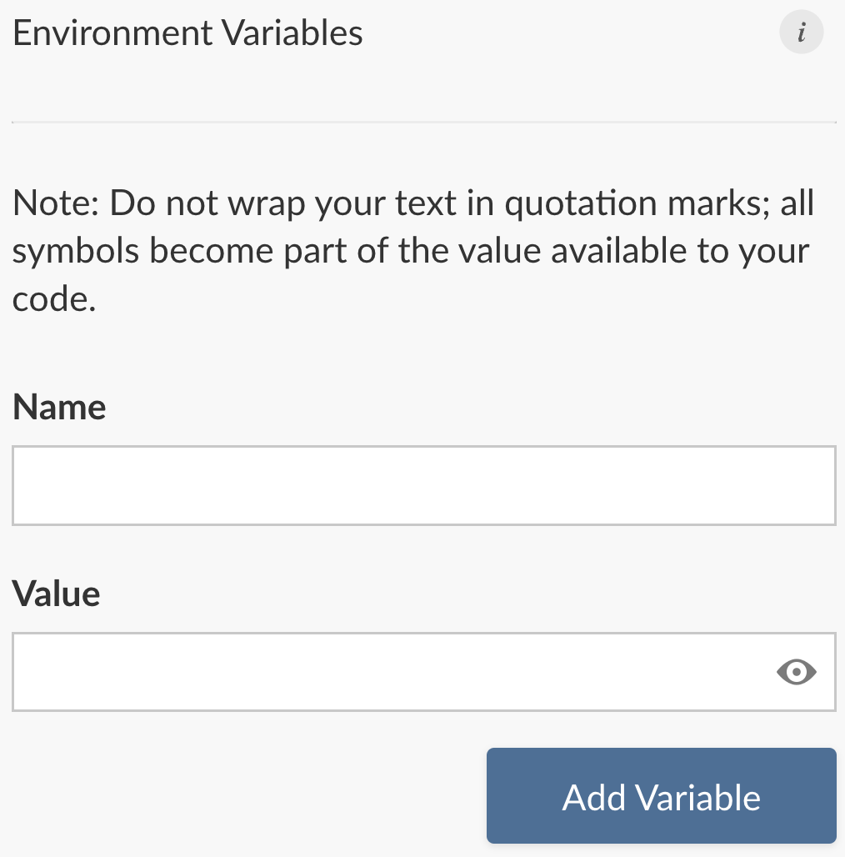

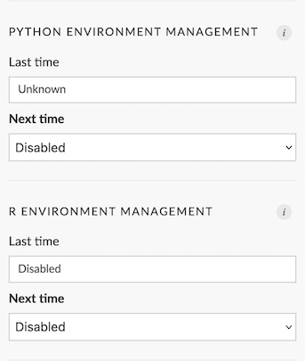

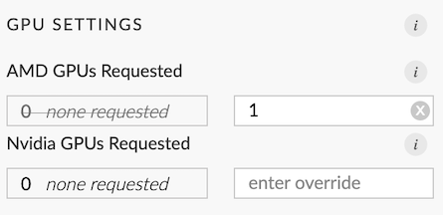



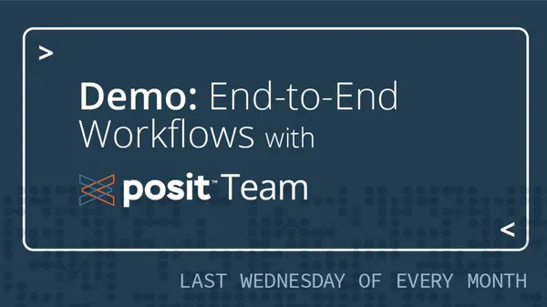
5
Publish your Content to Posit Connect
6
Share and Control your Content on Posit Connect
Supported Content Types on Posit Connect
Content controls are accessed by clicking the icon
Documents
Info and Content Metadata
Runtime Settings
Schedule and Emailing
Applications
Tune and scale applications and APIs by modifying the number of processes (e.g., Python and R sessions) and connections per process
Documents can be configured to execute on a schedule
Change content title
Content information
Add thumbnail
Usage data
Schedule type options
APIs
Pins
In this above configuration, the content can accommodate up to 100 concurrent connections (20 x 5). There will also be at least one process always running, meaning the content never goes to sleep
Email configuration options
Tip: Learn how to send custom and conditional emails: pos.it/rmd_email & pos.it/qmd_email
Used from Tableau workbooks to make real-time requests from Tableau to your Python and R code.
More usage info here:
pos.it/cookbook
Access Controls
Other Runtime Settings
Easily modify how your content runs by modifying any of the below settings. Note: some options may not be available depending on how Posit Connect is configured in your environment
Tags
Methods for Publishing to Posit Connect
Control who has access to your content
Tags make content organization, discovery, and filtering easier across the Connect dashboard
Publish content directly from R using the rsconnect R package
Publish content using the CLI within the rsconnect-python package
Environment Variables
Publish content with the click of a button using push button deployment
Share your content with a customized URL
Securely pass configuration options to your content as environment variables including API Keys and Passwords
VS Code Posit Publisher Extension
Publish directly from a git repository
Need Help? Want to learn More?
Join our monthly Posit Team Demos on the last Wednesday of every month: pos.it/team-demo
Questions about sales and licensing → sales@posit.co
Technical Issues → support@posit.co
Other questions? → info@posit.co
Posit Team docs → https://docs.posit.co
Release notes → https://docs.posit.co/release-notes.html
Open forum for any open source or Posit Team question:
https://forum.posit.co
CC BY SA Posit Software, PBC · info@posit.co · Learn more at posit.co/products/enterprise/team · HTML cheatsheets at pos.it/cheatsheets · Updated 2024-09

