Slide 1

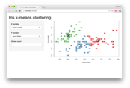















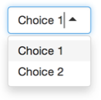

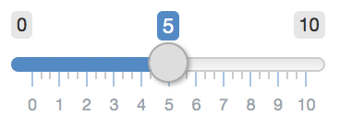
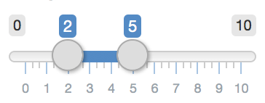


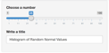

Shiny for R : : CHEATSHEET
Building an App
To generate the template, type shinyapp and press Tab in the RStudio IDE or go to File > New Project > New Directory > Shiny Application
Inputs
A Shiny app is a web page (ui) connected to a computer running a live R session (server).
# app.R
library(shiny)
ui <- fluidPage(
numericInput(inputId = "n",
"Sample size", value = 25),
plotOutput(outputId = "hist")
)
server <- function(input, output, session) {
output$hist <- renderPlot({
hist(rnorm(input$n))
})
}
shinyApp(ui = ui, server = server)
Collect values from the user.
Customize the UI with Layout Functions
Access the current value of an input object with input$<inputId>. Input values are reactive.
In ui nest R functions to build an HTML interface
Add Inputs with *Input() functions
actionButton(inputId, label, icon, width, …)
actionLink(inputId, label, icon, …)
checkboxGroupInput(inputId, label, choices, selected, inline, width, choiceNames, choiceValues)
checkboxInput(inputId, label, value, width)
dateInput(inputId, label, value, min, max, format, startview, weekstart, language, width, autoclose, datesdisabled, daysofweekdisabled)
dateRangeInput(inputId, label, start, end, min, max, format, startview, weekstart, language, separator, width, autoclose)
fileInput(inputId, label, multiple, accept, width, buttonLabel, placeholder)
numericInput(inputId, label, value, min, max, step, width)
passwordInput(inputId, label, value, width, placeholder)
radioButtons(inputId, label, choices, selected, inline, width, choiceNames, choiceValues)
selectInput(inputId, label, choices, selected, multiple, selectize, width, size) Also selectizeInput()
sliderInput(inputId, label, min, max, value, step, round, format, locale, ticks, animate, width, sep, pre, post, timeFormat, timezone, dragRange)
textInput(inputId, label, value, width, placeholder) Also textAreaInput()
Add Outputs with *Output() functions
Users can manipulate the UI, which will cause the server to update the UI’s displays (by running R code).
Tell the server how to render outputs and respond to inputs with R
Wrap code in render*() functions before saving to output
Save your template as app.R. Keep your app in a directory along with optional extra files.
Refer to UI inputs with input$<id> and outputs with output$<id>
app-name
The directory name is the app name
(optional) used in showcase mode
(optional) directory of supplemental .R files that are sourced automatically, must be named "R"
(optional) directory of files to share with web browsers (images, CSS, .js, etc.), must be named "www"
Call shinyApp() to combine ui and server into an interactive app!
app.R
DESCRIPTION
See annotated examples of Shiny apps by running runExample(<example name>). Run runExample() with no arguments for a list of example names.
README
R/
www/
Launch apps stored in a directory with runApp(<path to directory>).
Share
Outputs render*() and *Output() functions work together to add R output to the UI.
Share your app in three ways:
DT::renderDataTable(expr, options, searchDelay, callback, escape, env, quoted, outputArgs)
renderImage(expr, env, quoted, deleteFile, outputArgs)
renderPlot(expr, width, height, res, …, alt, env, quoted, execOnResize, outputArgs)
renderPrint(expr, env, quoted, width, outputArgs)
renderTable(expr, striped, hover, bordered, spacing, width, align, rownames, colnames, digits, na, …, env, quoted, outputArgs)
renderText(expr, env, quoted, outputArgs, sep)
renderUI(expr, env, quoted, outputArgs)
dataTableOutput(outputId)
imageOutput(outputId, width, height, click, dblclick, hover, brush, inline)
plotOutput(outputId, width, height, click, dblclick, hover, brush, inline)
verbatimTextOutput(outputId, placeholder)
tableOutput(outputId)
textOutput(outputId, container, inline)
uiOutput(outputId, inline, container, …) htmlOutput(outputId, inline, container, …)
Host it on shinyapps.io, a cloud based
service from Posit. To deploy Shiny apps:
Create a free or professiona
account at shinyapps.io
Click the Publish icon in RStudio IDE, or run:
rsconnect::deployApp("<path to directory>")
Purchase Posit Connect, a publishing platform for R and Python.
posit.co/products/enterprise/connect/
Build your own Shiny Server
posit.co/products/open-source/shinyserver/
These are the core output types. See htmlwidgets.org for many more options.
CC BY SA Posit Software, PBC • info@posit.co • posit.co • Learn more at shiny.posit.co • HTML cheatsheets at pos.it/cheatsheets • shiny 1.8.1.1 • Updated: 2024-05

Slide 2

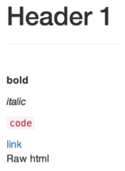
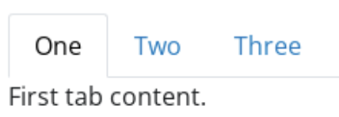
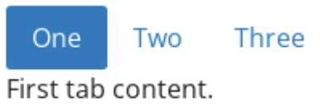
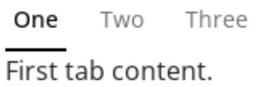

Reactivity
UI - An app’s UI is an HTML document.
Layouts
Reactive values work together with reactive functions. Call a reactive value from within the arguments of one of these functions to avoid the error Operation not allowed without an active reactive context.
Use Shiny’s functions to assemble this HTML with R.
Use the bslib package to lay out the your app and its components.
fluidPage(
textInput("a","")
)
## <div class="container-fluid">
## <div class="form-group shiny-input-container">
## <label for="a"></label>
## <input id="a" type="text"
## class="form-control" value=""/>
## </div>
## </div>
Returns
HTML
PAGE LAYOUTS
Dashboard layouts
page_sidebar() A sidebar page
page_navbar() Multi-page app with a top navigation bar
page_fillable() A screen-filling page layout
Add static HTML elements with tags, a list of functions that parallel common HTML tags, e.g. tags$a(). Unnamed arguments will be passed into the tag; named arguments will become tag attributes.
Basic layouts
page() page_fluid() page_fixed()
USER INTERFACE LAYOUTS
Run names(tags) for a complete list. tags$h1("Header") -> <h1>Header</h1>
Multiple columns
The most common tags have wrapper functions. You do not need to prefix their names with tags$
layout_columns() Organize UI elements into
Bootstrap’s 12-column CSS grid
layout_column_wrap() Organize elements into a grid
of equal-width columns
CREATE YOUR OWN REACTIVE VALUES
RENDER REACTIVE OUTPUT
render*() functions
ui <- fluidPage(
h1("Header 1"),
hr(),
br(),
p(strong("bold")),
p(em("italic")),
p(code("code")),
a(href="", "link"),
HTML("<p>Raw html</p>")
)
# *Input() example
ui <- fluidPage(
textInput("a","","A")
)
*Input() functions
Each input function creates a reactive value stored as input$<inputId>.
ui <- fluidPage(
textInput("a","","A"),
textOutput("b")
)
server <- function(input,output){
output$b <-
renderText({
input$a
})
}
shinyApp(ui, server)
Builds an object to display. Will rerun code in body to rebuild the object whenever a reactive value in the code changes.
Save the results to
output$<outputId>.
Multiple panels
#reactiveVal example
server <- function(input,output){
rv <- reactiveVal()
rv$number <- 5
}
reactiveVal(…)
Creates a single reactive values object.
reactiveValues(…)
Creates a list of names reactive values.
navset_tab()
navset_pill()
PERFORM SIDE EFFECTS
To include a CSS file, use includeCSS(), or
Place the file in the www subdirectory
Link to it with:
ui <- fluidPage(
textInput("a","","A"),
actionButton("go","Go")
)
server <- function(input,output){
observeEvent(
input$go,{
print(input$a)
}
)
}
shinyApp(ui, server)
observe(x, env)
navset_underline()
CREATE REACTIVE EXPRESSIONS
reactive(x, env, quoted, label, domain)
Creates an observer from the given expression.
tags$head(tags$link(rel = "stylesheet",
type = "text/css", href = "<file name>"))
ui <- fluidPage(
textInput("a","","A"),
textInput("z","","Z"),
textOutput("b"))
server <- function(input,output){
re <- reactive({
paste(input$a,input$z)
})
output$b <- renderText({
re()
})
}
shinyApp(ui, server)
nav_panel() Content to display when given item is selected
nav_menu() Create a menu of nav items
nav_item() Place arbitrary content in the nav panel
nav_spacer() Add spacing between nav items
Reactive expressions:
cache their value to reduce computation
can be called elsewhere
notify dependencies when invalidated
Call the expression with function syntax, e.g. re().
observeEvent(eventExpr, handlerExpr, event.env, event.quoted, handler.env, handler.quoted, ..., label, suspended, priority, domain, autoDestroy, ignoreNULL, ignoreInit, once)
To include JavaScript, use includeScript() or
Place the file in the www subdirectory
Link to it with:
tags$head(tags$script(src = "<file name>"))
Also dynamically update nav containers with nav_select(),
nav_insert(), nav_remove(), nav_show(), nav_hide().
Runs code in 2nd argument when reactive values in 1st argument change.
IMAGES
To include an image:
Place the file in the www subdirectory
Link to it with img(src="<file name>")
Sidebar layout
REACT BASED ON EVENT
sidebar() layout_sidebar() toggle_sidebar()
ui <- fluidPage(
textInput("a","","A"),
actionButton("go","Go"),
textOutput("b")
)
server <- function(input,output){
re <- eventReactive(
input$go,{input$a}
)
output$b <- renderText({
re()
})
}
shinyApp(ui, server)
eventReactive(eventExpr, valueExpr, event.env, event.quoted, value.env, value.quoted, ..., label, domain, ignoreNULL, ignoreInit)
REMOVE REACTIVITY
Themes
ui <- fluidPage(
textInput("a","","A"),
textOutput("b")
)
server <- function(input,output){
output$b <-
renderText({
isolate({input$a})
})
}
shinyApp(ui, server)
isolate(expr)
Use the bslib package to add existing themes to your Shiny app ui, or make your own.
Build your own theme by customizing individual arguments. bs_theme(bg = "#558AC5", fg = "#F9B02D", ...)
?bs_theme for a full list of arguments.
bs_themer() Place within the server function to use the interactive theming widget.
Runs a code block. Returns a non-reactive copy of the results.
library(bslib)
ui <- fluidPage(
theme = bs_theme(
bootswatch = "darkly",
...
)
)
Creates reactive expression with code in 2nd argument that only invalidates when reactive values in 1st argument change.
bootswatch_themes() Get a list of themes.
CC BY SA Posit Software, PBC • info@posit.co • posit.co • Learn more at shiny.posit.co • HTML cheatsheets at pos.it/cheatsheets • shiny 1.8.1.1 • Updated: 2024-05

