Slide 1



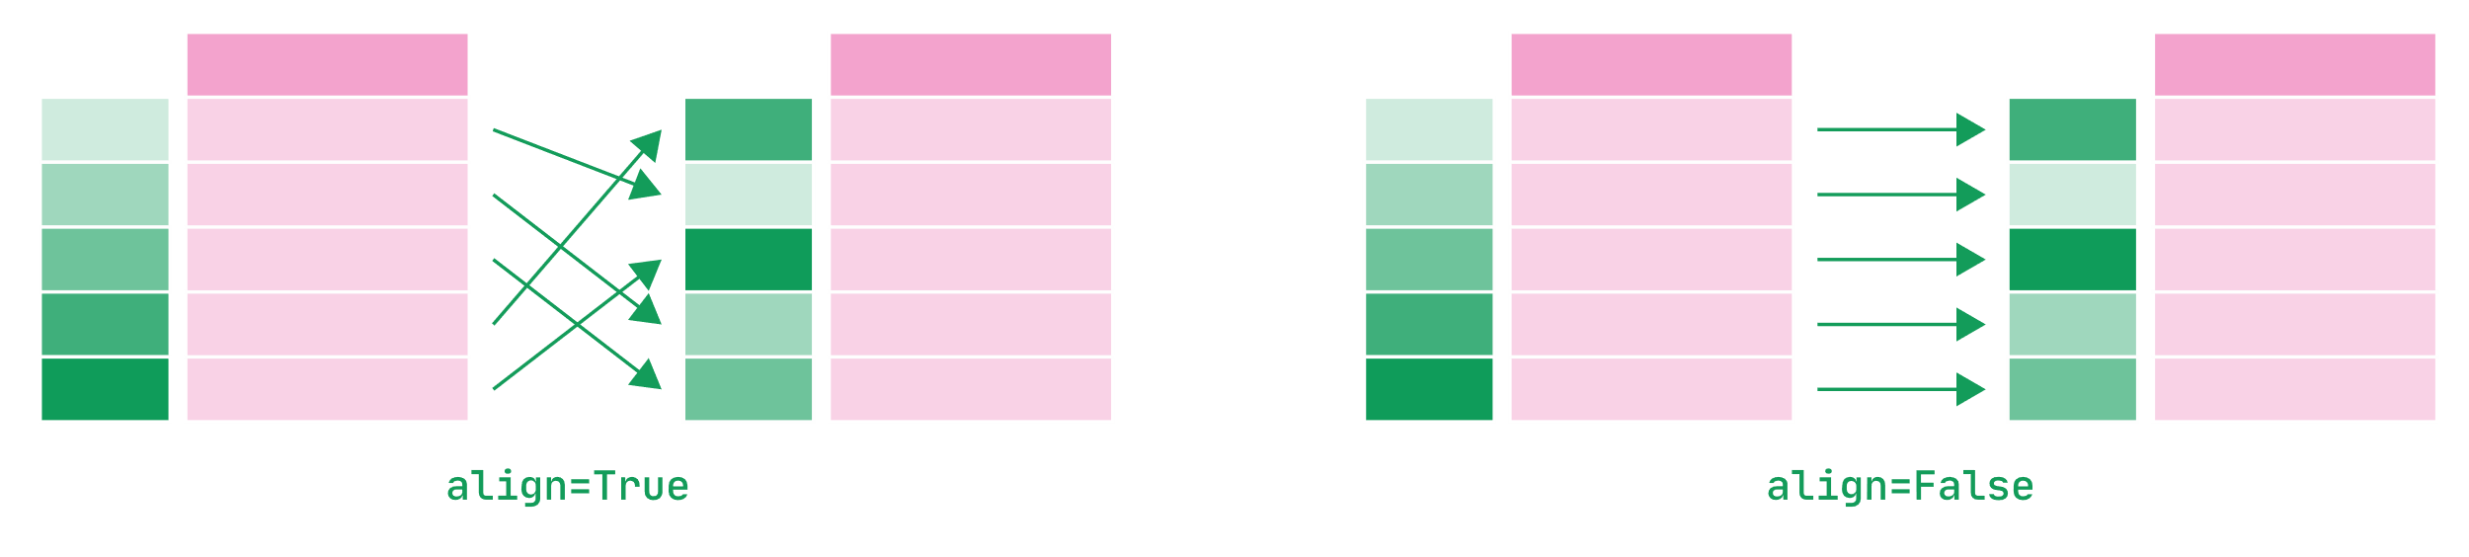
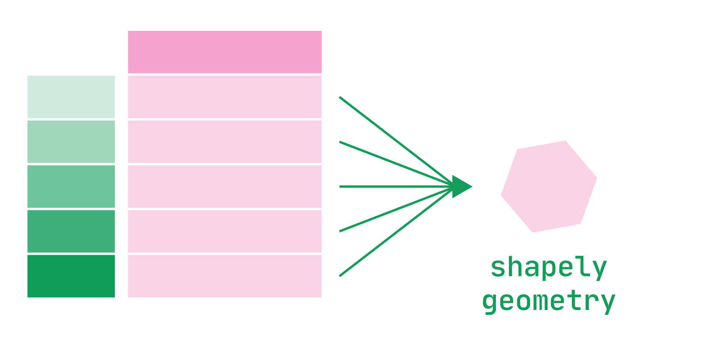
GeoPandas : : CHEAT SHEET
Geometric Confirmation
Geometric Operations
Geometric Creation (shapely)
From shapely.ops import triangulate, voronoi_diagram
From shapely.geometry import Point, MultiPoint, LineString, MultiLineString, MultiPolygon
gs = geopandas.GeoSeries()
From shapely.ops import linemerge, polygonize
gs.contains(other, align=True) Returns a Series of dytpe(‘bool’) with value True for each aligned geometry that contains other.
gs.covered_by(other, align=True) Returns a Series of dytpe(‘bool’) with value True for each aligned geometry that is entirely covered by other.
gs.covers(other, align=True) Returns a Series of dytpe(‘bool’) with value True for each aligned geometry that is entirely covering other.
gs.crosses(other, align=True) Returns a Series of dytpe(‘bool’) with value True for each aligned geometry that crosses other.
gs.disjoint(other, align=True) Returns a Series of dytpe(‘bool’) with value True for each aligned geometry disjoint to other.
gs.geom_equals(other, align=True) Returns a Series of dytpe(‘bool’) with value True for each aligned geometry is approximately equal to other.
gs.intersects(other, align=True) Returns a Series of dytpe(‘bool’) with value True for each aligned geometry that intersects other.
gs.touches(other, align=True) Returns a Series of dytpe(‘bool’) with value True for each aligned geometry that touches other.
gs.within(other, align=True) Returns a Series of dytpe(‘bool’) with value True for each aligned geometry that is within other.
gs.boundary Returns a GeoSeries of lower dimensional objects representing each geometry’s set-theoretic boundary.
gs.buffer(distance, resolution=16) Returns a GeoSeries of geometries representing all points within a given distance of each geometric object.
gs.centroid Returns a GeoSeries of points representing the centroid of each geometry.
gs.convex_hull() Returns a GeoSeries of geometries representing the convex hull of each geometry.
linemerge(lines) Returns a LineString or MultiLineString representing the merger of all contiguous elements of lines.
gs.representative_point() Returns a GeoSeries of (cheaply computed) points that are guaranteed to be within each geometry.
polygonize(lines) Returns an iterator over polygons constructed from the input lines.
gs.simplify(*args, **kwargs) Returns a GeoSeries containing a simplified representation of each geometry.
triangulate(geom, tolerance=0.0, edges=False) Returns a Delaunay triangulation of the vertices of geom.
voronoi_diagram(geom, envelope=None) Constructs a Voronoi diagram from the vertices of geom.
Point(coordinates) Creates a Point object from coordinate values or point tuple parameters.
MultiPoint(points) Creates a MultiPoint object from a list of point tuples: points.
LineString(coordinates) Creates a LineString object from an ordered list of 2 or more point tuples: coordinates.
MultiLineString(lines) Creates a MultiLineString object from a sequence of line-like sequences or objects.
Polygon(shell, holes=None) Creates a Polygon object from an ordered sequence of point tuples.
MultiPolygon(polygons) Creates a MultiPolygon object from an unordered sequence of Polygon instances.
Contains information licensed under the Open Government Licence – Toronto
CC BY SA Drew Seewald • https://github.com/atseewal/ • Learn more at https://geopandas.org/en/stable/ • geopandas version 0.12.2 • shapely version 2.0.0 • Updated: 2023-01

Slide 2
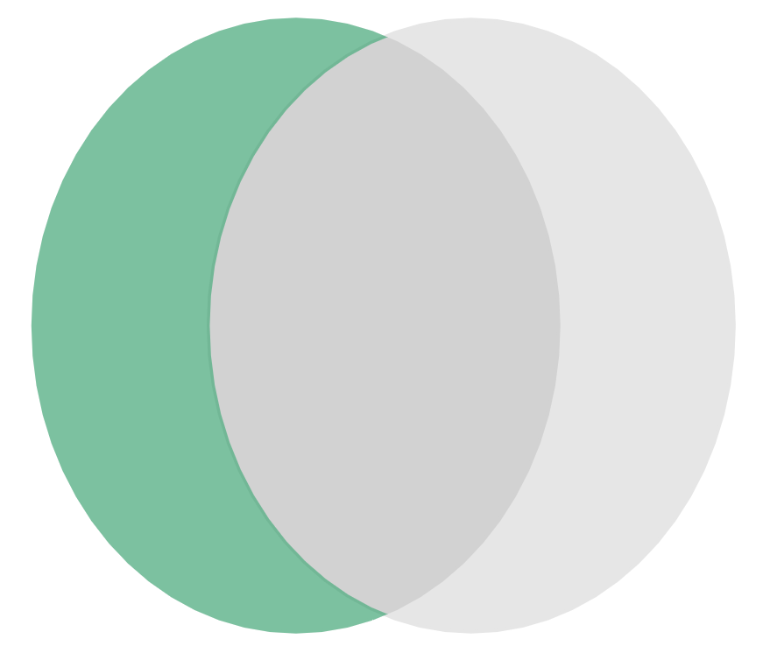
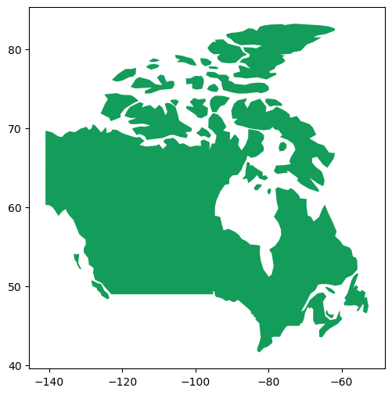
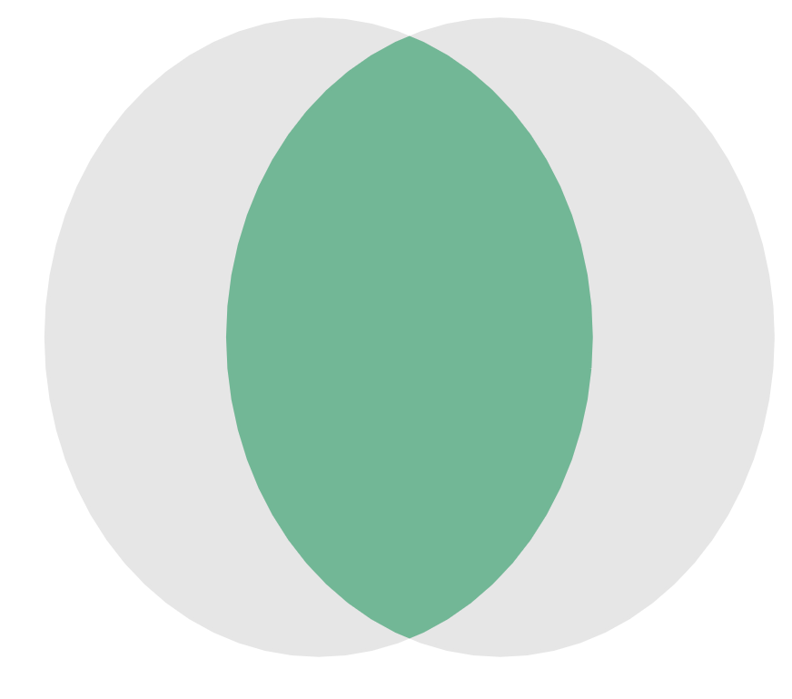
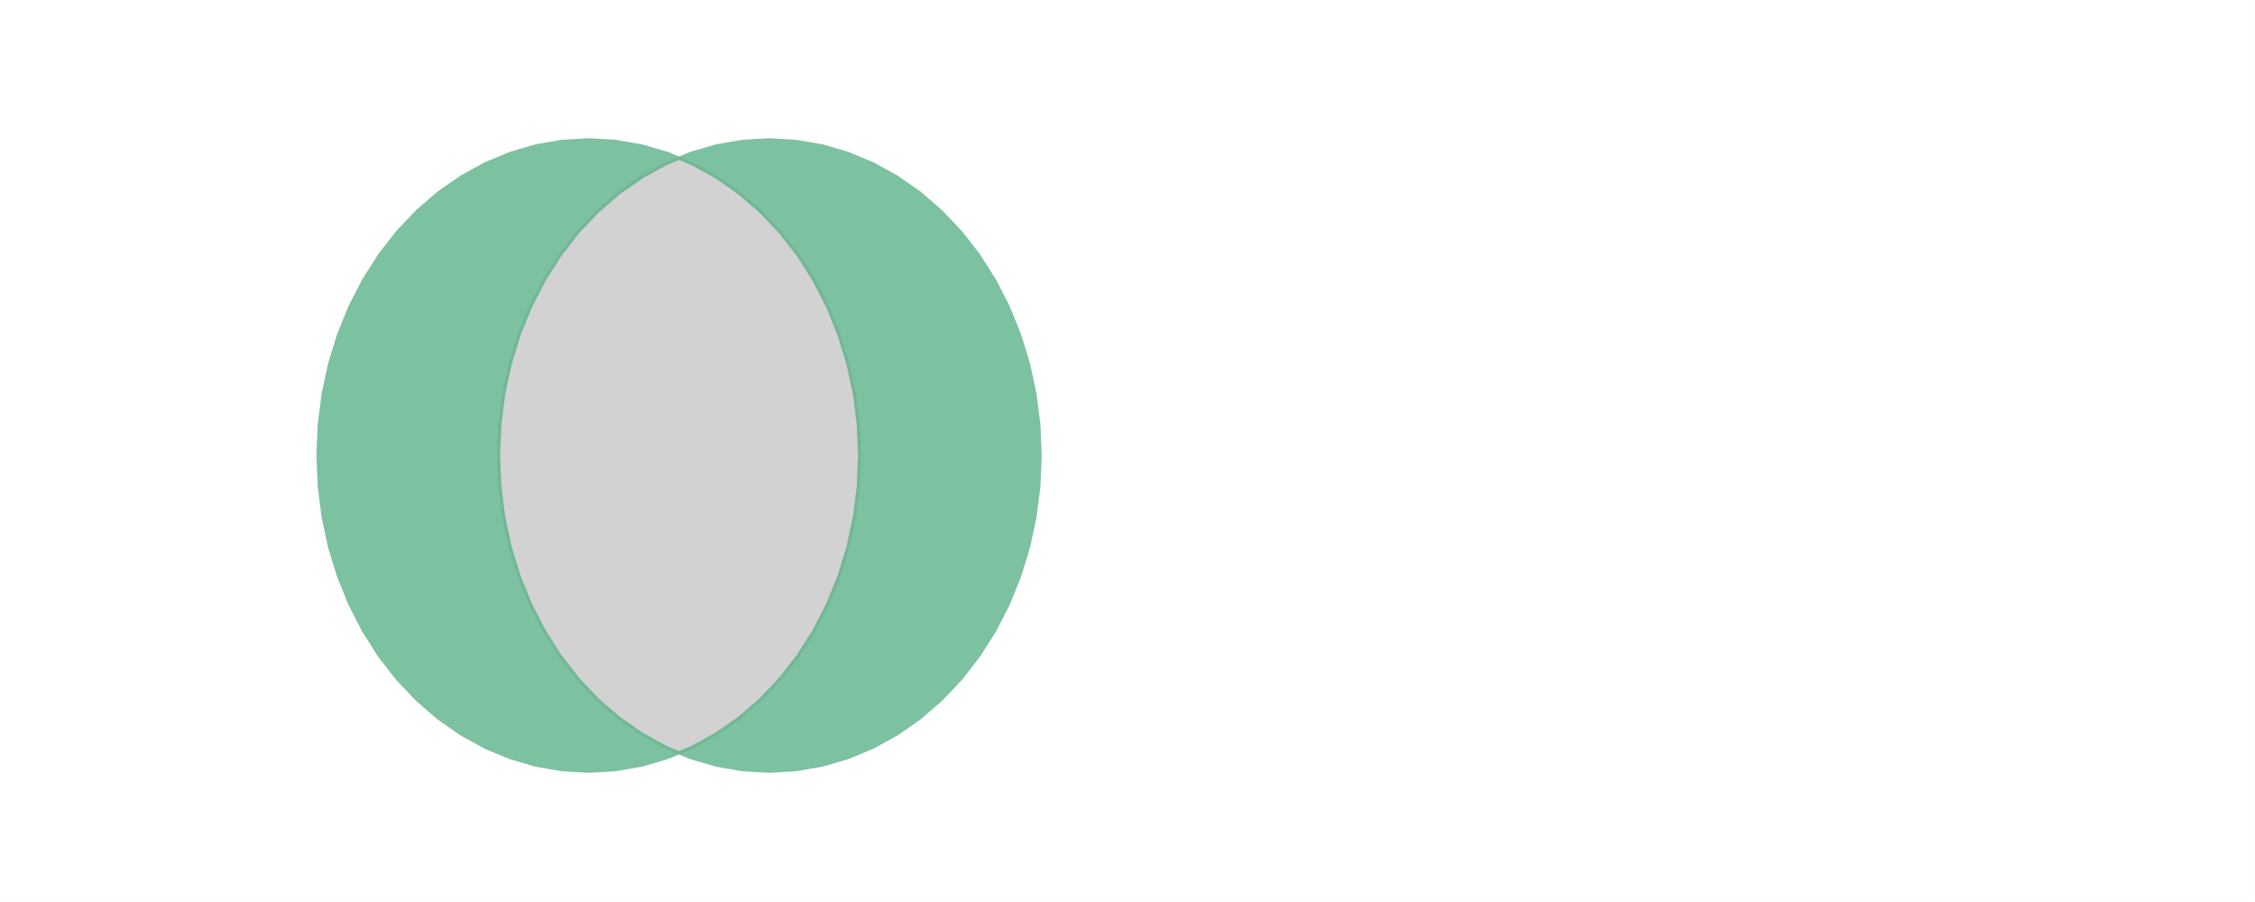

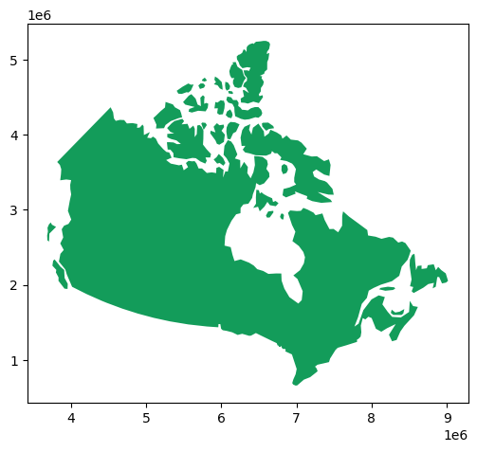
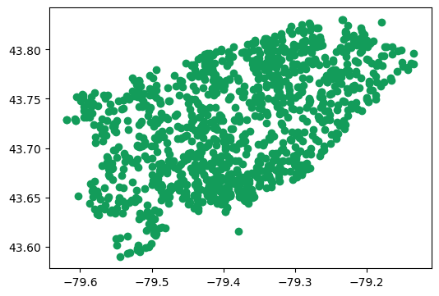
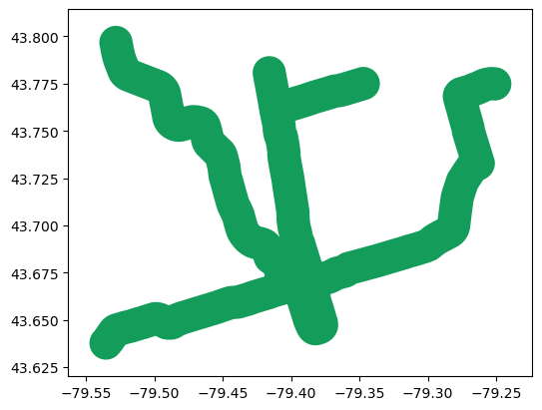
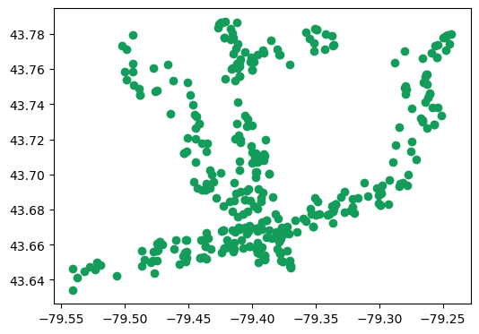
GeoPandas : : CHEAT SHEET
Geometry Operations
Misc. Operations
CRS Examples
gs = geopandas.GeoSeries()
from shapely.ops import snap
import geopandas as gpd
canada = gpd.read_file(“canada.shp”)
print(canada.crs)
# epsg:4326
canada.plot()
gs.difference(other, align=True) Returns a GeoSeries of the points in each aligned geometry that are not in other.
gs.intersection(other, align=True) Returns a GeoSeries of the intersection of points in each aligned geometry with other.
gs.symmetric_difference(other, align=True) Returns a GeoSeries of the symmetric difference of points in each aligned geometry with other.
gs.union(other, align=True) Returns a GeoSeries of the union of points in each aligned geometry with other.
snap(geom1, geom2, tolerance) Snaps vertices in geom1 to vertices in geom2, returning a copy. Input geometries are not modified.
gpd.GeoDataFrame(data=None, *args, geometry=None, crs=None, **kwargs) Creates a GeoDataFrame object from a pandas.DataFrame like object.
gs.astype(dtype, …) Cast a pandas object to a specified dtype dtype.
gs.crs The Coordinate Reference System (CRS) represented as a pyproj.CRS object.
GeoDataFrame.sjoin(gdf, how=‘inner’, …) gpd.sjoin(left_df, right_df, how=‘inner’, …) Spatial join of two GeoDataFrames.
gs.sindex.nearest(geometry, return_all=True) Return the nearest geometry in the tree for each input geometry in geometry.
gpd.read_file(filename, bbox=None, mask=None, rows=None) Returns a GeoDataFrame from a file or URL.
gs.to_crs(crs=None) Returns a GeoSeries with all geometries transformed to a new coordinate reference system.
Geometric Measurement
gs.area Returns a Series containing the area of each geometry in the GeoSeries expressed in the units of the CRS.
gs.distance(other, align=True) Returns a Series containing the distance to each aligned geometry in other.
gs.length Returns a Series containing the length of each geometry expressed in the units of the CRS.
canada.to_crs("3347").plot()
subway_mask = subway.to_crs(“3347”) \
.buffer(1000).to_crs(“4326”)
subway_mask.plot()
schools \
.intersection(subway_mask.unary_union) \
.plot()
schools.plot()
Contains information licensed under the Open Government Licence – Toronto
CC BY SA Drew Seewald • https://github.com/atseewal/ • Learn more at https://geopandas.org/en/stable/ • geopandas version 0.12.2 • shapely version 2.0.0 • Updated: 2023-01

