Slide 1
ECE 721 — Value Prediction Project
32KB Hybrid Out-of-Order
Value Predictor
1.66
Baseline IPC
2.054
SVP + VTAGE Hybrid Architecture
Our IPC
~24% gain
By: Aadesh Shah and Khang Pham
31.97
Budget Used
KB / 32 KB

Slide 2
Architecture Overview
Stride Value Predictor (SVP)
VTAGE — Tagged History Predictor
Role: Base Predictor
Role: Context-Aware Overlay
The SVP is the mathematical backbone of the predictor. It is indexed by PC. It tracks the stride between consecutive values produced by each instruction and predicts the next value as:
next = retired_value + (in-flight count × stride)
It excels on simple, predictable patterns: loop counters, constants, and sequential memory accesses. When an instruction's stride is consistent for many consecutive occurrences, SVP reaches maximum confidence and can fire with very high accuracy.
VTAGE is a tagged, multi-table predictor indexed by the global branch history. It maintains multiple tables with geometrically increasing history lengths, so short loops, medium function calls, and long execution paths each get a dedicated context window.
Each entry stores a predicted value, a confidence counter, and a usefulness bit. An entry only fires when it has proven itself through many consecutive correct predictions. This serves as a high confidence bar that filters noise.
VPQ
Best for:
Loop counters · Constants · Stride memory
Best for:
Complex control flow · Irregular value sequences
Limitation:
Cannot capture irregular, context-dependent patterns
Limitation:
Needs many correct observations to build confidence
Notes:
"At its core, our design merges two completely different prediction philosophies. On the left, we have the Stride Value Predictor, or SVP. It's a mathematical backbone. It's highly accurate on predictable patterns like loop counters, but because it only looks at the PC, it is completely blind to context.
To solve that, we overlaid VTAGE. VTAGE is a tagged, multi-table predictor indexed by the global branch history. It provides the context the SVP lacks. By sweeping through geometrically increasing history lengths, VTAGE can learn complex, chaotic control-flow paths. The entire architectural challenge of this project was getting these two systems to complement each other within a strict 32-kilobyte budget."

Slide 3
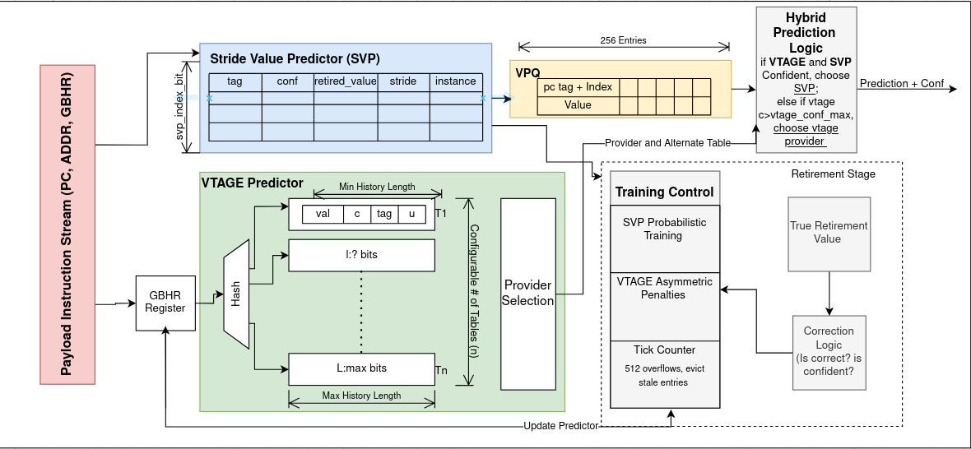
Block Diagram Architecture
Notes:
"This slide illustrates the high-level block diagram and the critical flow of data through our hybrid value predictor.
The process begins with a Concurrent Lookup: every instruction simultaneously queries the Stride Value Predictor, or SVP, and the multiple VTAGE tables.1
We then enter the Provider Selection phase: the longest-matching VTAGE table is selected as the primary 'Provider,' and the second longest becomes the 'Alternate,' which is used later for training decisions.1
Our Fallback Hierarchy means that if VTAGE provides no match, SVP acts as the backup prediction. If SVP also misses, no prediction is attempted for that slot.1
Finally, the prediction is placed into the Value Prediction Queue (VPQ). Here, we capture a snapshot of the global branch history, the Program Counter tag, and all prediction metadata from both the provider and the alternate. This concurrent approach ensures that we get the best prediction—whether from the deterministic SVP or the contextual VTAGE—for every single

Slide 4
Predictor Lifecycle: Prediction & Training Logic
The Prediction Phase
The Training Phase
CONCURRENT LOOKUP & SNAPSHOT
Simultaneous query of SVP (Stride) and multiple VTAGE (History) tables for every instruction.
Provider Selection: Longest-matching VTAGE table is the provider (primary prediction). Second longest becomes the alternate (used for training decisions).
Fallback Hierarchy: If no provider/alternate is found, SVP becomes backup. If SVP also misses, no prediction is attempted for that slot.
Hybrid Policy: Prediction priority deviates from traditional hierarchy when SVP is confident. SVP overrides VTAGE only when VTAGE is not yet fully confident (detailed on later slide). SVP becomes alternate.
State Capture: The VPQ captures a snapshot of the global branch history, PC tag/index, and all prediction metadata, including provider/alternate details.
POST-RETIREMENT ANALYSIS
Only applicable if instruction hit in SVP/VTAGE.
At retirement, the actual value is compared against what was predicted.
SVP Update: SVP updates its stride and confidence based on whether the stride was repeated.
Stochastic Training: Confidence updates are probabilistic and instruction-type-aware (e.g., Loads/FP train faster than ALU).
Asymmetric Penalty: Mispredicted ALU instructions are fully reset; Memory/FP operations receive only a soft dock penalty.
Usefulness Economics: VTAGE evaluates the usefulness of a prediction. A provider’s useful counter increments or decrements only if there is a disagreement between provider and alternate.
Notes:
"Moving to the lifecycle, let's look at how we predict and train. For every instruction, we query both the SVP and the VTAGE tables concurrently. Inside VTAGE, the longest matching history table becomes our 'Provider', and the second-longest becomes the 'Alternate'. If both of those miss, the base SVP acts as our ultimate fallback.
The real engineering happens post-retirement during the Training phase. We don't just blindly increment confidence. We implemented instruction-type-aware stochastic training—meaning Loads and Floating Point operations train twice as fast as generic ALUs. Furthermore, we use the Provider and Alternate predictions to grade usefulness. A VTAGE entry only gains 'usefulness' if it was uniquely correct compared to its alternate, which proves it actually learned a valuable pattern."

Slide 5
Predictor Lifecycle: Allocation & Rollback
Predictor Allocation Logic
Rollback & Recovery Process
WHEN DOES AN ENTRY ALLOCATE?
If SVP misses and no confident VTAGE provider exists.
When VTAGE misses/mispredicts, it climbs to a longer history table. Shorter history tables have a larger chance of ‘winning’.
Allocation Veto: New VTAGE entries are blocked from allocating if the Stride Predictor (Alternate) was correct.
RULES & CAPACITY PROTECTION
Instruction-Type Priority: Loads and FP operations always allocate; Generic ALU is throttled 1-in-16 to preserve capacity.
Useful Bits: Won't overwrite entries with high "useful" bits.
TICK Counter: Periodically decays bits to evict stale entries. Max is 512 and it relieves pressure after allocation, otherwise, it adds pressure by number of unsuccessful allocation tables.
Safe Start: New entries begin at half-confidence to filter noise.
THE RECOVERY SEQUENCE
Triggered when a high-confidence prediction is found incorrect.
FULL SQUASH:
VPQ Wipe: Head pointer/phase = Tail Pointer/phase
Instance Clear: SVP instance counters are erased
Architectural GBHR: Global GBHR is restored to architectural GBHR which is only modified after retired instructions.
Partial Rollback
VPQ Rewind: Current tail pointer is returned to checkpointed tail pointer/phase. SVP instance is decremented for each VPQ entry rewinded.
State Correction: Restore Global GBHR to the checkpointed GBHR stored with conflicting instruction.
Notes:
"Allocation is where we aggressively protect our hardware capacity. VTAGE only attempts to allocate a new entry if it missed or mispredicted. But we put strict gates on this. We throttle ALU allocations to 1-in-16, and we use a global TICK counter to periodically decay usefulness bits, forcing stale entries to evict.
But our strongest gate is the Allocation Veto. If VTAGE misses, but our SVP base was correct, the SVP hard-vetoes the VTAGE allocation entirely to prevent redundancy.
Finally, if a confident prediction turns out to be wrong, we trigger a rollback. Depending on the severity, this ranges from a partial VPQ rewind to a full pipeline squash where we clear the SVP instances and restore the architectural branch history register to prevent future pollution."

Slide 6
Hybrid Prediction Policies
The key architectural question: when SVP and VTAGE both have a prediction, which one fires?
SVP Supremacy
Modified SVP Supremacy
How it works
How it works
When SVP reaches maximum confidence, it overrides VTAGE entirely — regardless of VTAGE's confidence level. SVP is treated as the ground truth for stride-predictable instructions. SVP is listed as alternate for potential allocation blocking.
SVP overrides VTAGE only when VTAGE has NOT yet reached its maximum confidence. Once VTAGE achieves full confidence (63 correct predictions), it wins — its deeply proven pattern takes priority over SVP. SVP can again block allocation regardless of if it wins.
Why it makes sense
Why it makes sense
SVP's mathematical model is deterministic and highly accurate on simple patterns. Letting it take precedence prevents VTAGE from corrupting clean stride predictions.
A VTAGE entry at conf_max=63 has survived 63+ correct predictions under varying history conditions. This is a stronger proof of correctness than SVP's simpler stride match, especially for complex instructions. Furthermore, VTAGE has a more contextual prediction based on the GBHR.
Trade-off
Trade-off
VTAGE entries that have spent 63 correct predictions proving themselves can still be overridden by SVP, wasting that learned state.
Slightly more confident mispredictions from VTAGE on chaotic workloads, mitigated by the high confidence bar and asymmetric penalty.
Notes:
Regarding the hybrid policy we discussed earlier, we use the modified SVP supremacy policy. This means that whenever SVP is confident we use it’s prediction unless VTAGE is also confident. We also tested SVP Supermacy where SVP always overrides VTAGE but it was less effective. Regardless, for both policies we list SVP as alternate for allocation blocking

Slide 7
Inspiration from Literature — What We Borrowed & What We Changed
Borrowed from Literature
Our Divergences & Innovations
Configuration Innovations
Stochastic Confidence Training:
Confidence increases randomly after correct predictions (Loads/FP 1-in-2, ALU 1-in-8), requiring proof of long-term stability.
TAGE "Useful-Bit" Economics
Entries only gain/lose "usefulness" if uniquely correct/incorrect, preserving valuable data (from TAGE paper).
Instruction-Type-Aware Allocation
Priority allocation for Loads/FP; generic ALU heavily throttled.
TICK-Based Usefulness Decay
Global counter periodically decrements usefulness bits to evict stale entries.
Geometric History Lengths
History lengths across tables use geometric interpolation between min and max (a TAGE technique for pattern coverage efficiency).
VTAGE Supremacy Over Base
If one predictor is confident, it predicts. If both are confident, VTAGE takes priority over SVP, favoring history-based proof over stride math.
No Last Value Predictor
Typical last value predictor replaced as VTAGE base with the more influential SVP.
Provider/Alternate Architecture
When VTAGE hits, the longest history is the provider; the alternate is a shorter VTAGE match or base SVP. Innovation: If SVP is the correct alternate, it hard-vetoes VTAGE allocation, preventing redundancy.
Anti-Aliasing SVP Shield
If VTAGE correctly predicts a PC at max confidence upon retirement, it blocks new PCs from evicting established SVP entries.
Conditional-Branch-Only History
Global branch history register (GBHR) shifts only on conditional branches, using taken/not-taken outcomes; unconditional branches and non-branches are excluded.
Asymmetric Penalty by Instruction Type
Mispredicted ALU instructions reset to zero. Memory/FP receive a soft fractional penalty because their patterns tend to reappear.
Decoupled Confidence Ceilings
SVP predicts quickly (max 47). VTAGE requires more validation (max 63) before overriding, suppressing noise.
5-Table History Sweep (3–54 branches)
Five tables geometrically sweep history lengths from 3 to 54 branches, optimized for short loops to longer cross-function patterns within the 32KB budget.
32KB Capacity Allocation
SVP uses 19kb for stride prediction. Five VTAGE tables use the remaining 13kb or complex history.
VPQ Capacity Optimization
The Value Prediction Queue (VPQ) is locked at 256 entries. Increasing to 300 entries showed minimal IPC gains, so capacity was capped and reallocated to VTAGE tables.
Notes:
"This slide breaks down exactly what we borrowed from Seznec's literature, and how we diverged to get our IPC gains. The blue column covers our foundational baseline: things like TAGE's geometric history lengths and stochastic training.
Our true architectural contributions are in the green and yellow columns. The biggest departure from standard value prediction was porting over TAGE's branch-prediction Alternate logic. We turned the Alternate into a weapon—our Anti-Aliasing SVP Shield blocks VTAGE from evicting established SVP entries, and our Veto prevents redundant allocations.
In the yellow column, you can see our empirical hardware tuning. We capped our Value Prediction Queue at 256 entries to save capacity, and we heavily decoupled our confidence ceilings—forcing VTAGE to hit 63 confident predictions before firing—to perfectly filter out chaotic noise."

Slide 8
Championship Configuration
--vp-vtage=256,10,10,47,5,3,54,63,8,11,1
VPQ Size
256
256 in-flight prediction slots
Max History
54
Longest history: captures function-level context
SVP Index Bits
10
1,024 SVP table entries
VTAGE Conf Max
63
High confidence bar — entries must prove themselves 63+ times
SVP Tag Bits
10
Tag precision for SVP lookup
VTAGE Index Bits
8
256 entries per VTAGE table
SVP Conf Max
47
SVP fires sooner — helps structured workloads like perlbench & h264ref
VTAGE Tag Bits
11
Precise tag matching — reduces aliasing
VTAGE Tables (N)
5
Five tables with geometrically spaced history lengths
e_mode
ON
Instruction-type-aware training rates enabled
Min History
3
Shortest history: captures innermost loops
Storage Budget: SVP = 19.07 KB | VTAGE = 12.97 KB | TOTAL = 31.97 KB ✓ Under 32 KB
Notes:
p.
SVP Conf Max (47): We set the Stride Value Predictor's maximum confidence at 47. This allows the SVP to fire sooner, which is crucial for structured workloads like perlbench and h264ref where simple stride patterns are highly accurate.
VTAGE Configuration: For the VTAGE predictor, we use 5 tables with geometrically spaced history lengths ranging from a minimum of 3 branches to a maximum of 54 branches. This provides excellent coverage from short innermost loops to longer, function-level execution context.
VTAGE Conf Max (63): Crucially, we set the VTAGE maximum confidence to a high bar of 63. This means a VTAGE entry must prove itself with 63 or more correct predictions before it is considered fully confident, acting as a robust misprediction filter.
Storage Budget: The final configuration is highly optimized for capacity. The SVP uses approximately 19 KB, and the five VTAGE tables use about 13 KB, bringing our Total Storage to 31.97 KB, successfully keeping us under the 32 KB budget."

Slide 9
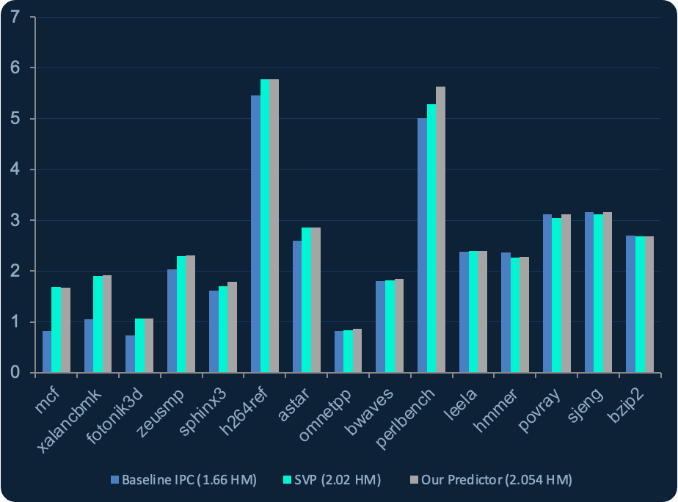
IPC Results — Championship Run
2.054
Harmonic Mean
vs 1.66 baseline
+12.4%
perlbench
5.01 → 5.63 IPC
+0%
sjeng / povray
Chaotic workloads
Held Ground on Volatile Traces
+103.6%
mcf
Memory workload
0.82 -> 1.67 IPC
Notes:
"The results of our championship run are summarized here. Our final configuration achieved a Harmonic Mean IPC of 2.054 against the baseline of 1.66, representing a substantial gain of approximately 24%.
Structured Workloads: We saw strong gains in structured workloads, such as a 12.4% boost for perlbench, increasing its IPC from 5.01 to 5.63.
Memory Workloads: Our hybrid predictor was particularly effective on the memory-intensive workload mcf, achieving a massive 103.6% gain, pushing its IPC from 0.82 to 1.67.
Chaotic Workloads: Importantly, on volatile and chaotic traces like sjeng and povray, we managed to hold ground at +0% gain. This demonstrates that our high-confidence policy successfully avoided aggressive, high-confidence mispredictions in unpredictable scenarios, preventing performance degradation

Slide 10
VP Metrics — What the Data Reveals
Confident & Correct
Confident & Wrong (Mispredictions)
perlbench confident correct predictions skyrocket from 2.24 million (SVP) to 5.28 million. This +135% increase is direct IPC gain. VTAGE successfully maps complex control-flow loops that simple stride math is physically incapable of learning.
Confident mispredictions on povray drop from 5,438 (SVP) to just 2,415 — a 55% reduction in pipeline flushes. The high VTAGE confidence ceiling of 63 acts as a natural misprediction filter on chaotic workloads where patterns quickly shift.
Unconfident but Correct (Silent IPC)
Complete Misses
mcf silent correct predictions jump from 504K (SVP) to 1.88 million. The predictor is successfully tracking nearly 3x more correct pointer-chasing paths beneath the surface, representing massive unexplored IPC potential.
omnetpp drops from 1.91 million misses under the SVP to exactly 358,151 misses in our hybrid. VTAGE's branch-history context fills in predictions for complex pointer-chasing graph traversals that the baseline stride predictor is completely blind to.
Key takeaway: conf_max=63 nearly eliminates confident mispredictions on chaotic workloads. Decoupling SVP conf_max to 47 recovers structured workload performance without sacrificing that safety.

Slide 11
Exploration — Software, Hardware & Their Interactions
The critical insight: every software change creates a new hardware configuration optimum. We tested these as a joint space, not independently.
Hardware Geometry
Allocation & Table Management
Training & Prediction Logic
Number of VTAGE tables: 4, 5, 6
History range: 16, 24, 32, 48, 64 branches
Entries per table: 128, 256, 512
VPQ Buffer Sizing: 128, 256, 300 entries
SVP Table Capacity: 512, 1024, 2048 entries
ALU allocation throttling: 1-in-4, 1-in-8, 1-in-16
TICK decay thresholds: 128, 256, 512, 1024
Veto Evolution: Tested Intra-VTAGE alternate blocking before isolating to Inter-Predictor (SVP) blocking.
Base Training Independence: Tested independent SVP allocation vs. strictly VTAGE-miss-gated allocation.
Confidence-gated eviction: Protecting proven entries from aggressive LRU replacement.
Stochastic training rates per instruction type
Misprediction penalty: soft dock vs full reset
Seznec Folded Hashing: Tested complex indexing by shifting the GBHR and XORing it with the PC.
Modified vs original SVP supremacy policy
Misprediction Timeout: Experimented with implementing a "penalty box" cooldown period after a burst of consecutive mispredictions.

Slide 12
Conclusions
Achieved 2.054 harmonic mean IPC — a meaningful improvement over the 2.02 pure SVP baseline — by pairing SVP's mathematical stride model with VTAGE's history-correlated pattern learning inside a strict 32 KB budget.
The hybrid delivers real architectural value: perlbench gains 12.4% from VTAGE capturing complex control flow, while modified SVP supremacy lets deeply-proven VTAGE entries take precedence over stride predictions.
Decoupling confidence ceilings was the single most impactful discovery: conf_max=63 for VTAGE eliminates confident mispredictions on chaotic workloads, while conf_max=47 for SVP keeps structured workloads firing aggressively.
Novel contributions include porting branch-prediction Alternate logic to Value Prediction, designing the anti-aliasing SVP shield, and modifying the SVP supremacy policy — all with measurable IPC impact.
The joint code-configuration space remains vastly unexplored: per-PC confidence thresholds, memory-latency-aware training, confidence-gated eviction, and implementing EVES-style indirect value pointers are among the most promising remaining directions.

Slide 13
References & Citations
[1]
Seznec, A. "Exploring value prediction with the EVES predictor." 1st Championship Value Prediction (CVP-1), 2018.
[2]
Perais, A., & Seznec, A. "Practical Data Value Speculation for Future High-end Processors." IEEE 20th International Symposium on High Performance Computer Architecture (HPCA), 2014.
[3]
Seznec, A. "A case for (partially) Tagged Geometric history length branch prediction." Journal of Instruction-Level Parallelism, 2006.
All methodology and architectural baselines derived from the Championship Value Prediction (CVP) framework.

