Slide 1
Analyzing sentiment in drug reviews
Atousa Chaharsough, PhD

Slide 2

1. Introduction
The patients' reviews after mass production are a great source of information for pharmaceutical companies to learn more about customer reaction to their products, discover potential problems before they occur, and better allocate their resources.
In this project, we will aim to predict whether or not a customer review is negative based on the review.
Analyze what indicators in a review make it most likely to be negative for different types of drugs
Which patients tend to have more negative reviews.

Slide 3
2. Data
The data¹² set has 161297 rows (number of reviews), and 7 attributes.
This data set contains patients’ review and rating of 3436 different drugs.
The condition of the patients for which the drug is taken is given and the number of people who found the review useful.
The data is imbalanced with only 21.6% of low rating reviews.
¹ UCI Machine Learning Repository-drug review data set
²Felix Gräßer, Surya Kallumadi, Hagen Malberg, and Sebastian Zaunseder. 2018. Aspect-Based Sentiment Analysis of Drug Reviews Applying Cross-Domain and Cross-Data Learning. In Proceedings of the 2018 International Conference on Digital Health (DH '18). ACM, New York, NY, USA, 121-125.

Slide 4
3. Exploratory data analysis (EDA)

Slide 5

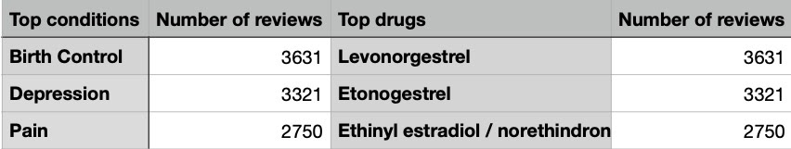
3.1 Highest number of reviews
We restrict our study to the drugs and conditions with at least 100 reviews.
The top conditions with the highest number of reviews are birth control, depression and pain.
The top drugs with the highest number of reviews are Levonorgestrel, Etonogestrel, and
Ethinyl estradiol / norethindrone. The first two drugs are used for birth control and the third
one is used to treat symptoms of menopause.
Fig 3.1
Conditions and drugs with the highest number of reviews.

Slide 6
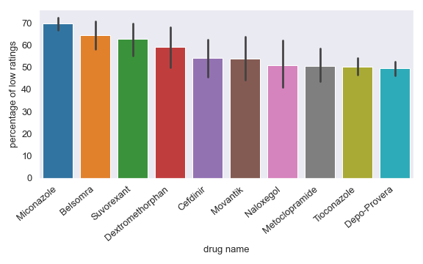
3.2 Top low rated drugs
The top low rated drug is ‘Miconazole’ with
70% low rating reviews. ‘Miconazole’ is used to
treat vaginal yeast infection. The main complaint about this drug is itching/burning.
Fig 3.2
Top low-rated drugs

Slide 7
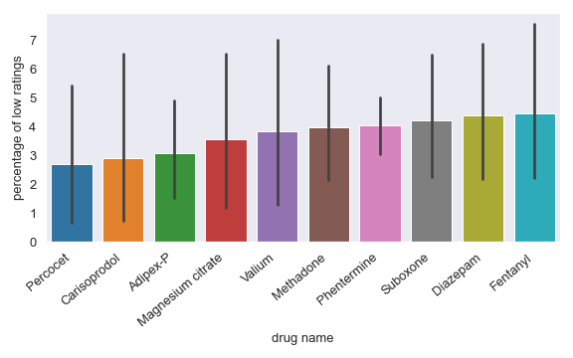
3.3 least low rated drugs
The lowest low-rated drugs is’ Percocet’, pain-killer, with 27% of low ratings.
Carisoprodol; muscle relaxant, Adipex-P and Phentermine; weight loss, Magnesium citrate; constipation, Valium and Diazepam are sedatives; anxiety, muscle spasm and seizures, Methadone and Fentanyl are narcotics; treat pain, Suboxone; opiate addiction.
Fig 3.3
Least low rated drugs

Slide 8
4. Classification

Slide 9
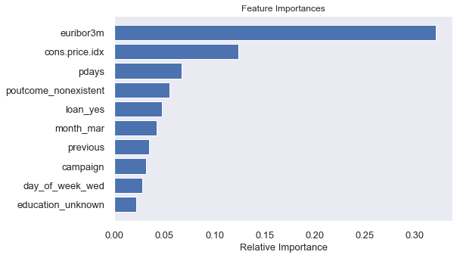
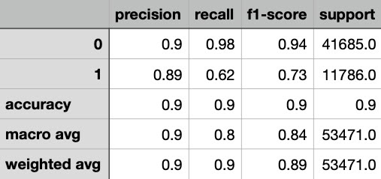
4.1 Model selection
Logistic regression and Multinomial Naive Bayes classification methods return a roc-auc score of 0.93 and 0.95 respectively on both test and train data sets.
The classification report table 4.1, for MNB model shows 90% accuracy.
The recall and f1 score for low-rated reviews, class “1”, are lower than high-rated reviews, class “0”, as a result of imbalanced data.
Table 4.1
Classification report for Multinomial Naïve Bayes model.

Slide 10
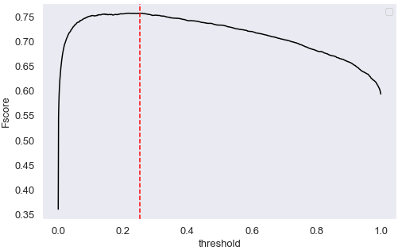
4.2 Threshold tuning
Threshold tuning the Multinomial Naïve Bayes model by maximizing f-score returns the best threshold=0.253 with maximum f-score=0.75.
Fig 4.2
F-score vs threshold
The red line shows the best threshold which maximizes the f-score

Slide 11
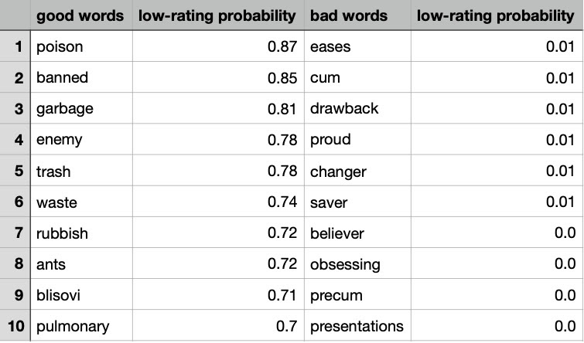
4.3 Most predictive words
The most predictive words (good words!) and the least predictive words (bad words!) for low-rating reviews are listed in the table 4.3 below.
The good words are as expected since the top eight have negative polarity.
Some of the bad words like ‘eases’, ‘proud’, ‘changer’, ‘saver’, ‘believer’, ‘obsessing’ are as expected since they have positive polarity.
The birth control drugs have the highest number of reviews in this data set (section 2.4). This might explain the appearance of ‘cum’ and ‘precum’ as least predictive words for low-rated drugs.
Table 4.3
The most predictive words (good words) and the least predictive words
(bad words) for low rating drugs.

Slide 12
6. Takeaway and future research
In this project, we built multiple classification models that predict the low-rated drugs based on the reviews.
The best model, Multinomial Naive Bayes, achieved a roc-auc score of 95%, on both the train and test data sets, and an accuracy of 0.9, which are considerably high.
This result was achieved by defining a function which preprocessed the text before passing it to the text vectorizer, by grid searching the model and 5-fold cross validating the data.
Since the number of people who found each review useful is given, it would be interesting to investigate what element in the review makes it useful.

