Slide 1
Innovative Opportunities for
Patient Safety Using Electronic Health Record (EHR) Data:
Perspectives from the FDA
MONDAY, 5:00 – 5:30PM
FDA to CONNECT
Mitra Rocca, Associate Director in Medical Informatics
Food and Drug Administration

Slide 2
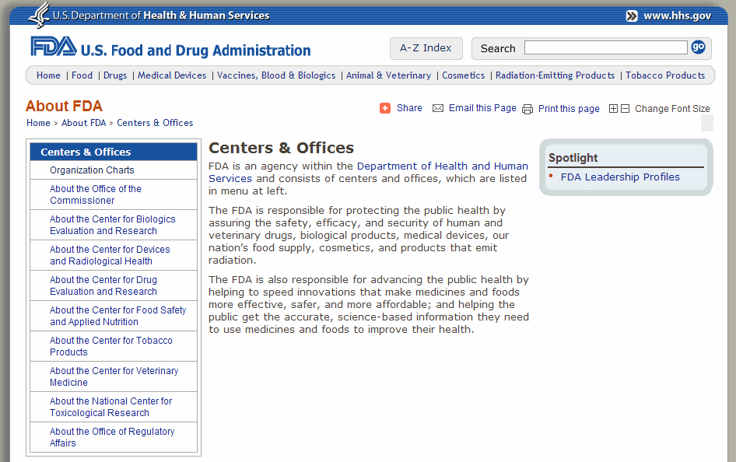
The Food and Drug Administration (FDA)
The FDA is responsible for protecting the public health by assuring the safety, efficacy, and security of human and veterinary drugs, biological products, medical devices, our nation’s food supply, cosmetics, and products that emit radiation.
HIMSS 2010

Slide 3
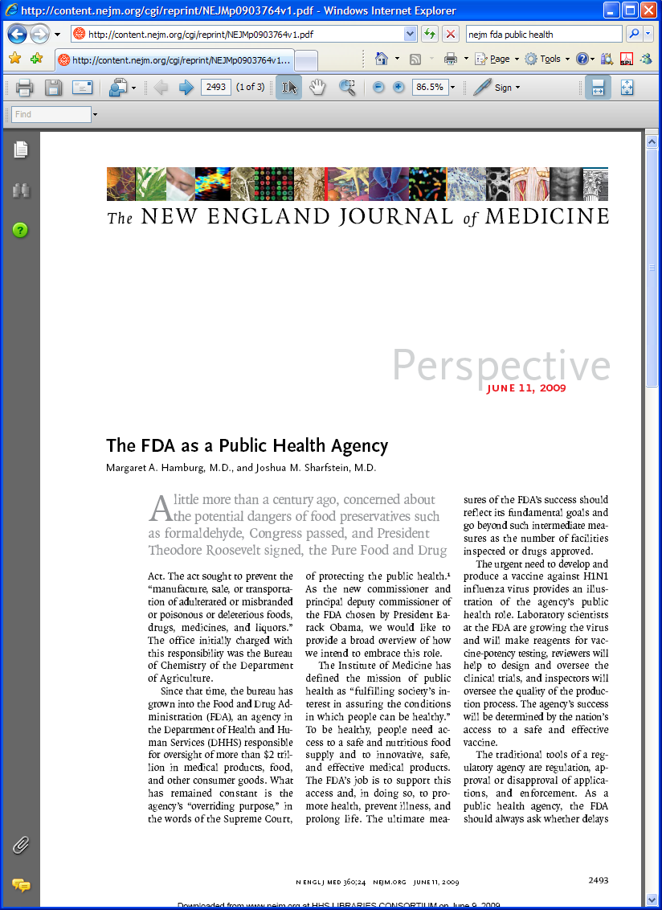
The FDA as a Public Health Agency
Margaret A. Hamburg, M.D., and Joshua M. Sharfstein, M.D.
“…The FDA’s job is to minimize risks through education, regulation, and enforcement. To be credible in all these tasks, the agency must communicate frequently and clearly about risks and benefits— and about what organizations and individuals can do to minimize risk….”
NEJM, June 11, 2009
HIMSS 2010
Notes:
Institute of Medicine Report
“To Err Is Human” – 1999
Claims of up 98,000 deaths yearly due to medical errors
Vioxx withdrawn from market – Sept 2004
FDA criticized for lax post-market surveillance in face of reports of excess cardiac deaths related to Cox2 use
Congressional interest in FDA
FDA request of IOM for independent assessment
IOM Report – The Future of Drug Safety: Promoting and Protecting the Health of the Public – Sept 2006

Slide 4




Some Initiatives Focusing on Improving Drug Safety
Sentinel
OMOP
MedWatch
Spontaneous Adverse Event Reporting via
EHRs
HIMSS 2010

Slide 5
Example 1:
FDA Initiative Aiming at Improving Drug Safety
  Sentinel: Develop an active surveillance system
  Goals:
  Strengthen FDA's ability to monitor post-market performance of
  medical products
      Active surveillance may identify an increased risk of common
      adverse events (e.g., MI, fracture) that health care providers may
      not suspect are related to medical products
      Safety issues may be identified and evaluated in near real-time
  Augment, not replace, existing safety monitoring systems
  Enable FDA to access existing automated healthcare data by partnering with data
  holders (e.g., health plans, owners of electronic health records, others)
HIMSS 2010

Slide 6

Example 2:
Public-Private Initiative Aiming at Improving Drug Safety
  Observational Medical Outcomes Partnership (OMOP): A public-private partnership to serve the public health by testing whether multi-source observational data can improve our ability to assess drug safety and benefits
  Goals:
  Assess the appropriate technology and data infrastructure required for systematic
  monitoring of observational data
  Develop and test the feasibility and performance of the analysis methods
  Evaluate required governance structures
HIMSS 2010

Slide 7

Example 3:
Initiatives Aiming at Improving Device Safety Post-Market Electronic Submission
  Goal: Promote and protect the health of the public by ensuring the safety
  and effectiveness of medical devices and the safety of radiological products
  Initiatives at Center for Devices and Radiological Health (CDRH):
  Unique Device Identifier
  Electronic Medical Device Reporting (eMDR)
  MedSun – web-based reporting from trained Hospitals
  Event Problem Codes – standard vocabulary for capturing device problems
HIMSS 2010

Slide 8
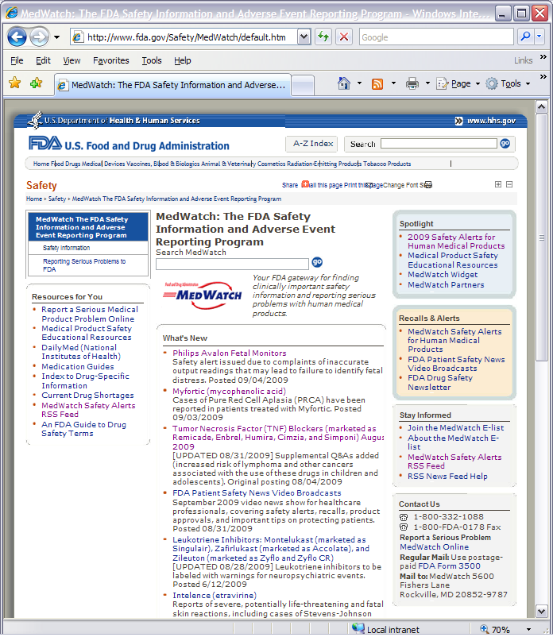
MedWatch: The FDA Adverse Event Reporting Program
Overview
  Background: 1993 - MedWatch, announced by Commissioner David Kessler
  Spontaneous voluntary reporting
  Benefits:
  Make it easier for providers to identify and report
  adverse events
  Increase physician understanding and awareness of
  drug induced diseases
  More widely disseminate safety information on the
  FDA’s actions that have resulted from adverse event
  and product problem reporting
HIMSS 2010
Notes:
When the MedWatch program began 10 years ago, the focus was almost entirely on REPORTING IN of adverse events
in 2004 our emphasis has change to the broadcasting of SAFETY INFORMATION
with the intention that it be both timely and clinically useful and delivered at the point of care where healthcare decisions by providers and their patients takes place

Slide 9
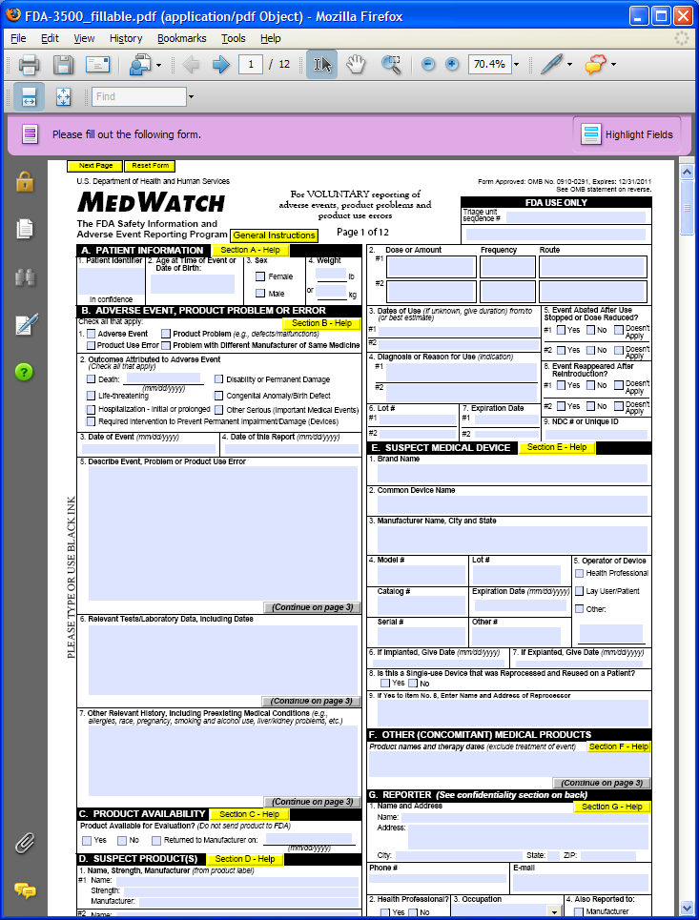

Current Process in Adverse Event Reporting:
Healthcare Provider’s Perspective
  Challenges: Inconvenient to healthcare providers
  Issues:
  Interrupts healthcare provider’s workflow
  The 30 second rule [C. McDonald]
  Requires multiple entry of data from various
  sources into free text and structured fields
  Not clear what data required/requested
  Not clear how or where to submit report
  Lack of knowledge and training
HIMSS 2010
Notes:
When the MedWatch program began 10 years ago, the focus was almost entirely on REPORTING IN of adverse events
in 2004 our emphasis has change to the broadcasting of SAFETY INFORMATION
with the intention that it be both timely and clinically useful and delivered at the point of care where healthcare decisions by providers and their patients takes place

Slide 10
FDA Use Case: Reporting of Spontaneous Adverse Event Reporting to FDA via EHR Systems
  Problem to be Studied: Reporting adverse events interrupts the routine of providing care and imposes a burden on health care providers – greatly decreasing the probability that events will be reported to FDA and medical product manufacturers
  Use Case Description:
  Spontaneous Adverse Event Reporting via EHR Systems
  Data collection incorporated at point of care
  Very light footprint for EHR
  Portable to other EHR systems
  Can take advantage of further developments in automated recognition
  Global solution
  Coordinated Use of Industry standards (ISO/HL7 Individual Case Safety Report (ICSR), Continuity of Care Document (CCD), IHE Retrieve Form for Data Capture (RFD)
HIMSS 2010

Slide 11



Adverse Event Reporting Information Flow
(Brigham and Women’s Hospital)
Physician discontinues drug due to Adverse Event (AE)
EHR System creates XML data file
EHR System sends XML data file via RFD
Physician completes and submits AE form
EHR (LMR)
XML data file is received and pre-populates AE form
AE form is displayed to physician
AE Form data is stored in AE repository as an AE report
AE report
data coded (MedDRA)
Safety Reporting for EHR
Transmit
message
to FDA
via CONNECT
Create an
ICSR message
Set serious flag (Y/N)
Receive message
via CONNECT
Adverse event message is displayed (MedWatch form)
HIMSS 2010

Slide 12
Adverse Event Reporting Information Flow
Physician discontinues drug due to Adverse Event (AE)
EHR System creates XML data file
EHR System sends XML data file via RFD
Physician completes and submits AE form
(PrimeSuite)
XML data file is received and pre-populates AE form
AE form is displayed to physician
AE Form data is stored in AE repository as an AE report
AE report
data coded (MedDRA)
Safety Reporting for EHR
Transmit
message
to FDA
via CONNECT
Create an
ICSR message
Set serious flag (Y/N)
Receive message
via CONNECT
Adverse event message is displayed (MedWatch form)
HIMSS 2010

Slide 13
Thank You
The participation of any company or organization in the NHIN and CONNECT area within the HIMSS Interoperability showcase does not represent an endorsement by the Office of the National Coordinator for Health Information Technology, the Federal Health Architecture or the Department of Health and Human Services.

Slide 14
Backup Slides

Slide 15
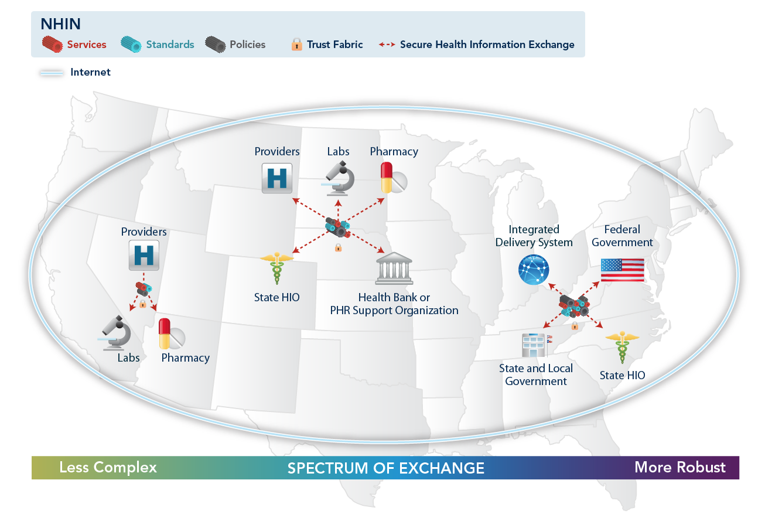
The Nationwide Health Information Network
HIMSS 2010
Notes:
Exchange of electronic health information to:
improve the quality / efficiency of health care
empower the individual patient
support public health, emergency preparedness, and research
Requires common elements:
minimum set of detailed standards - a shared network “dial tone”
support for consumer / inter-organizational trust
value of exchanging data exceeds the cost

Slide 16
Unique Device Identification
Current State:
All in supply chain add their own id number/catalogue number to a product
Information on device use difficult to capture in EHR
No unique number
HIMSS 2010

Slide 17
Unique Device Identification
Future:
UDI added to EHR to documenting medical device use
in patient’s EHR/PHR, hospital information systems,
claims data
Improve AE Reporting
Improve FDA’s ability to query data systems for relevant device information – Sentinel
HIMSS 2010

Slide 18
Electronic Medical Device Reporting (eMDR)
Initiated in 2005
First Report received in 2007
Notice of Propose Rule Making published late 2009
Total of 48 Device Firms Report this way
Submissions can be sent via FDA Gateway or through Data Entry
  Uses HL7 v3 r1 as data exchange method
  Vocabulary used in message is stored in NCI Thesaurus
HIMSS 2010

Slide 19
Medical Product Safety Network MedSun
Response to Device Adverse Event Reporting Requirement for User Facilities (Voluntary for Drugs)
  2002 – First Reports
  350+ Network of User Facilities
Feedback and Training
  Sites specifically trained in medical product adverse event reporting
  Feedback and User Groups
On-line Reporting
  FDA builds relationship with Clinicians, Safety Officers, Risk managers and other Designated Reporters
HIMSS 2010

Slide 20
Who are the Stakeholders with Interest in Adverse Event Reporting?
  Goal of Capturing and Reporting Adverse Events: Managing the risks of medical product use
  Stakeholders:
  Patients/Consumers
  Healthcare providers and their organizations who wish to identify best use of drugs/devices to avoid care decisions
  Industry that has regulatory responsibility to manage safety of their marketed products
  FDA as a public health agency responsible for risk/safety communication
HIMSS 2010

