Slide 1

Machine Learning &
Content Analytics
Title: Argument Detection

Slide 2


Agenda
Introduction to Team
The Existing Problem
Methodology
Results

Slide 3
The Team
GOAL 13: Take urgent action to combat climate change and its impacts
Group 5:
Full Name | Student IDs
Stavros Konstantinos Gardelis | p2821902
Anastasios Pliatsikas | p2821919
Athanasia Eleni Sideri | p2821923
Academic Background
Information Technology
Statistics
Business Management and Technology
All the members had the below roles to achieve this consolidated result:
Prepare the data (document collection and annotation)
Code development for the models (RNN, CNN, Comparison)
Building report with description and interpretation

Slide 4

The Problem
Content Quality Evaluation of existing bibliography (scientific documents, essays, e-books , articles etc) regarding the achievement or not of the sustainable development goals.
The majority of papers do not include the necessary information in order to elaborate their findings. Need for a mechanism to detect valid papers that include complete arguments, meaning evidences that support existing claims.

Slide 5
Methodology
Data
Build RNN Model
Build CNN Model
Model Comparison
Evaluation on test data
Results
Pre-Trained Glove Embeddings
Model Structure
Hyper - Parameters
Performance Measurements
Class Weights
Optimizers and Learning Rates
Data Acquisition
Data Preprocessing
Data Cleansing
Data preparation
✓ F1 – Score (focused on claim and evidence classes)
✓ Confusion Matrix
✘ Accuracy
Predictions of the best model on blind data set.
Showcasing the best model and its performance with plots, curves and matrices.

Slide 6
Hyper-Parameters Testing
CNN
RNN
Number of Filters
Extra Layers
Kernel Size
Batch Size
Number of Epochs
Dropout Rate (before/after pooling layer)
Class Weights
Optimizers
Learning Rate
Batch Size
Number of Epochs
Dropout Rate
Class Weights
Optimizers
Learning Rate

Slide 7
Best CNN Model
Characteristics |  | Values
Hyper-parameters | Number of filters (1st layer) | 15
 | Number of filters (2nd layer) | 25
 | Kernel size | 3
 | Hidden size | 50
 | Epochs | 100
 | Batch size | 32
 | Dropout rate | 0.2
Extras | Optimizers | Adam
 | Learning Rate | 1E-3
 | Class Weights | -

Slide 8
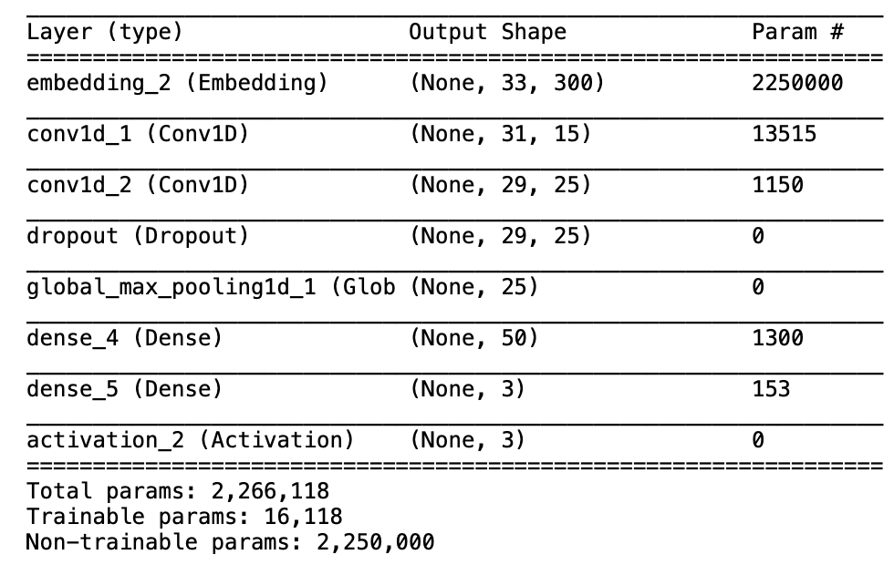
CNN Model Architecture

Slide 9
Best CNN Model
Characteristics |  | Values
Hyper-parameters | Bidirectional LSTM(1st layer) | 33
 | Bidirectional LSTM(2nd layer) | 33
 | Epochs | 60
 | Batch size | 256
 | Dropout rate | 0.1
Extras | Optimizers | SGD
 | Learning Rate | 1E-3
 | Class Weights | -

Slide 10
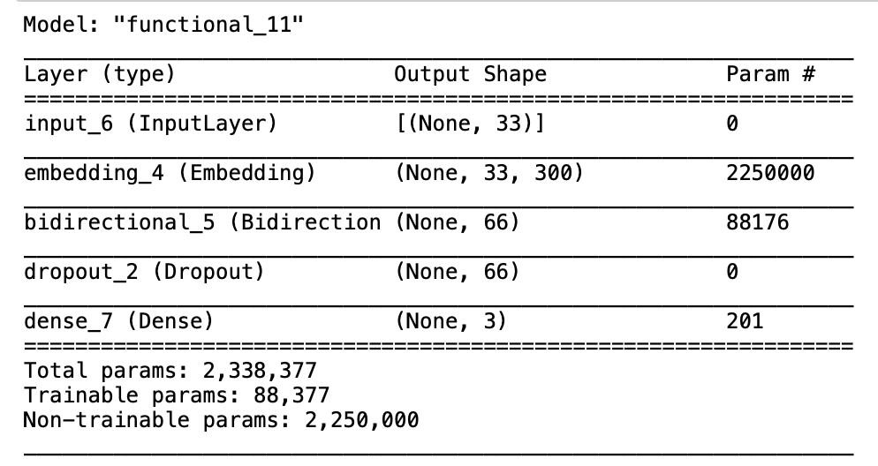
RNN Model Architecture

Slide 11
Results – Model Comparison
From Classification Report
From Confusion Matrix
Best Chosen Model | f1-score (Class 0) | f1-score (Class 1) | Accuracy
RNN | .403 | .370 | .736
CNN | .399 | .407 | .694
Best Chosen Model | Claims | Evidences
RNN | 82/198 = 41% | 117/297 = 39%
CNN | 108/198 = 54% | 153/297 = 51%

Slide 12
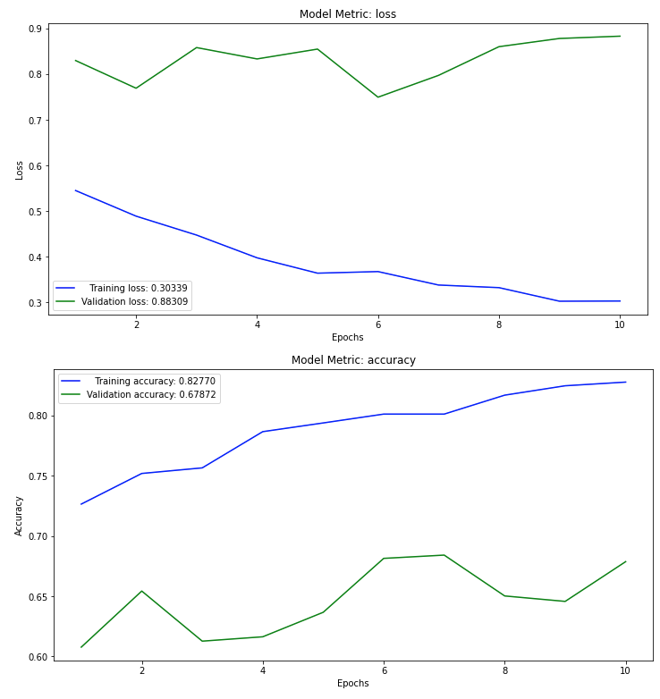
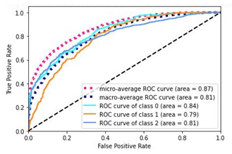
Results – Best Model
Roc Curves
Loss and Accuracy plots

Slide 13

Questions and Thoughts?
Thank you!

