Slide 1





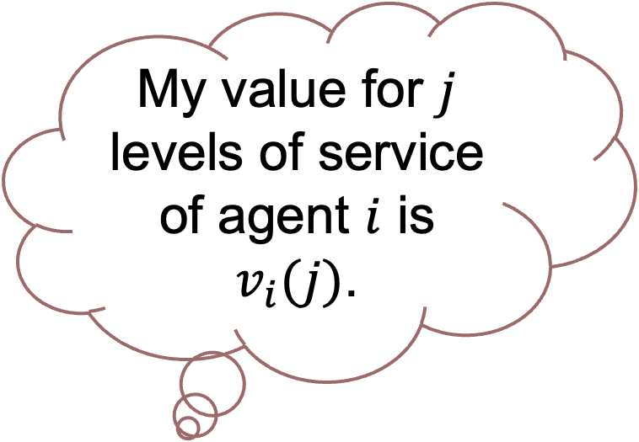








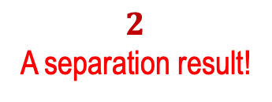
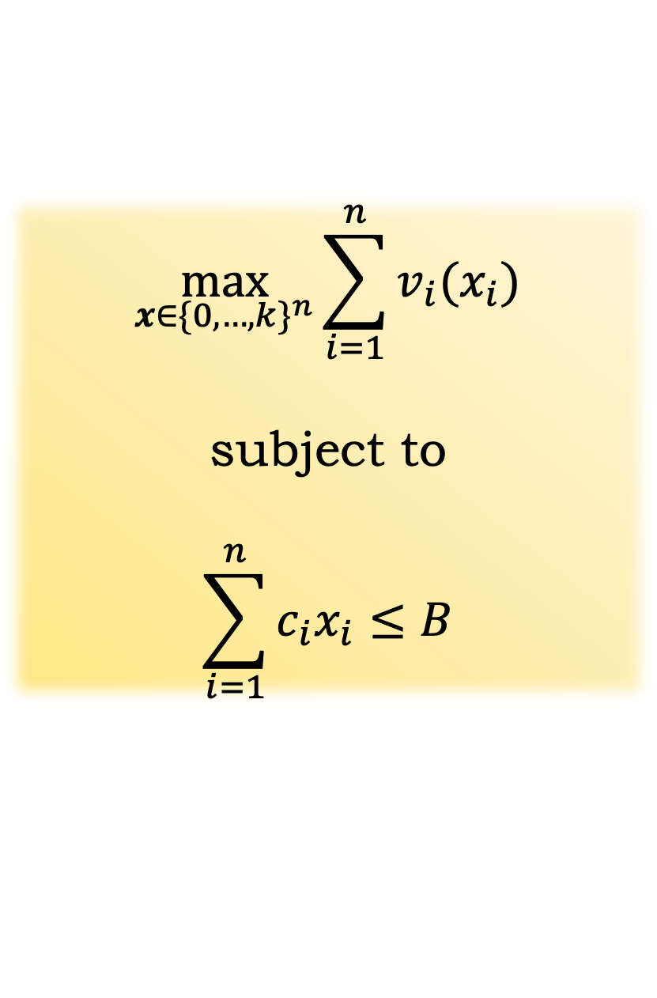
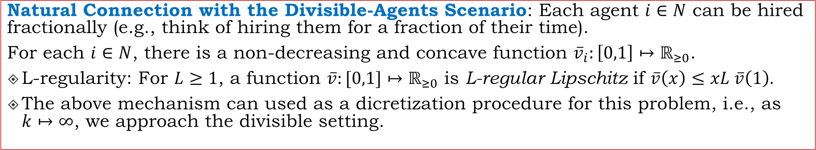

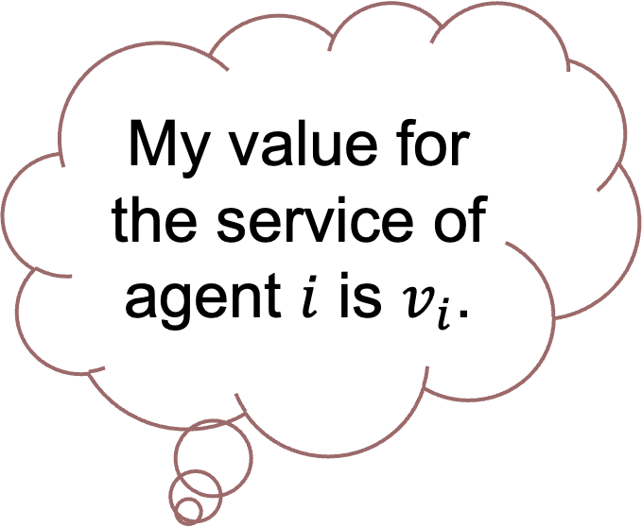
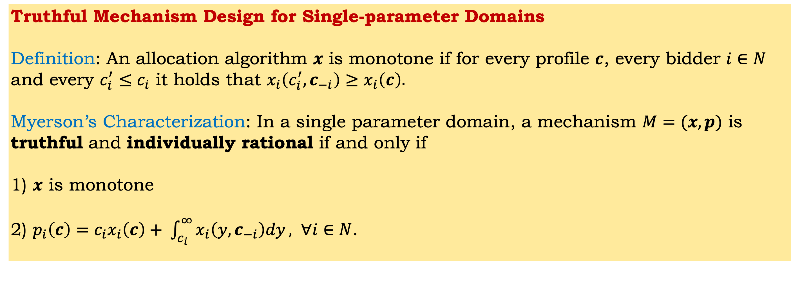
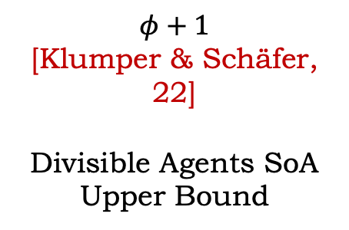





Truthful Mechanism Design for Single-parameter Domains Definition: An allocation algorithm $x$ is monotone if for every profile $c$, every bidder $i∈N$ and every $c_{i}^{′}≤c_{i}$ it holds that $x_{i}\left(c_{i}^{′},c_{−i}\right)≥x_{i}\left(c\right).$ Myerson’s Characterization: In a single parameter domain, a mechanism $M=(x,p)$ is truthful and individually rational if and only if 1) $x$ is monotone 2) $p_{i}\left(c\right)=c_{i}x_{i}\left(c\right)+ \int_{c_{i}}^{∞}{x_{i}\left(y,c_{−i}\right)dy}, ∀i∈N$.
Partial Allocations in Budget-Feasible Mechanism Design: Bridging Multiple Levels of Service and Divisible Agents
Georgios Amanatidis^{1,7}, Sophie Klumper^{2,3}, Evangelos Markakis^{4,5,7}, Guido Schäfer^{2,6}, Artem Tsikiridis²
1. University of Essex 2. Centrum Wiskunde & Informatica (CWI)
3. Vrije Universiteit Amsterdam 4. Athens University of Economics and Business
5. Input/Output Global 6. University of Amsterdam 7. Archimedes (Athena Research Center)
Budget Feasible Procurement Auctions
Truthful Budget Feasible Mechanisms for MLoS
An auctioneer with a budget $B>0$ is looking to hire a subset of $n$ strategic agents.
10$
The non-strategic optimal solution $OPT_{I}^{k} (c)$:
Design Objectives for $M=(x,p)$
Budget-feasibility: A payment rule should satisfy that $∀c$
$\sum_{i=1}^{n}{p_{i}(c)}≤B$.
Individual Rationality: Bidders should be incentivized to participate, i.e., $∀c$ and all $i∈N$
$p_{i}\left(c\right)≥x_{i}\left(c\right)c_{i}$.
Truthfulness: Bidders have no incentives to lie about their costs.
Primary Goal of the Auctioneer: Find an$α$-approximate mechanism for the smallest $α$ possible.
This is called Bounded Knapsack!
$$\max_{x∈{\{0,…,k\}}^{n}}{\sum_{i=1}^{n}{v_{i}(x_{i})}}$$
subject to
$$\sum_{i=1}^{n}{c_{i}x_{i}}≤B$$
My value for the service of agent $i$ is $v_{i}$.
I want to be paid at least $c_{1}$.
.
.
.
I want to be paid at least $c_{n}$.
α-approximate mechanism: for every profile $c$ it holds that
$OPT_{I}^{k}\left(c\right)≤αV\left(x\left(c\right)\right)$.
Question [Singer ’10]: Who should the auctioneer hire and how much should he pay (keeping in mind his budget 𝐵)?
Multiple Levels of Service Model (MLoS):
Agents can offer $k$ levels of service.
My value for $j$ levels of service of agent $i$ is $v_{i}(j)$.
I want to be paid at least $c_{1}$ per level.
.
.
.
A Mechanism for Multiple Levels of Service
Input: A profile $c$ and parameters $α,β$.
Let $i^{∗}=argmax_{i∈N}\frac{v_{i}\left(k\right)}{OPT_{F}^{k}\left(c_{−i}\right)}$.
If $v_{i^{∗}}\left(k\right)≥βOPT_{F}^{k}\left(c_{−i^{∗}}\right)$, then set $x_{i^{∗}}=k$ and $x_{i}=0$ for all $i≠i^{∗}$.
Else:
Solve $OPT_{F}^{k}(c)$ and call its allocation $x^{∗}$ -> A list of decreasing marginal rates of the form (marginal value)/cost.
Initialize $x$ to be the integral part of $x^{∗}.$
Keep removing the last element from the list and decrementing $x$ until
$\sum_{i=1}^{n}{v_{i}\left(x_{i}\right)≥αOPT_{F}^{k}(c)}$ holds minimally.
Return x and set $p\left(c\right) \text{according} \text{to} \text{Myerson}$.
I want to be paid at least $c_{n}$ per level.
$OPT_{F}^{k} (c)$ is the fractional relaxation of $OPT_{I}^{k} (c)$.
Question (this work): What hiring scheme should the auctioneer implement and how much should he pay (keeping in mind his budget 𝐵)?
Formally:
An auctioneer with a budget $B$ and a set of agents $N=\{1,…,n\}$ with $k$ levels of service.
For each $i∈Ν$, a private cost parameter $c_{i}≥0$.
Bidders can be hired for some levels of service (e.g., we can think of a service having premium versions).
A mechanism $M=(x, p)$ consists of:
An allocation algorithm that takes as input a vector $c={\left(c_{i}\right)}_{i∈N}$ of costs and outputs an allocation $x\left(c\right)∈{\left\{0,…,k\right\}}^{n}$.
A payment rule that determines the payments $p\left(c\right)∈ℝ_{≥0}^{n}$ of the auctioneer.
For each $i∈N$, there is a non-decreasing concave value function $v_{i}:\left\{0,1,…,k\right\}↦ℝ_{≥0}$.
The total value of the auctioneer is $V\left(x\left(c\right)\right):=\sum_{i=1}^{n}{v_{i}{(x}_{i}\left(c\right)).}$
For each $i∈N$we assume that $c_{i}k≤B$ (each bidder can be hired entirely on their own).
Theorem 1: There exist constants $a, β$ for which the mechanism is individually rational, truthful, budget-feasible and $(2+√3)$-approximate.
Natural Connection with the Divisible-Agents Scenario: Each agent $i∈N$ can be hired fractionally (e.g., think of hiring them for a fraction of their time).
For each $i∈N$, there is a non-decreasing and concave function ${\overline{v}}_{i}:\left[0,1\right]↦ℝ_{≥0}$.
L-regularity: For $L≥1$, a function $\overline{v}:[0,1]↦ℝ_{≥0}$ is L-regular Lipschitz if $\overline{v}\left(x\right)≤xL \overline{v}\left(1\right).$
The above mechanism can used as a dicretization procedure for this problem, i.e., as $k↦∞$, we approach the divisible setting.
Theorem 2: There is a mechanism for Divisible Agents that is individually-rational, truthful, budget-feasible and $L(φ+1)$-approximate.
The Linear $(L=1)$ Case: The guarantee becomes $φ+1$, matching the state-of-the-art mechanism of [Klumper & Schäfer ‘22] for the divisible-agents scenario. But we can do slightly better!
$$0$$
$e/(e−1)$
[Anari et al. 18]
Divisible Agents SoA Lower Bound
$$2$$
A separation result!
$√2+1$
[Chen et al, 12]
Indivisible Agents SoA Lower Bound
$φ+1$
[Klumper & Schäfer, 22]
Divisible Agents SoA Upper Bound
$3$
[Gravin et al., 19]
Indivisible Agents SoA Upper Bound
References
[1] Singer, Y.: Budget Feasible Mechanisms. FOCS 2010
[2] Klumper, S., Schäfer, G.: Budget Feasible Mechanisms for Procurement Auctions with Divisible Agents. SAGT 2022
[3] Chen, N., Gravin, N., Lu, P.: On the Approximability of Budget Feasible Mechanisms. SODA 2011
[4] Gravin, N., Jin, Y., Lu, P., Zhang, C.: Optimal Budget-feasible Mechanisms for Additive Valuations. TEAC 2020
[5] Anari, N., Goel, G., Nikzad, A.: Budget Feasible Procurement Auctions. OR 2018

