Slide 1
Cruise Control: An HLS Auto-Optimzation Tool
Thomas Furlong, Andrew Smith
ECE 527 Final Project Proposal

Slide 2
Challenge
HLS is a great tool for rapid prototyping, development and optimization of custom hardware accelerators
Optimizing the performance is still a very manual process of placing pragmas at specific points in the code with trial and error

Slide 3
Goal
Design a tool to explore design space and produce a “good” result
Reduce the effort required by designers to create an efficient accelerator

Slide 4
Cruise Control
A design tool that can parse HLS source code and automatically evaluate different pragma placement permutations for an efficient solution.

Slide 5
Approach

Slide 6
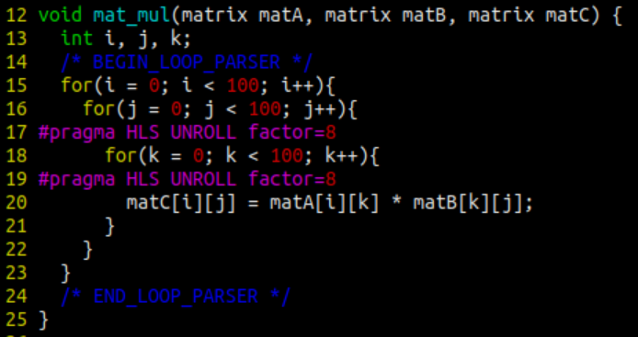
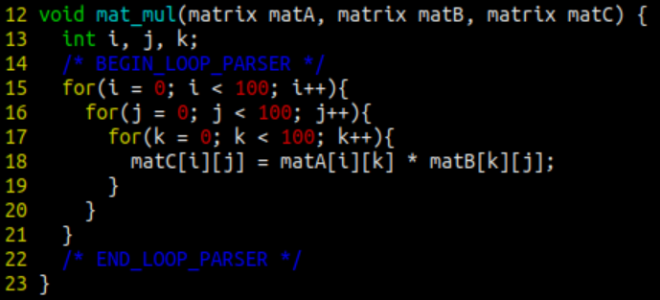
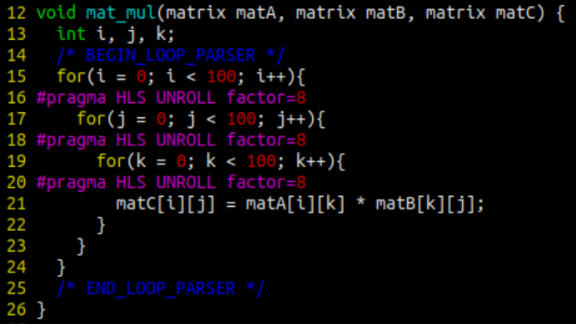
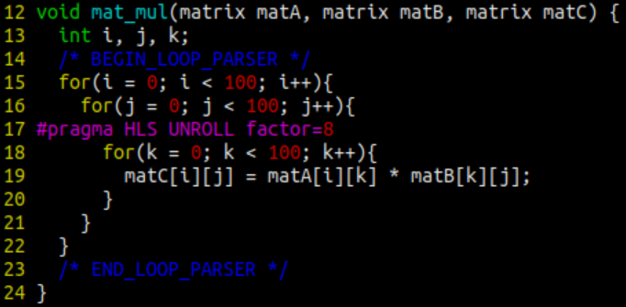
Input Parser

Slide 7
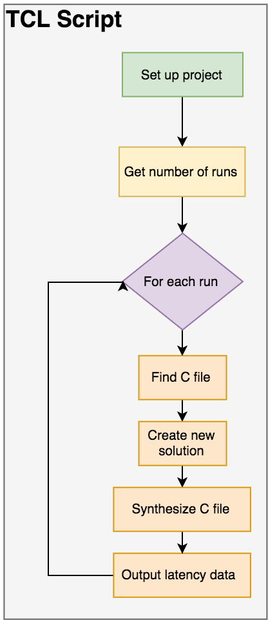
TCLer
The TCLer
Uses Vivado HLS TCL interface
Minimal set up time
Synthesizes every pragma placement
Writes design statistics to report file

Slide 8
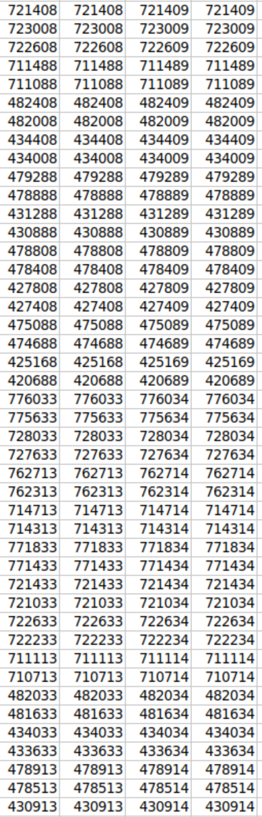
Output Parser
Enables the designer to choose highest performing design
Outputs a CSV file for easy analysis in Excel
Can then choose output that’s best suited for application’s physical constraints

Slide 9
Current State
The current tool can find an optimal solution, but BFS and exhaustive search scales exceptionally poorly.
With the number of loops in a small accelerator easily exceeding 9 runtime

Slide 10
Results: Designer Effort
Drastically reduces designer effort
Cruise control can evaluate 15 permutations of pragma placements in the same amount of time a designer can evaluate 1
7.9s per iteration
15x improvement in human efficiency
Can multitask while CruiseControl runs in background

Slide 11
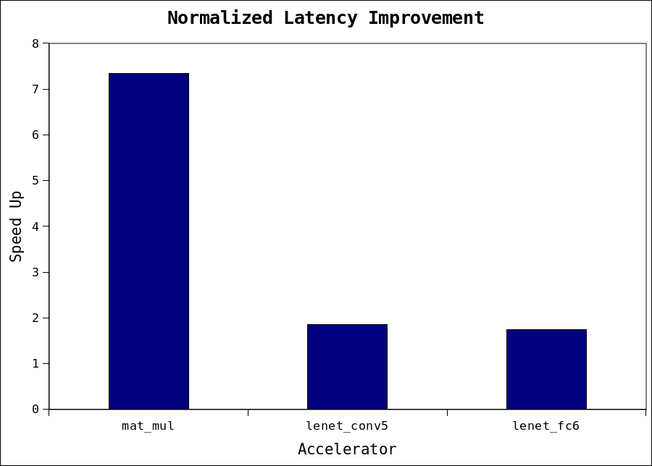
Results: Speed Up

Slide 12
Future Work
Heuristic based search through design space
Resource constraint input parameters

