Slide 1
Cruise Control: An HLS Auto-Optimzation Tool
Thomas Furlong, Andrew Smith
ECE 527 Final Project

Slide 2
Challenge
HLS is a great tool for rapid prototyping, development and optimization of custom hardware accelerators
Optimizing the performance is still a very manual process of placing pragmas at specific points in the code with trial and error

Slide 3
Goal
Design a tool to explore design space and produce a “good” result
Reduce the effort required by designers to create an efficient accelerator

Slide 4
Cruise Control
A design tool that can parse HLS source code and automatically evaluate different pragma placement permutations for an efficient solution

Slide 5
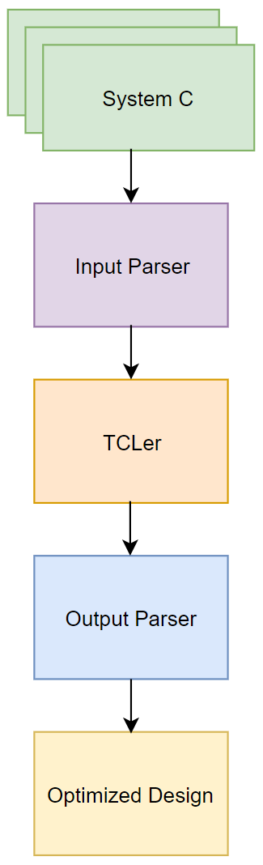
Approach

Slide 6
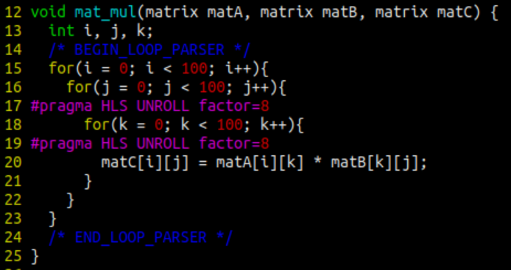
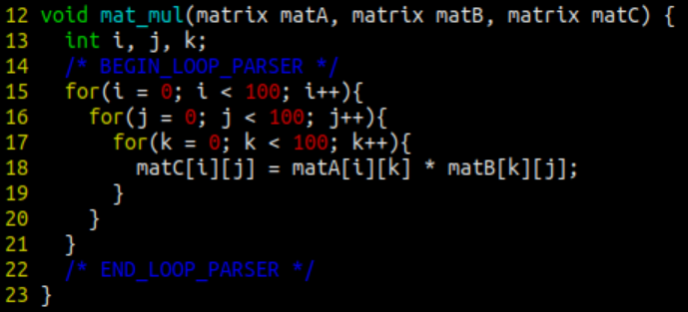
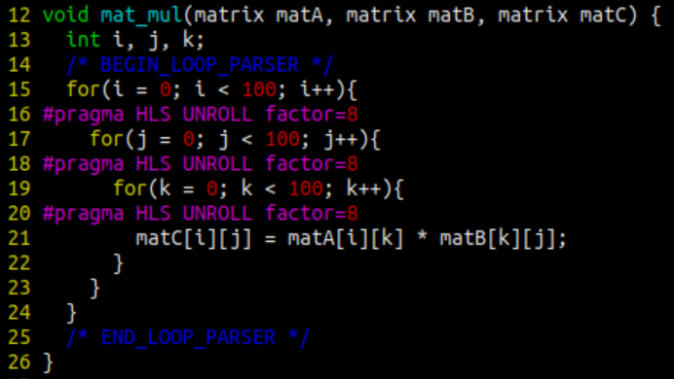
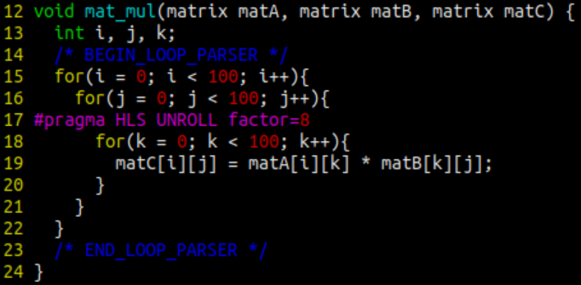
Approach: Input Parser

Slide 7
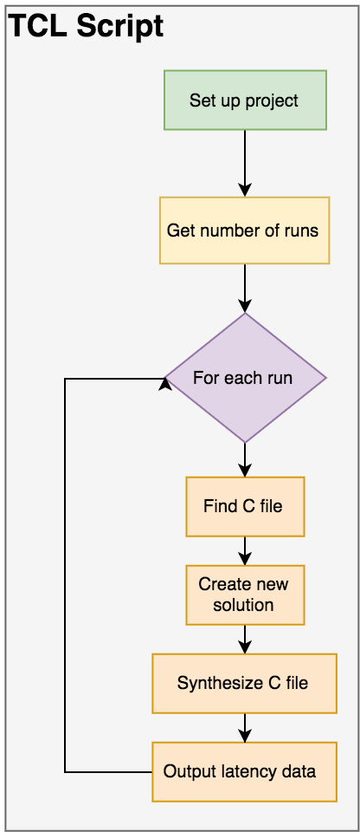
Approach: TCLer
The TCLer
Uses Vivado HLS TCL interface
Minimal set up time
Synthesizes every pragma placement
Writes design statistics to report file

Slide 8
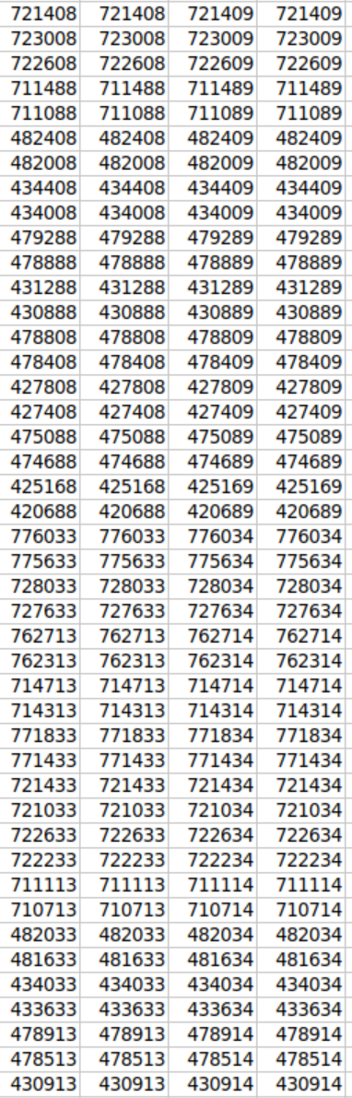
Approach: Output Parser
Enables the designer to choose highest performing design
Outputs a CSV file for easy analysis in Excel
Can then choose output that’s best suited for application’s physical constraints

Slide 9
Current State
The current tool can find an optimal solution, but exhaustive search scales poorly
With the number of loops in a small accelerator easily exceeding 9, which leads to ~512 search states
We want to implement simulated annealing or a smarter search that throws out states based on the data we’ve collected so far

Slide 10
Challenges
Cannot analyze power without first placing and routing a netlist
Not clear how to do this through TCL
Debugging TCL scripts is time consuming
Windows…

Slide 11
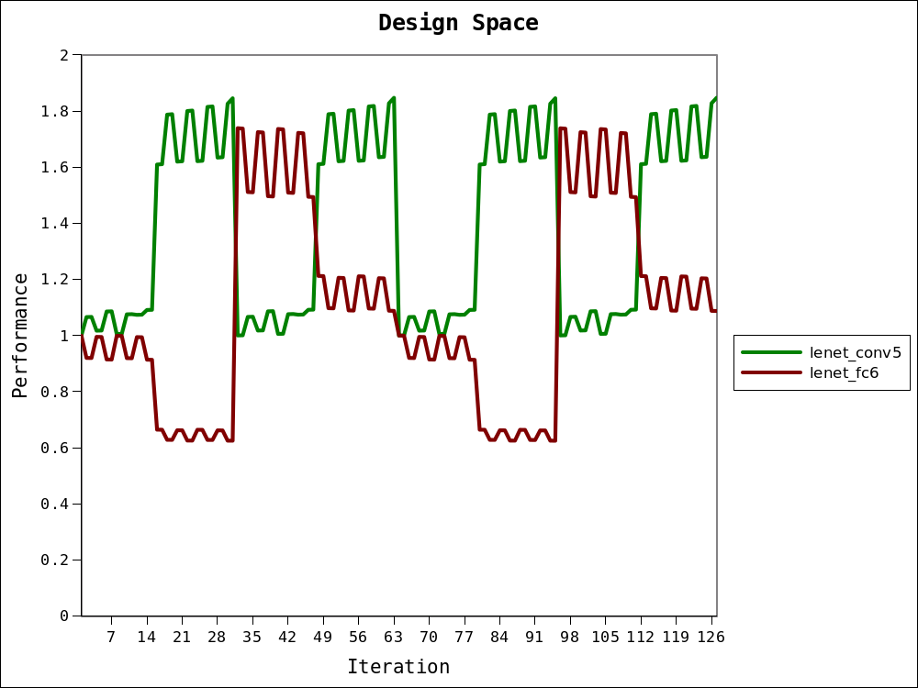
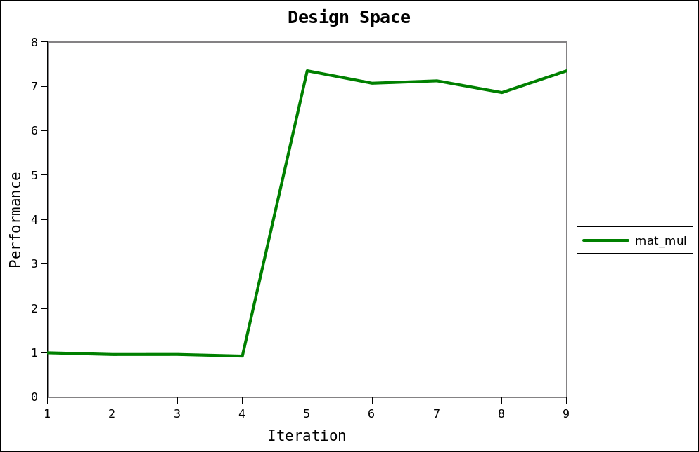
Design Space Analysis

Slide 12
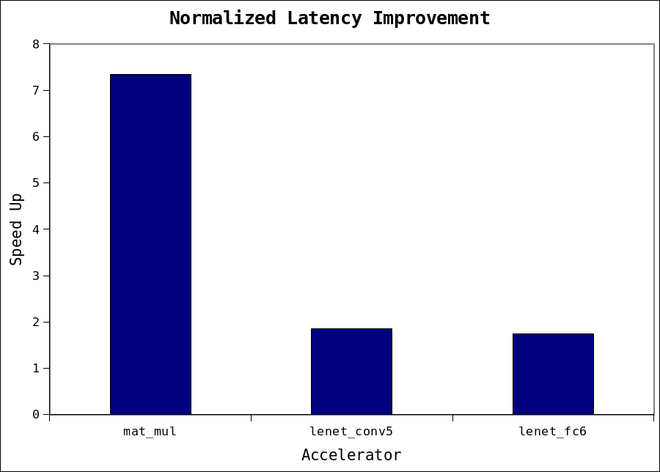
Results: Speed Up
mat_mul: 7.35x
lenet_conv5: 1.85x
lenet_fc6: 1.73x

Slide 13
Results: Designer Effort
Drastically reduces designer effort
Cruise control can evaluate 15 permutations of pragma placements in the same amount of time a designer can evaluate 1
7.9 seconds per iteration
15x improvement in human efficiency
Can multitask while CruiseControl runs in background

Slide 14
Future Work
Smarter search strategy
Simulated annealing
Throw out states known to be bad
Power Optimization
Need valid place & route
Different loop unrolling factors
Optimize based on size of loop
Improve user experience
Integration into Vivado HLS GUI

Slide 15
Q/A

