Slide 1
Cruise Control: An HLS Auto-Optimzation Tool
Thomas Furlong, Andrew Smith
ECE 527 Final Project Proposal

Slide 2
Challenge
HLS is a great tool for rapid prototyping, development and optimization of custom hardware accelerators
Optimizing the performance is still a very manual process of placing pragmas at specific points in the code with trial and error

Slide 3
Goal
Design a tool to explore design space and produce a “good” result
Reduce the effort required by designers to create an efficient accelerator

Slide 4
Cruise Control
A design tool that can parse HLS source code and automatically evaluate different pragma placement permutations for an efficient solution.

Slide 5
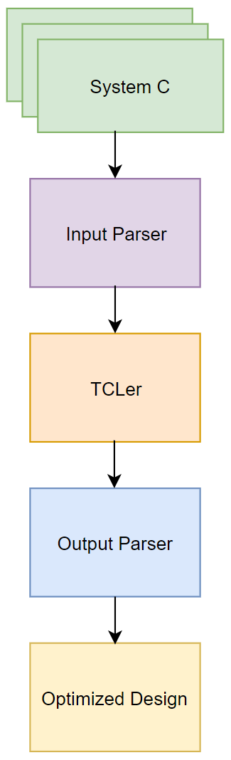
Approach

Slide 6
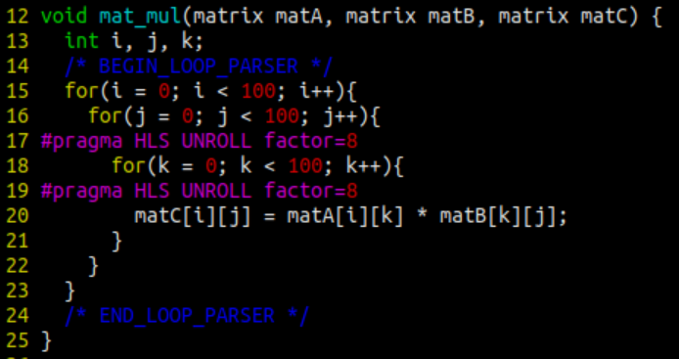
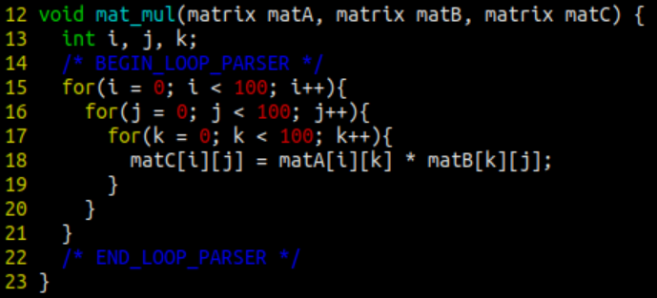
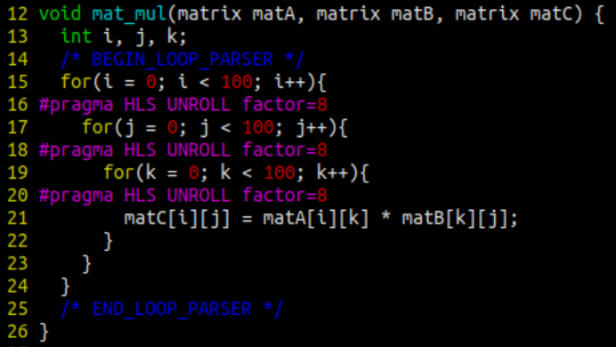
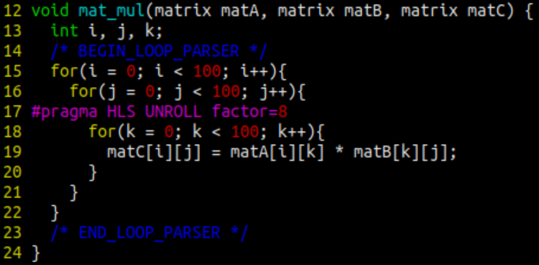
Approach: Input Parser

Slide 7
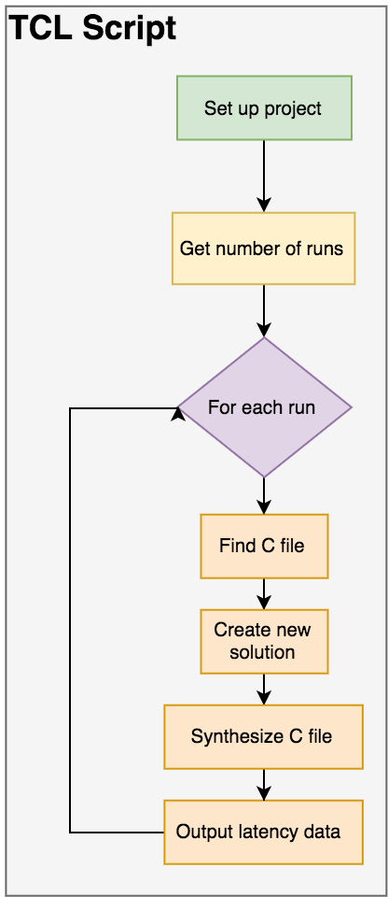
Approach: TCLer
The TCLer
Uses Vivado HLS TCL interface
Minimal set up time
Synthesizes every pragma placement
Writes design statistics to report file

Slide 8
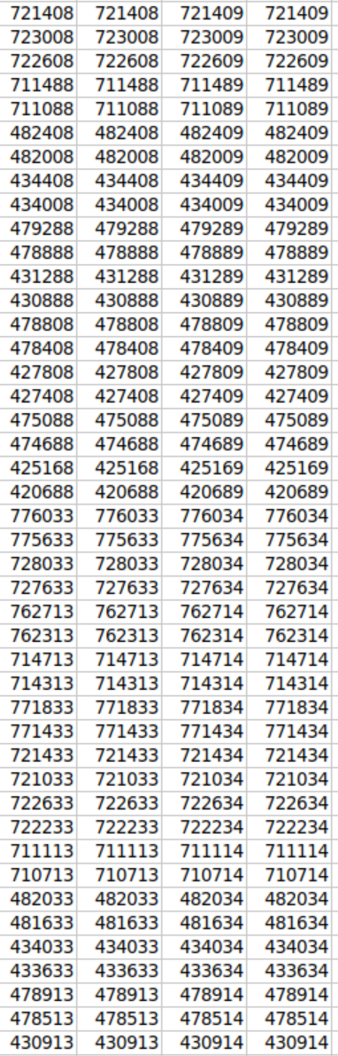
Approach: Output Parser
Enables the designer to choose highest performing design
Outputs a CSV file for easy analysis in Excel
Can then choose output that’s best suited for application’s physical constraints

Slide 9
Current State
The current tool can find an optimal solution, but exhaustive search scales poorly
With the number of loops in a small accelerator easily exceeding 9, which leads to ~512 search states
We want to implement simulated annealing or a smarter search that throws out states based on the data we’ve collected so far

Slide 10
Challenges
Cannot analyze power without first placing and routing a netlist
Not clear how to do this through TCL
Debugging TCL scripts time consuming
Windows…

Slide 11
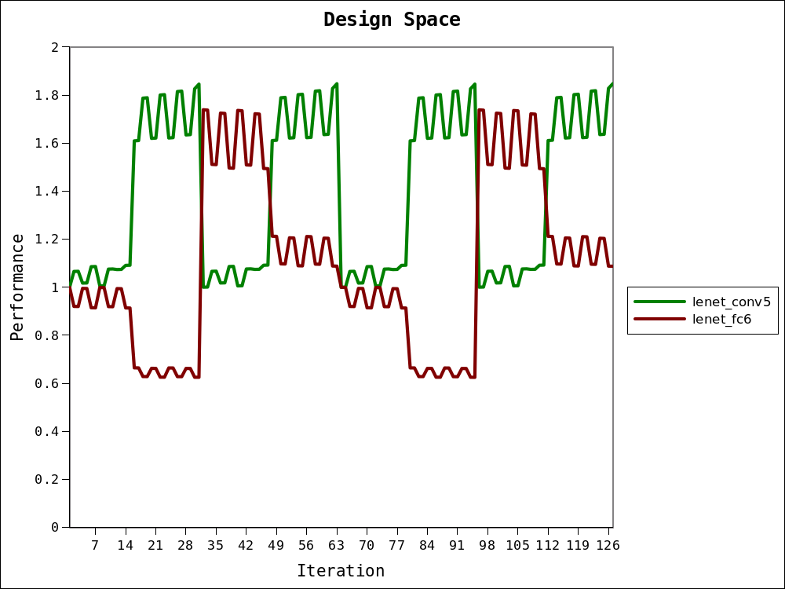
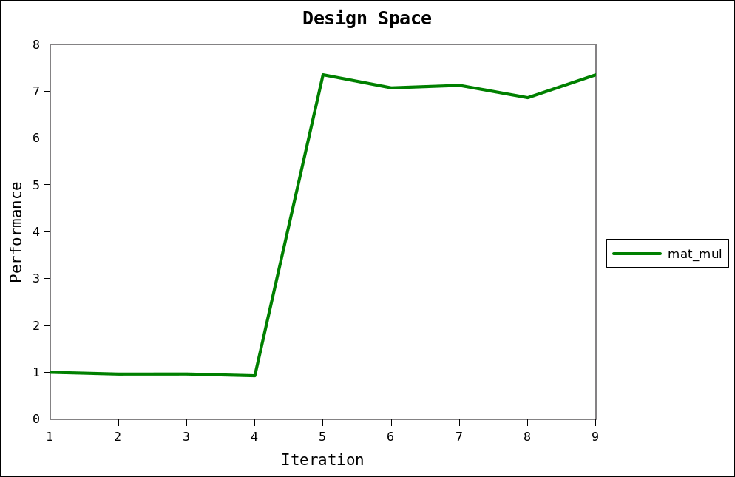
Design Space Analysis

Slide 12
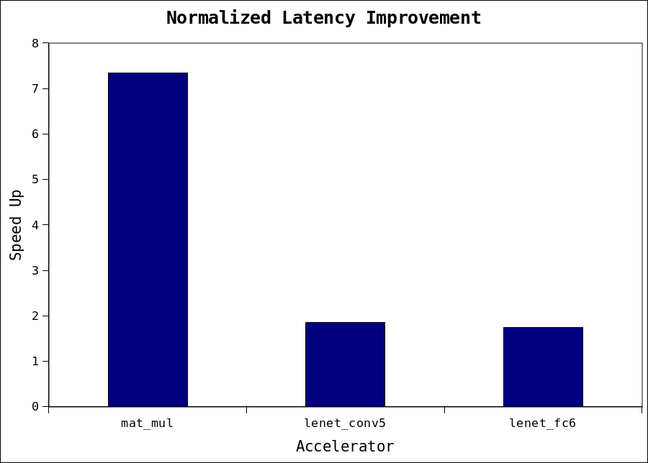
Results: Speed Up
mat_mul: 7.3x
lenet_conv5: 1.8x
lenet_fc6: 1.75x

Slide 13
Results: Designer Effort
Drastically reduces designer effort
Cruise control can evaluate 15 permutations of pragma placements in the same amount of time a designer can evaluate 1
7.9 seconds per iteration
15x improvement in human efficiency
Can multitask while CruiseControl runs in background

Slide 14
Future Work
Smarter search strategy
Simulated annealing
Power Optimization
Need valid place & route
Different loop unrolling factors
Optimize based on size of loop
Improve user experience
Integration into Vivado HLS GUI

Slide 15
Q/A

