Slide 1
Cruise Control: A HLS Design Tool for Low Power
Thomas Furlong, Andrew Smith
ECE 527 Final Project Proposal

Slide 2
Challenge
HLS is a great tool for rapid prototyping, development and optimization of custom hardware accelerators
Optimizing the performance is still a very manual process of placing pragmas at specific points in the code with trial and error
Easy to boost performance with HLS but reducing power is not intuitive

Slide 3
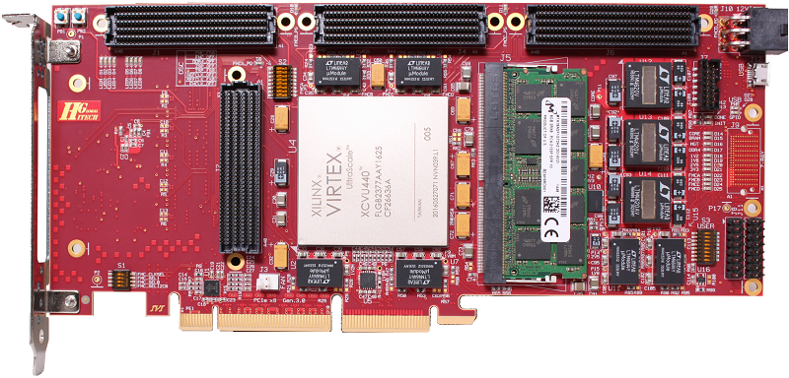
Goal
Design a tool to explore design space and produce a “good” result
Reduce the effort required by designers to create an efficient accelerator

Slide 4
Cruise Control
A design tool that can parse HLS source, and automatically evaluate different pragma placement permutations for a power efficient solution.
Use a heuristic based search to find a solution satisfying Power, Performance, and Utilization constraints.

Slide 5
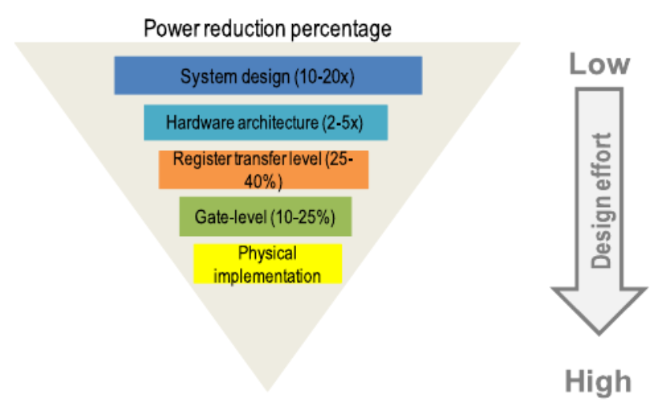
Support
Most power savings can be made at the highest level of abstraction.
Makes sense to search over this level of abstraction and take advantage of the HLS flow to do heavy lifting.
[1]

Slide 6
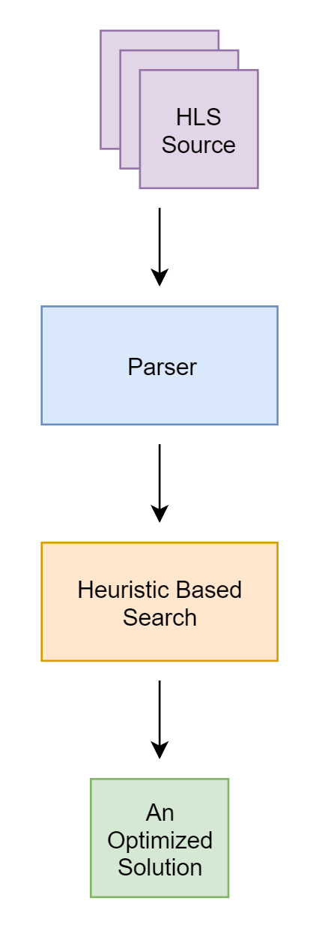
Approach

Slide 7
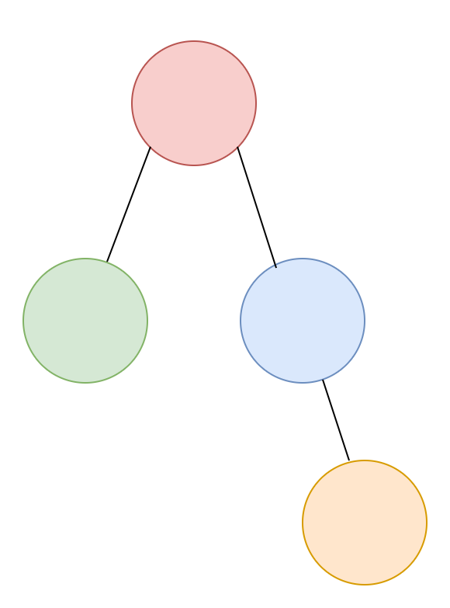
Approach: Parser
Will analyze the HLS Source for for loops and their nesting relationship.
For(i…) {
For(j…) {
…
}
For(j…) {
For(k…) {
…
}
}
}

Slide 8
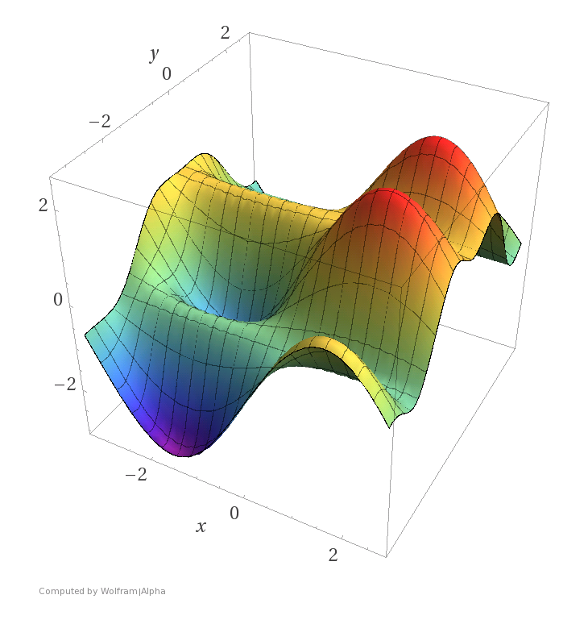
Approach: Search
Will hopefully use a heuristic based search to evaluate the design space placement to satisfy given constraints
Need to better profile the design space before determining a heuristic search is possible

Slide 9
Bottlenecks
Relies on Synthesis to evaluate search state
Large source code with many states could take a long time to evaluate
Could explore some way of learning what kind of pragma placements make for energy efficient logic to avoid synthesis every step

