Slide 2
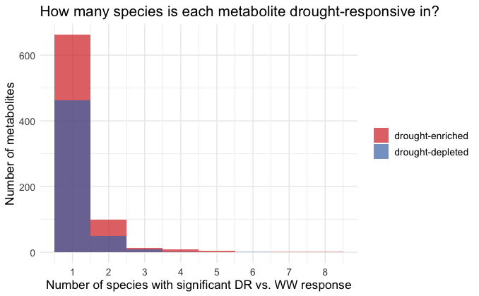
By setting the core threshold = 4, we have 15 drought-enriched and 2 drought-depleted core metabolites across the 7275 features.(less than 0.3%)

Slide 3
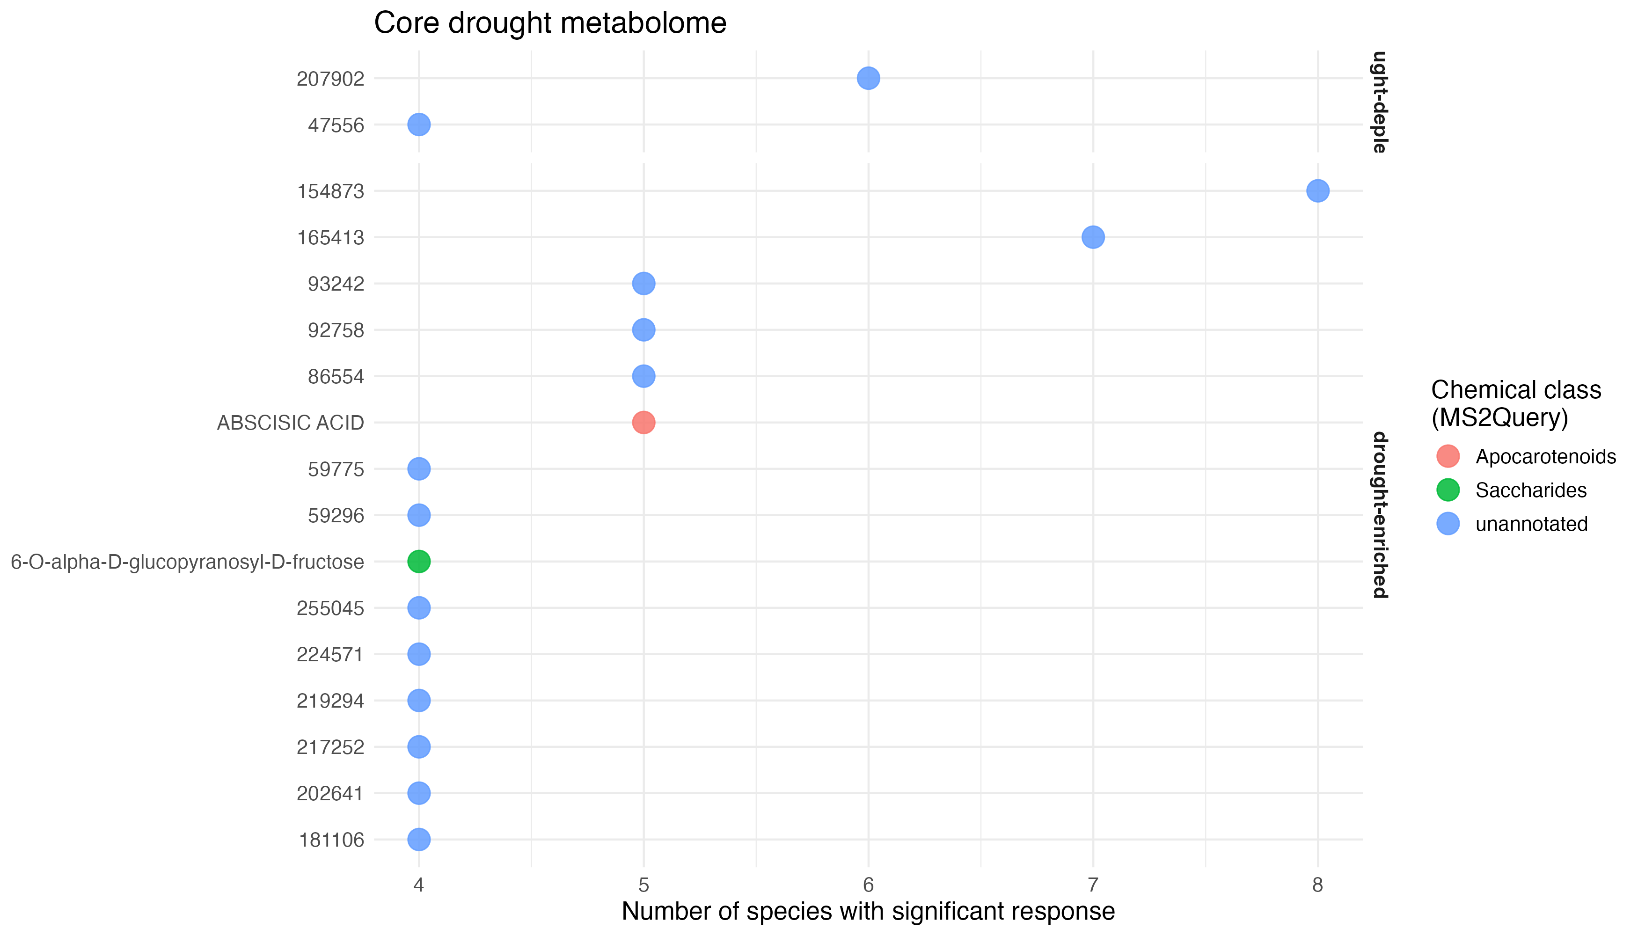
Feature 67300 (positive, n=5): ABSCISIC ACID. MS2Query annotates this as Abscisic Acid with superclass "Apocarotenoids" — that's the main drought signalling hormone in plants. The fact that our analysis independently recovers ABA as one of the most cross-species consistent drought-enriched metabolites is a direct biological validation that the method works correctly.
Feature 86554 (negative, n=5): also ABA. This is unannotated in our table but it's the exact feature the paper identifies in the text as ABA in negative ionization mode — the one that correlates with Penicillium fASV_46. So ABA appears twice in our core list, once in each ionization mode, both enriched in 5 species. Same compound, two detections.
Feature 36800 (negative, n=4): SIRIUS annotates this as dihydrophaseic acid-4-O-beta-glucoside, which is a direct breakdown product of ABA. So we have ABA itself enriched in drought, and one of its catabolites also enriched — consistent with plants ramping up the entire ABA pathway under drought.
The most intriguing features are 154873 (n=8) and 165413 (n=7) — the most cross-species consistent drought metabolites in the entire dataset, more consistent than even ABA, both completely unannotated. These are your best candidates for novel drought-associated compounds worth investigating further.

