Slide 1
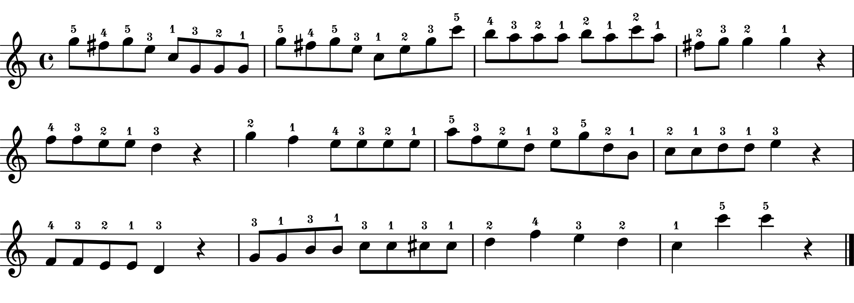
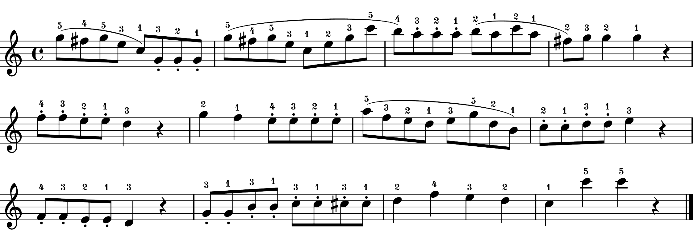
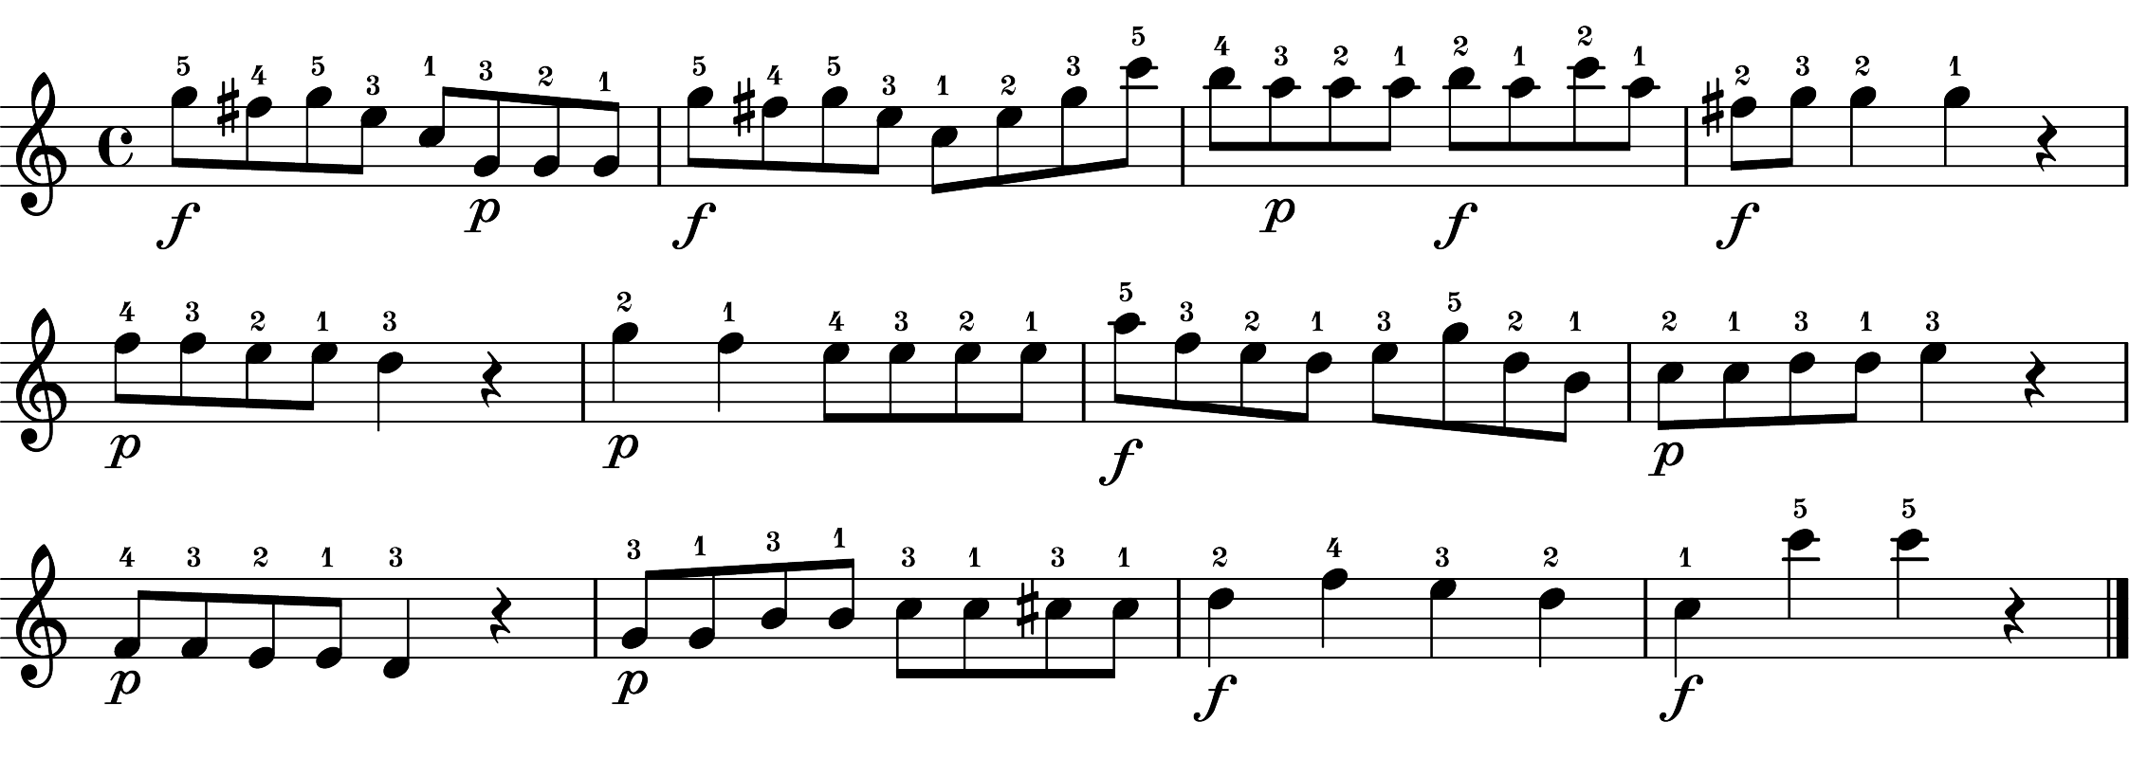
(I) Extract performances features from dataset
A. Tempo (IOIs)
B. Articulation (sound duration)
C. Dynamics (velocity profiles)
Performances without expressive notations
baseline performances
16 instances for A, B, C were generated
by averaging three of each performance
feature of baseline performances
D. Articulation (sound duration)
16 instances for D were generated
by averaging the articulation performance
feature of articulation performances
Performances with notated articulation
articulation performances
E. Dynamics (velocity profiles)
16 instances for E were generated
by averaging the dynamics performance
feature of dynamics performances
Performances with notated dynamics
dynamics performances
(II) Combine extracted features
(III) Selected recordings
(Fig. 7 – Fig. 10 for details)
None recordings (16 instances)
- Combine A, B, C
Art-only recordings (16 instances)
- Combine A, D, C
Dyn-only recordings (16 instances)
- Combine A, B, E
Both recordings (16 instances)
- Combine A, D, E
None recordings (4 instances)
- none_1, none_2, none_3, none_4
Art-only recordings (4 instances)
- art_only_1, art_only_2, art_only_3, art_only_4
Dyn-only recordings (4 instances)
- dyn_only_1, dyn_only_2, dyn_only_3, dyn_only_4
Both recordings (4 instances)
- both_1, both_2, both_3, both_4

