Slide 1
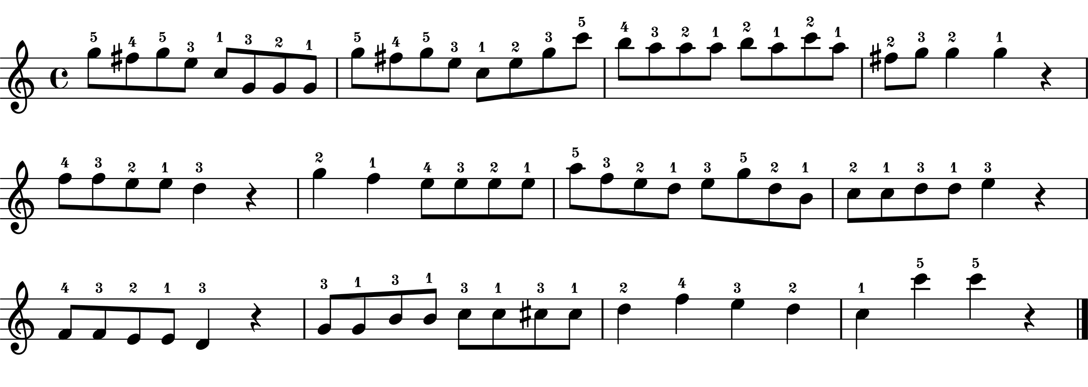
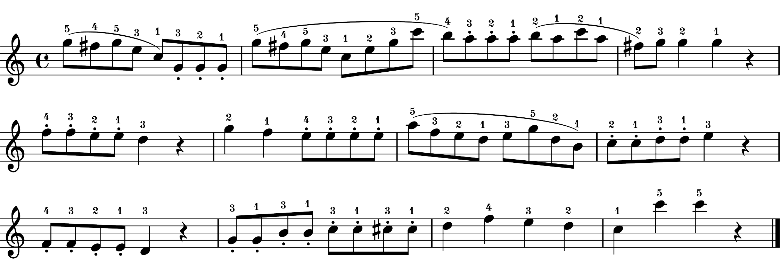
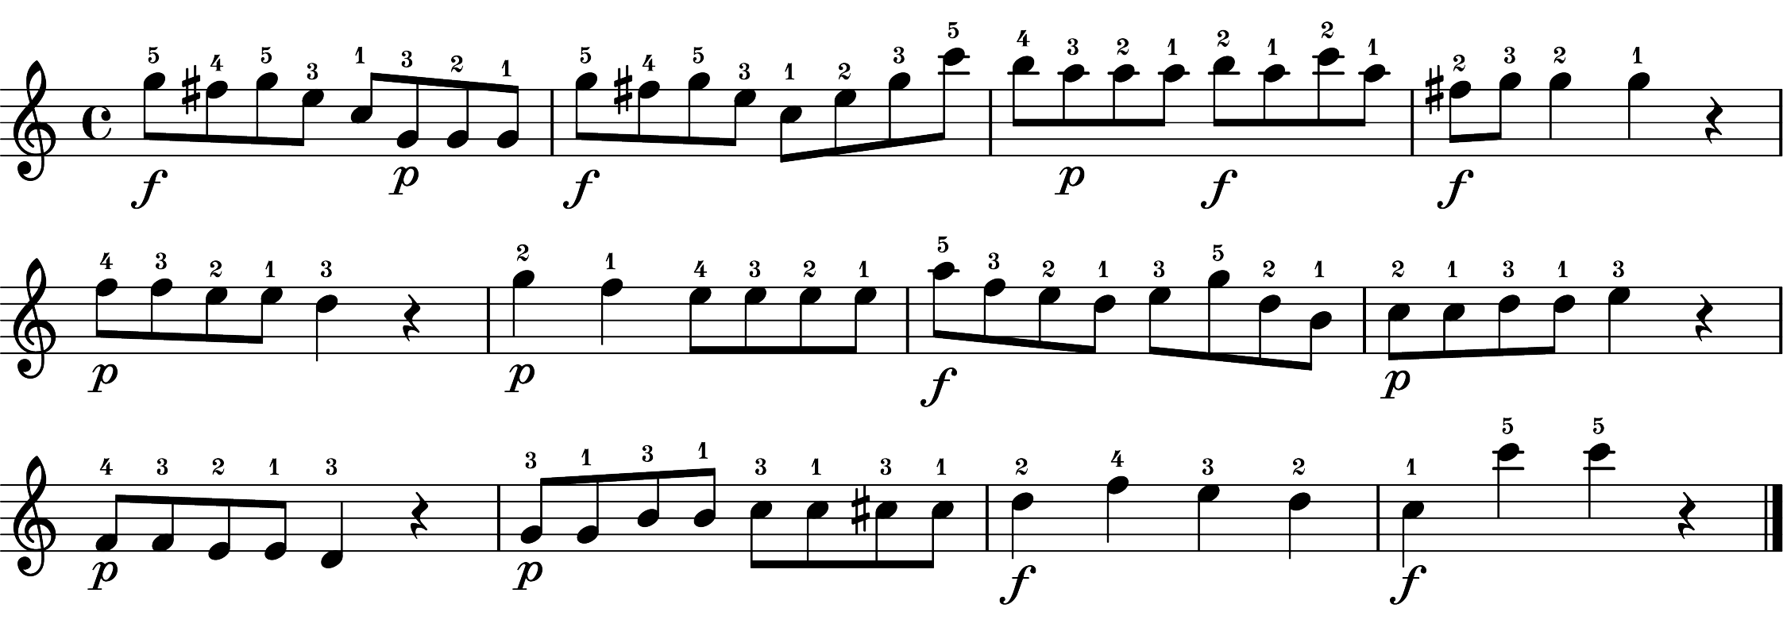
(I) Extract performances
features from dataset
A. Tempo (IOIs)
(II) Combine
extracted features
(III) Selected recordings
(Fig. S2 – Fig. S5 for details)
B. Articulation
(sound duration)
C. Dynamics
(velocity profiles)
None recordings (16 instances)
- Combine A, B, C
Art-only recordings (16 instances)
- Combine A, D, C
Dyn-only recordings (16 instances)
- Combine A, B, E
Both recordings (16 instances)
- Combine A, D, E
None recordings (4 instances)
- none_1, none_2, none_3, none_4
Art-only recordings (4 instances)
- art_only_1, art_only_2, art_only_3, art_only_4
Dyn-only recordings (4 instances)
- dyn_only_1, dyn_only_2, dyn_only_3, dyn_only_4
Both recordings (4 instances)
- both_1, both_2, both_3, both_4
16 instances for A, B, C were generated by averaging three of each performance feature of baseline performances
Performances
without expressive notations
baseline performances
D. Articulation
(sound duration)
Performances
with notated articulation
articulation performances
16 instances for D were generated by averaging the articulation performance feature of articulation performances
E. Dynamics
(velocity profiles)
Performances
with notated dynamics
dynamics performances
16 instances for E were generated by averaging the dynamics performance feature of dynamics performances

