Slide 1
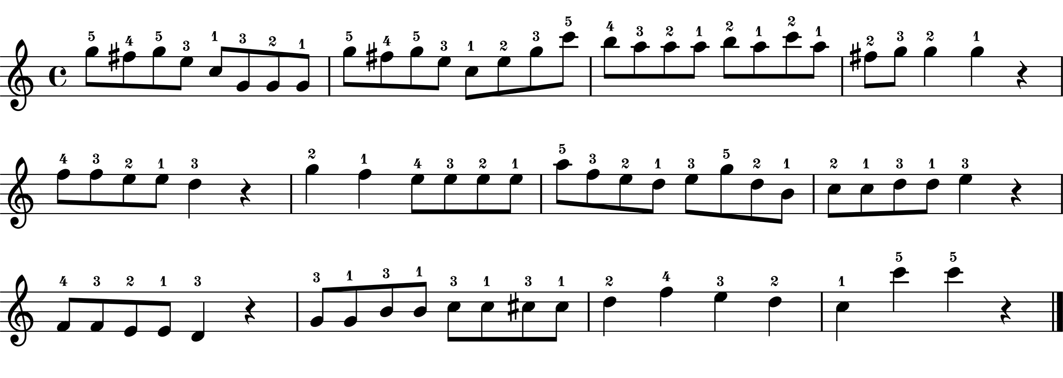
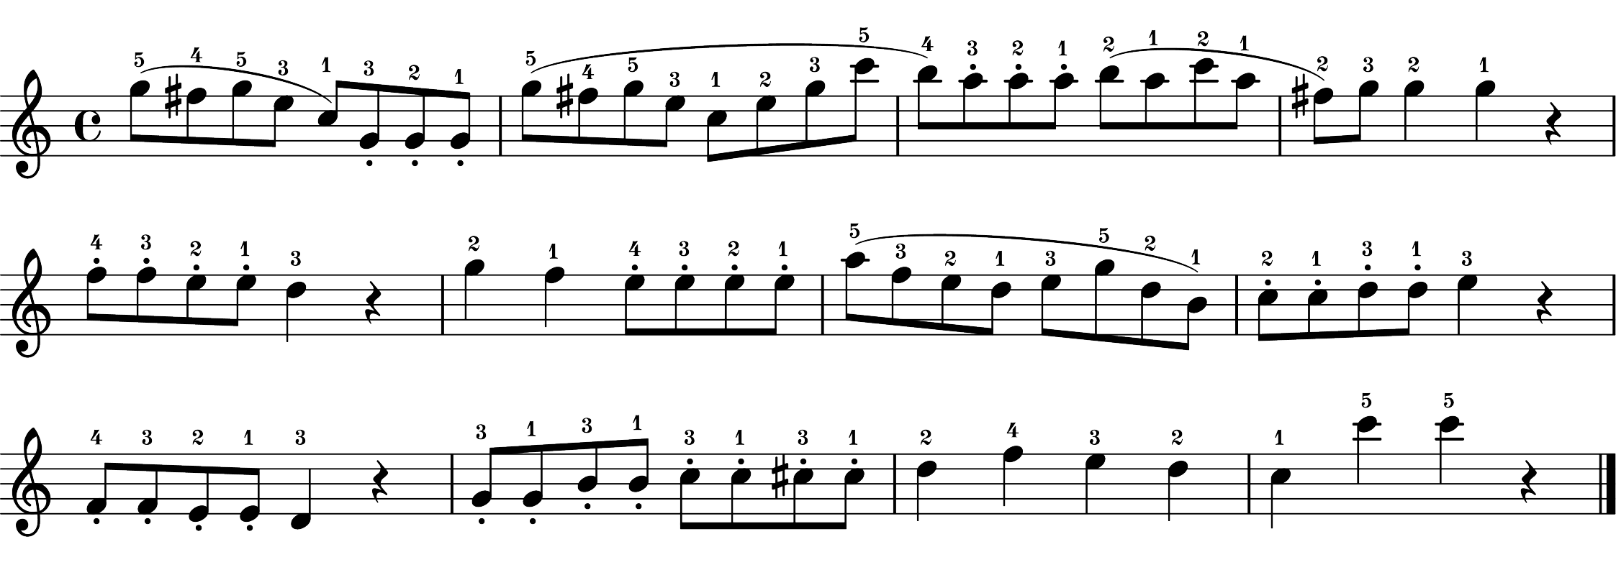
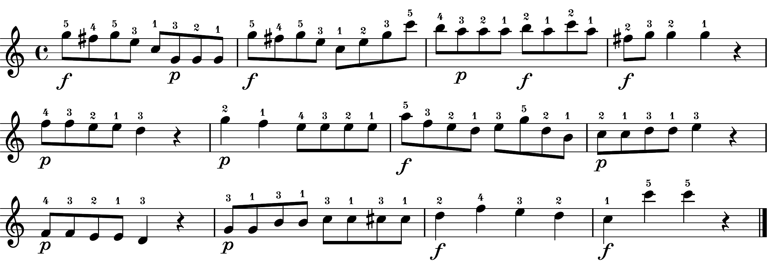
Generation of 16 instances
Per each type
Extracted performances features
A. Tempo (IOIs)
B. Articulation (sound duration)
Performances
without expressive notations
(baseline performances)
C. Dynamics (velocity profiles)
16 instances for A, B, C were generated
by averaging three of each performance
feature of baseline performances
D. Articulation (sound duration)
Performances
without notated articulation
(articulation performances)
16 instances for D were generated
by averaging the articulation performance
feature of articulation performances
E. Dynamics (velocity profiles)
Performances
without notated dynamics
(dynamics performances)
16 instances for E were generated
by averaging the dynamics performance
feature of dynamics performances
None recordings (16 instances)
- Combine A, B, C
Art-only recordings (16 instances)
- Combine A, D, C
Dyn-only recordings (16 instances)
- Combine A, B, E
Both recordings (16 instances)
- Combine A, D, E

