Slide 1
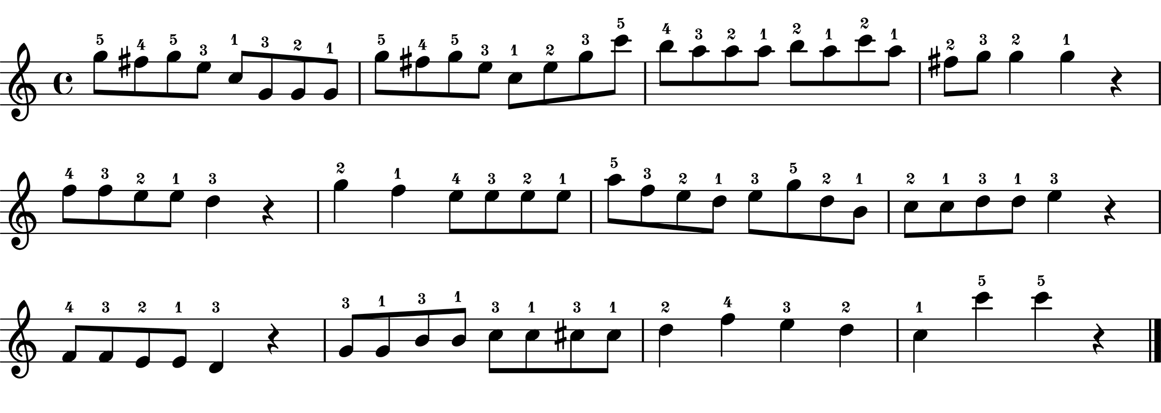
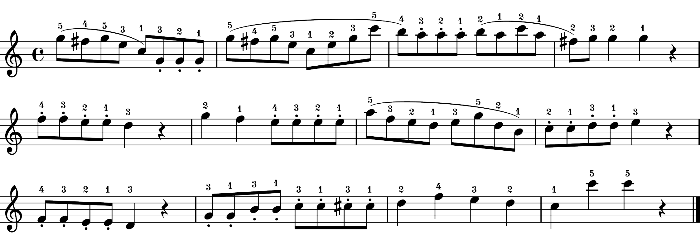
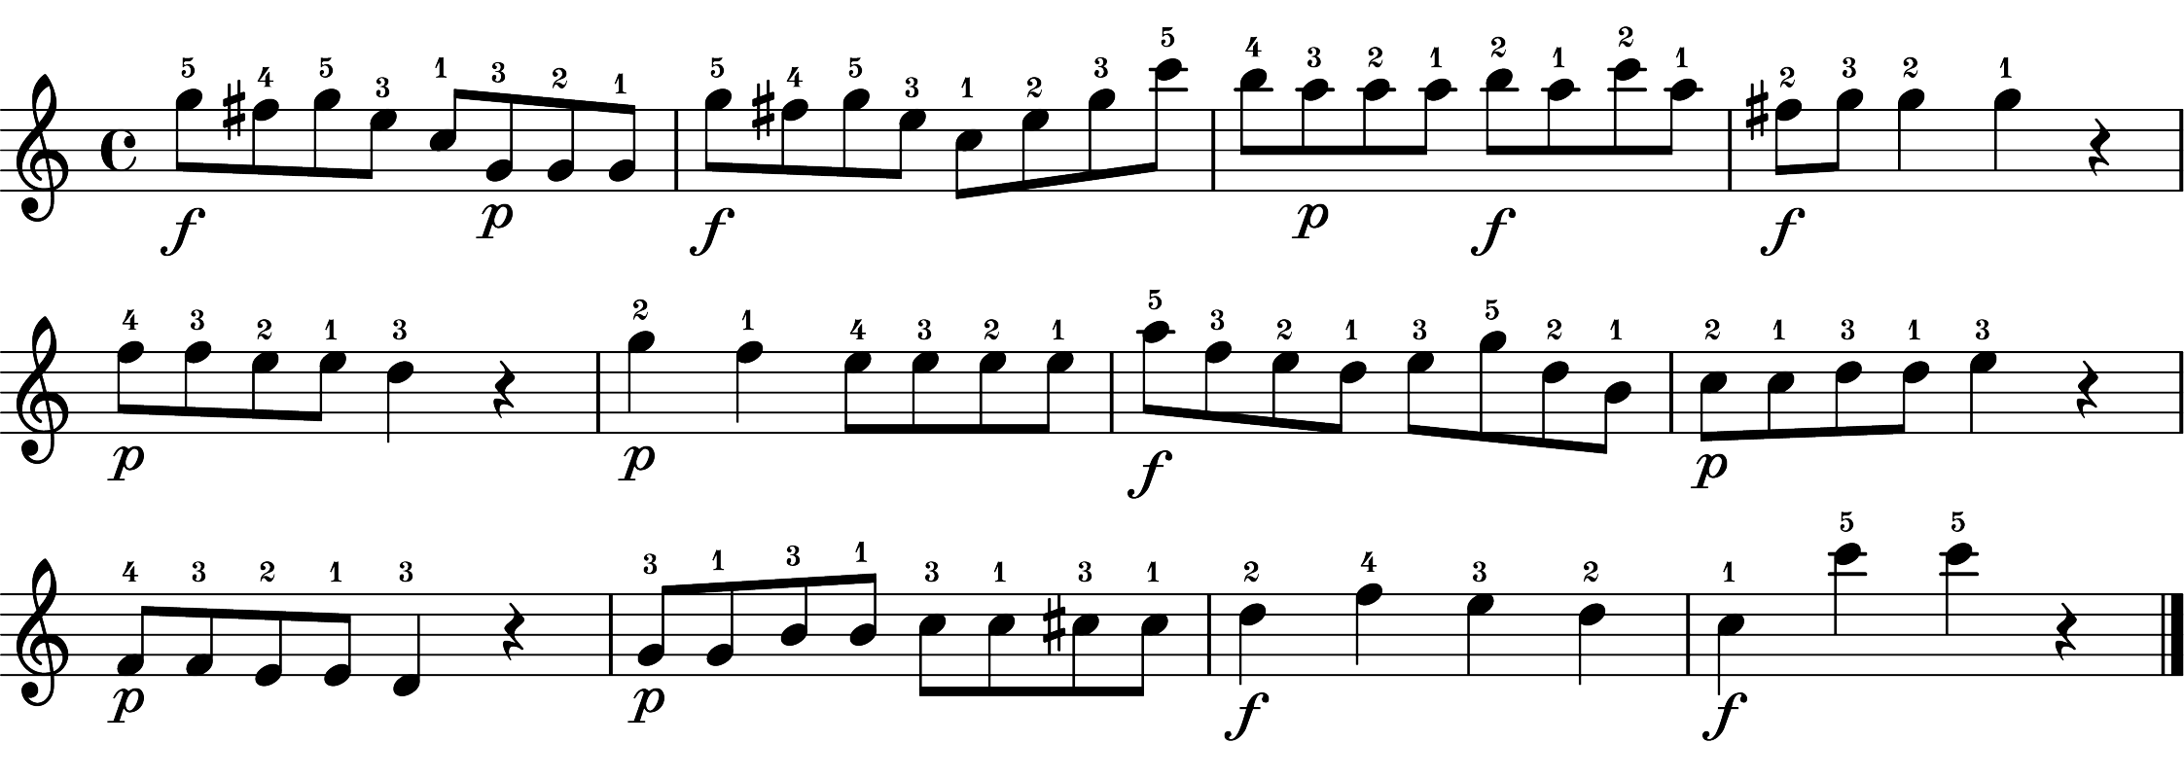
(I) Extract performances
features from dataset
(II) Combine
extracted features
A. Tempo (IOIs)
None recordings (16 instances)
- Combine A, B, C
Art-only recordings (16 instances)
- Combine A, D, C
Dyn-only recordings (16 instances)
- Combine A, B, E
Both recordings (16 instances)
- Combine A, D, E
B. Articulation (sound duration)
C. Dynamics (velocity profiles)
Performances
without expressive notations
- baseline performances
16 instances for A, B, C were generated by averaging three of each performance feature of baseline performances
D. Articulation (sound duration)
(III) Selected recordings
(Fig. S2 – Fig. S5 for details)
Performances
with notated articulation
- articulation performances
16 instances for D were generated by averaging three of
the articulation performance feature of articulation performances
None recordings (4 instances)
- none_1, none_2, none_3, none_4
Art-only recordings (4 instances)
- art_only_1, art_only_2, art_only_3, art_only_4
Dyn-only recordings (4 instances)
- dyn_only_1, dyn_only_2, dyn_only_3, dyn_only_4
Both recordings (4 instances)
- both_1, both_2, both_3, both_4
E. Dynamics (velocity profiles)
Performances
with notated dynamics
- dynamics performances
16 instances for E were generated by averaging three of
the dynamics performance feature of dynamics performances

