Slide 1
Ludus
Andrew Sullivan
3/18/15

Slide 2
What is It?
Ludus is an online fitness tracker
The focus is on simplicity and appealing UI

Slide 3
Project Goals
Create athlete account
Log daily workouts (WODs)
Create goals
Analyze progress

Slide 4
Justification
There is a need for it
All similar products are apps
Websites with same idea are:
Paid
Overcomplicated
Bad UI
Complex enough for a semester

Slide 5
Scenarios
I want to Log a workout I did yesterday
Create a new workout, add the details, and set the date to yesterday. It is then saved into your workout log.

Slide 6
Scenarios
I am running a race next month and want to have set a goal of a 5 minute mile by then.
Create a new goal for running a 5 minute mile. Make the deadline the date of your race. When you reach it, check it off.

Slide 7
Scenarios
I want to see how much I have progressed since I started.
Go to your log and search your logged workouts by date
Go to your profile and see the percentages of your strength increase since the first logged workout

Slide 8
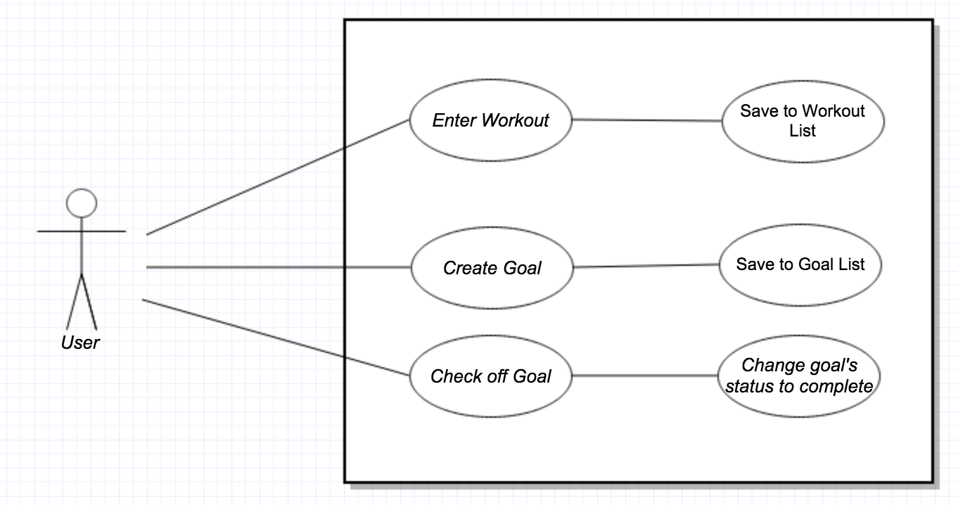
UML Use Case Diagram

Slide 9

Navigation

Slide 10
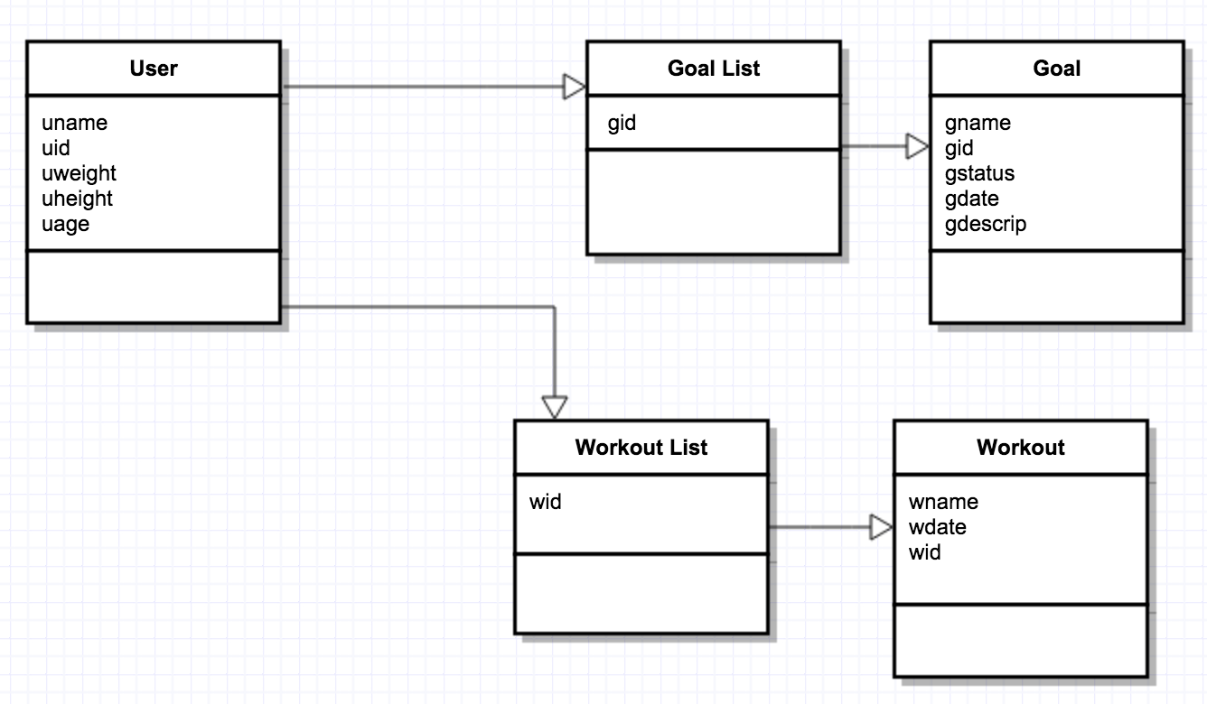
Class Diagrams

Slide 11
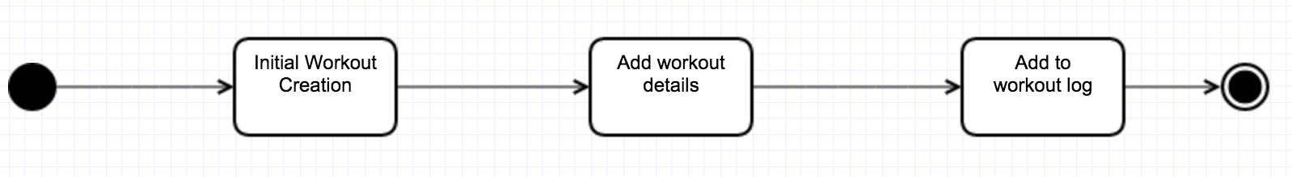
State Diagram Add workout

Slide 12
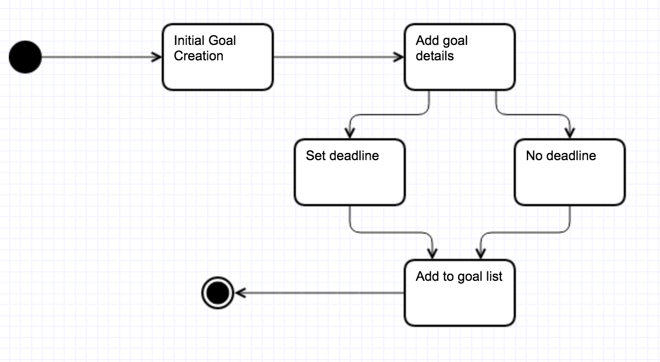
State Diagram Add Goal

Slide 13
Project Challenges
Building API
Little experience
Using new technologies
User Interface
Deciding on form of UI
Balancing simplicity while not avoiding necessary features

Slide 14
Accomplishments
Started API
Decided on Technologies for Backend
Node.js
Hapi.js
Neo4j
Began Landing Page
Began Profile Page
Status Report
Next Week’s Plans
Make progress on API
Account creation
Finalize navigation for UI
Risks / Help Needed
No risks identified so far
May need help with backend

Slide 15
Questions?

