Slide 1
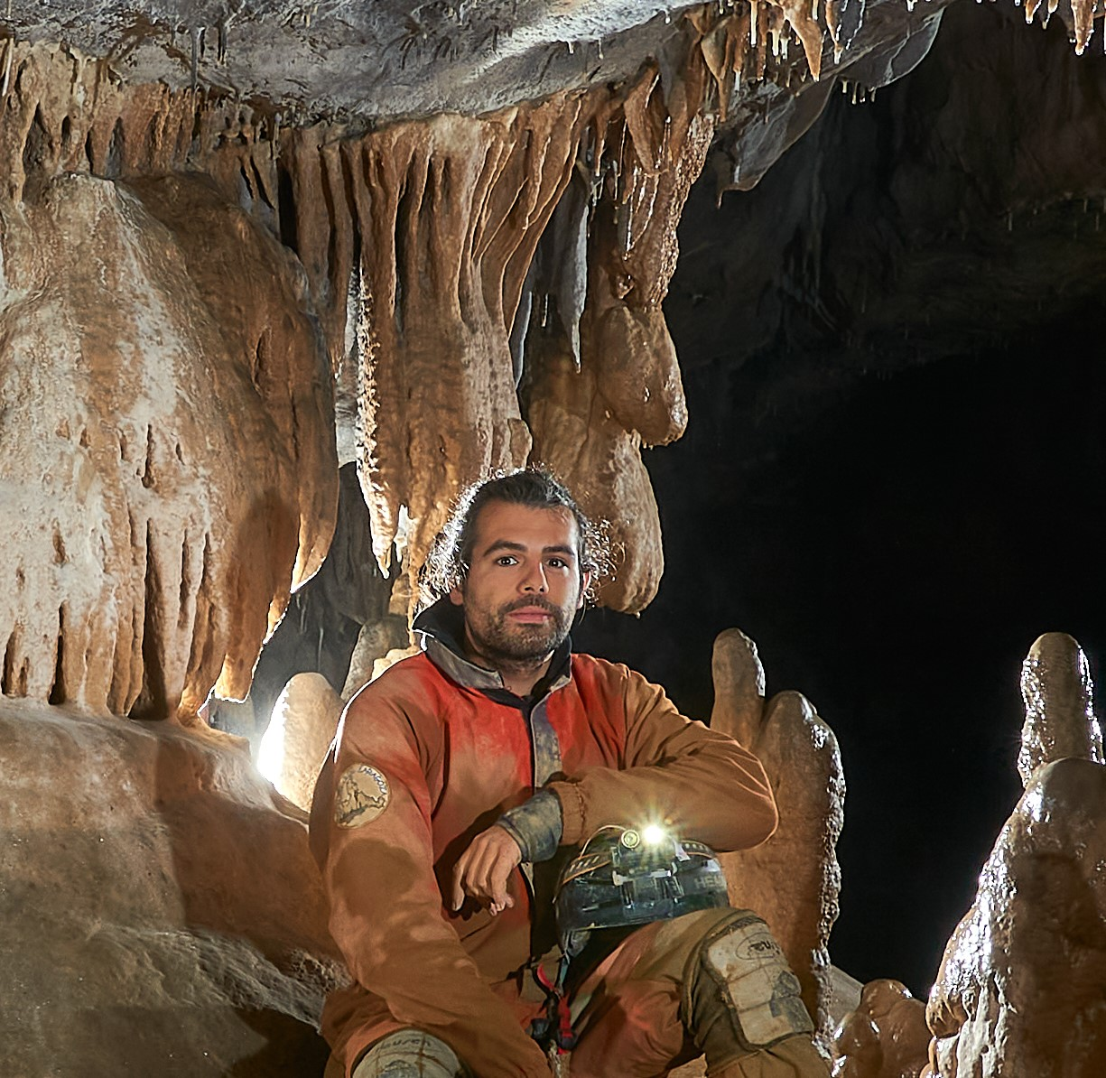


Online Young Scientist School (YSS) MEGAPOLIS 2022
Modelling of water erosion, its hydrological and geochemical impacts
Day 1 — December 1st, 2022
IVAN LIZAGA
Past, present and future of sediment fingerprinting

Slide 2

Online Young Scientist School (YSS) MEGAPOLIS 2022
Modelling of water erosion, its hydrological and geochemical impacts
Day 2 — December 2nd, 2022
Zhengzheng Zhou
Extreme storm analysis and Machine learning applications for rainfall prediction in urban areas

Slide 3
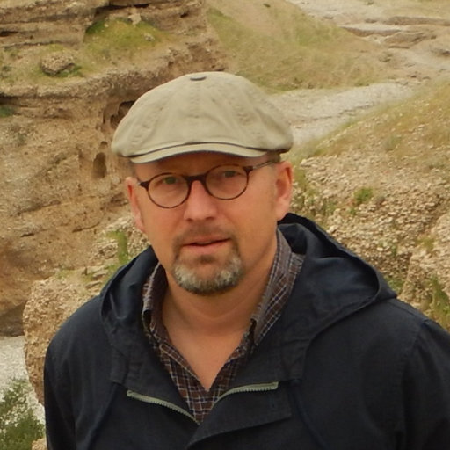
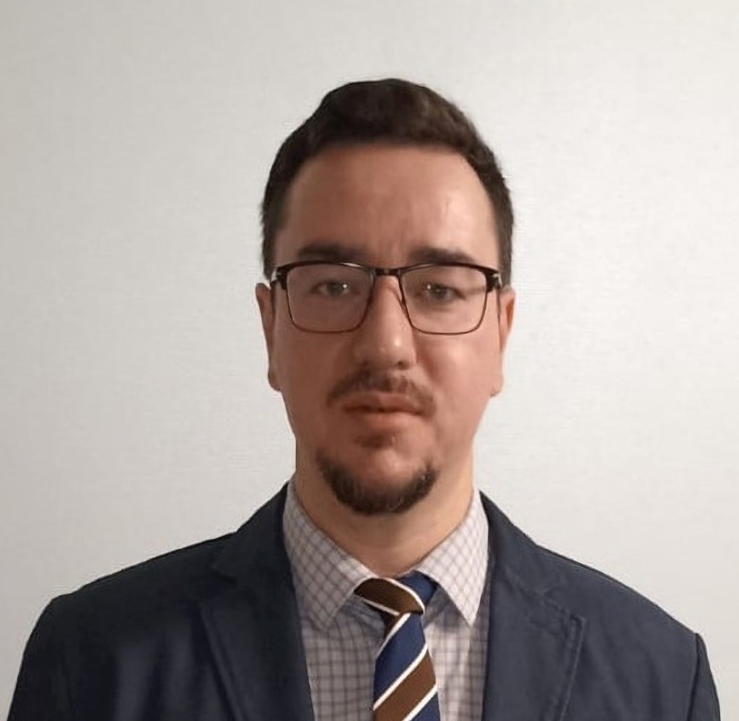
Online Young Scientist School (YSS) MEGAPOLIS 2022
Modelling of water erosion, its hydrological and geochemical impacts
Day 3 — December 3rd, 2022
Michael maerker
Integrated Soil Erosion Assessment: Concepts, Methods and Applications
Andrey Zhidkin
Historical reconstruction and forecast of soil cover degradation based on erosion modeling and field soil survey data

Slide 4
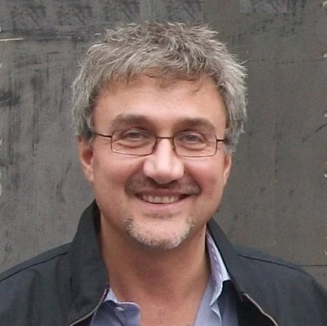

Online Young Scientist School (YSS) MEGAPOLIS 2022
Modelling of water erosion, its hydrological and geochemical impacts
Day 4 — December 5th, 2022
Paolo Porto
¹³⁷Cs traditional and re-sampling approaches to estimate soil erosion for different time scales
Anatoly Tsyplenkov
Soil erosion modeling in R (workshop)

Slide 5
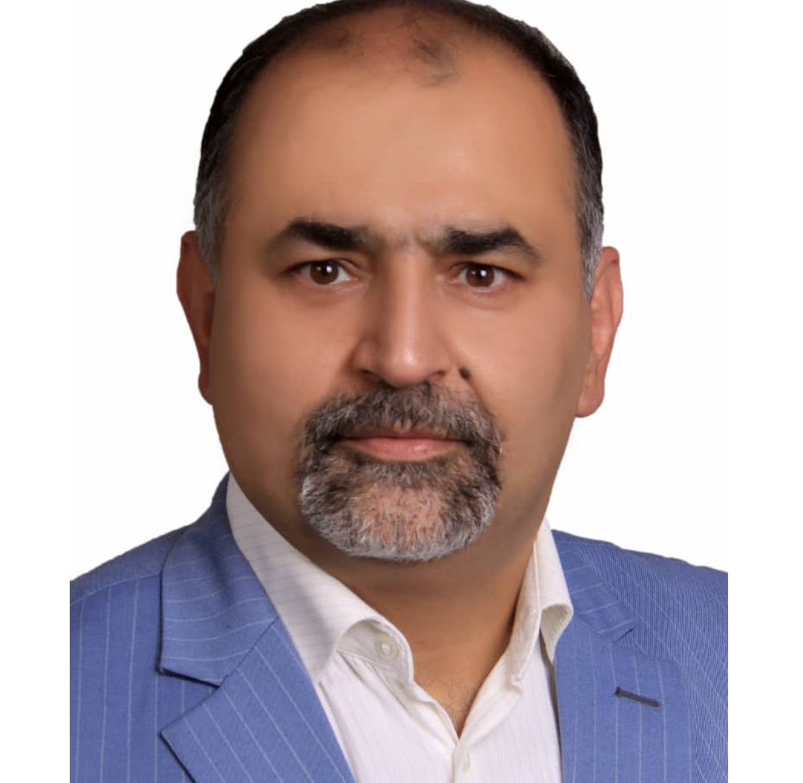
Online Young Scientist School (YSS) MEGAPOLIS 2022
Modelling of water erosion, its hydrological and geochemical impacts
Day 5 — December 6th, 2022
Seyed Hamidreza Sadeghi
Necessity of the Watershed Health Assessment in Hydrology

