Slide 1
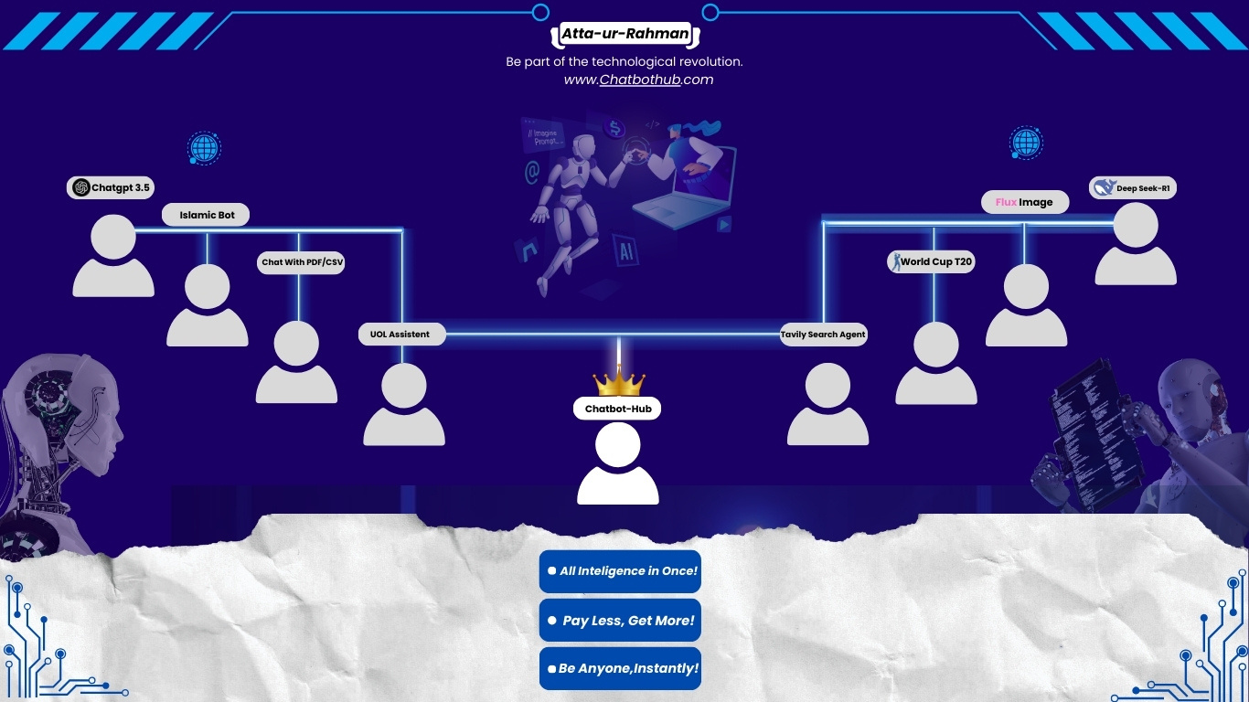

Slide 2


PAGE 01
CHATBOT-HUB
Pay less get more
https://generative-ai-hub-and-chat-bots.vercel.app/login

Slide 3
Contents:
PAGE 02
Introduction
Problem Identification
Problem Statement
A Rising Competitor in LLMs
Dataset info
Fine tunning Results
Future Prospects
Future of LLMs

Slide 4
PROBLEM IDENTIFICATION
PAGE 03
The current AI landscape is highly fragmented, with various models like ChatGPT-4, Gemini, LLaMA-2, and others requiring separate subscriptions. This scattered approach increases costs and complicates accessibility, making it difficult for users to leverage AI efficiently. The financial burden restricts innovation and prevents seamless AI integration within the computer science community. Additionally, there is a lack of specialized AI bots tailored to specific domains such as university-related information, cricket, politics, and current events. Users often struggle to find AI solutions that cater to their unique interests in a single platform. Furthermore, the absence of efficient tools for personal data analysis limits users' ability to extract meaningful insights. A system that allows users to upload files and interact with a chatbot for data-driven decision-making is essential. Addressing these challenges, a unified AI platform with domain-specific bots and personalized data analysis capabilities can enhance accessibility, affordability, and user experience.

Slide 5
PROBLEM Statement
PAGE 04
There is no unified AI platform that integrates multiple AI models, offers domain-specific chatbots, and enables personal data analysis. This fragmentation leads to increased costs, accessibility challenges, and inefficiencies for users seeking AI-driven insights. A centralized AI platform is needed to streamline access, reduce expenses, and provide tailored solutions for various domains and data-driven decision-making

Slide 6

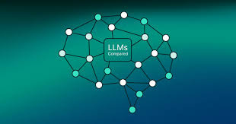
PAGE 05
LLMs
ADVANCED NATURAL LANGUAGE PROCESSING
1.
LLMs, such as ChatGPT, Gemini, and LLaMA, are trained on vast datasets to understand and generate human-like text, enabling tasks like content generation, translation, and question-answering.
2.
HIGH DATA AND COMPUTATIONAL REQUIREMENTS
Training LLMs requires massive amounts of data and extensive computational power, making them resource-intensive and costly to develop and maintain.
3.
SCALABILITY AND ETHICAL CHALLENGES
While LLMs can be fine-tuned for various applications across industries, they raise concerns about bias, misinformation, and responsible AI usage, highlighting the need for ethical considerations and continuous improvements.

Slide 7


STUDIO SHODWE
Limitations
PAGE 06
High Computational Cost.
Model Integration Challenge
Data Privacy and Security Risks
Internet Dependency

Slide 8
PAGE 07
Overview Of Proposed Solution
We propose a unified AI platform that brings multiple LLMs together in one place, allowing users to access premium AI models under a single subscription. The platform also enables users to upload PDF and CSV files, interact with them using AI, and leverage fine-tuned models for domain-specific queries."
Key Features of Our Solution:
✅ Multiple LLMs in One Platform – Access ChatGPT-4, deepseek-R1, LLaMA, and other models under a single subscription.
✅ Cost-Effective Premium AI Access – No need for multiple expensive subscriptions; one plan unlocks several AI models.
✅ File Upload & AI Interaction – Upload PDFs and CSVs, ask questions, and extract insights instantly.
✅ Fine-Tuned AI Models – Specialized models trained for University of Lahore (academic queries) and Cricket.
✅ Seamless Switching Between LLMs – Choose the best model for different tasks effortlessly

Slide 9

STUDIO SHODWE
PAGE 08
A RISING COMPETITOR IN LLMS
1.
WHAT IS DEEPSEEK?
2.
IMPACT ON OPENAI
3.
IMPACT ON NVIDIA
DeepSeek is an advanced AI research company focused on open-source large language models.
Competing with major players like OpenAI and NVIDIA by developing high-performance, cost-efficient AI models.
DeepSeek’s open-source approach challenges OpenAI’s closed ecosystem.
Provides affordable AI alternatives, attracting developers and enterprises looking for customizable AI models.
DeepSeek’s optimization of AI models for smaller hardware could reduce dependency on NVIDIA’s high-end GPUs.
Encourages competition in AI hardware efficiency, pushing for cost-effective AI training.

Slide 10

PAGE 09
DATASET COLLECTION
1.
UNIVERSITY OF LAHORE WEBSITE
Academic programs, faculty details, admission info, student guidelines.
2.
CRICINFO
Player stats, match records, team rankings.
dataset link

Slide 11
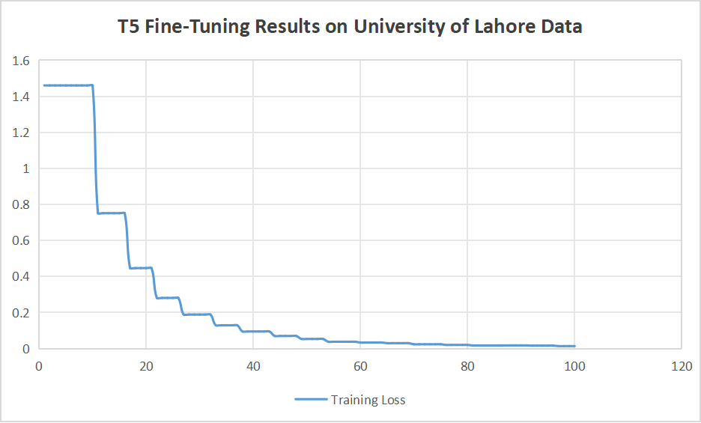
T5 Fine-tunning Graph
PAGE 10

Slide 12
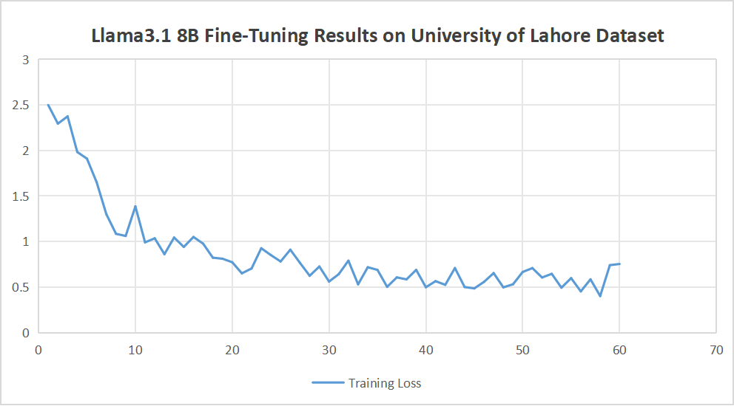
Llama3.1 8B Fine-tunning Graph
PAGE 11

Slide 13
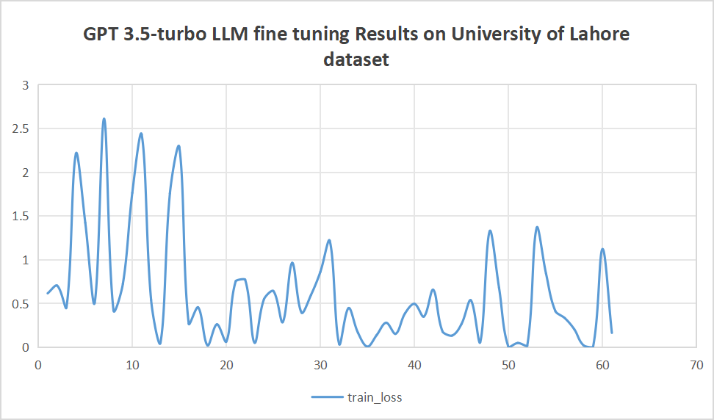
GPT 3.5-turbo Fine-tuning Graph
PAGE 12

Slide 14
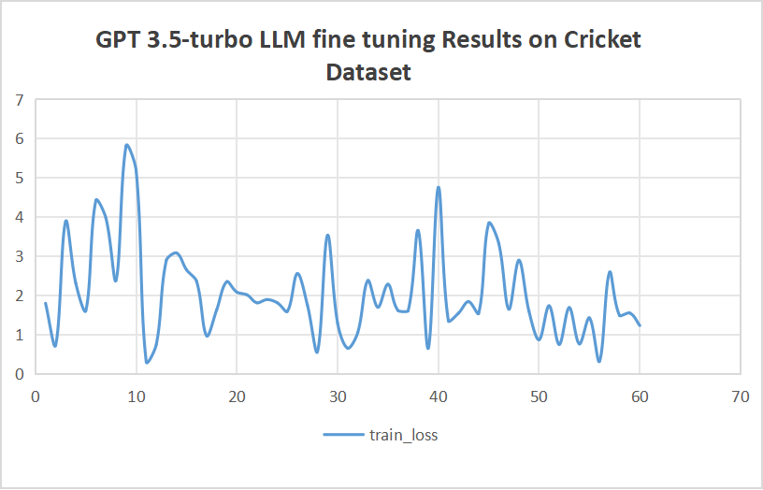
GPT 3.5-turbo Fine-tuning Graph
PAGE 13

Slide 15


PAGE 14
FUTURE
PROSPECTS
1️⃣ Expansion of LLMs & AI Capabilities
More AI Models (Claude, Mistral, Future OpenAI Models)
Custom Model Selection & Switching
Multimodals.
2️⃣ Advanced File Analysis & Insights
Support for More File Types (Word, Excel, JSON)
AI-Powered Summarization & Data Extraction
Real-Time Data Processing & Visualization
3️⃣ Domain-Specific AI Expansion
More Fine-Tuned Models (Medicine, Law, Finance)
Integration with Real-Time APIs (University Portals, Sports Data, Finance)

Slide 16

FUTURE OF LLMS
PAGE 15
Automation & AI Agents 🤖 – LLMs will power autonomous agents that automate workflows, assist in decision-making, and handle complex tasks with minimal human intervention.
Multimodal & Personalized AI 🎨🔊 – Future LLMs will integrate text, images, audio, and video, providing more interactive experiences while adapting to individual user needs.
Scalability & Ethical AI ⚖️ – Advances in AI hardware will make LLMs more cost-efficient, while stricter regulations will ensure fairness, transparency, and responsible AI usage.

Slide 17
THANK
YOU!

