Slide 1
Emotion Integrated Music Recommendation System Using Generative Adversarial Networks
Mrinmoy Bhaumik; Patricia U Attah
Dr. Faizan Javed

Slide 2
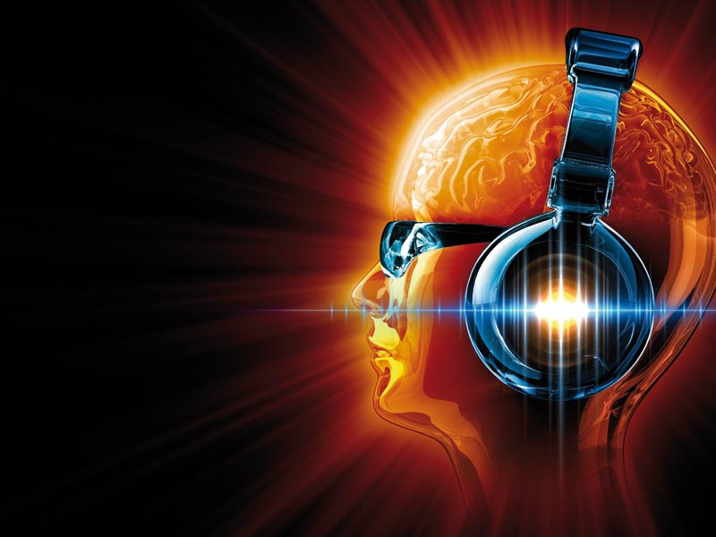
Music is an important aspect of the human experience
It has the ability to evoke an emotional response
Music can be a way for people to regulate, enhance and even lower negative the amount of negative emotional states
Many studies have been done to show the relationship between music and emotion

Slide 3
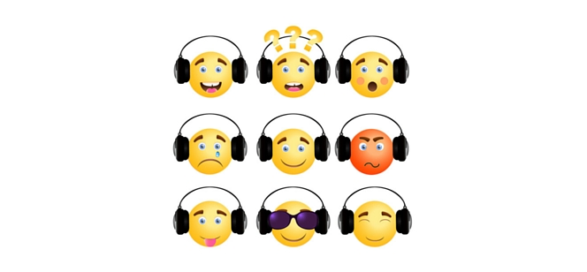
The enjoyment of pleasurable or happy music is appears to involved the same dopamine systems of the brain that typically involved in highly reinforcing and addicting behaviors
Memories are also evidence of the connection between music and emotions. Musical emotion and memory and known to last when other forms of the memory tend to disappear
Music doesn’t only evoke emotions to people personally it can also affect large groups of people. Such as happy or sad music being played at concerts or calm and relaxing music being played at restaurants or stores
Mood regulation is also common in music where people can listen to music to regulate their mood. Often times people can listen to music where the lyrics resonate with them personally and help voice feelings that they can’t explain on their own.

Slide 4
Music Recommendation
In this day and age one of the popular ways to listen to music is through streaming services like Spotify, Tidal, or Apple Music
One of the problems that is currently being worked and improved upon is music recommendation.
Recommendation systems have been used in multiple industries to help predict a rating or preference a user would have for a specific item
The music recommendation system is currently a very interesting topic since music and musical taste is so varied and each individual user is very different
Emotion has a strong connection to music and would be a key feature in helping build a strong music recommendation system
A good music recommender system can be built while using emotion as a key feature while using some sort of deep learning model

Slide 5
Music Recommendation With GAN
There have been emotion based music recommendation systems that have used deep learning models like CNN ( Convolutional Neural Networks)
These models have shown promise but in this problem we want to see if we can build off that
Instead of using CNN we will be using a GAN
GAN is a generative adversarial network
GANs are typically used for classification problems, specifically image classification
GANs consists of a network of two models, one called the generator and the other called the discriminator

Slide 6
Music Recommendation With GAN
The generator model will take a random input vector and try to use that input and generate a new and different output example (fake data)
The discriminator model will then take any of the original data (real data) and the fake data and try to be able to classify whether the data is real or fake
This goes on during the training process and the discriminator model is usually discarded and the user is left with the generator model as the model
There has been some recent literature pointing to the fact that GAN recommendation systems can compete as well or even better than other deep learning recommendation systems
We want to see how well an emotion based music recommendation system will do with a GAN

Slide 7
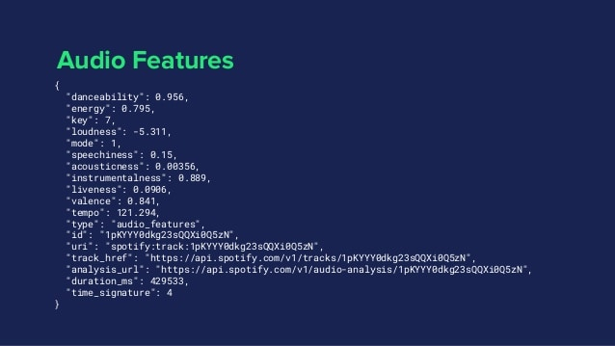
DATA
Data that was gathered was from the Spotify API
Consists of two data sets
Data set A 18454 songs and 25 features
Data set A 686 songs and19 features

Slide 8
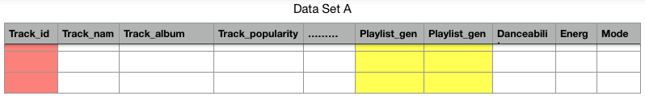
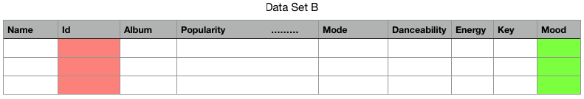
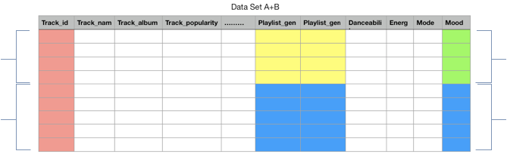
Data Generation
Data set A
Playlist genre
Playlist subgenre
Rows - 18454
Columns - 25
Data set B
Mood
Rows - 686
Columns - 19
Partial
labeled
Supervised
Learning model
Unsupervised
Learning model
Mostly
unlabeled
Semi Supervised model created data set

Slide 9
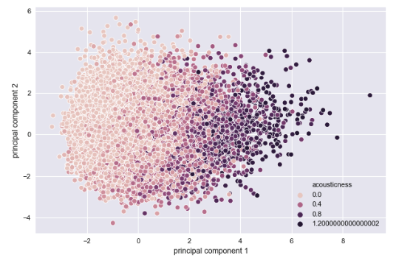
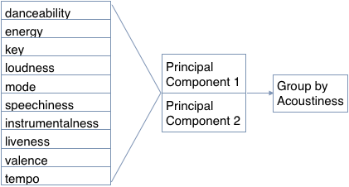
Data Exploration
Data set A

Slide 10
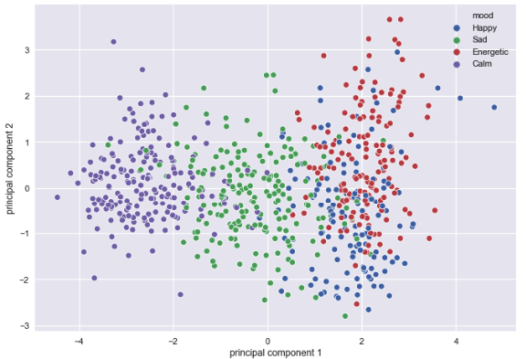
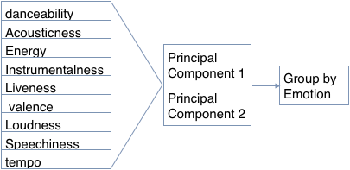
Data Exploration
Data set B

Slide 11
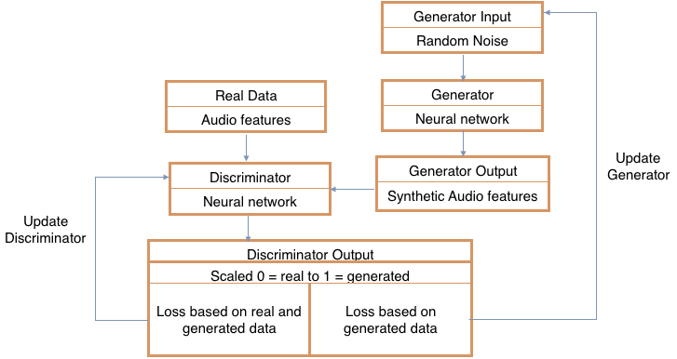
GAN Flow chart

Slide 12
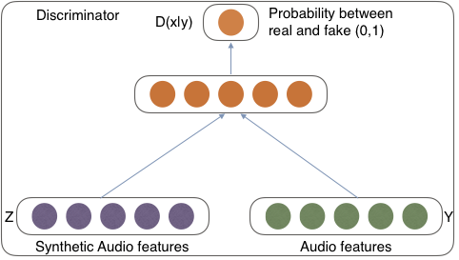
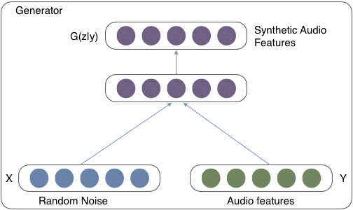
GAN Components

