Slide 1
ANALYTICS: Superstore

Slide 2
Project Overview
Introduction: This project analyzed Superstore dataset with different tools to arrive at meaningful findings and insights.
Objectives: To determine
The total revenue of Superstore.
The region with the highest sales.
The region with the lowest sales.
The product category that contribute the most sales.
The sales trend of Superstore.

Slide 3
Outcome
Power BI and Microsoft Excel dashboards showing valuable insights for decision making.

Slide 4
Tools Used
Microsoft Excel: Data cleaning and dashboard.
Power BI: Dashboard and descriptive statistics.
Python: Data cleaning and descriptive statistics.

Slide 5
Insights and Visualizations
This section summarizes key findings using Power BI and Excel supported by Python for data exploration.
Key findings:
The total revenue of Superstore was 2.30M.
The average profit of Superstore was 29K.
The region with the highest sales was the West with a total sales of 728K.
The region with the lowest sales was the south with a total sales of 389K.
The product category that contributed the most sales was Technology with a total sales of 836K.
For the four year period (2019-2022), 2021 recorded the highest sales with 0.73M whiles 2019 recorded the lowest sales with 0.48M.

Slide 6
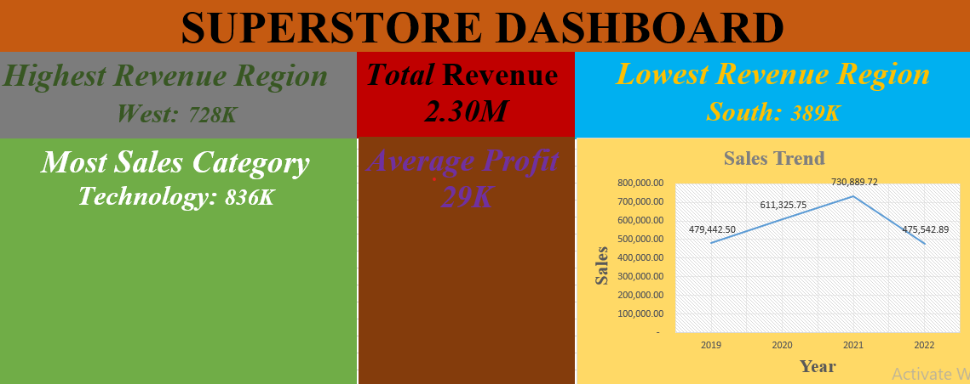
Excel Dashboard

Slide 7
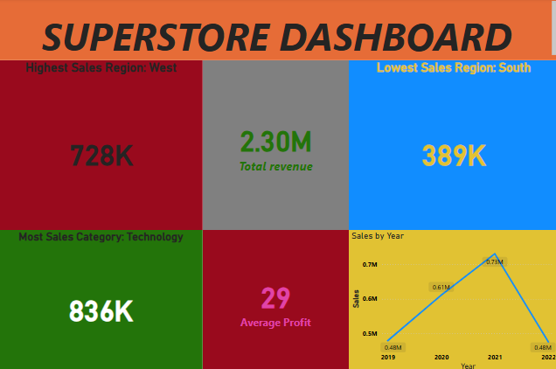
Power BI Dashboard

Slide 8
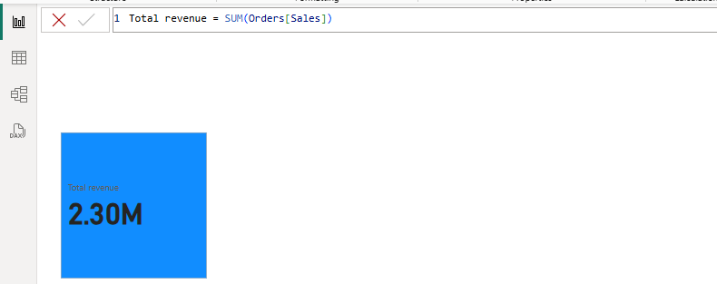
Power BI operations
Total Revenue

Slide 9
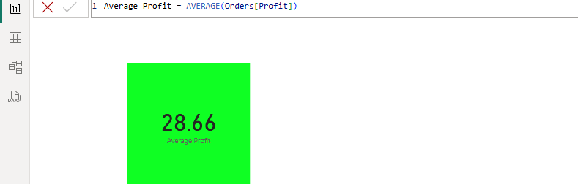
Power BI operations
Average profit

Slide 10
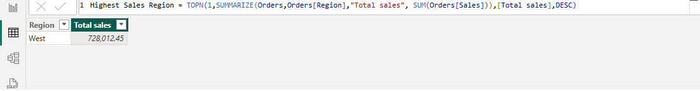
Power BI operations
Region with the highest sales

Slide 11
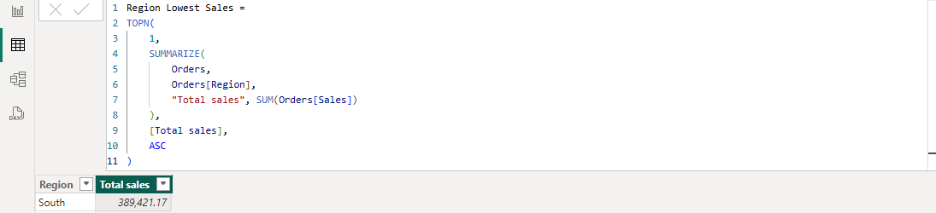
Power BI operations
Region with the lowest sales

Slide 12
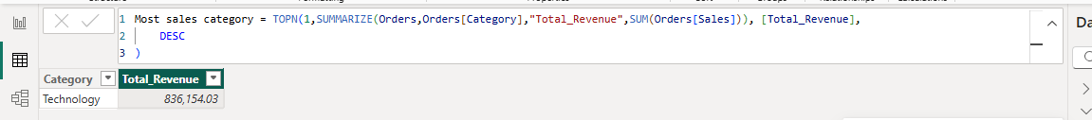
Power BI operations
Product category with the highest sales

Slide 13
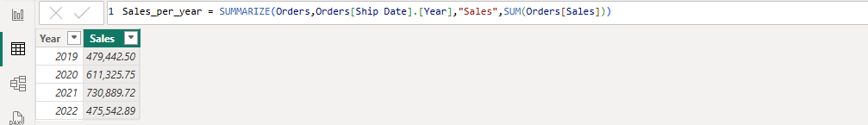
Power BI operations
Sales trend

Slide 14
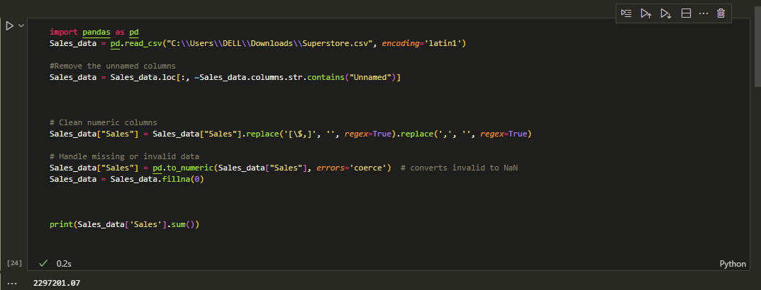
Python operations
Data cleaning and total Revenue

Slide 15
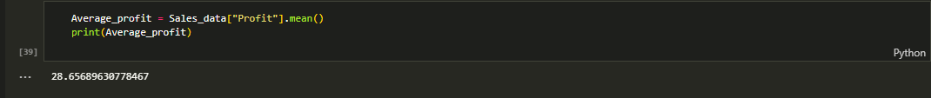
Python operations
Average profit

Slide 16
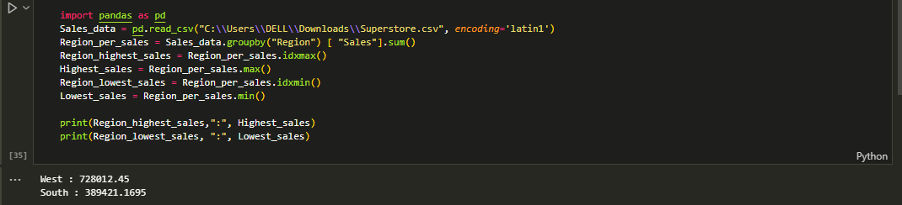
Python operations
Regions with the highest and the lowest sales

Slide 17
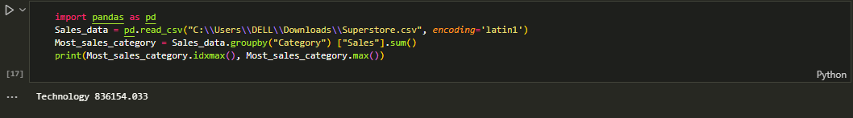
Python operations
Product category with the highest sales

Slide 18
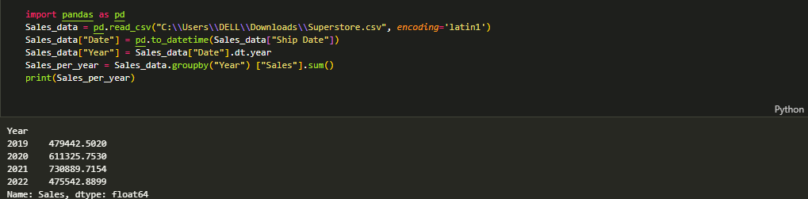
Python operations
Sales trend

