Slide 1
INSIGHTS: Titanic Dataset

Slide 2
Project Overview
Introduction: This project analyzes Titanic dataset with different technologies to derive insights.
Objectives: To determine
The average age of passengers.
The Proportion of male to female passengers
The survival rate of passengers
The class of passengers with the highest survival rate
The distribution of passenger fares

Slide 3
Outcome
Two similar dashboards built with Power BI and Microsoft Excel highlighting vital insights.

Slide 4
Technologies Used
Microsoft Excel: Data cleaning and dashboard.
SQL: Data definition, manipulation and querying.
Power BI: Dashboard and descriptive statistics.
Python: Data cleaning and descriptive statistics.

Slide 5
Insights and Visualizations
This section summarizes key findings using Power BI and Excel supported by Python and SQL for data querying, definition, manipulation and descriptive statistics.
Key Insights:
The average age of passengers on the ship was 28.53 years.
The survival rate of passengers on was 38.38%.
Male passengers formed 64.76% of total passengers whiles female passengers form 35.24% of the total passengers.
Class 3 passengers had the highest survival rate with a survival count of 491 out of 891 passengers.
Passengers who paid 8.05 as fare were more than any other group of passengers in terms of fare.
The least number of passengers onboard paid between 4.0125 and 221.7792 as fare.

Slide 6
Insights and Visualizations
7. The mean fare paid by passengers was 32.20.
8. The standard deviation of fares paid by passengers was 49.69.
9. The minimum and the maximum fares paid by passengers were 0.00 and 512.33 respectively.

Slide 7
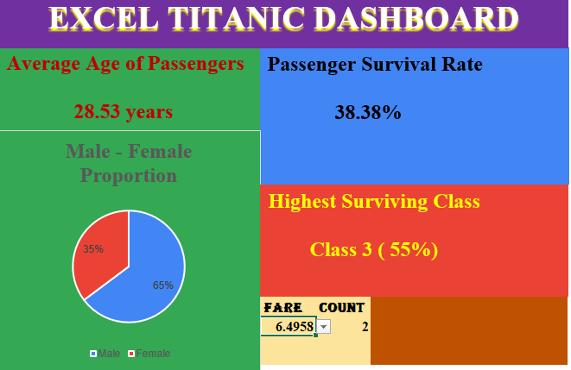
Excel Dashboard

Slide 8
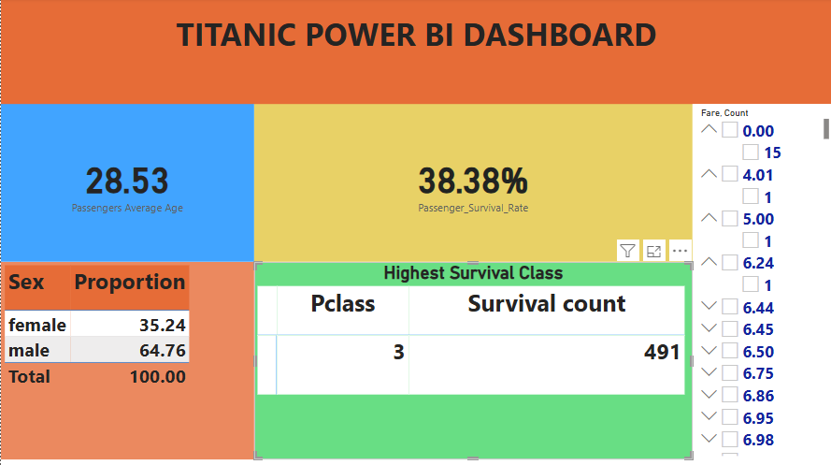
Power BI Dashboard

Slide 9
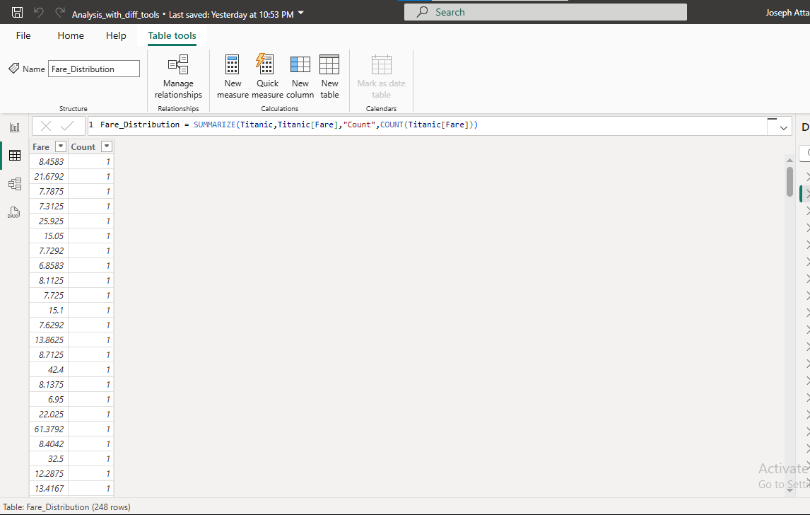
Power BI operations
Fare distribution

Slide 10
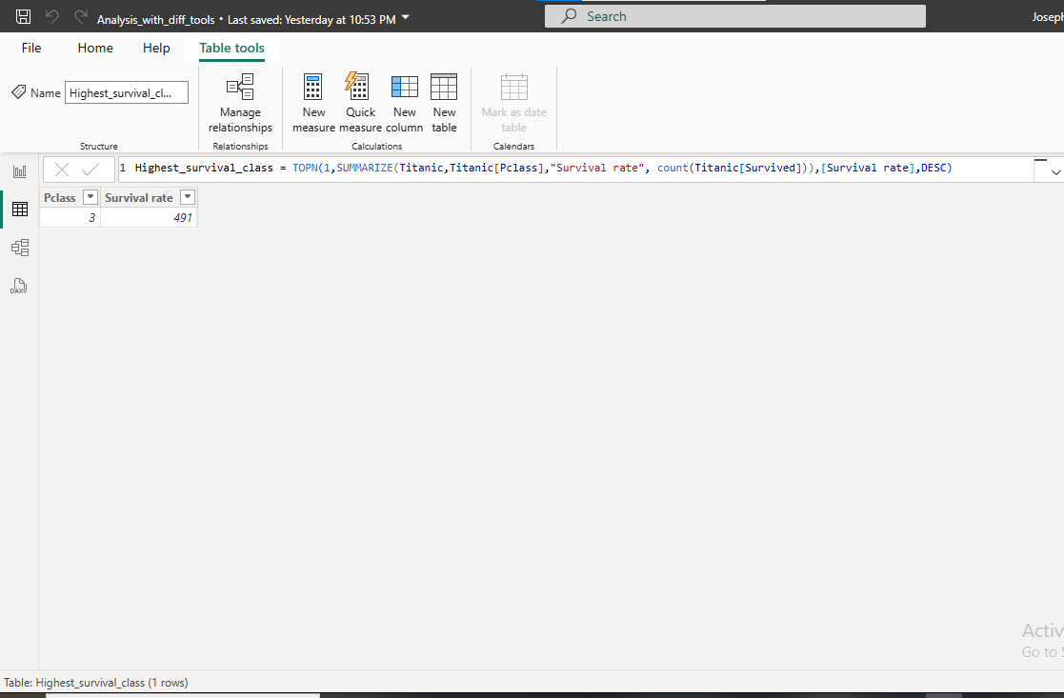
Power BI operations
Highest surviving class

Slide 11
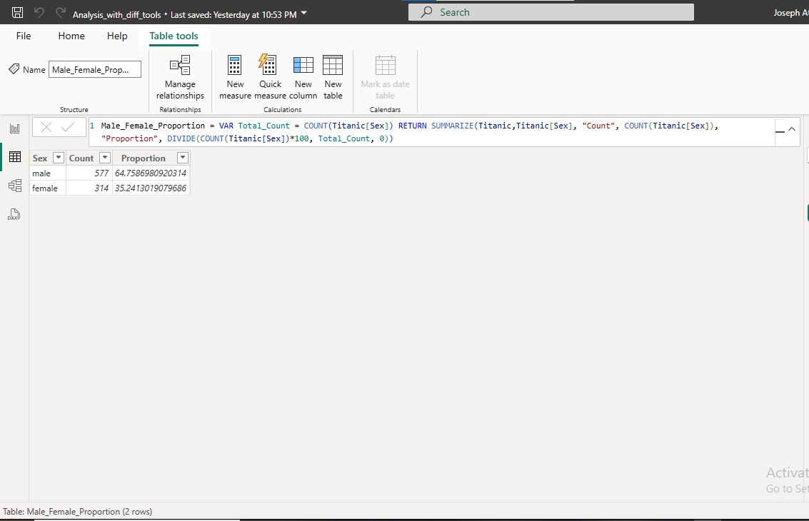
Power BI operations
Male – Female Proportion

Slide 12
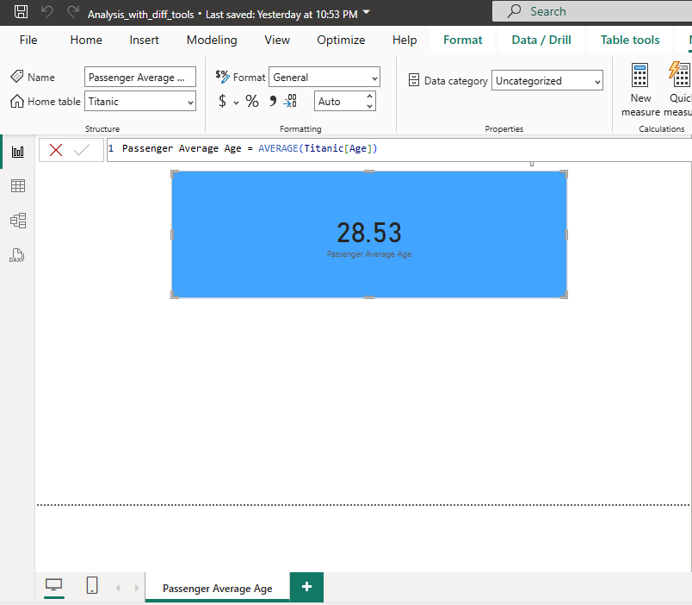
Power BI operations
Average age of passengers

Slide 13
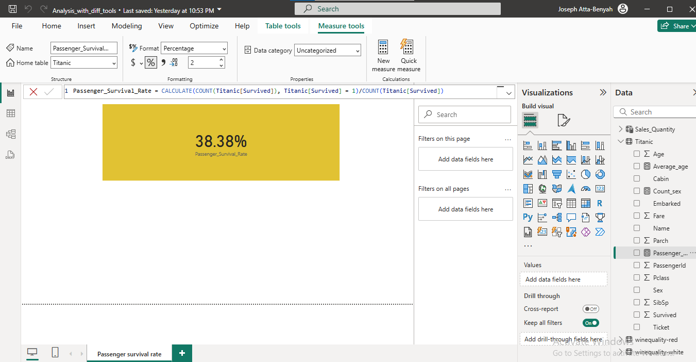
Power BI operations
Passengers survival rate

Slide 14
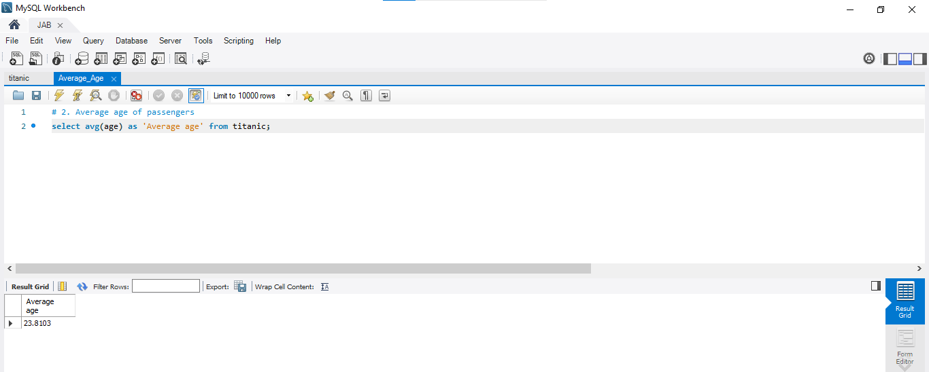
SQL queries
Average age of passengers

Slide 15
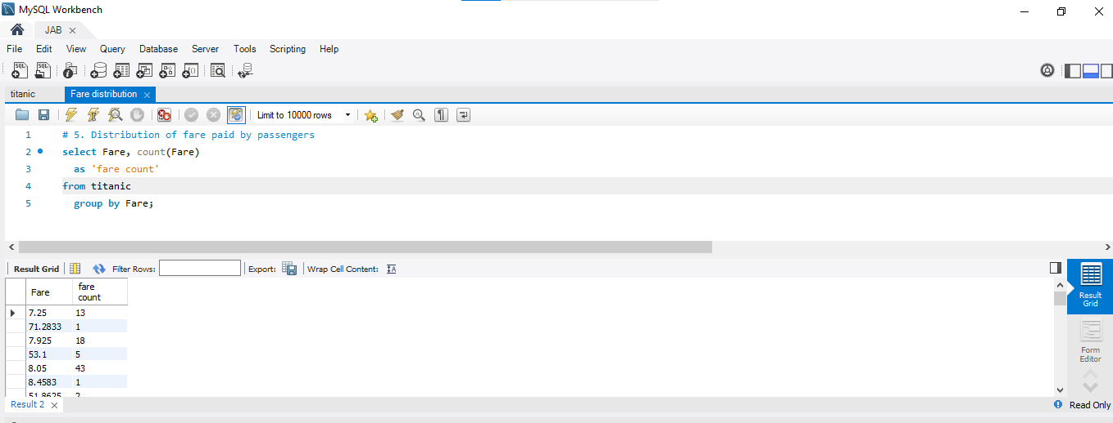
SQL queries
Fare distribution

Slide 16
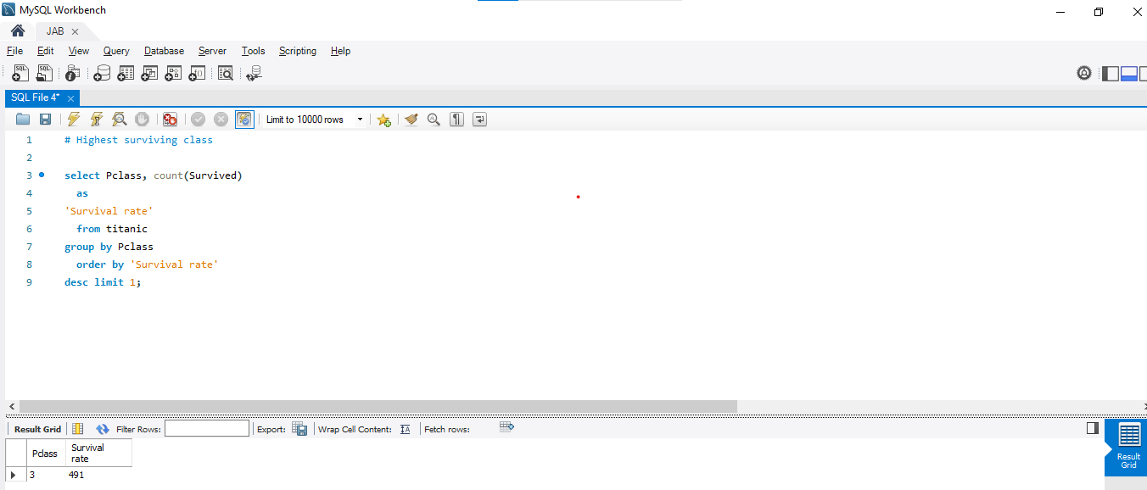
SQL queries
Highest survival class

Slide 17
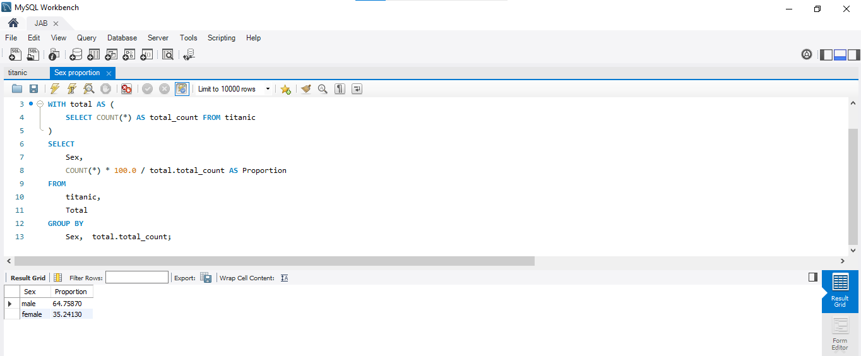
SQL queries
Male – Female Proportion

Slide 18
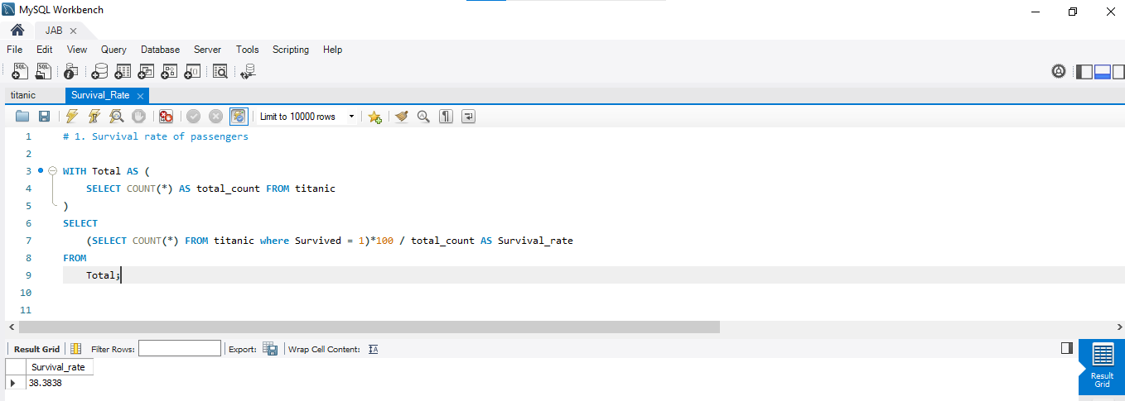
SQL queries
Survival rate

Slide 19
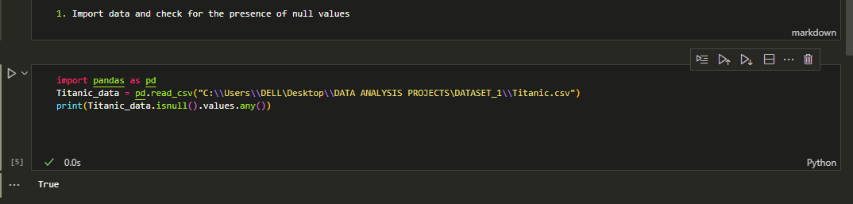
Python operations
Importing Titanic data and checking for null values

Slide 20
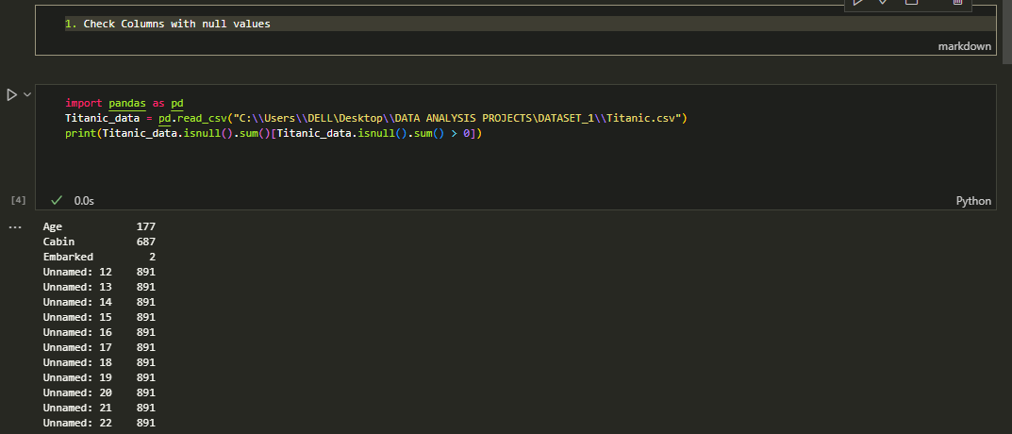
Python operations
Checking for columns with null values

Slide 21
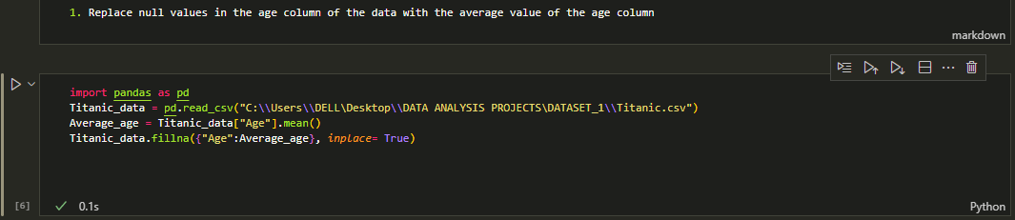
Python operations
Filling the null values of the age column

Slide 22
Python operations
Removing unnamed columns from the dataset

Slide 23
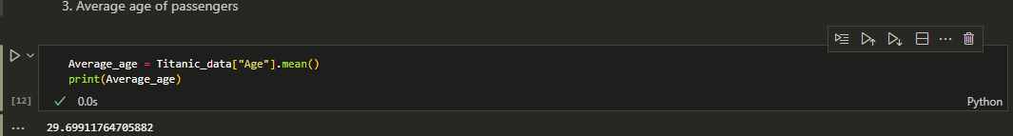
Python operations
Average age of passengers

Slide 24
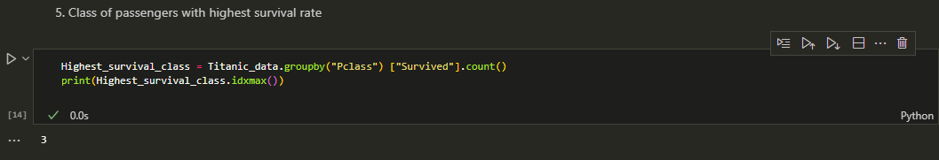
Python operations
Highest surviving class

Slide 25
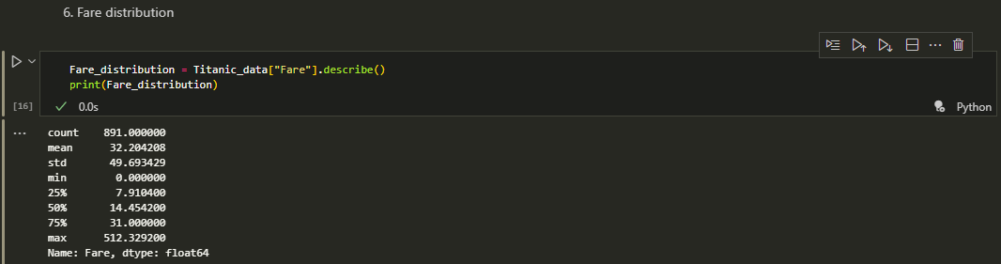
Python operations
Fare distribution

Slide 26
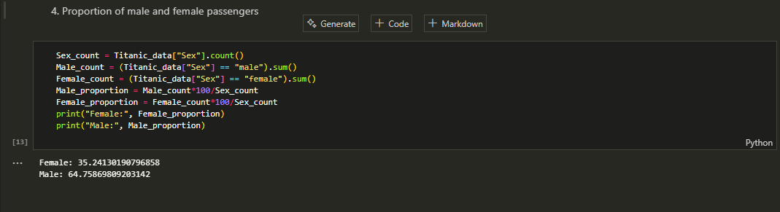
Python operations
Male – Female proportion

Slide 27
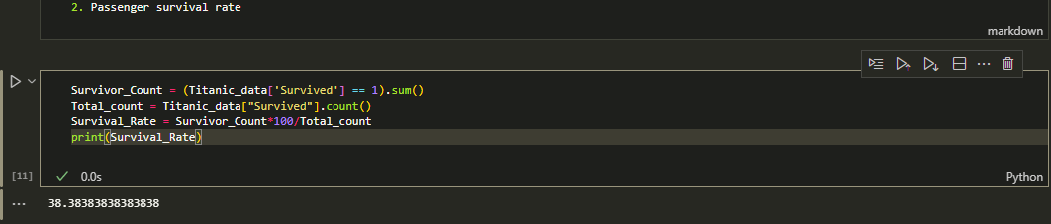
Python operations
Passenger survival rate

