Slide 1

AWS
Systems Manager Parameter Store
Secure Configuration & Secrets Management
.
Presented by: Attaluri Sai Teja Course: Cloud Computing / AWS Architecture

Slide 2
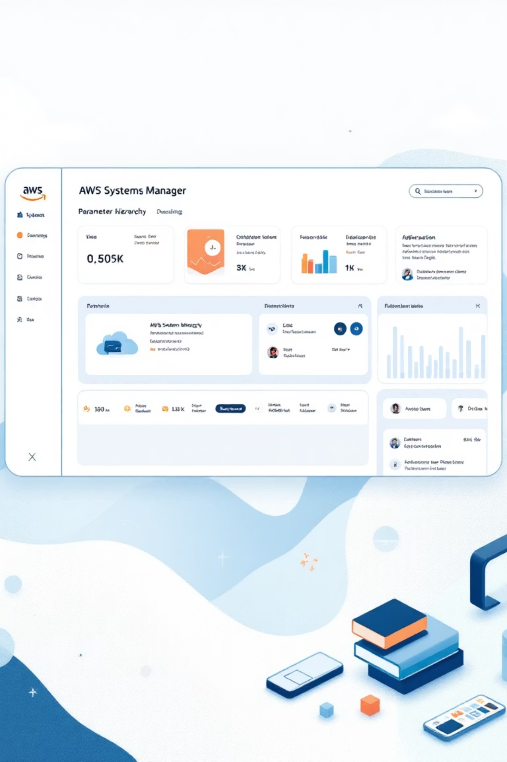




AWS SYSTEMS MANAGER
What is Parameter Store?
Fully managed AWS service for configuration & secrets
Secure, hierarchical key–value storage
Centralizes application configuration
Eliminates hardcoded secrets
Plain Text
Configuration values
Store critical information like database connection strings, passwords, AMI IDs, and license codes as parameter values that can be referenced throughout your applications and AWS services.
Encrypted
Sensitive secrets
Integrated
AWS services

Slide 3
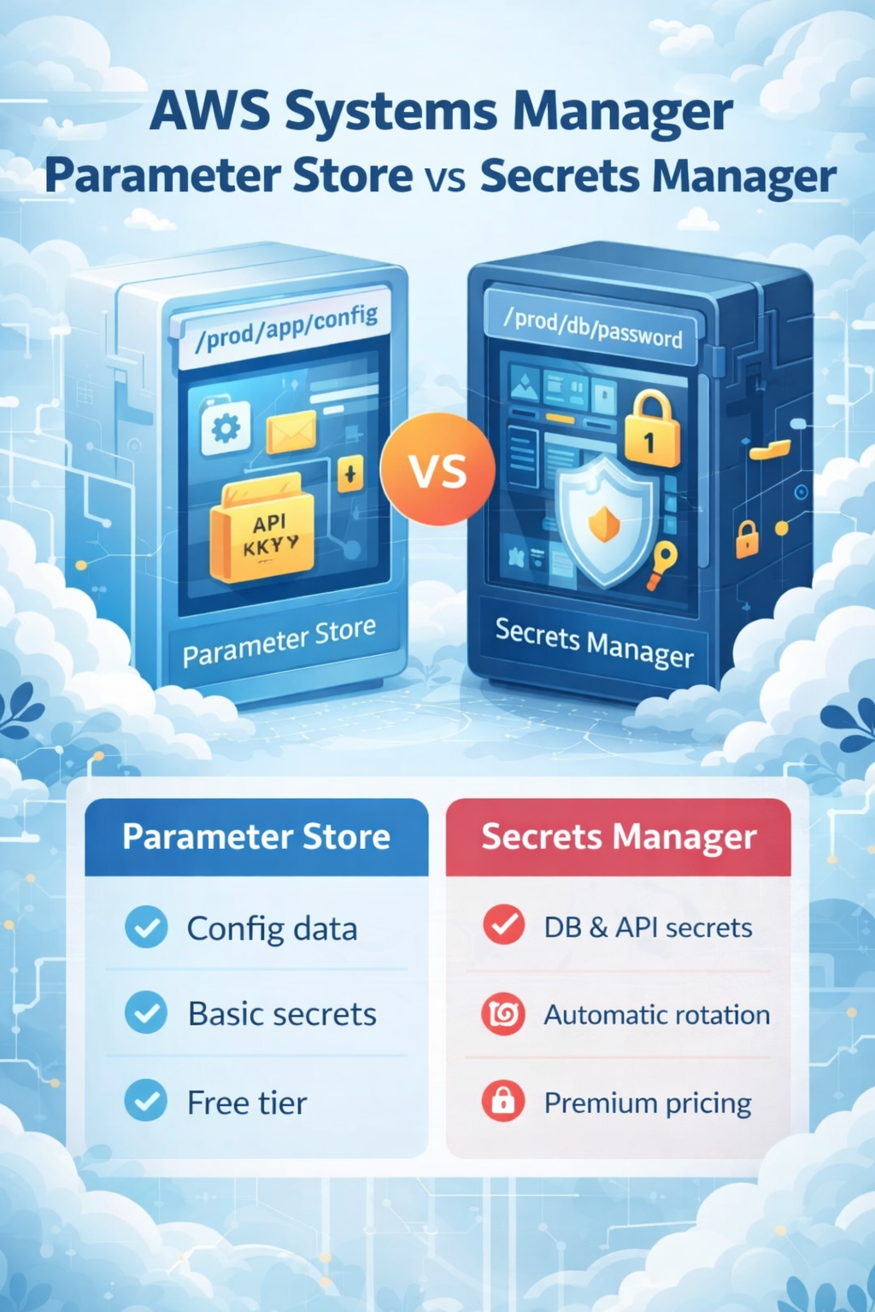
A simple architecture diagram
Application (EC2 / Lambda / ECS)
↓
IAM Role
↓
Parameter Store (SecureString + KMS)

Slide 4

Why Use Parameter Store? Key Benefits
1
Centralized & Scalable
Store configuration data in a single, highly available location that scales automatically across multiple Availability Zones. No infrastructure management required.
2
Enhanced Security
Separate secrets from your application code and infrastructure templates. Reduce exposure of sensitive data in version control systems and deployment pipelines.
3
Fine-Grained Control
Leverage AWS IAM policies for precise access control. Track every parameter access and modification with comprehensive CloudTrail audit logging.
4
Version Management
Maintain complete parameter history with automatic versioning. Organize parameters in hierarchical structures for intuitive management across environments.

Slide 5
Parameter Types & Hierarchies
Parameter Store supports three distinct parameter types, each designed for specific use cases. Understanding these types helps you choose the right approach for your configuration data.
String
StringList
SecureString
Plain text values for non-sensitive data
Comma-separated values
Encrypted sensitive data
Multiple environment names
Database passwords
API endpoints and URLs
Lists of approved AMI IDs
API keys and tokens
Configuration flags
Feature flags arrays
License codes
Application settings
Hierarchical Organization
/prod/db/password
/dev/api/endpoint
/shared/license/key
Production database credentials
Development API configuration
Cross-environment resources

Slide 6


Security & Encryption
Encryption Architecture
Access Control & Auditing
SecureString parameters use AWS Key Management Service (KMS) for robust encryption. Choose between AWS-managed keys or customer-managed keys for maximum control over your encryption strategy.
IAM Policies
Define granular permissions for who can read, write, or delete parameters
Default KMS Key
Use alias/aws/ssm for automatic, managed encryption
CloudTrail Logging
Audit every parameter access, modification, and deletion with complete visibility
Customer-Managed Keys
Create custom KMS keys with specific rotation policies
Resource Policies
Control cross-account access with advanced policy configurations
Symmetric Encryption
Only symmetric KMS keys supported for SecureString

Slide 7






Creating & Managing Parameters
Choose Your Method
Create parameters via AWS Console for quick setup, CLI for automation, SDK for application integration, or CloudFormation for infrastructure as code
Configure Parameter
Define parameter name, type (String/StringList/SecureString), description, and value. For SecureString, select your KMS key
Add Metadata
Apply tags for organization, set parameter policies, and configure change notifications via EventBridge integration
Version Control
Track parameter changes automatically with version history. Use labels to mark stable versions for rollback capability
Example CLI Command: aws ssm put-parameter --name "/prod/db/password" --value ""<encrypted-secret>"" --type SecureString --key-id "alias/aws/ssm"

Slide 8






Integration & Use Cases
Parameter Store seamlessly integrates with the AWS ecosystem, enabling secure configuration management across your entire infrastructure and application stack.
AWS Lambda
EC2 User Data
Reference parameters in Lambda environment variables or retrieve them dynamically at runtime for serverless applications
Inject configuration values into EC2 instances at launch time without hardcoding secrets in AMIs
ECS Tasks
CloudFormation
Supply container configurations and secrets to ECS task definitions securely
Reference parameters in infrastructure templates for dynamic, environment-specific deployments
CI/CD Pipelines
Secrets Manager
Automate configuration updates and secrets retrieval in CodePipeline, Jenkins, and other CI/CD tools
Integrate with AWS Secrets Manager for advanced lifecycle management and automatic rotation

Slide 9

Pricing Overview
Standard Parameters
Free tier included
Up to 10,000 parameters
Maximum 4 KB parameter size
No parameter policies
Advanced Parameters
$0.05 per advanced parameter per month
Up to 100,000 parameters
Maximum 8 KB parameter size
Parameter policies supported
Additional API interaction charges
Additional Costs
Variable pricing
AWS KMS encryption charges apply
CloudTrail logging costs
Data transfer charges if applicable
Parameter Store offers a cost-effective alternative to AWS Secrets Manager for many use cases, especially when automatic rotation isn't required.

Slide 10
Best Practices & Limitations
Security First
Organized Hierarchies
Always use SecureString for sensitive data. Implement least-privilege IAM policies and rotate KMS keys regularly according to compliance requirements.
Design meaningful parameter paths that reflect your application structure. Use consistent naming conventions across teams and environments.
Governance & Monitoring
Know the Limits
Apply parameter policies to enforce expiration dates. Configure EventBridge notifications for parameter changes to maintain oversight.
Standard parameters: 10,000 max, 4 KB size. Advanced: 100,000 max, 8 KB size. Consider API rate limits for high-throughput applications.
When to Use Secrets Manager Instead
For complex secrets lifecycle management requiring automatic rotation, multi-region replication, or built-in integration with RDS and other databases, consider AWS Secrets Manager as a complement to Parameter Store.

Slide 11












Summary & Next Steps
Secure Storage
Scalable Solution
Centralized, encrypted configuration and secrets
Highly available across multiple AZs
Access Control
Fine-grained IAM and audit logging
Get Started Today
5
AWS Systems Manager Parameter Store provides enterprise-grade configuration management with minimal operational overhead. Start building more secure, maintainable applications by centralizing your secrets and configuration data.
AWS Integration
Seamless workflow automation

