Slide 1
Code Security
In the Internet of Things

Slide 2


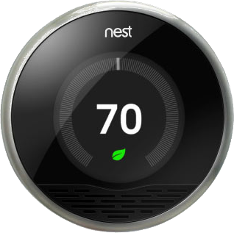

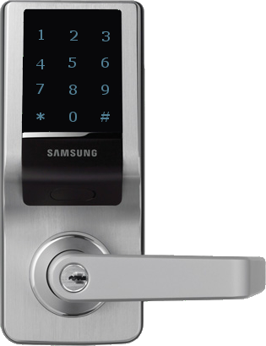


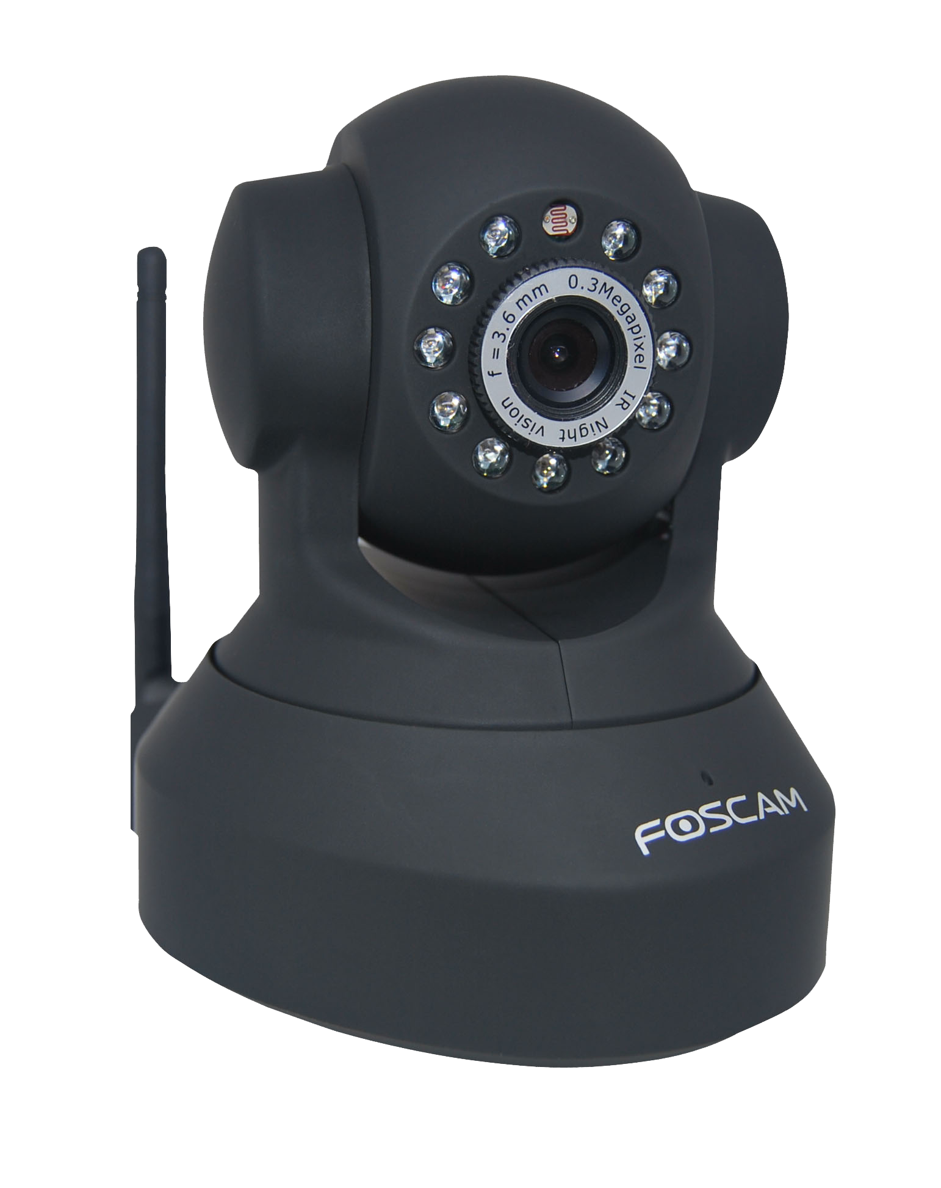


Slide 3
Why Security Matters
More and more Things are becoming connected.
Each Thing creates a possible entry point for a hacker.
Once a network is compromised, every Thing on that network is in danger.

Slide 4
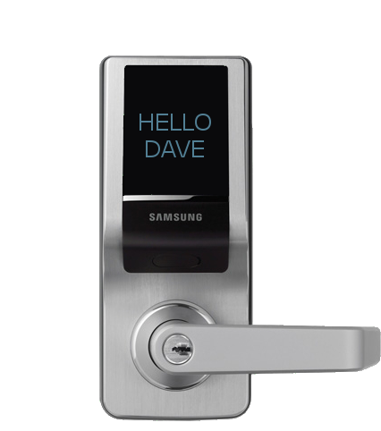



IoT Hack
If an app uses insecure code, then a Hacker doesn’t need to crack your WiFi or your Phone.
They just need to emulate a Thing your network or phone is already familiar with.

Slide 5
What can we do?

Slide 6
On the Thing
Make sure that the OS is stripped down to only the absolute essentials. (You don’t need a media player on a lock.)
Ensure that only specific commands from registered devices can be “heard”.
Close unnecessary ports.

Slide 7
On the Thing
Authenticate sessions.
Limit authentication attempts.
Use multifactor authentication.
Sanitize command input.
Avoid backdoors (even the ones made for testing).

Slide 8
On the App
Use certificates to ensure that your phone isn’t talking to a spoofed Thing.
Do not allow input from other programs (including keyboards).
Force app timeout.

Slide 9
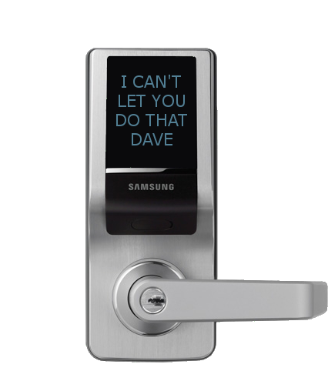


Slide 10
Further Reading
Excellent Node.JS Code Security Walk-through:
https://blog.risingstack.com/node-js-security-checklist/
OWASP’s Application Security Checklist:
    https://www.owasp.org/index.php/Web_Application_Security_Testing_Cheat_Sheet
IBM’s Code Security Best Practices:
    http://www.ibm.com/developerworks/library/iot-security-best-practices-iot-apps/
NIST Bluetooth Security Guide:
www.nist.gov/customcf/get_pdf.cfm?pub_id=911133

Slide 11



Andrew Long
theNetruist
@theNetruist
theNetruist@aleronfoundation.com

