Slide 1

Chinook Music Store Analysis
Mudassir Attar

Slide 2

About Chinook
Chinook Music Services is a premier name in the physical music records industry, dedicated to delivering exceptional musical entertainment to audiences around the world.
With a global network of retail outlets, distribution channels, and customer-focused services, Chinook provides music lovers with access to an unparalleled collection of physical media.
From timeless classics to contemporary hits, our extensive catalog spans every major genre, ensuring that every musical taste is catered to.
Beyond offering a wide selection, Chinook is committed to preserving the cultural value of physical music formats—vinyl, CDs, and special editions—helping collectors and audiophiles alike connect with music in its most authentic form.
Whether you're a casual listener or a dedicated fan, Chinook Music Services invites you to experience the richness of music through expertly curated content, high-quality products, and passionate service.

Slide 3
Introduction and Objectives
The music retail industry benefits immensely from data-driven strategies to understand customers and optimize offerings for increased success.
This project focuses on analyzing Chinook Music Store's data to provide key insights for informed decision-making in areas like marketing, inventory, and customer engagement.
Project Context & Objectives
The primary goal is to analyze Chinook Music Store's sales and customer data to uncover valuable patterns and trends.
This will be achieved through:
Data Quality
Sales Performance
Customer Analytics
Geographic Insights
Strategic Opportunities
Identifying top-selling music, artists, and genres to inform inventory and promotion strategies.
Understanding customer demographics, purchasing habits, and loyalty to tailor marketing efforts.
Analyzing sales and customer distribution across different locations to identify key markets.
Recommending promotional focus areas and uncovering insights for customer retention and growth.
Ensuring the data is accurate, complete, and consistent for reliable analysis.
Database Enhancement
Improving the data structure for more effective analysis (e.g., adding release year).

Slide 4
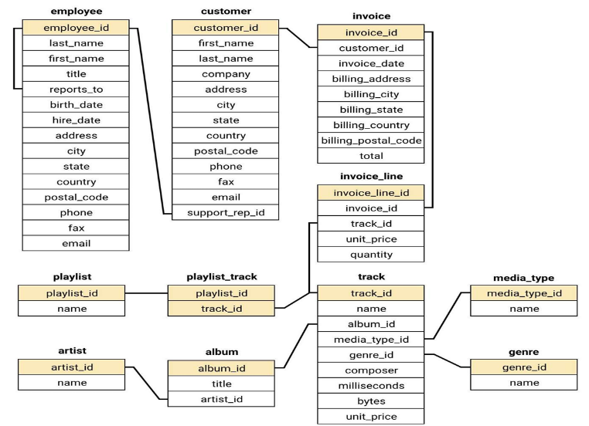
Chinook Music Store Database Schema

Slide 5

Chinook Data Overview
The dataset comprises 11 detailed tables, each containing structured information covering different facets of Chinook Music Services’ operations.
Chinook caters to a diverse global customer base, with users located in 53 cities across 24 countries.
Its music catalog features tracks from 25 distinct genres including Rock, Metal, Jazz, Classical, and more demonstrating the company’s dedication to musical variety.
The catalog includes 275 artists and 347 unique albums, offering listeners a rich and varied selection of music that appeals to a wide range of tastes and preferences.
Detailed information is provided for both albums and their corresponding artists, allowing for in-depth exploration of musical content and artist contributions.
The invoice table captures all customer transactions, offering a complete record of sales activity, including dates, purchase amounts, customer details, and purchased items.
The dataset provides valuable insights into global music preferences, purchasing behavior, and the performance of various genres and artists.

Slide 6
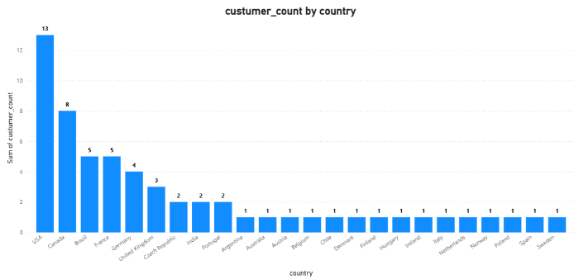
Customers In Each Country
The USA has the highest number of customers, significantly leading with 13.
Canada follows as the second largest customer base with 8 customers.
Brazil, France, and Germany show a similar customer count, each having 5 customers.
A long tail of countries each contributes a smaller number of customers, ranging from 1 to 4.
The customer demographic breakdown is very diversified.

Slide 7
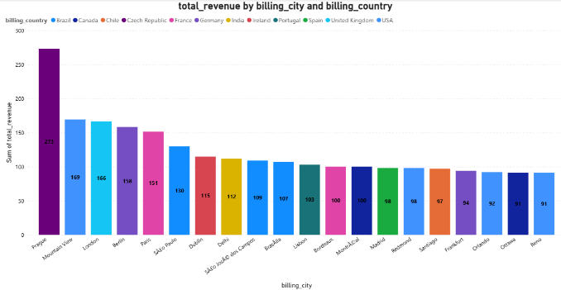
Revenue Across Cities & Countries
Prague (Czech Republic) stands out with the highest total revenue, significantly surpassing all other billing cities.
Mountain View (USA) and London (United Kingdom) follow as the next highest revenue-generating cities, with relatively close total revenue figures.
Several European cities, including Berlin (Germany) and Paris (France), contribute substantial total revenue, ranking among the top performers.
While many cities show similar total revenue in the lower range, Ottawa (Canada) and Reno (USA) exhibit some of the lowest total revenue among the displayed billing cities.

Slide 8
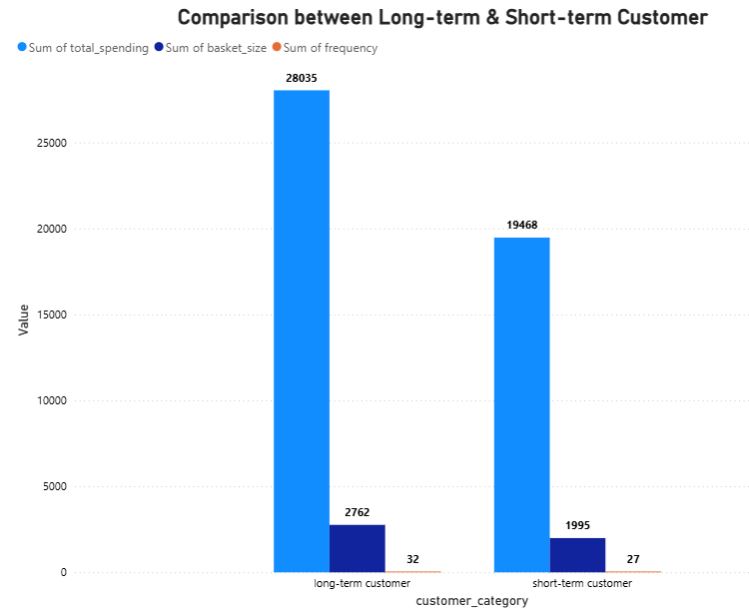
Customer Purchasing Behavior
Long-term customers consistently outperform short-term customers in purchase frequency, average basket size, and total spending.
This visual strongly emphasizes the crucial role of customer loyalty as a significant driver of increased company revenue.
Cultivating long-term customer relationships leads to higher overall sales due to their increased purchasing habits.
Prioritizing customer retention strategies is essential for sustainable revenue growth and maximizing the value of existing customers.

Slide 9
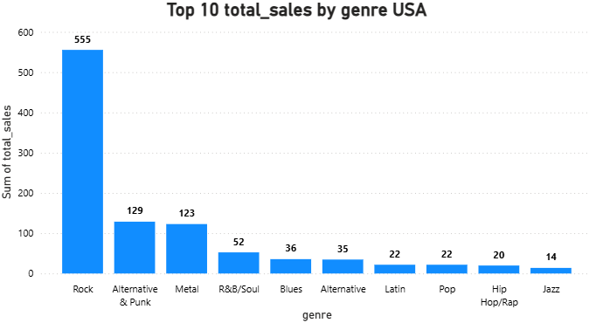
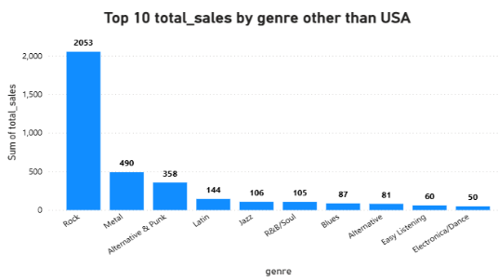
Sales By Genre In USA & Other Countries
Rock music generates the highest total sales in the USA, with a value of 555, significantly outperforming all other genres.
Alternative & Punk and Metal follow as the next highest-grossing genres in the USA, achieving similar total sales figures of 129 and 123 respectively.
The remaining genres in the top 10 contribute considerably less to the total sales, with Jazz generating the lowest at a value of 14, indicating a smaller market share compared to Rock.
Rock music accounts for the largest portion of sales with a significantly higher value of 2053, highlighting its widespread financial success globally.
Metal and Alternative & Punk are the next strongest genres in terms of sales internationally, mirroring the US trend but with greater revenue.
A wider variety of genres contribute in regions outside the USA, including Latin, Jazz, R&B/Soul, Blues, Alternative and others although their individual sales are lower than Rock and Metal.

Slide 10
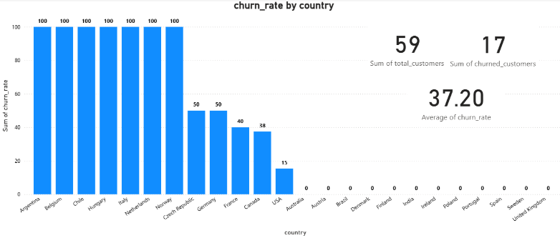
Churn Rate
Critical Churn in Key Regions: Several countries face a 100% customer churn, indicating a severe retention crisis requiring immediate investigation.
High Average Churn: An average churn rate of 37.20% signifies a significant loss of customers, necessitating urgent action to stabilize the customer base.
Inconsistent Retention Globally: Customer retention varies widely by country, suggesting the need for tailored strategies and learning from successful regions (0% churn).
Actionable Strategies Needed: Implement improved customer service and launch targeted campaigns (promotions, events) to reduce churn and attract new customers effectively.

Slide 11
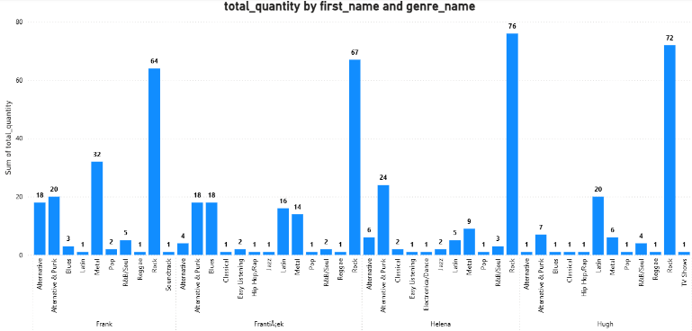
Product Affinity Analysis for Recommendations
Genre-Based Preferences:
Rock, Metal, and Alternative & Punk are often bought together, so fans of one genre may enjoy the others too.
Latin and Blues show up as secondary choices and can be grouped into themed playlists or bundles.
Cross-Selling Ideas:
Bundles & Discounts: Create combo offers like Rock + Metal album packs or give discounts for buying within related genres.
Recommendations: Show suggestions like People who bought Rock albums also bought Punk and Alternative albums.

Slide 12
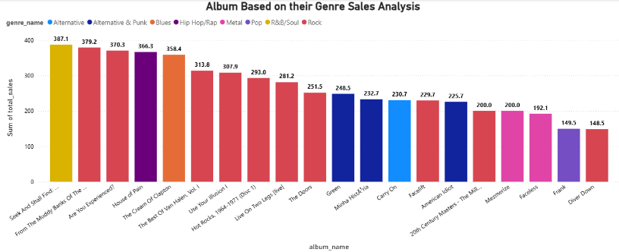
Prioritizing USA Album Promotion
Seek And Shall Find: More Of The Best (1963–1981)
Genre: R&B/Soul, Sales Value: 387.09 (Highest)
Justification: This album tops the sales chart, highlighting a strong market demand for R&B/Soul in the USA.
From The Muddy Banks Of The Wishkah [Live]
Genre: Rock, Sales Value: 379.17
Justification: With Rock being a leading genre, this live album is likely to attract a loyal fanbase and drive promotional success.
Are You Experienced?
Genre: Rock, Sales Value: 370.26
Justification: A classic rock album with proven sales potential, making it an ideal candidate for focused marketing efforts.

Slide 13

Overall Strategy
Focus on High-Performing Genres: Given the consistent dominance of Rock in both the USA and other markets, and the strong performance of R&B/Soul in the USA, prioritize marketing and inventory for these genres in the physical music market.
Address High Churn in Specific Regions: The alarmingly high churn rates (100%) in several European and South American countries (e.g., Argentina, Belgium, Italy) demand immediate investigation into localized issues and the implementation of targeted retention strategies.
Leverage Long-Term Customer Value: Recognize that long-term customers exhibit significantly higher purchase frequency, basket size, and overall spending. Implement loyalty programs and engagement initiatives to nurture these valuable relationships in the physical market.
Explore Product Affinity for Bundling: The co-purchase patterns of genres like Rock, Metal, and Alternative & Punk suggest opportunities for creating physical product bundles or in-store recommendations to encourage cross-selling and increase basket size.

Slide 14

Conclusion
Data Overview: Chinook Music Services’ dataset of 11 detailed tables, covering global sales across 53 cities in 24 countries and a catalog of 275 artists and 347 albums across 25 genres, provides a solid foundation for data-driven strategies in the physical music market.
Genre Promotion Based on Sales Insights: Focus on promoting top-performing genres like Rock and Alternative & Punk in the USA, while adapting to regional trends such as Metal's global appeal.
Cross-Selling Through Purchase Patterns: Use co-purchase data to identify genre and artist affinities, enabling effective cross-selling strategies that boost order value and revenue.
Customer Retention for Long-Term Value: Reduce churn by targeting high-value, long-term customers with personalized campaigns that foster loyalty and maximize lifetime value.
Sustained Growth Through Data-Driven Strategy: By leveraging sales insights, purchase behavior, and customer data, Chinook can enhance genre marketing, optimize cross-selling, tailor regional approaches, and drive long-term growth in the physical music market.

Slide 15
Thank you

