Slide 1

ATTENDR
The Attendance App

Slide 2


TEAM MEMBERS
ANSHUMAN AGARWAL : E18CSE022
ANUDIT NAGAR : E18CSE024
ANURUP JALOTA : E18CSE025
ANUSHKA UPADHYAYA : E18CSE026
BHAVYA BATRA : E18CSE035
OUR MENTOR: Dr. Mayank Swarnkar

Slide 3

THE IDEA
The project aims to develop a working prototype of a system that will facilitate class control by automatically marking the attendance of students by using a self-mutilating QR code and a mobile app using a database of students. Attendr can be used to manage attendance and generate relevant statistics for the students and the teachers using an intuitive interface as well.

Slide 4

WHY ATTENDR ?
We decided to take all these problems that plague the current systems and create a superior, more efficient, and most importantly, a cheap and easy-to-use product with the focus being on academic institutions. We also wanted to make a product that is extensible by nature and can accommodate most requirements of academic institutions out of the box and has customizable parameters that can be adjusted to fit the needs of the institution.

Slide 5
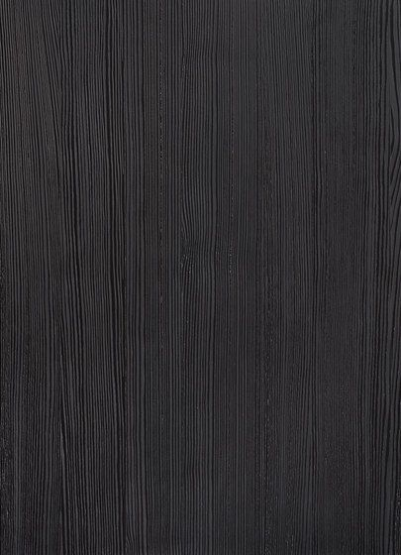
PERSPECTIVE
Attendr allows universities to simplify the monotonous procedure of manual attendance by automating the procedure by using self-mutating QR Codes and providing a dashboard to the universities for easily accessing and managing attendance of their students.

Slide 6
FUNCTIONS
CLASS PORTAL
TEACHER PORTAL
UNIVERSITY PORTAL
Mark Attendance
Enroll Students
Remove Students
View Statistics
Add Teachers
Remove Teachers
View Statistics

Slide 7

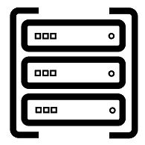


HOW IT WORKS ?
Student Scans QR Code
Request Is Sent To The Server
Attendance Is Marked In The Database

Slide 8
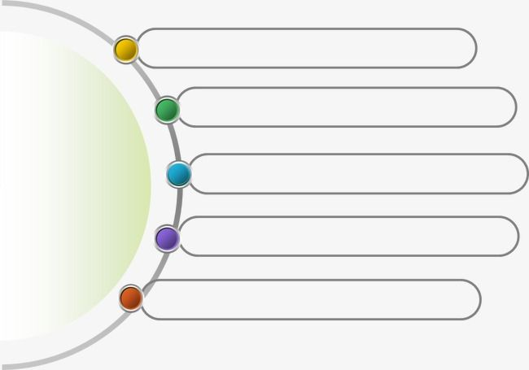
Android App Development (Using JAVA)
It Communicates Over A REST API To The Backend
LEARNINGS
Application Of FLASK In The Backend
Also, Application of POSTGRES In The Backend
Runs On UBUNTU Server Instance

Slide 9

FLAWS & LIMITATIONS
Attendance takes a lot of time, can create a mess, and is often inaccurate due to the extensive methods students find out to cheat the system.
Attendr is currently limited to smartphones. Attendr’s prototype can only work on Android devices, however, in the future, we will expand it to other operating systems.
Attendr again is also limited by the ability to show the QR codes, which usually requires projectors or TV screens. Some universities may not have the infrastructure for screening.

Slide 10
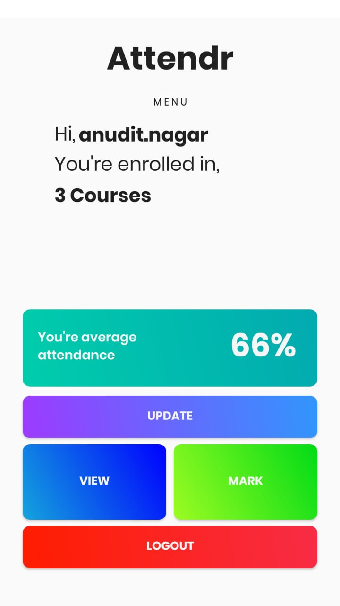
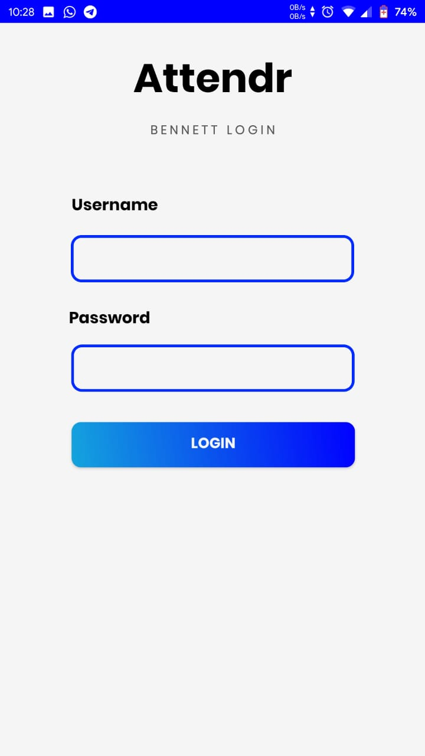
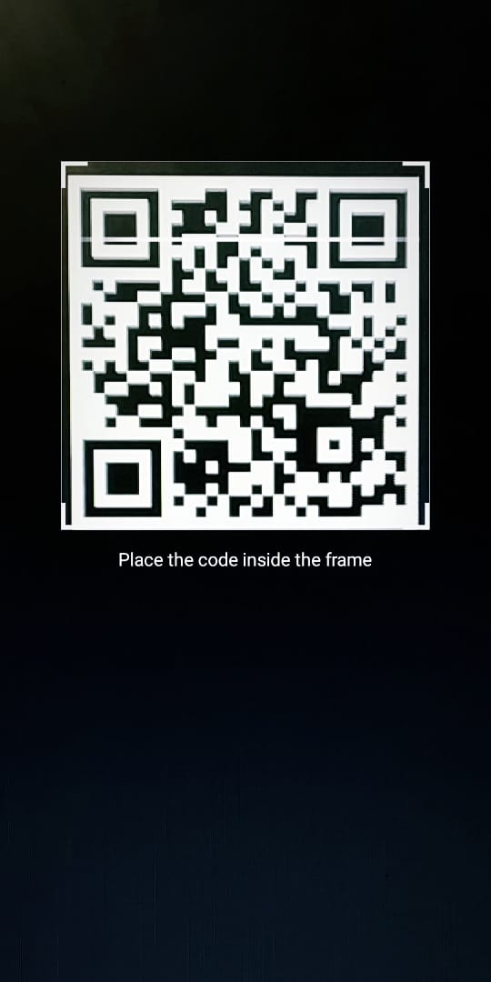
ATTENDR SCREENSHOTS
The Login Page
Main Screen
Marking Attendance

Slide 11


