Slide 1
Agenda
Virtual memory

Slide 2
Ideal Memory
Zero access time (latency)
Infinite capacity
Zero cost
Infinite bandwidth (to support multiple accesses in parallel)

Slide 3
Abstraction: Virtual vs. Physical Memory
Programmer sees virtual memory
Can assume the memory is “infinite”
Reality: Physical memory size is much smaller than what the programmer assumes
The system (system software + hardware, cooperatively) maps virtual memory addresses to physical memory
The system automatically manages the physical memory space transparently to the programmer
+ Programmer does not need to know the physical size of memory nor manage it →A small physical memory can appear as a huge one to the programmer → Life is easier for the programmer
-- More complex system software and architecture

Slide 4
Benefits of Automatic Management of Memory
Programmer does not deal with physical addresses
Each process has its own mapping from virtual → physical addresses
Enables
Code and data to be located anywhere in physical memory (relocation)
Isolation/separation of code and data of different processes in physical processes (protection and isolation)
Code and data sharing between multiple processes (sharing)

Slide 5
Basic Mechanism
Indirection (in addressing)
Address generated by each instruction in a program is a “virtual address”
i.e., it is not the physical address used to address main memory
An “address translation” mechanism maps this address to a “physical address”
Address translation mechanism can be implemented in hardware and software together

Slide 6
A System with Virtual Memory (Page based)
Memory
Address Translation: The hardware converts virtual addresses into physical addresses via an OS-managed lookup table (page table)
0:
Page Table
1:
Virtual
Addresses
Physical
Addresses
0:
1:
CPU
P-1:
N-1:
Disk

Slide 7
Virtual Pages, Physical Pages
Virtual and physical address space divided into pages
A virtual page is mapped to
A physical page, if the page is in physical memory
A location in disk, otherwise
If an accessed virtual page is not in memory, but on disk
Virtual memory system brings the page into a physical page and adjusts the mapping → this is called demand paging
Page table is the table that stores the mapping of virtual pages to physical frames

Slide 8
Supporting Virtual Memory
Virtual memory requires both HW+SW support
Page Table is in memory
Can be cached in special hardware structures called Translation Lookaside Buffers (TLBs)
The hardware component is called the MMU (memory management unit)
Includes Page Table Base Register(s), TLBs, page walkers
It is the job of the software to leverage the MMU to
Populate page tables, decide what to replace in physical memory
Change the Page Table Register on context switch (to use the running thread’s page table)
Handle page faults and ensure correct mapping

Slide 9
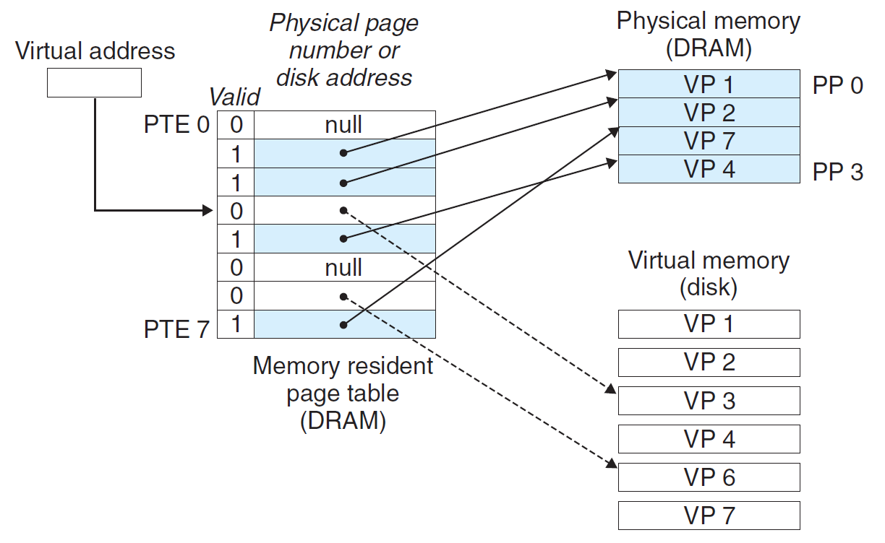
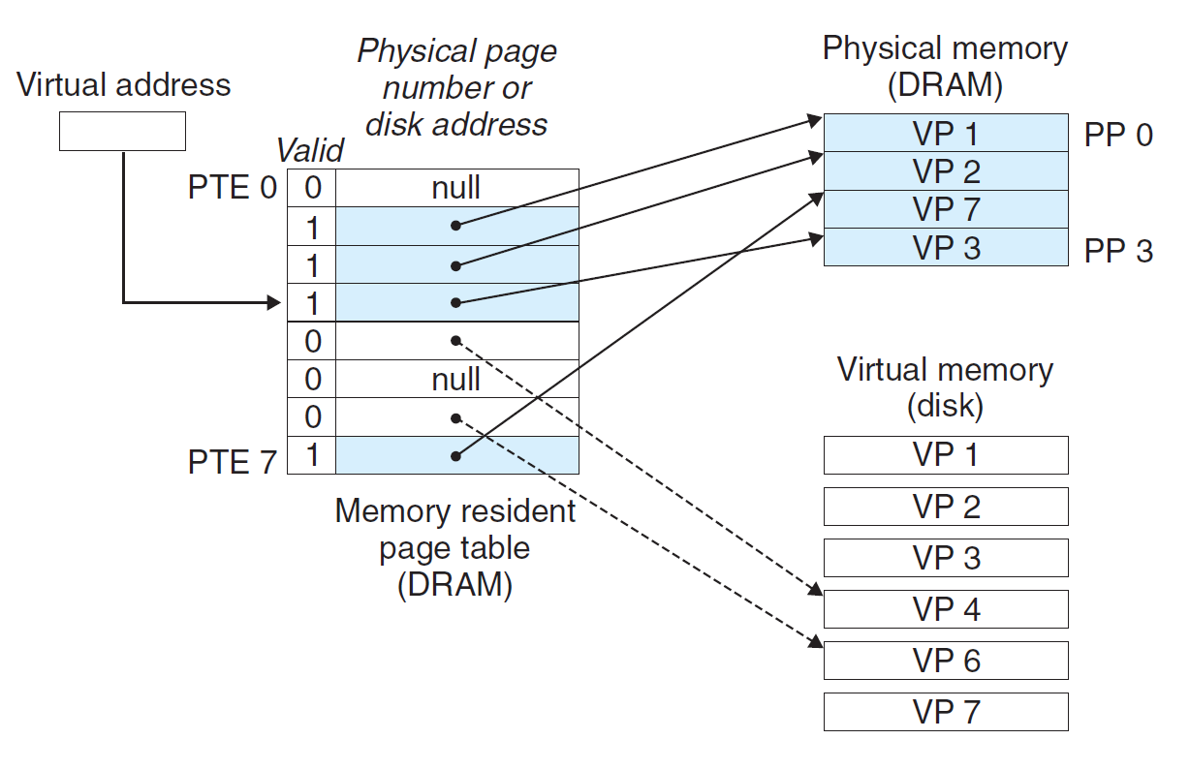
Page Fault (“A Miss in Physical Memory”)
If a page is not in physical memory but disk
Page table entry indicates virtual page not in memory
Access to such a page triggers a page fault exception
OS trap handler invoked to move data from disk into memory
Other processes can continue executing
OS has full control over placement

Slide 10
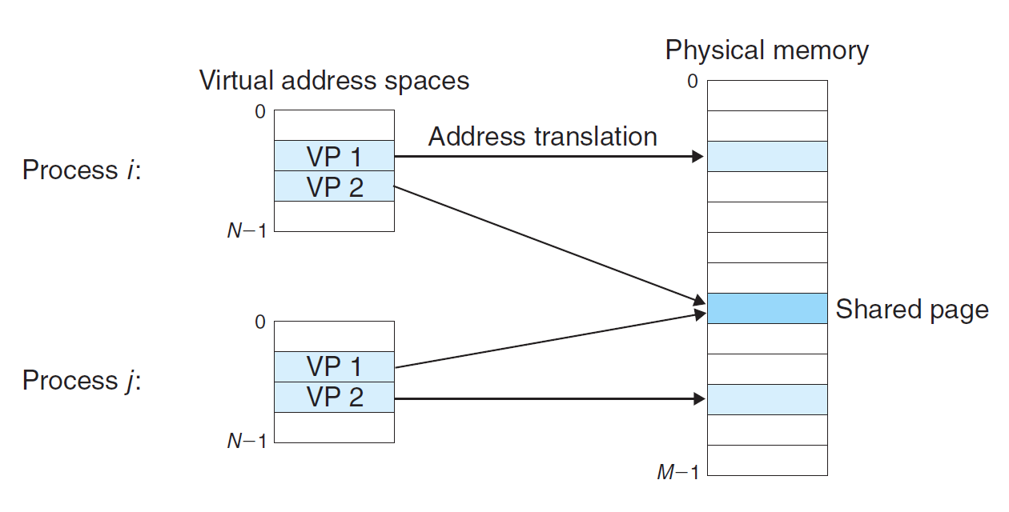
Page Table is Per Process
Each process has its own virtual address space
Full address space for each program
Simplifies memory allocation, sharing, linking and loading
(e.g. read/only library code)

Slide 11
Address Translation
Separate (set of) page table(s) per process
VPN forms index into page table (points to a page table entry)
Page Table Entry (PTE) provides information about page
page table
base register
(per process)
virtual address
0
n–1
p
p–1
virtual page number (VPN)
page offset
valid
access
physical page number (PPN)
VPN acts as
table index
if valid=0
then page
not in memory (page fault)
m–1
p
p–1
0
physical page number (PPN)
page offset
physical address

Slide 12
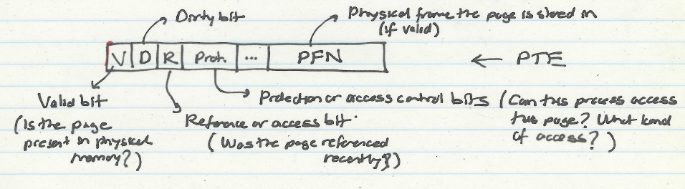
What Is in a Page Table Entry (PTE)?
Need a valid bit → to indicate validity/presence in physical memory
Need PPN → to support translation
Need bits to support replacement
Need a dirty bit to support “write back caching”
Need protection bits to enable access control and protection

Slide 13
Some Issues in Virtual Memory

Slide 14
Three Major Issues
How large is the page table and how do we store and access it?
How can we speed up translation & access control check?
When do we do the translation in relation to cache access?
There are many other issues we will not cover in detail
What happens on a context switch?
How can you handle multiple page sizes?
…

Slide 15
Virtual Memory Issue I
How large is the page table?
Where do we store it?
In hardware?
In physical memory? (Where is the PTBR?)
In virtual memory? (Where is the PTBR?)
How can we store it efficiently without requiring physical memory that can store all page tables?
Idea: multi-level page tables
Only the first-level page table has to be in physical memory
Remaining levels are in virtual memory (but get cached in physical memory when accessed)

Slide 16
Issue: Page Table Size
Suppose 64-bit VA, 40-bit PA and 4kB page size how large is the page table?
2^52 entries * ~4 bytes per entry ≈ 16 * 10^15 bytes
And that is for just one process
And the process may not be using the entire VM space
VPN
PO
Page Table
PPN
PO

Slide 17
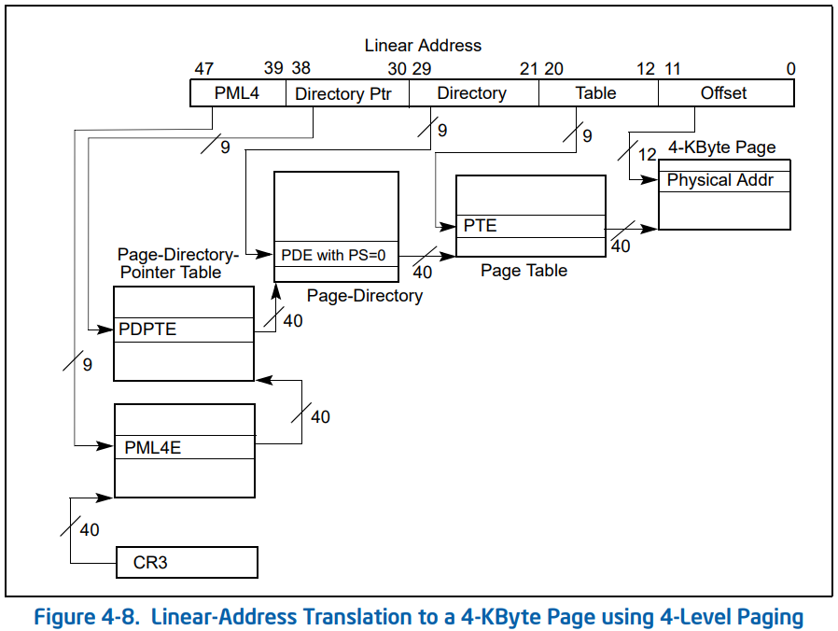
Solution: Multi-Level Page Tables
Four-level paging in x86
Intel® 64 and IA-32 Architectures Software Developer’s Manual

Slide 18
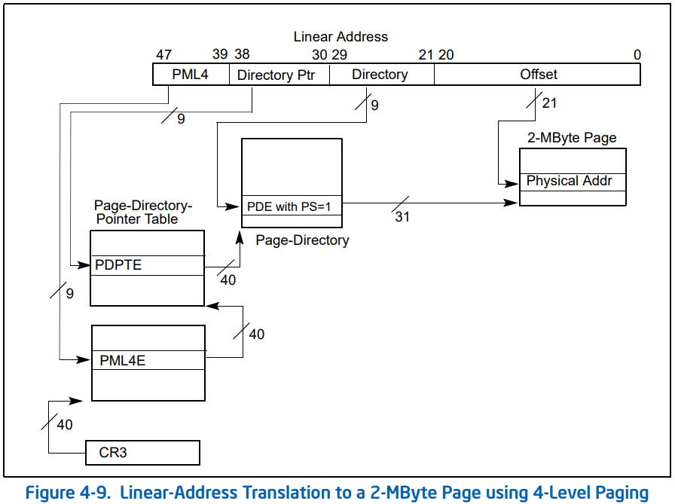
Solution: Multi-Level Page Tables
Four-level paging in x86
Intel® 64 and IA-32 Architectures Software Developer’s Manual

Slide 19
Virtual Memory Issue II
How fast is the address translation?
How can we make it fast?
Idea: Use a hardware structure that caches PTEs → Translation lookaside buffer
What should be done on a TLB miss?
What TLB entry to replace?
Who handles the TLB miss? HW vs. SW?
What should be done on a page fault?
What virtual page to replace from physical memory?
Who handles the page fault? HW vs. SW?

Slide 20
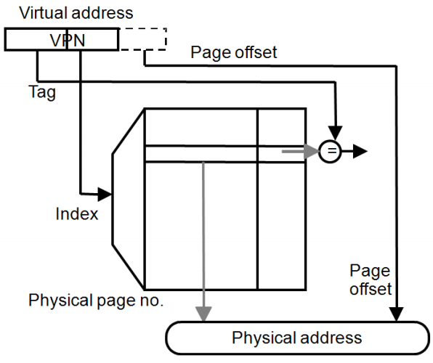
Speeding up Translation with a TLB
Essentially a cache of recent address translations
Avoids going to the page table on every reference
Index = lower bits of VPN
Tag = unused bits of VPN + process ID
Data = a PTE
Status = valid, dirty

Slide 21
Virtual Memory and Cache Interaction

Slide 22
Address Translation and Caching
When do we do the address translation?
Before or after accessing the L1 cache?
In other words, is the cache virtually addressed or physically addressed?
Virtual versus physical cache
What are the issues with a virtually addressed cache?
Synonym problem:
Two different virtual addresses can map to the same physical address → same physical address can be present in multiple locations in the cache → can lead to inconsistency in data

Slide 23
Homonyms and Synonyms
Homonym: Same VA can map to two different PAs
Why?
VA is in different processes
Synonym: Different VAs can map to the same PA
Why?
Different pages can share the same physical frame within or across processes
Reasons: shared libraries, shared data, copy-on-write pages within the same process, …
Do homonyms and synonyms create problems when we have a cache?
Is the cache virtually or physically addressed?

Slide 24
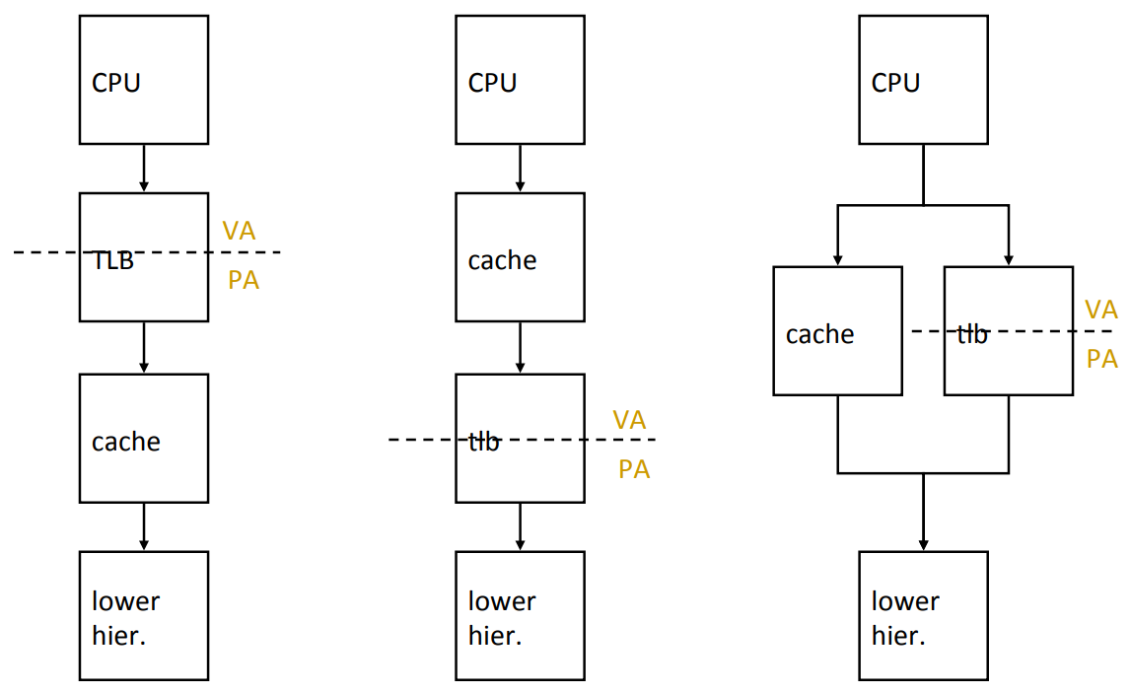
Cache-VM Interaction
PIPT
VIVT
VIPT

Slide 25
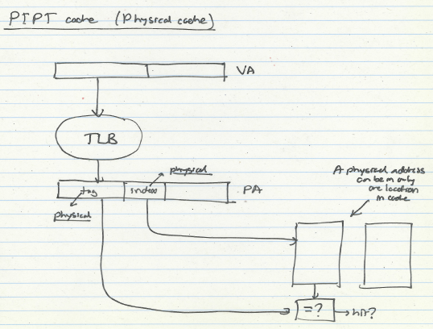
Physical Cache

Slide 26
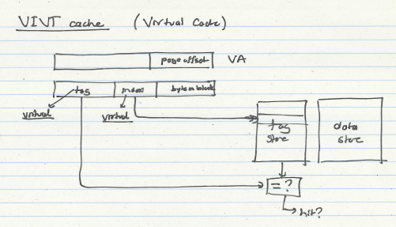
Virtual Cache

Slide 27
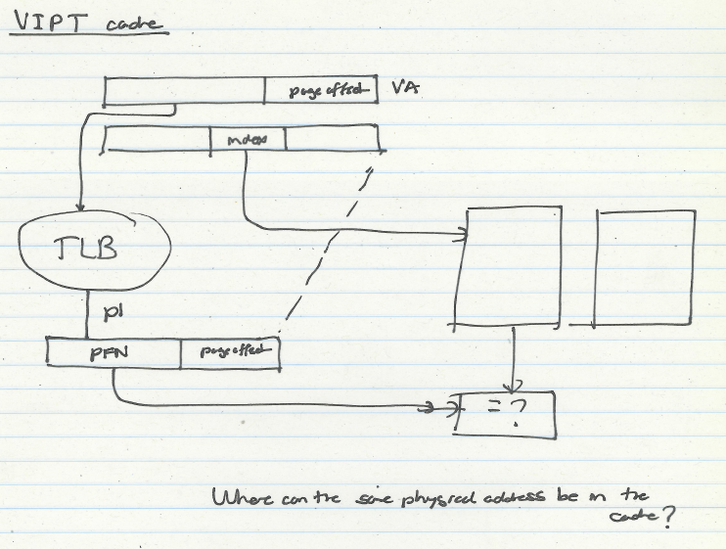
VIPT

Slide 28
Slides Credit
Attiano Purpura-Pontoniere
Yuchen Hao
Onur Mutlu

