Slide 1
Electronics Club

Slide 2
Could We Tunes Easier?
Previously we were writing lots of code, for each note…
What do musicians use while playing an instrument?
They separate the rendition into two bits:
The knowledge of ‘what’ to play
The knowledge of ‘how’ to play an instrument

Slide 3
Loops and Arrays!
We can use an ‘array’ to hold the information of ‘what’ to play
We can implement the ‘how’ to make the buzzer work inside a ‘for loop’
This allows us to very easily extend the tune, or swap it for another!

Slide 4
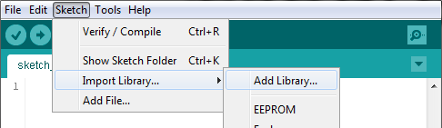
Online Resources
Go to:
http://afterschooltech.co.uk/week_04
Download ASTC_notes.zip from the libraries folder
You’ll need to click the ‘View Raw’ link
Then install the new library:
Sketch -> Import Library… -> Add Library…

Slide 5
Online Resources
Go to: http://afterschooltech.co.uk/week_04
Look at _01_tune_player/_01_tune_player.ino
You’ll need to click the ‘View Raw’ link to copy the code

Slide 6
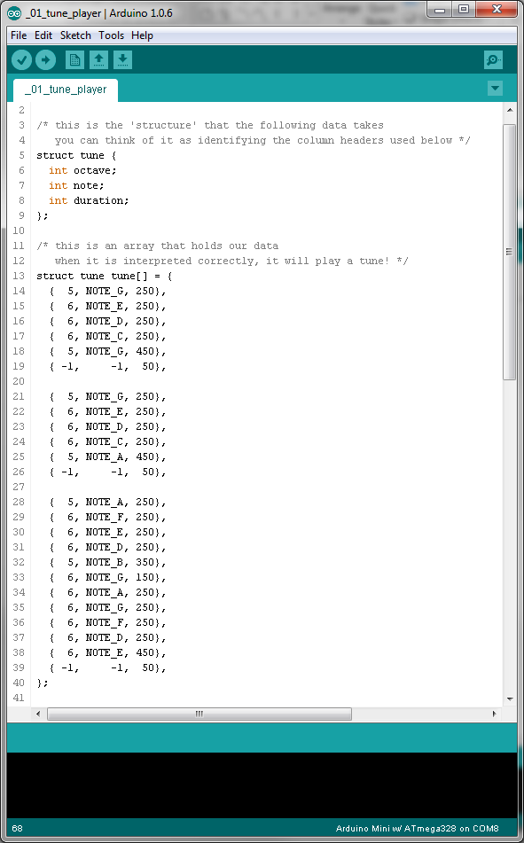
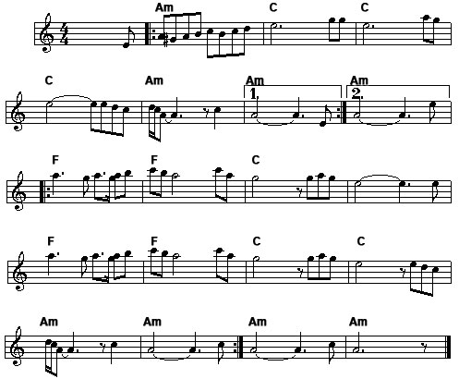

Slide 7
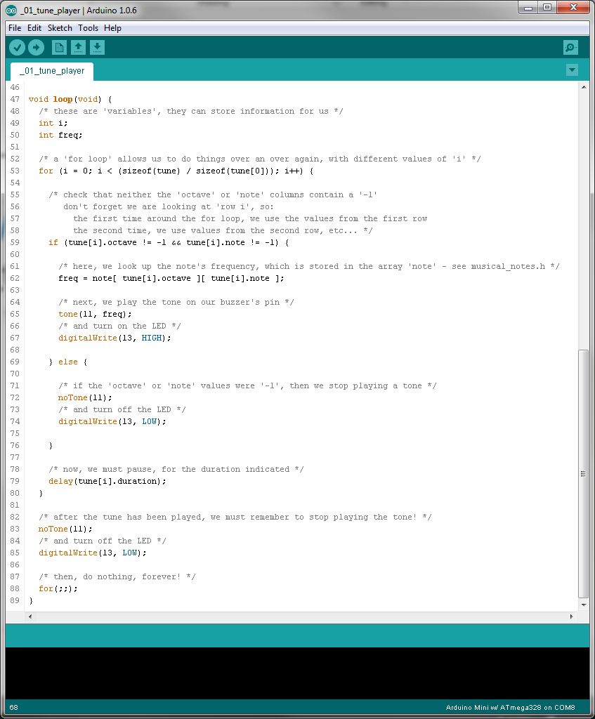

Slide 8
Can you improve it?
Can you…
Complete the tune?
Improve the tune? (better timing, etc…)

Slide 9
How about flashing LEDs too?!
Go to: http://afterschooltech.co.uk/week_04
-> _02_tune_and_flash/_02_tune_and_flash.ino
You’ll need to click the ‘View Raw’ link to copy the code

Slide 10
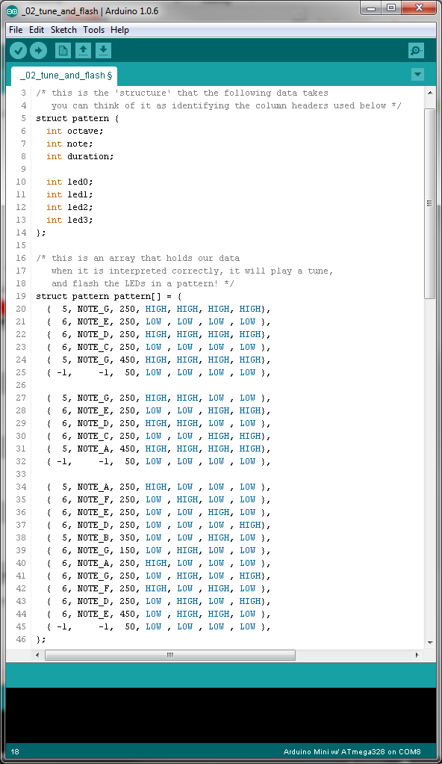

Slide 11
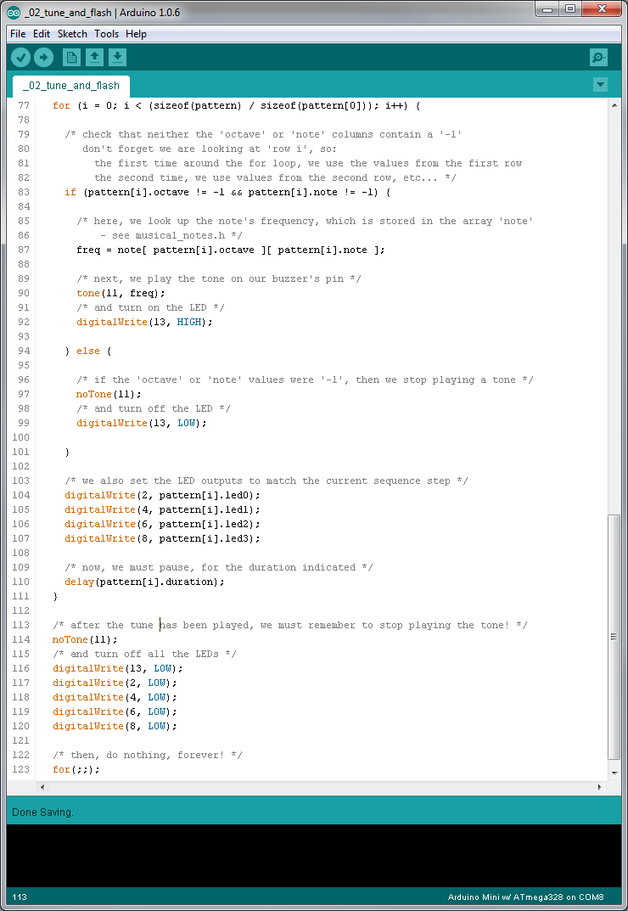

Slide 12
Can you improve it?
Can you…
Easily import your old tune?
Make the LEDs flash faster than the notes advance??

