Slide 1
Electronics Club

Slide 2
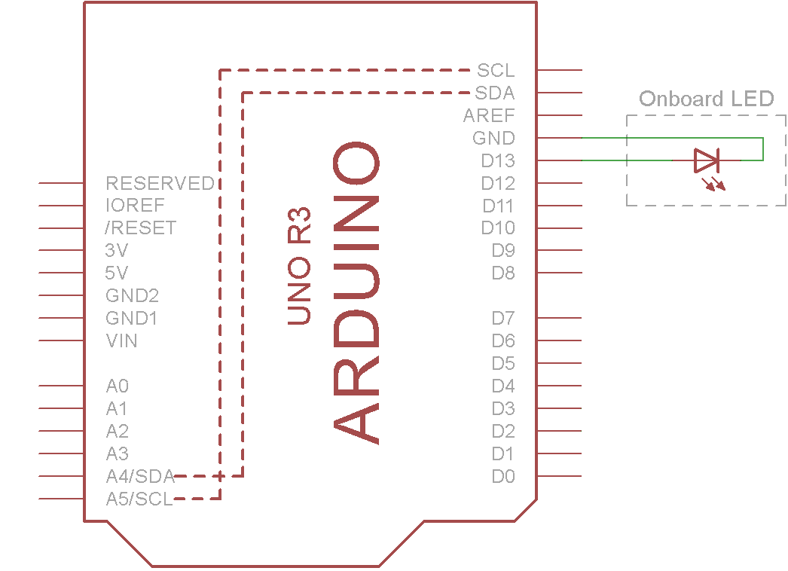
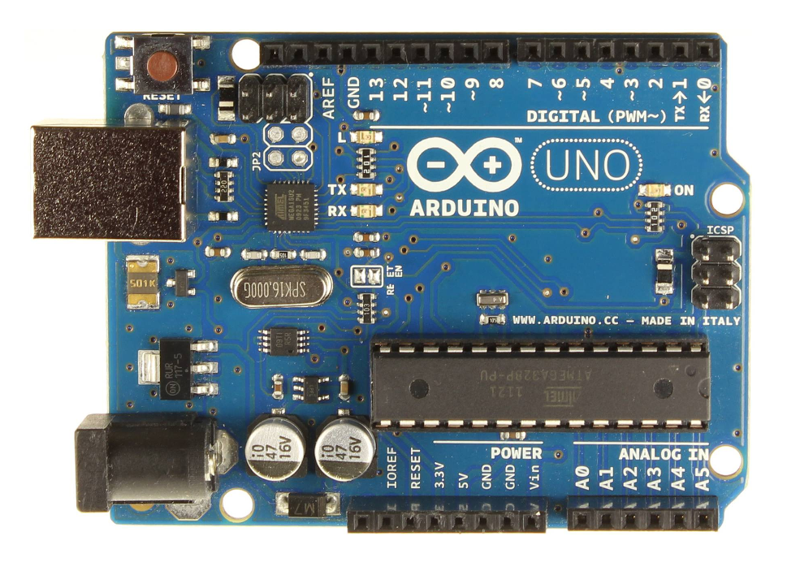
Blink On-Board LED
Make the on-board LED blink, using these functions:
pinMode()
digitalWrite()
delay()

Slide 3
Blink On-Board LED
What does the delay() function do?
What was the effect of changing the number?
Did you work out what the units were?
What were the options that you can use for the digitalWrite() function?

Slide 4
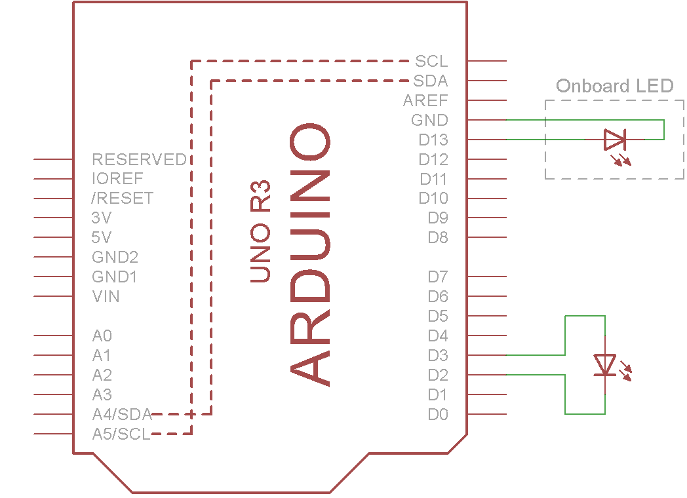
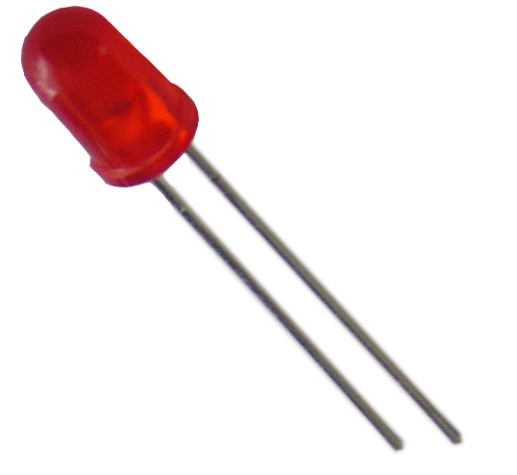

Blink External LED
Plug in an LED and make it blink
+
-
-
+

Slide 5
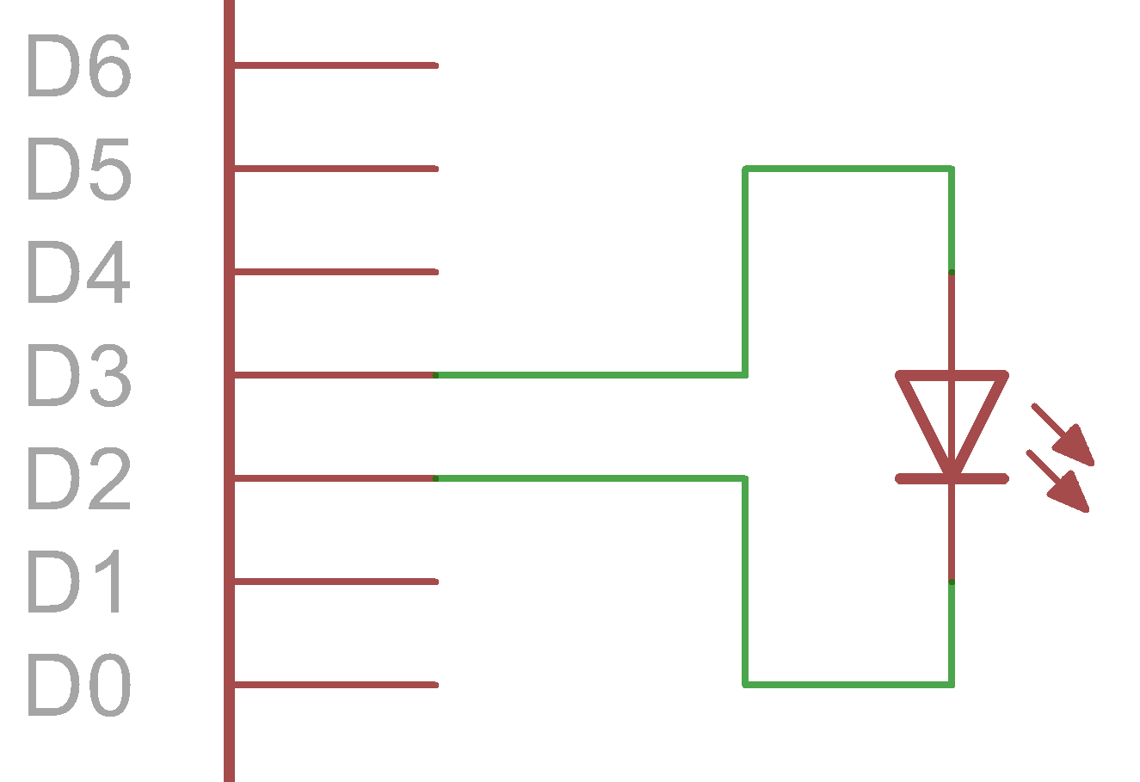
Blink External LED
How did we make the LED light up?
Used pinMode() to setup pins 2 and 3
What digitalWrite() options did we need to use?
D2 (pin 2) is set LOW
D3 (pin 3) is set HIGH
+
-

Slide 6
Blink External LED
Now that we’ve made the LED light up, how did we make it blink?
Set pin 2 and 3 to anything other than Low and High respectively
We can use a ‘truth table’ to describe this behaviour:
D2 | D3 | LED
LOW ( - ) | LOW ( - ) | Off
LOW ( - ) | HIGH ( + ) | On
HIGH ( + ) | LOW ( - ) | Off
HIGH ( + ) | HIGH ( + ) | Off

Slide 7
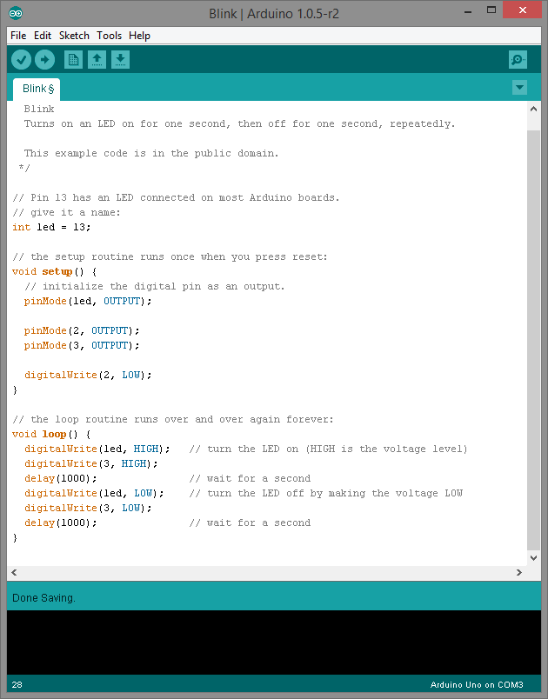
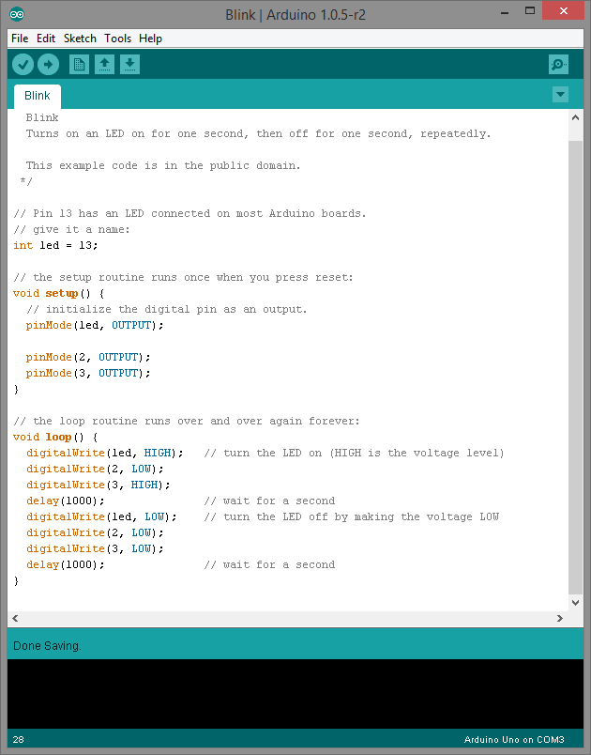
Blink External LED
We ended up with this code:

Slide 8
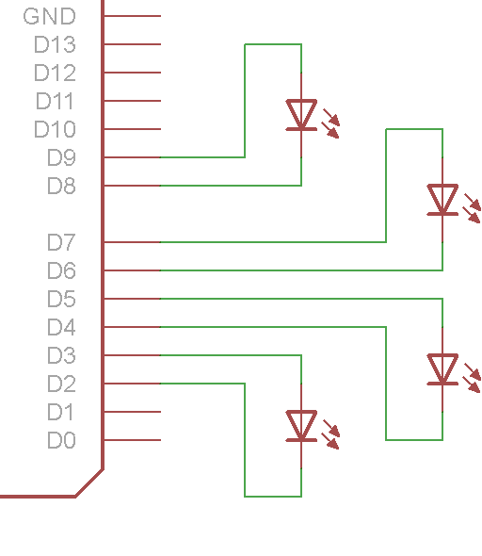
Blink More External LEDs!
What code do we need to write to make all of these LEDs turn on?
What about to make them blink?
+
-
+
-
+
+
-
-

Slide 9
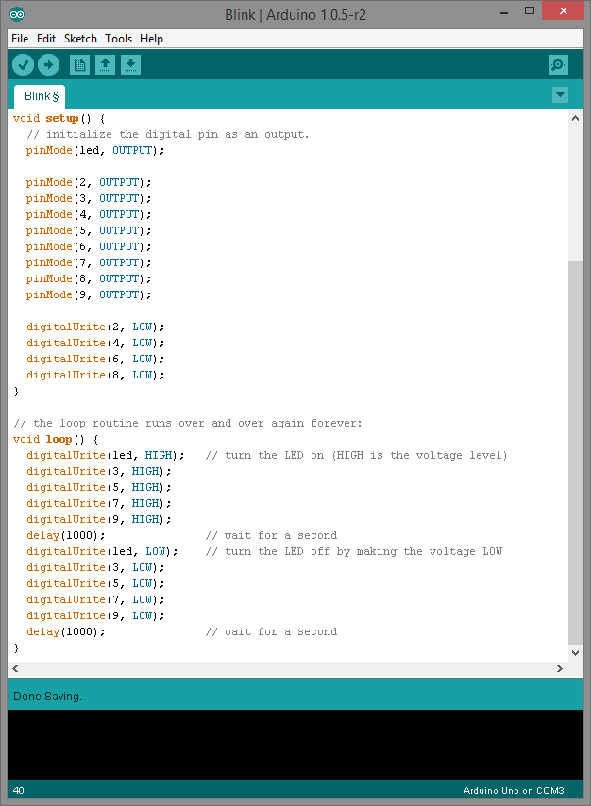
Blink More External LEDs!
We end up with this code:

Slide 10
Making the LEDs ‘Chase’
Now, try to make it so that each of the LEDs is lit, one after another…
Do you notice anything special about your code?
Look for repetitions, or similar-looking code

Slide 11
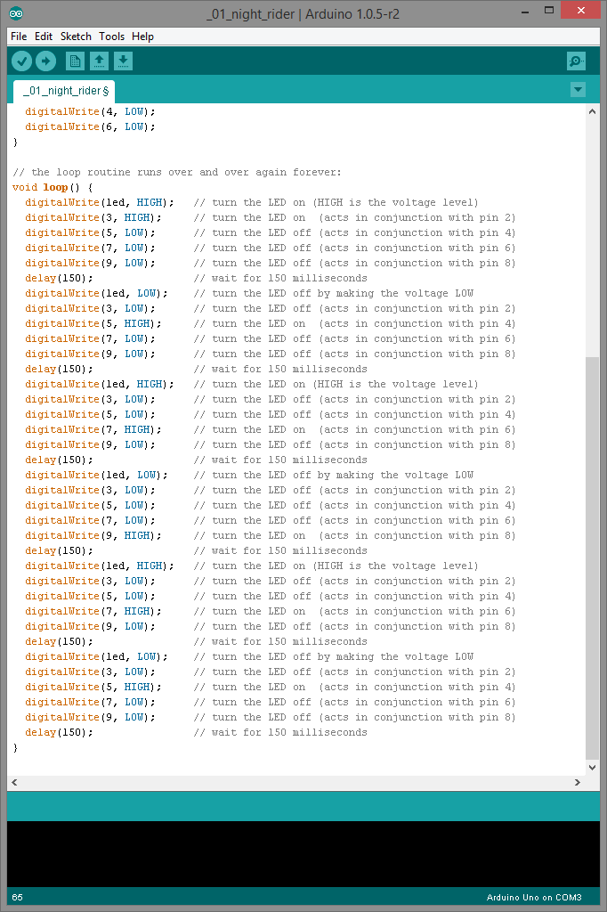

Slide 12
Can we make this code smaller?
We could tidy up the redundant function calls
We could use a for loop
We could use an array to hold our sequence

Slide 13
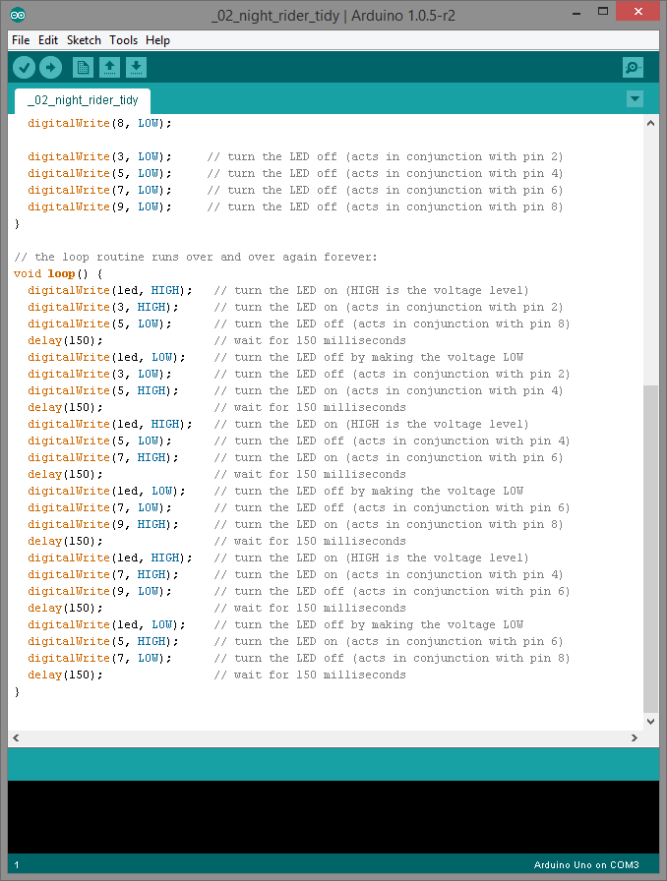

Slide 14
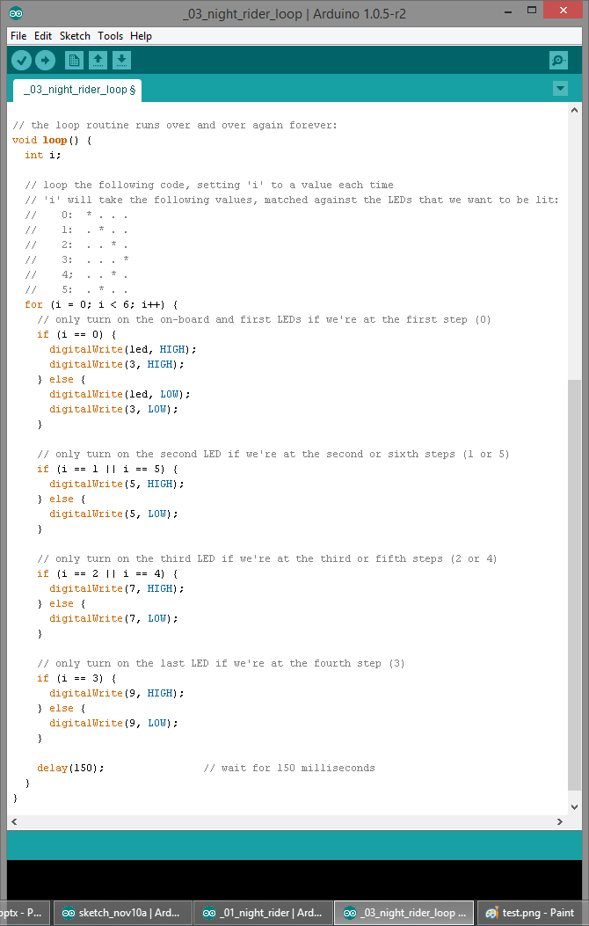

Slide 15
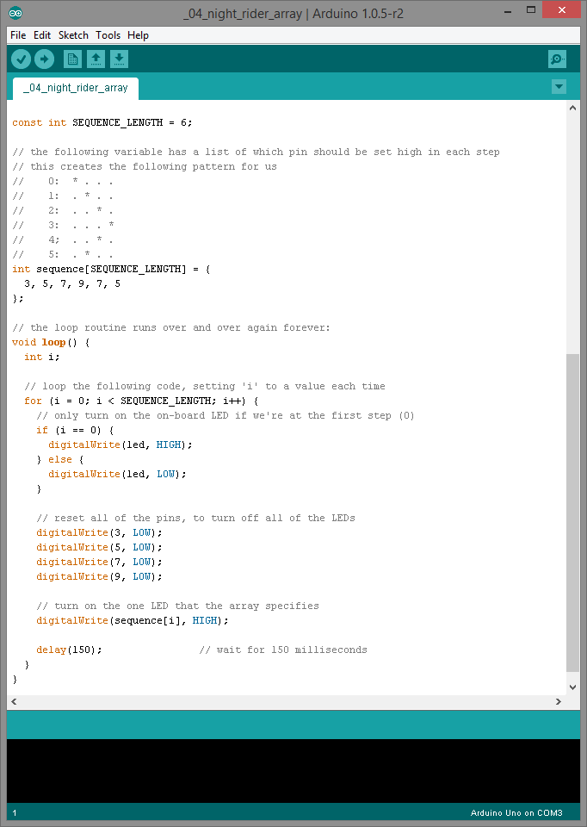

Slide 16
Can we make it more flexible?
Using the array method, we can only turn on one LED at a time…
We could use a struct, that stores the output state for each LED…
… and by using an array of structs, we can store the information for each step

Slide 17
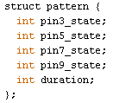
What is a Struct?
The term ‘struct’ is short for ‘structure’
We can group data together, and store it in one place
This struct is able to store the following items:
pin3_state – HIGH or LOW
pin5_state – HIGH or LOW
pin7_state – HIGH or LOW
pin9_state – HIGH or LOW
duration – milliseconds

Slide 18
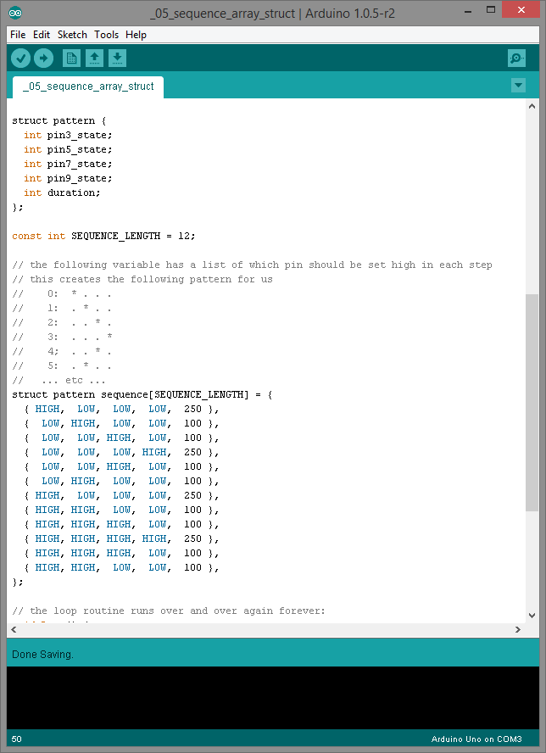
How can we store a pattern?

Slide 19
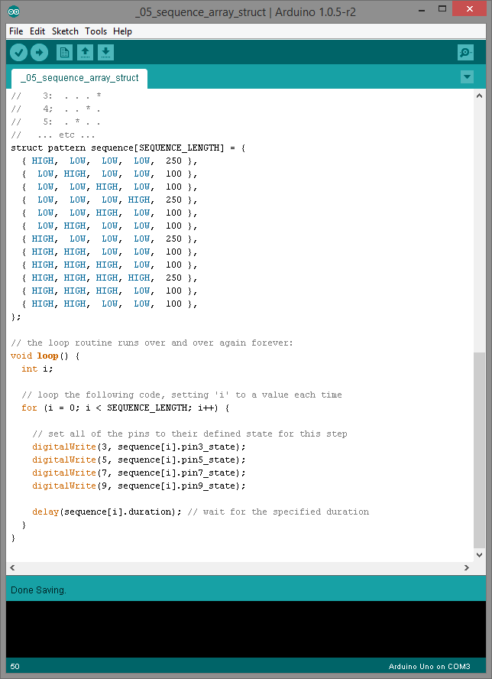
How do we use that?

