Slide 1
Electronics Club

Slide 2
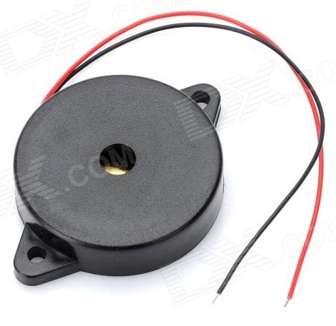
What is a Piezo Element?
+
-
-
+

Slide 3
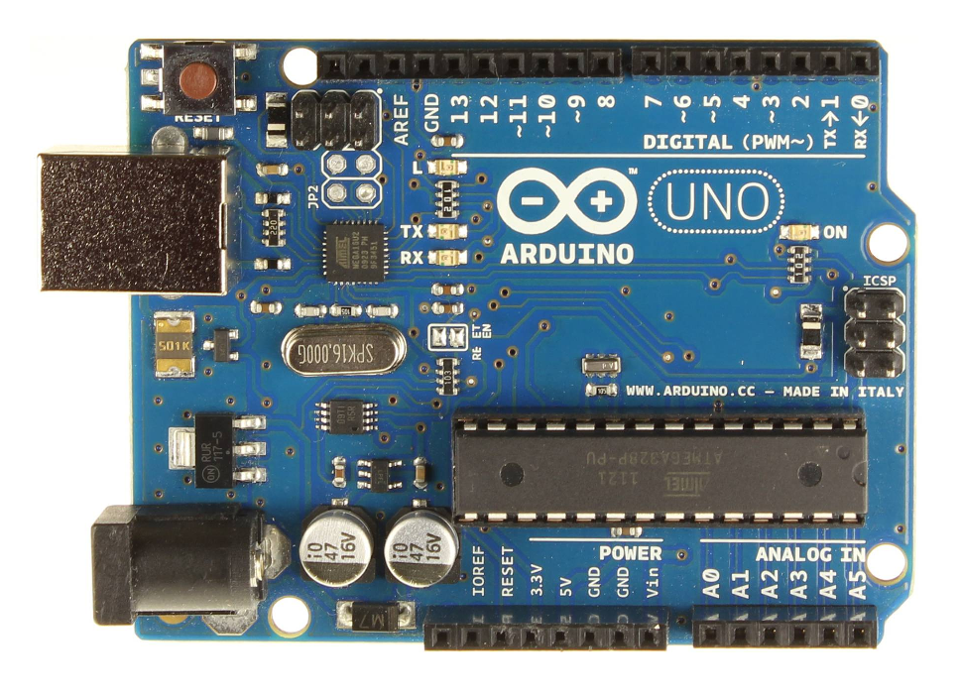
Beep a Piezo Element
We made the on-board LED blink, using these functions:
pinMode()
digitalWrite()
delay()

Slide 4
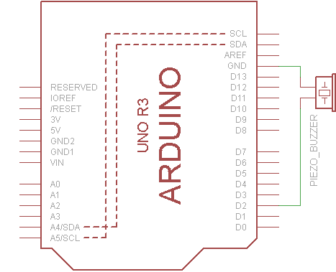
Beep a Piezo Element
A similar approach can be used to make the Piezo element ‘beep!’
Connect a piezo buzzer to D2 and make it beep!

Slide 5
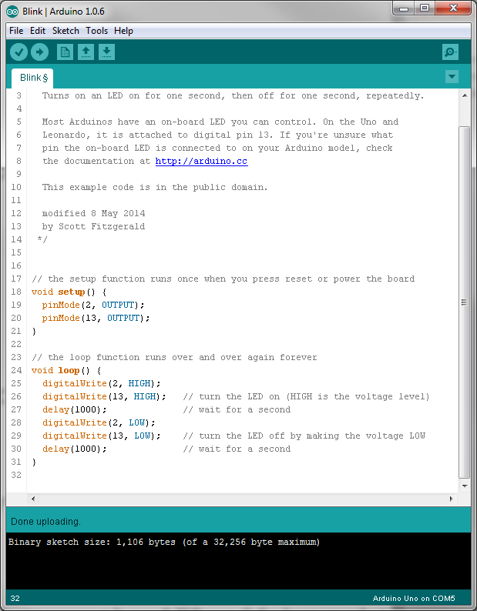

Slide 6
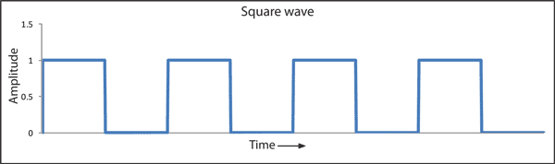
What is the highest pitch possible?
Using delay(1);
f = 1 / t
t is 2ms for a full cycle (1ms for half cycle)
1 / t → 1 / 2ms → 1 / 0.002 = 500Hz
HIGH
LOW
HIGH
0ms
1ms
2ms

Slide 7
What is the highest pitch possible?
Using delayMicroseconds(250);
f = 1 / t
t is 500µs for a full cycle (250µs for half cycle)
1 / t → 1 / 500µs → 1 / 0.0005 = 2000Hz → 2kHz

Slide 8
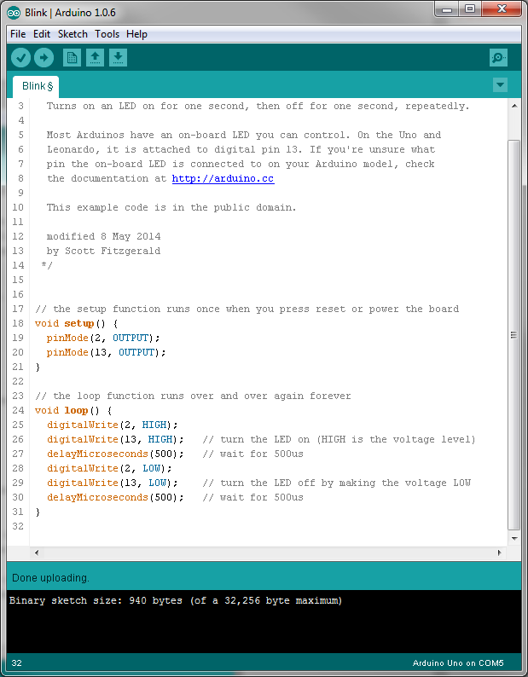

Slide 9
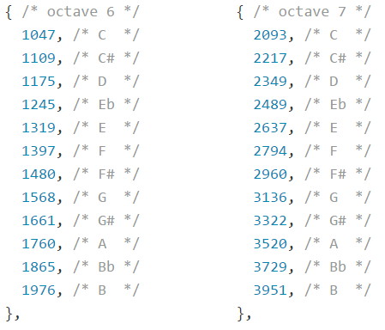
Is there an easier way?
Using tone(); - there are two options:
tone(pin, frequency);
tone(pin, frequency, duration);
Try and play a tune!

Slide 10
